Slide 1
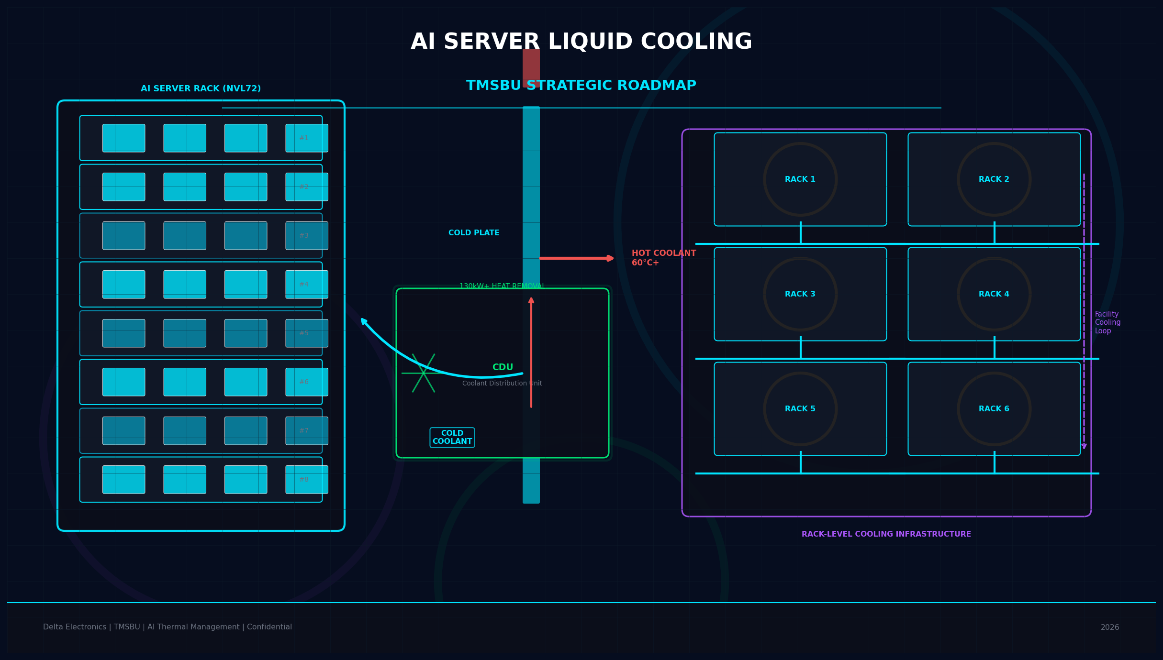
AI Server Liquid Cooling:
TMSBU Commercial Opportunity
Strategic Roadmap V3 — Layout Optimized for Executive Reading
Delta Electronics | TMSBU | Confidential | 2026
Notes:
Cover: AI server liquid cooling is the defining thermal management challenge of the AI infrastructure era. This V3 version is re-designed for executive readability — clear visual hierarchy, 3-second Big Decision Message, and minimal text per slide. Target audience: TMSBU leadership, group executives, key customers.

Slide 2
Executive Summary
02
液冷是商業模式轉型，不是產品升級
TREND
01
MARKET
02
HYBRID
03
1,400WGPU TDP by 2027+
60%+new AI DC by 2026
BOTH，TMSBU 兩者皆受益
GPU Power Exceeds Air Cooling
Liquid Cooling Is Standard
Air + Liquid Coexist
GPU TDP by 2027+
new AI DC by 2026
，TMSBU 兩者皆受益
OPPORTUNITY
04
ACTION
05
$1.8BSOM addressable (assumptions apply)
NOWPhase 1 需立即啟動
TMSBU: Component → System Solution
6–18 Months: Critical Window
SOM addressable (assumptions apply)
Phase 1 需立即啟動
💡 The future belongs to thermal system integrators — not component suppliers.
Sources: MarketsandMarkets (TAM) | Gartner (adoption rate) | NVIDIA official specs | TMSBU analysis
Notes:
Speaker Notes: Each card represents a key executive message. (1) GPU TDP trend: 400W→700W→1,400W by 2027+. (2) Liquid cooling adoption: 20%→60% by 2026. (3) Hybrid architecture: Air handles memory/PCB; liquid handles GPU/CPU hotspots. TMSBU benefits from both. (4) SOM $1.8B = assumption (14% share of SAM), needs internal validation. (5) The 6-18 month window is critical — Tier-1 customer qualification cycles take 12-18 months. Starting NOW is essential.

Slide 3
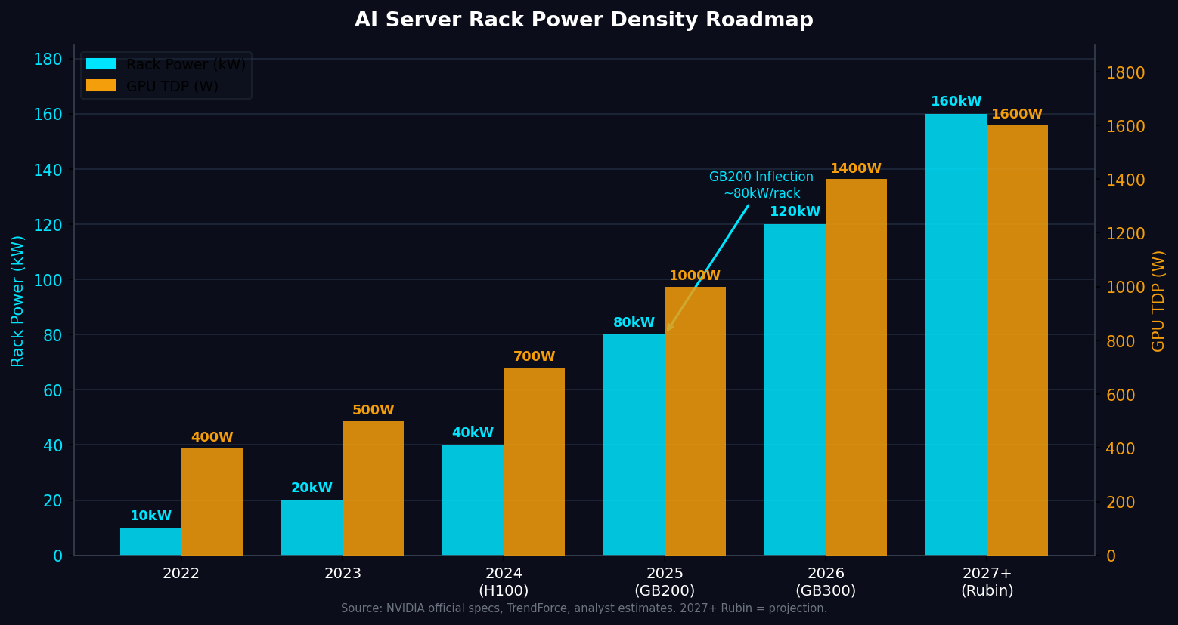
Market Inflection: AI Compute Density
Creates Thermal Bottleneck
03
GPU TDP 突破風冷散熱上限，散熱瓶頸成為 AI 基礎建設擴張的硬約束
1,400W
160kW
$39.1B
GPU TDP @ 2027+ Rubin
Rack Power @ 2027+ (est.)
Liquid Cooling TAM by 2030
KEY INSIGHTS
GB200 NVL72（~80–130kW/rack）是風冷物理瓶頸的轉折點
Rubin（2027+）功率密度 160kW+，浸沒式冷卻可能成下一個轉折
散熱瓶頸 = 誰能解決散熱、誰就能贏得 AI 基礎建設市佔
Sources: NVIDIA official GB200 specs | TrendForce rack power analysis | MarketsandMarkets TAM | Rubin = AnandTech projection
Notes:
Speaker Notes: The chart shows rack power density doubling every generation — from 10kW in 2022 to projected 160kW+ in 2027+. The GB200 NVL72 at 80-130kW/rack is the key inflection point where liquid cooling shifts from optional to mandatory. By Rubin (2027+), air cooling alone cannot handle the thermal load. Key inflection markers: (1) 2024 H100 = 40kW/rack, air still viable; (2) 2025 GB200 = 80-130kW/rack, liquid required; (3) 2027+ Rubin = 160kW+/rack, immersion cooling becomes relevant.

Slide 4
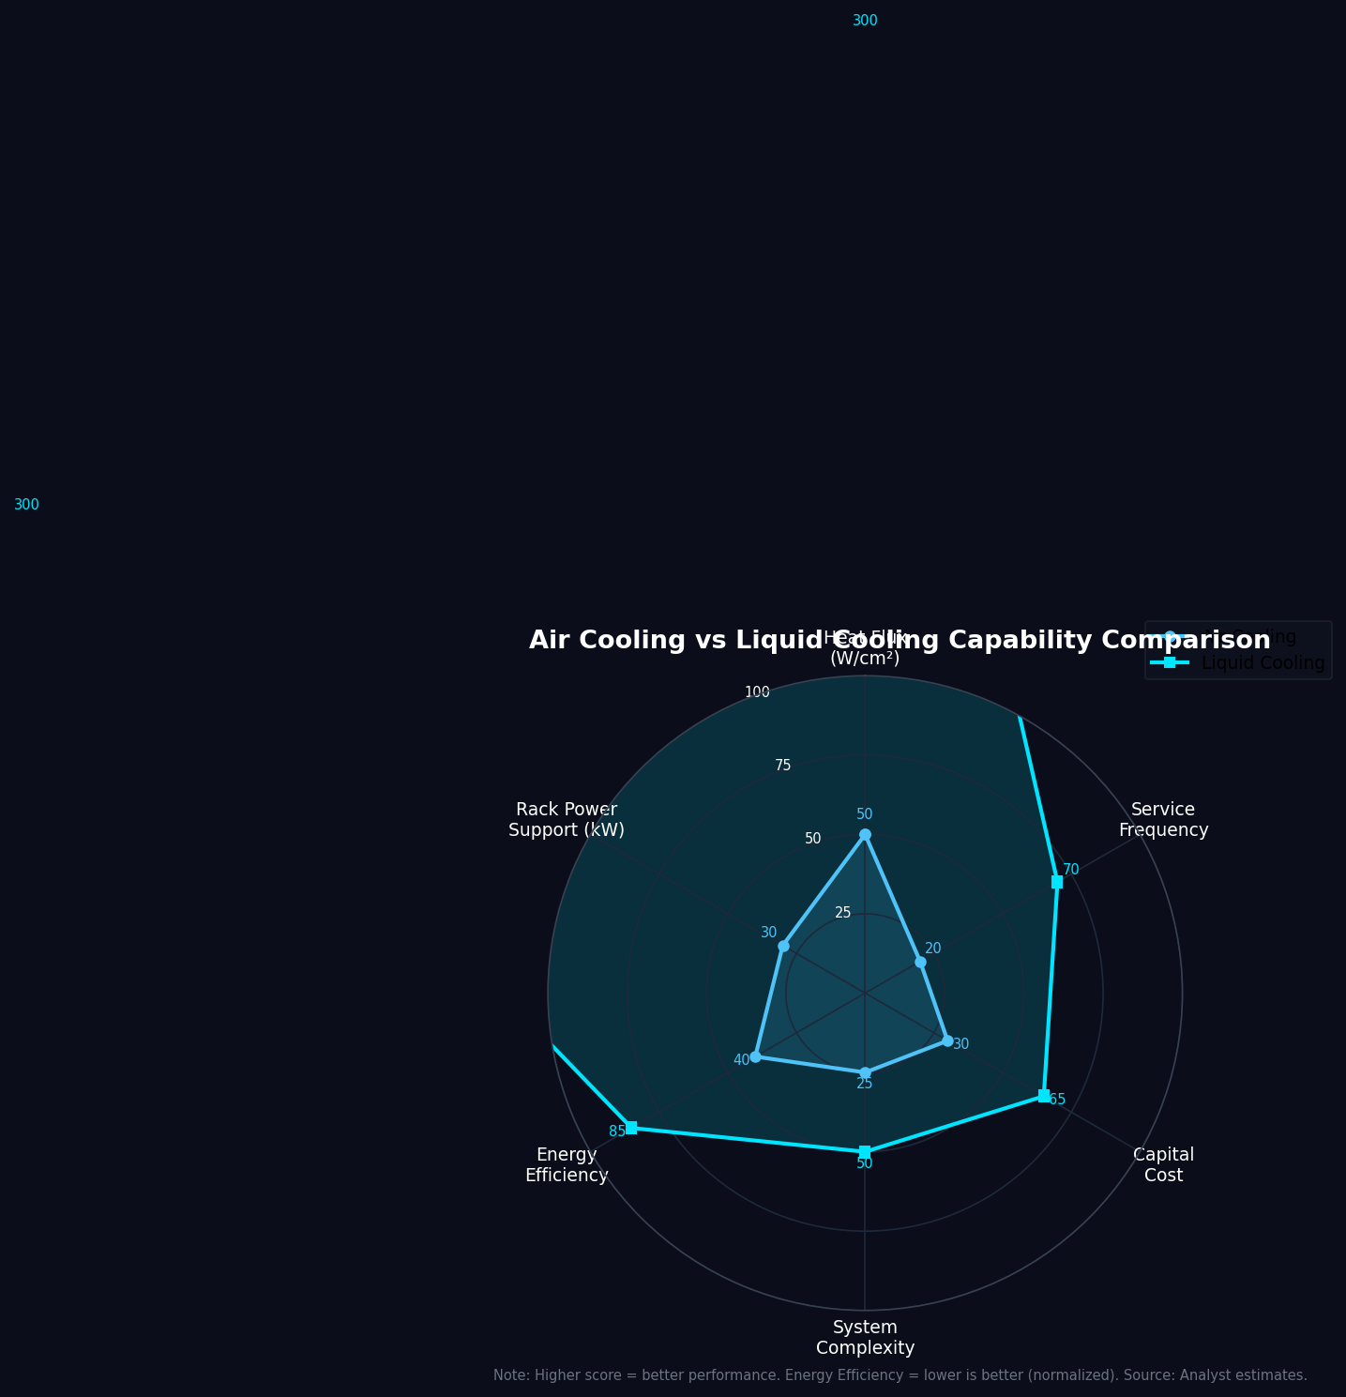
Why Air Cooling Alone Is No Longer Enough
04
Not Air vs. Liquid — The Future Is Hybrid Architecture
LIQUID COOLING
AIR COOLING
Handles GPU / CPU Hotspot
Handles Memory / PCB / Power
GPU TDP 700W–1,400W+ 直接導熱
Cold Plate 直接接觸 die，效率 > 95%
CDU 130kW+ 熱移除能力
Manifold 分流至多 server
HBM Memory（每模組 ~1kW）散熱
PCB / 電源供應模組
Networking / Storage 元件
低功率 accessory 元件
+
Not Air vs. Liquid — The Future Is Hybrid Architecture
TMSBU BENEFIT: Fan / VC / HS demand ↑ with liquid cooling adoption (more non-GPU components need air cooling)
Notes:
Speaker Notes: The key insight is NOT 'air vs liquid' — it is 'air AND liquid.' Liquid cooling handles the high-power GPU/CPU thermal load. Air cooling remains essential for: HBM memory stacks at ~1kW per module, PCBs, power delivery components, and low-power accessories. This means TMSBU's fan business does NOT decline with liquid cooling adoption — it grows because more air cooling is needed for non-GPU components in liquid-cooled servers. The radar chart (bottom left) compares air vs liquid across 6 dimensions: heat flux, rack power support, energy efficiency, system complexity, capital cost, and service frequency. No single technology wins — the hybrid wins.

Slide 5
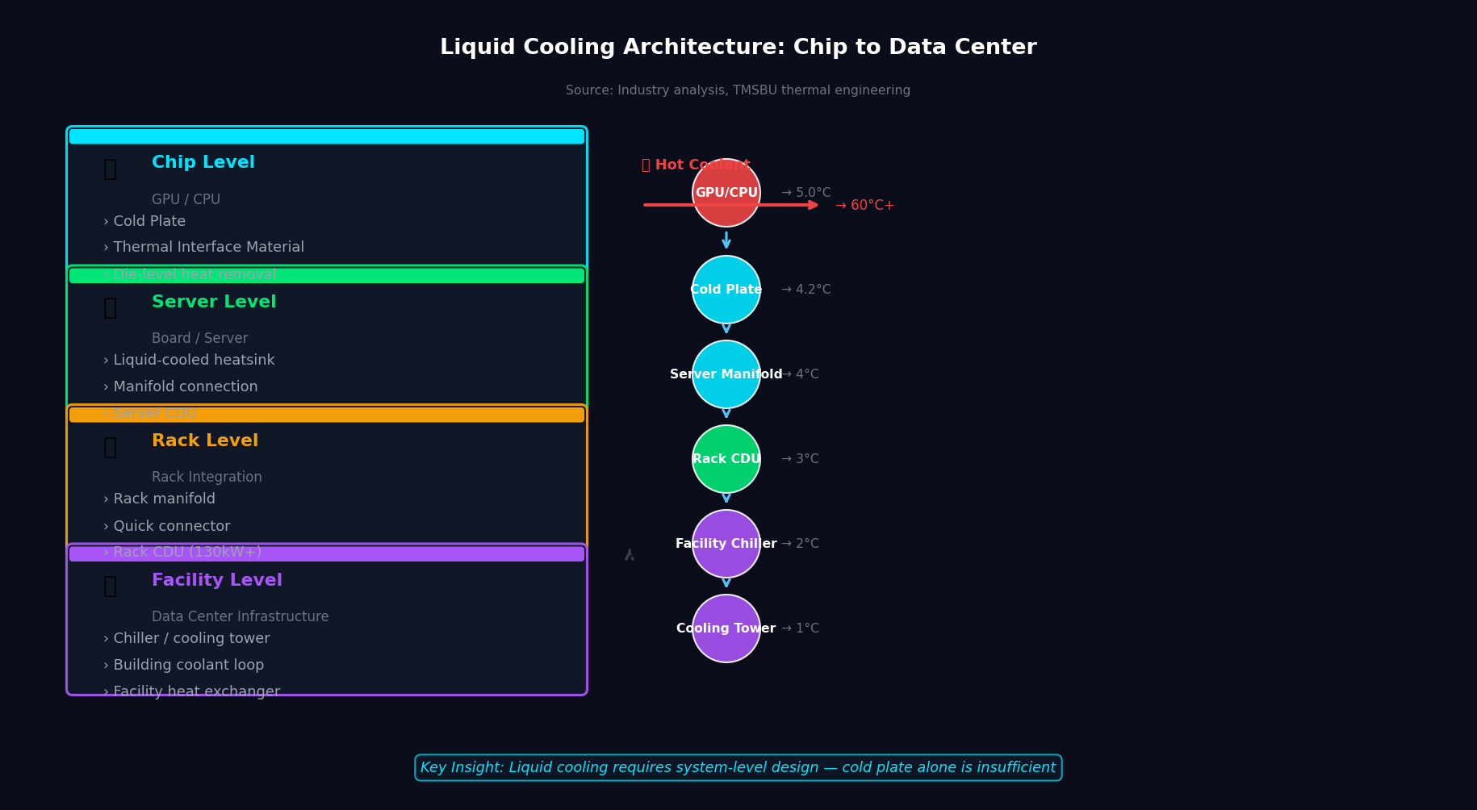
Liquid Cooling Architecture Becomes
the New Standard
05
液冷的價值在完整系統整合：Cold Plate → CDU → Manifold → Quick Connector
KEY INSIGHTS
Cold Plate + CDU + Manifold + Quick Connector + Leak Detection = 完整液冷系統
系統整合複雜度是最高附加價值的來源 — 不是單一零件
Vendor 能提供完整系統者，才能拿下最高市佔與毛利
Source: Industry analysis, TMSBU thermal engineering. Components: CoolIT, Rittal, Staubli public specs.
Notes:
Speaker Notes: Liquid cooling is not a single product — it is a system with 5 key components. (1) Cold Plates at chip level with direct contact cooling — direct contact with GPU/CPU die, thermal resistance < 0.1°C-in²/W. (2) CDUs (Coolant Distribution Units) that circulate and reject heat — typically 130kW+ capacity per CDU unit. (3) Manifolds that distribute coolant to multiple servers in a rack. (4) Quick Connectors that enable hot-swap maintenance without draining the system — leak rate < 0.5g/year. (5) Leak detection and monitoring for reliability. The bottom panel shows the temperature gradient: hot coolant at 60°C+ from GPU exits the cold plate, is cooled to 5-10°C by the CDU/chiller, and returns to the cold plate.

Slide 6
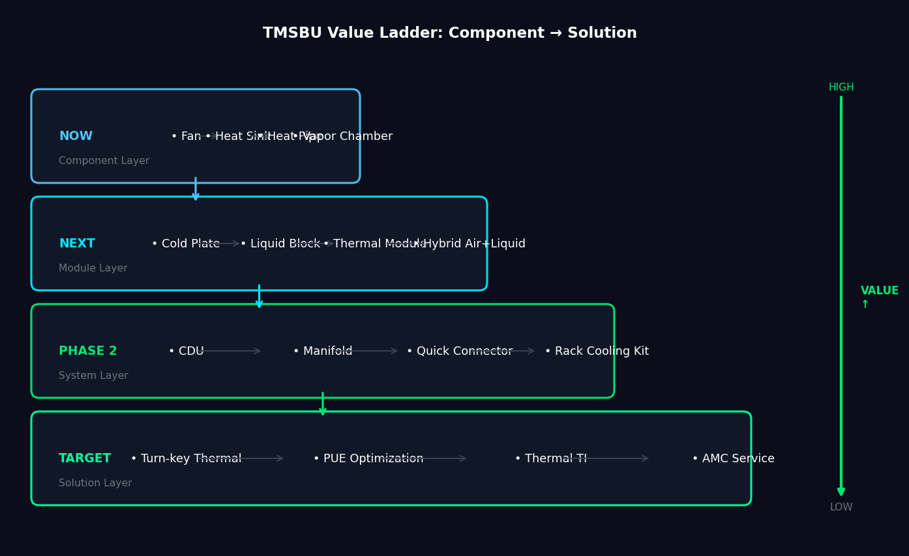
TMSBU Portfolio Mapping:
From Component to System Solution
06
自然擴張路徑：零件 → 模組 → 系統 → 解決方案
KEY INSIGHTS
CDU + Quick Connector + Manifold = TMSBU 最高價值的擴張方向
從零件報價升級到系統方案統包報價，改變商業模式
目標：成為客戶眼中不可或缺的 Thermal System Partner
Source: TMSBU internal product portfolio analysis
Notes:
Speaker Notes: The value ladder shows 4 layers of TMSBU's expansion path. NOW (Component Layer): Fan, Heat Sink, Heat Pipe, Vapor Chamber — existing products with established manufacturing. NEXT (Module Layer): Cold Plate, Liquid Block, Thermal Module, Hybrid Air+Liquid — natural next step from existing VC/HP expertise. PHASE 2 (System Layer): CDU, Manifold, Quick Connector, Rack Cooling Kit — requires new capabilities (CDU design, connector qualification). TARGET (Solution Layer): Turn-key Thermal Solution, PUE Optimization, Thermal Design-In, AMC Service — business model transformation from component supplier to system partner. Key message: The highest value capture is at the Solution Layer, but each layer builds capability for the next. Start NOW with components and modules to fund the journey to system solutions.

Slide 7
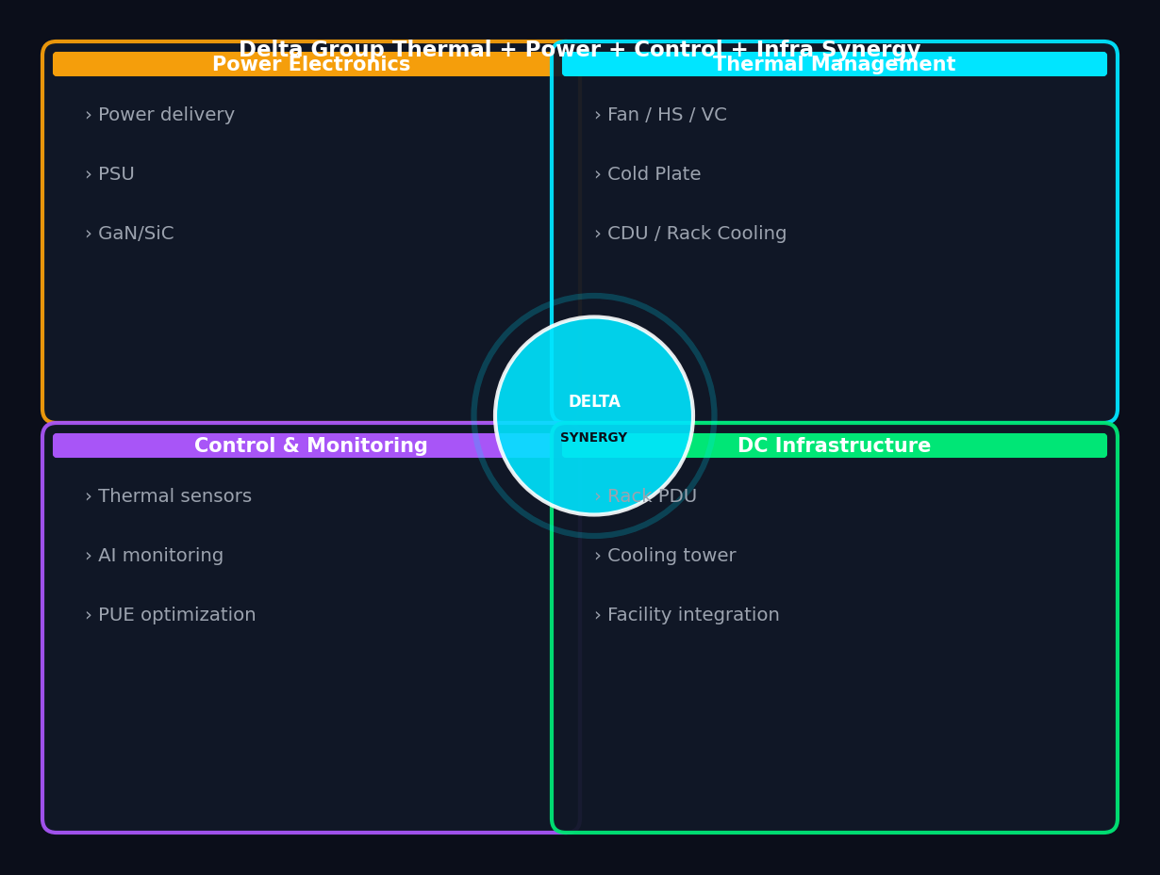
Delta Group Synergy:
Why TMSBU Can Win in Liquid Cooling
07
唯一同時具備風冷與液冷能力的供應商 + Delta 集團層級綜效
KEY INSIGHTS
Delta 集團唯一能 Chip-level → Rack-level → Facility-level 全段熱管理整合
Fan + Power + Control + DC Infra 集團綜效為競爭對手無法快速複製的護城河
Manufacturing scale + Global support network 支撐 Tier-1 客戶信任
Source: Delta Electronics public information, TMSBU analysis
Notes:
Speaker Notes: Delta's competitive advantage comes from 4 synergistic pillars. (1) Power Electronics: Delta's leading power supply and power delivery capability means thermal management is integrated with power architecture from day one — a unique advantage. (2) Thermal Management: TMSBU's core business — fans, heat sinks, vapor chambers, cold plates. (3) Control & Monitoring: Delta's sensor and control systems enable intelligent thermal management and PUE optimization — differentiating from pure mechanical cooling suppliers. (4) DC Infrastructure: Delta's data center infrastructure portfolio (rack PDU, cooling towers) enables facility-level cooling integration. The center circle 'DELTA SYNERGY' represents the compound advantage of all 4 pillars working together — something no competitor can replicate quickly.

Slide 8

Market Opportunity: TAM / SAM / SOM
08
系統層級解決方案擴大 TMSBU 可觸及市場規模
KEY INSIGHTS
TAM $39.1B（M&M 2024）涵蓋整個 AI 資料中心液冷市場
SOM = 假設 TMSBU 滲透率 14% of SAM，需要 James 內部驗證
3 情境：保守 $0.8B / 基準 $1.8B / 積極 $3.2B — 取決於 TMSBU 執行速度
⚠ SOM figures are assumptions — need internal TMSBU validation. TAM: MarketsandMarkets. SAM: analyst estimate (~33% of TAM). Scenarios: TMSBU analysis.
Notes:
Speaker Notes: The market opportunity funnel shows 3 levels. TAM (Total Addressable Market): $39.1B by 2030 — the entire AI data center liquid cooling market, including infrastructure (chillers, cooling towers). SAM (Serviceable Addressable Market): ~$12.8B — cold plates + CDU + manifolds + quick connectors. SOM (Serviceable Obtainable Market): $0.8B-$3.2B — TMSBU's realistic capture based on market share assumptions. The 3 scenarios reflect different TMSBU execution speeds and success rates. Conservative (8% share of SAM): $0.8B. Base case (14%): $1.8B. Aggressive (25%): $3.2B. Key assumption: SOM = 14% of SAM is based on Delta's current share in server thermal components. This needs internal validation from James and the TMSBU team. The market is large enough to be significant even at conservative assumptions.

Slide 9
Capability Gap & Risk Assessment
09
3 項最高優先風險：CDU 能力 / 洩漏可靠性 / 客戶認證週期
Risk Item
Impact
Urgency
Priority Action
CDU Design & Manufacturing
HIGH
HIGH
核心系統零件。合作或收購，Phase 1 決策
Leak Detection & Reliability
HIGH
HIGH
單次洩漏可摧毀 $50萬 server。可靠性 non-negotiable
Customer Qualification Cycle
MED
HIGH
12-18 個月 design-in cycles。立即啟動
Quick Connector Qualification
HIGH
MED
Staubli/Liiver 夥伴關係確認
Coolant Compatibility
MED
MED
OEM 專屬 coolant specs，需早期 engagement
Thermal Simulation & Testing
MED
MED
Chip-to-rack 多物理場模擬能力建立
Integration Responsibility
HIGH
MED
系統銷售邊界與保固責任需提前定義
Global Support Network
MED
LOW
Tier-1 hyperscaler 合約門檻
China Supply Chain Price War
MED
MED
冷板 / Manifold 成本競爭，以品質差異化
Talent / Skill Gap
MED
MED
液冷系統工程師人才儲備
IMMEDIATE PRIORITIES
① CDU Strategy (in-house / partner / acquire) | ② Leak reliability (quick connector qualification) | ③ Customer qualification cycle (start NOW)
Source: TMSBU internal risk assessment. Urgency = time sensitivity. Impact = business consequence if risk materializes.
Notes:
Speaker Notes: The risk heatmap prioritizes 10 identified risks. RED (HIGH × HIGH): Top 3 immediate priorities. (1) CDU capability: TMSBU does not currently have CDU design/manufacturing. Decision needed in Phase 1 — partner (CoolIT, Condair), acquire, or develop in-house. (2) Leak reliability: A single leak incident can destroy a $500K server. Quick connector qualification and leak detection are non-negotiable. (3) Customer qualification cycle: 12-18 months. Starting NOW is essential to be considered for GB300/Rubin. ORANGE (HIGH × MED or MED × HIGH): Address in Phase 2. GREEN (MED × LOW): Monitor and address in Phase 3-4. Note: The China supply chain risk (cold plate/manifold price competition) is real but can be addressed through differentiation on quality, reliability, and global support — not by competing on price.

Slide 10
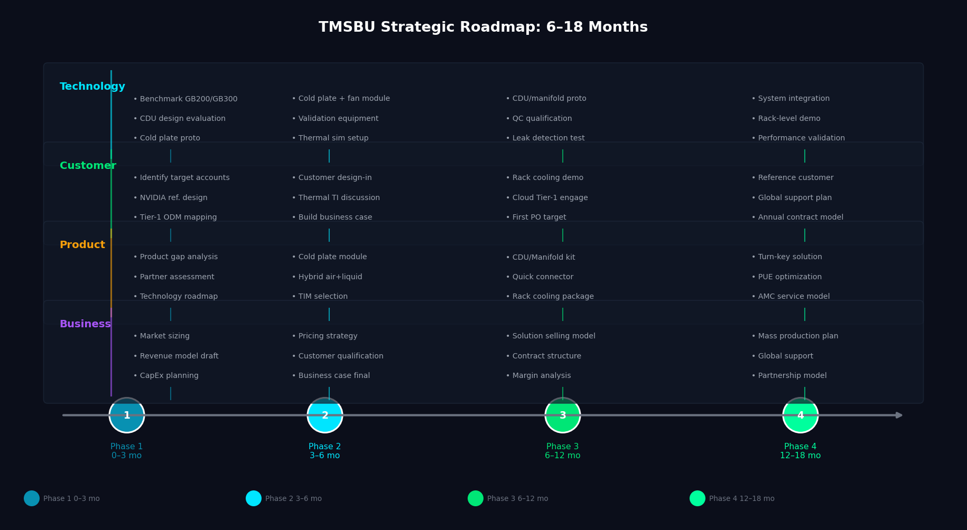
Strategic Roadmap & Recommended Actions
10
4 階段 6-18 個月 Roadmap：Phase 1 基礎 → Phase 4 規模化
Phase 1: 0–3M
Phase 2: 3–6M
Phase 3: 6–12M
Phase 4: 12–18M
KEY INSIGHTS
Phase 1 最重要決策：CDU 是內部開發 / 合作夥伴 / 併購？這將決定 TMSBU 液冷策略成敗
所有 Phase 的最終目標：從 Component Supplier 轉型為 Thermal System Solution Provider
落後的代價：失去 GB300/Rubin 平台的供應商資格，影響未來 5-10 年競爭地位
Confirm CDU partner • Benchmark GB200/GB300 • Build product gap list • Identify target customers
Cold plate + fan module proto • Validation equipment • Thermal TI discussions • Business case
CDU/manifold kit proto • Quick connector qualification • Rack cooling demo • Tier-1 engagement
Solution selling model • AMC service design • Reference customer • Mass production plan
Source: TMSBU strategic planning analysis. Timelines are indicative and subject to internal alignment.
Notes:
Speaker Notes: The 4-lane roadmap covers Technology, Customer, Product, and Business Model tracks across 4 phases. Phase 1 (0-3 months): Foundation. Confirm target customers and platforms (GB200/GB300/Rubin), benchmark thermal architectures, build complete product gap list, identify CDU and quick connector partners. Phase 2 (3-6 months): Development. Develop cold plate + hybrid air/liquid reference module, establish thermal validation capability, start thermal design-in discussions, finalize TAM/SAM business case. Phase 3 (6-12 months): Prototype & Engage. Prototype CDU/manifold system kit, qualify quick connectors and leak detection, create rack-level demo, engage Tier-1 server OEM/ODM and cloud customers. Phase 4 (12-18 months): Scale. Transition from product selling to solution selling, design annual maintenance/service model, establish first reference customer, prepare for mass production and global support. KEY MESSAGE: Every phase builds toward the same goal — becoming the customer's indispensable Thermal System Partner, not just a component supplier.

