Slide 1
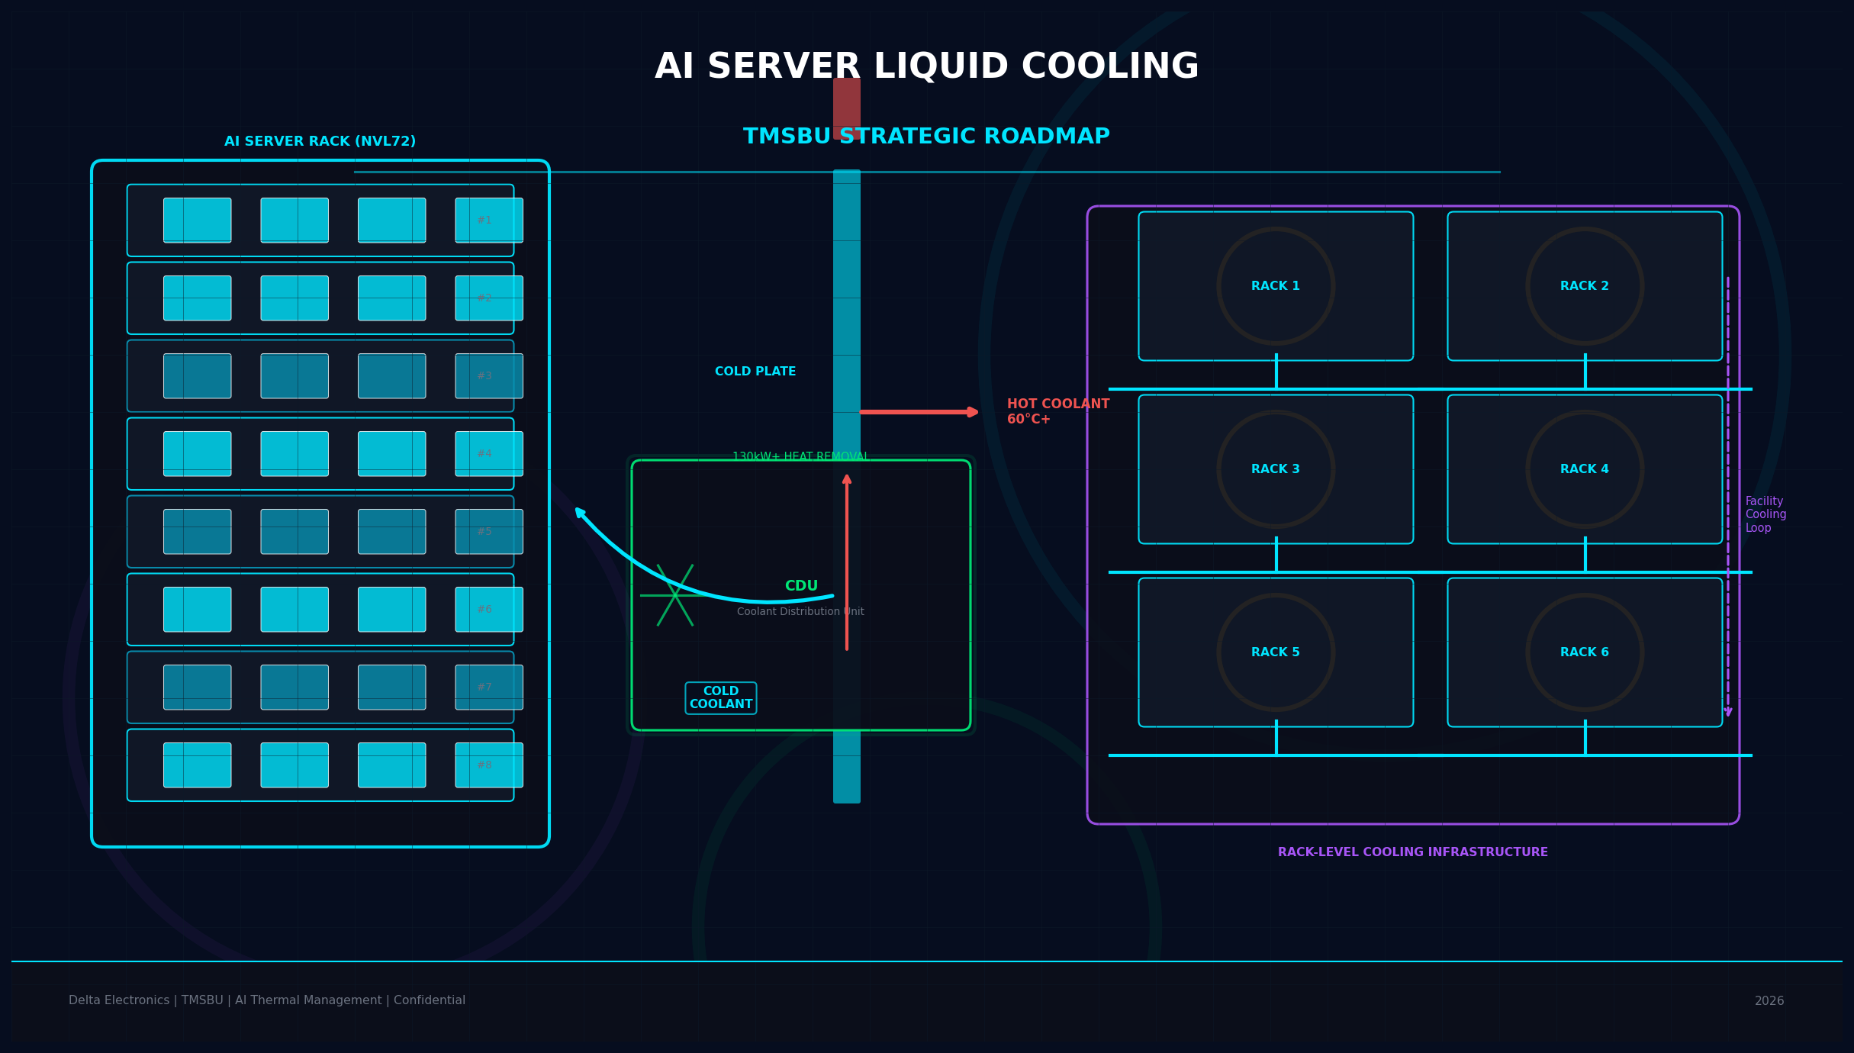
AI Server
Liquid Cooling
Strategic Roadmap
TMSBU Commercial Opportunity Analysis
Delta Electronics · TMSBU · Confidential · 2026
V4
Notes:
Cover: AI Server Liquid Cooling is the defining thermal challenge of AI infrastructure era. V4 is typography-corrected for executive readability. Target audience: TMSBU leadership, Delta Group executives, key customers/partners. Core message: Liquid cooling is a business model transformation, not just a product upgrade.

Slide 2
Executive Summary
02
液冷是商業模式轉型，不是產品升級
TREND
MARKET
HYBRID
1,400W
60%+
BOTH
GPU TDP @ 2027+
new AI DC by 2026
TMSBU 風冷液冷皆受益
OPPORTUNITY
ACTION
$1.8B
NOW
SOM（需內部驗證）
6-18M 關鍵窗口
KEY INSIGHTS
散熱瓶頸是 AI 基礎建設擴張的硬約束 — 誰能解決、誰就能贏得市佔
液冷市場 TAM $39.1B（CAGR 45%），現在是佈局關鍵時刻
Delta 集團唯一同時具備風冷+液冷+Power+Control 全段整合能力
Sources: MarketsandMarkets · Gartner · NVIDIA official specs · TMSBU analysis
Notes:
Executive Summary: 5 key messages in 5 cards. (1) GPU TDP trend: 400W→700W→1,400W by 2027+. (2) Liquid cooling adoption: 20%→60%+ by 2026. (3) Hybrid architecture: Air handles non-GPU; liquid handles GPU/CPU. TMSBU benefits from both. (4) SOM $1.8B = assumption, 14% share of SAM $12.8B — needs internal validation. (5) 6-18 month critical window — Tier-1 qualification cycles take 12-18 months, starting NOW is essential.

Slide 3
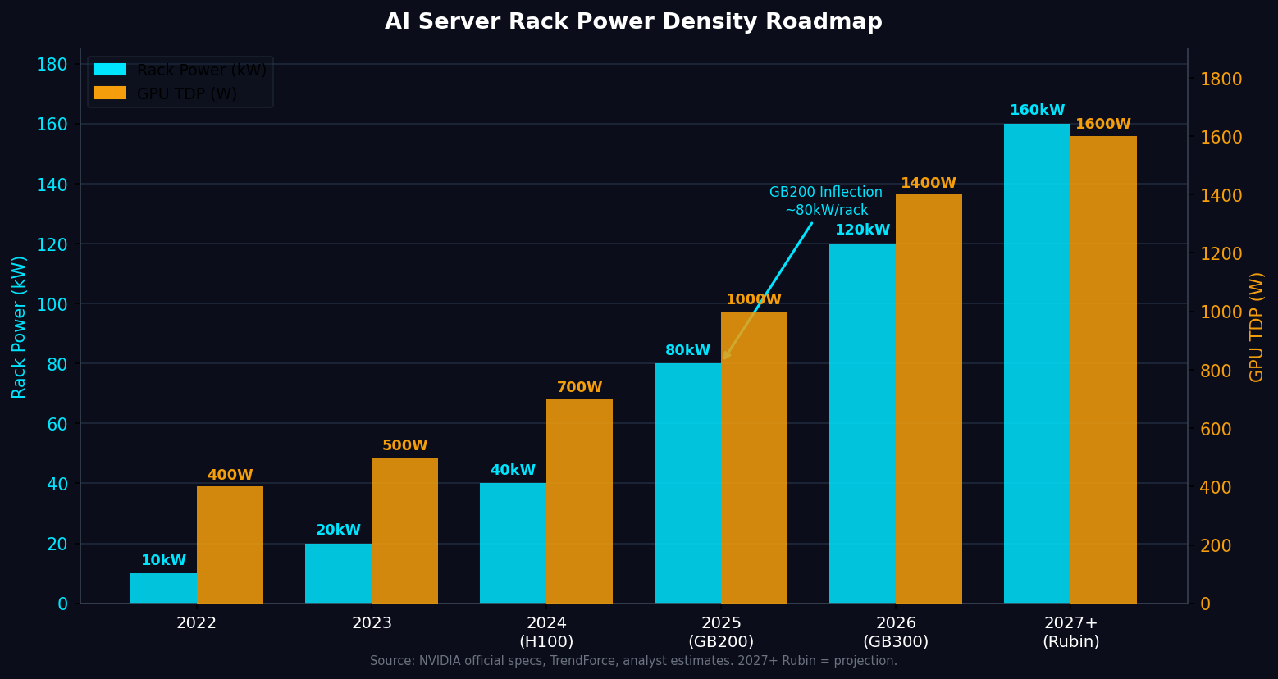
Market Inflection: AI Compute Density Creates Thermal Bottleneck
03
GPU TDP 突破風冷散熱上限，散熱瓶頸成為 AI 基礎建設擴張的硬約束
1,400W
160kW
$39.1B
GPU TDP @ 2027+
Rack Power @ 2027+
Liquid Cooling TAM by 2030
KEY INSIGHTS
GB200 NVL72（80–130kW/rack）是風冷物理瓶頸的轉捩點
Rubin（2027+）功率密度挑戰 160kW+，浸沒式冷卻可能是下一個轉折
散熱瓶頸等於誰能解決、誰就能贏得 AI 基礎建設市佔
Sources: NVIDIA GB200 specs · TrendForce · MarketsandMarkets · Rubin = AnandTech projection
Notes:
Rack power density doubling each generation — from 10kW in 2022 to projected 160kW+ in 2027+. GB200 NVL72 at 80-130kW/rack is the key inflection where liquid cooling shifts from optional to mandatory. By Rubin (2027+), air cooling alone cannot handle the thermal load. Key inflection: (1) 2024 H100 = 40kW/rack, air still viable; (2) 2025 GB200 = 80-130kW/rack, liquid required; (3) 2027+ Rubin = 160kW+/rack, immersion cooling becomes relevant.

Slide 4
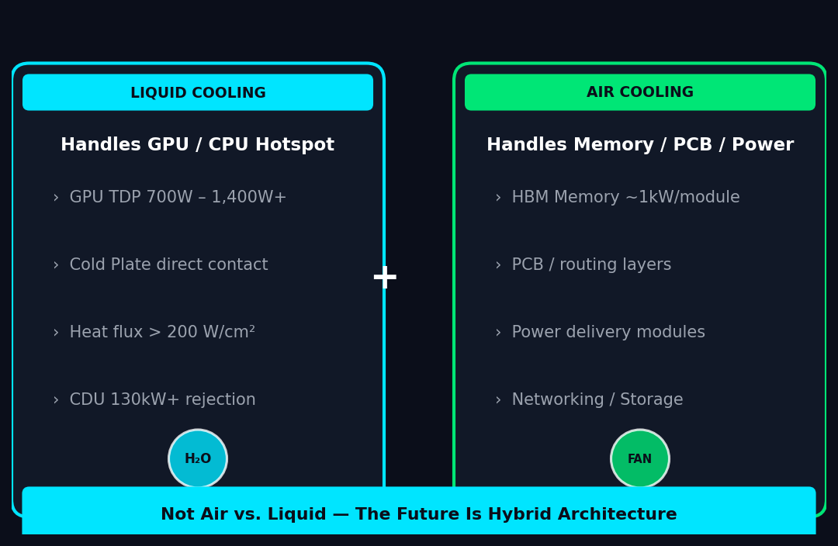
Why Air Cooling Alone Is No Longer Enough
04
Not Air vs. Liquid — The Future Is Hybrid Architecture
💡 TMSBU BENEFIT: Fan / VC / HS demand rises with liquid cooling adoption — more non-GPU components need air cooling in liquid-cooled servers
Source: TMSBU thermal engineering analysis · NVIDIA GB200 architecture
Notes:
Key insight: NOT 'air vs liquid' — it is 'air AND liquid.' Liquid handles GPU/CPU thermal load. Air remains essential for HBM memory (~1kW per module), PCBs, power delivery, and low-power accessories. This means TMSBU's fan business does NOT decline with liquid cooling — it grows. Radar chart compares air vs liquid across heat flux, rack power, energy efficiency, system complexity, capital cost, and service frequency. No single technology wins — the hybrid wins.

Slide 5
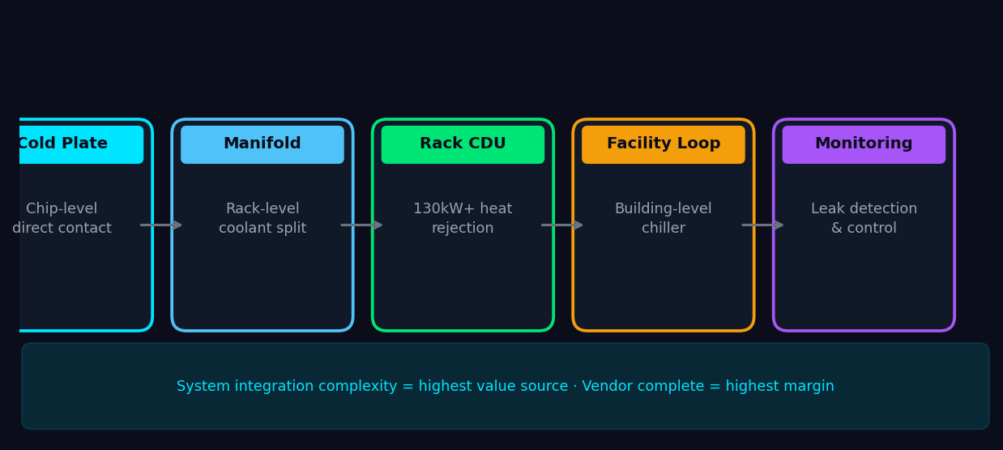
Liquid Cooling Architecture Becomes the New Standard
05
液冷的價值在完整系統整合：Cold Plate → CDU → Manifold → Quick Connector
KEY INSIGHTS
Cold Plate + CDU + Manifold + Quick Connector + Leak Detection = 完整液冷系統
系統整合複雜度是最高附加價值來源 — 不是單一零件
能提供完整系統的Vendor，才能拿下最高市佔與毛利
Source: Industry analysis · TMSBU thermal engineering · CoolIT / Rittal / Staubli public specs
Notes:
Liquid cooling = system with 5 components. (1) Cold Plates: chip-level direct contact, thermal resistance <0.1°C-in²/W. (2) CDUs: 130kW+ capacity per unit. (3) Manifolds: distribute coolant to multiple servers. (4) Quick Connectors: hot-swap without draining, leak rate <0.5g/year. (5) Leak detection and monitoring. Temperature gradient: hot coolant 60°C+ from GPU exits cold plate, cooled to 5-10°C by CDU/chiller, returns to cold plate.

Slide 6
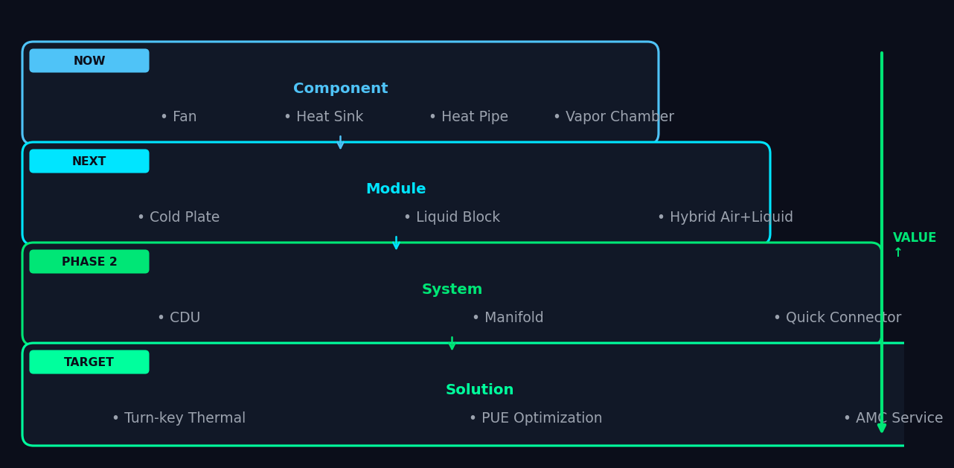
TMSBU Portfolio Mapping: From Component to System Solution
06
自然擴張路徑：零件 → 模組 → 系統 → 解決方案
KEY INSIGHTS
CDU + Quick Connector + Manifold = TMSBU 最高價值的擴張方向
從零件報價升級到系統方案統包報價，改變商業模式
目標：成為客戶不可或缺的 Thermal System Partner
Source: TMSBU internal product portfolio analysis
Notes:
Value ladder: 4 layers. NOW (Component): Fan, HS, HP, VC — existing products. NEXT (Module): Cold Plate, Liquid Block, Hybrid Air+Liquid — natural from VC/HP expertise. PHASE 2 (System): CDU, Manifold, Quick Connector, Rack Cooling Kit — requires new capabilities. TARGET (Solution): Turn-key Thermal, PUE Optimization, Thermal TI, AMC Service — business model transformation. Highest value capture at Solution Layer, but each layer builds capability for the next.

Slide 7
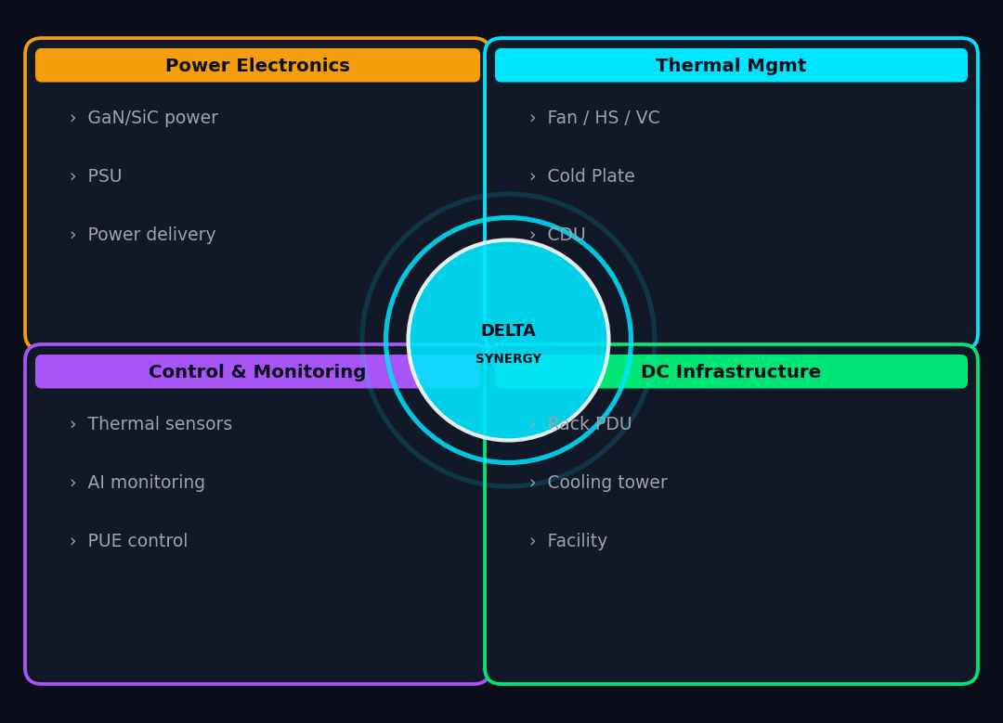
Delta Group Synergy: Why TMSBU Can Win in Liquid Cooling
07
唯一同時具備風冷與液冷能力的供應商 + Delta 集團層級綜效
KEY INSIGHTS
Delta 集團唯一能 Chip-level → Rack-level → Facility-level 全段熱管理整合
Fan + Power + Control + DC Infra 集團綜效是競爭對手無法快速複製的護城河
Manufacturing scale + Global support network 支撐 Tier-1 客戶信任
Source: Delta Electronics public information · TMSBU analysis
Notes:
4 synergistic pillars: (1) Power Electronics — Delta's leading power supply means thermal integrated with power architecture from day one. (2) Thermal Management — TMSBU core business. (3) Control & Monitoring — Delta sensor/control systems enable intelligent thermal management. (4) DC Infrastructure — Delta rack PDU, cooling towers enable facility-level integration. Center circle = compound advantage of all 4 working together — no competitor can replicate quickly.

Slide 8

Market Opportunity: TAM / SAM / SOM
08
系統層級解決方案擴大 TMSBU 可觸及市場規模
KEY INSIGHTS
TAM $39.1B（M&M 2024）涵蓋整個 AI 資料中心液冷市場
SOM = 假設 TMSBU 滲透率 14% of SAM，需要 James 內部驗證
三情境：保守 $0.8B / 基準 $1.8B / 積極 $3.2B
⚠ SOM = assumption, needs internal TMSBU validation. TAM: MarketsandMarkets. SAM: analyst estimate. Scenarios: TMSBU analysis.
Notes:
Market funnel: TAM $39.1B by 2030 (entire AI DC liquid cooling market). SAM ~$12.8B (cold plates + CDU + manifolds + quick connectors). SOM $0.8B-$3.2B based on TMSBU market share assumptions. 3 scenarios: Conservative (8% share): $0.8B. Base case (14%): $1.8B. Aggressive (25%): $3.2B. SOM = 14% of SAM based on Delta's current share in server thermal components — needs internal validation from James and TMSBU team.

Slide 9
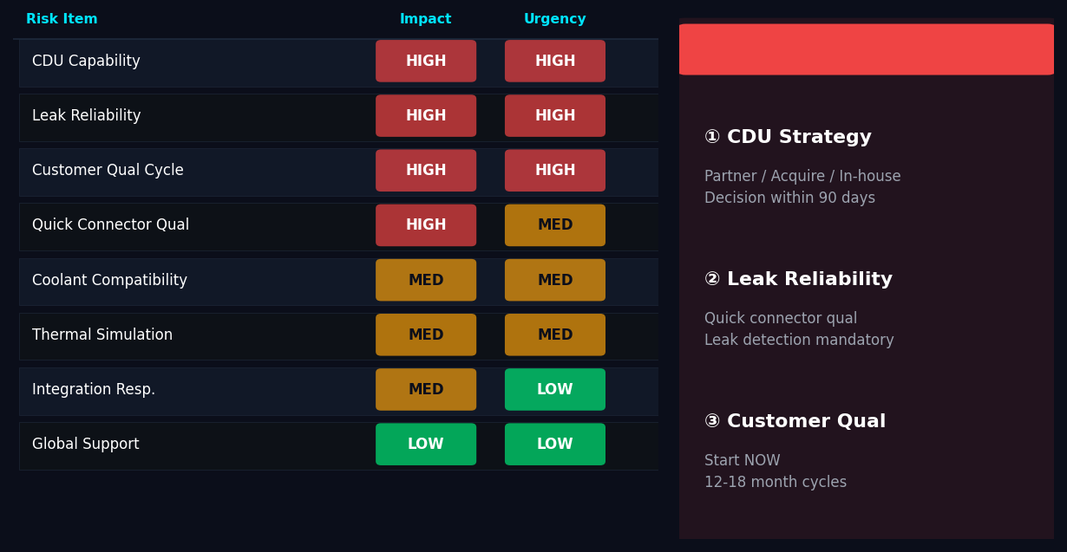
Capability Gap & Risk Assessment
09
3 項最高優先風險：CDU 能力 / 洩漏可靠性 / 客戶認證週期
KEY INSIGHTS
CDU Strategy 是 Phase 1 最關鍵決策 — 合作 / 併購 / 自製，90 天內鎖定
洩漏可靠性是紅線：單次洩漏可摧毀 $50 萬 server，不可妥協
客戶認證週期 12-18 個月，現在啟動才能趕上 GB300/Rubin
Source: TMSBU internal risk assessment. Urgency = time sensitivity. Impact = business consequence if risk materializes.
Notes:
Risk heatmap: 8 risks scored by Impact × Urgency. RED (HIGH×HIGH): Top 3 immediate priorities. (1) CDU capability: partner (CoolIT, Condair), acquire, or develop in-house — decision needed in Phase 1. (2) Leak reliability: quick connector qualification and leak detection non-negotiable. (3) Customer qualification cycle: 12-18 months — start NOW. ORANGE (HIGH×MED or MED×HIGH): Phase 2. GREEN (MED×LOW): Phase 3-4. China supply chain risk (cold plate/manifold price competition) is real but can be addressed through quality differentiation, not price competition.

Slide 10
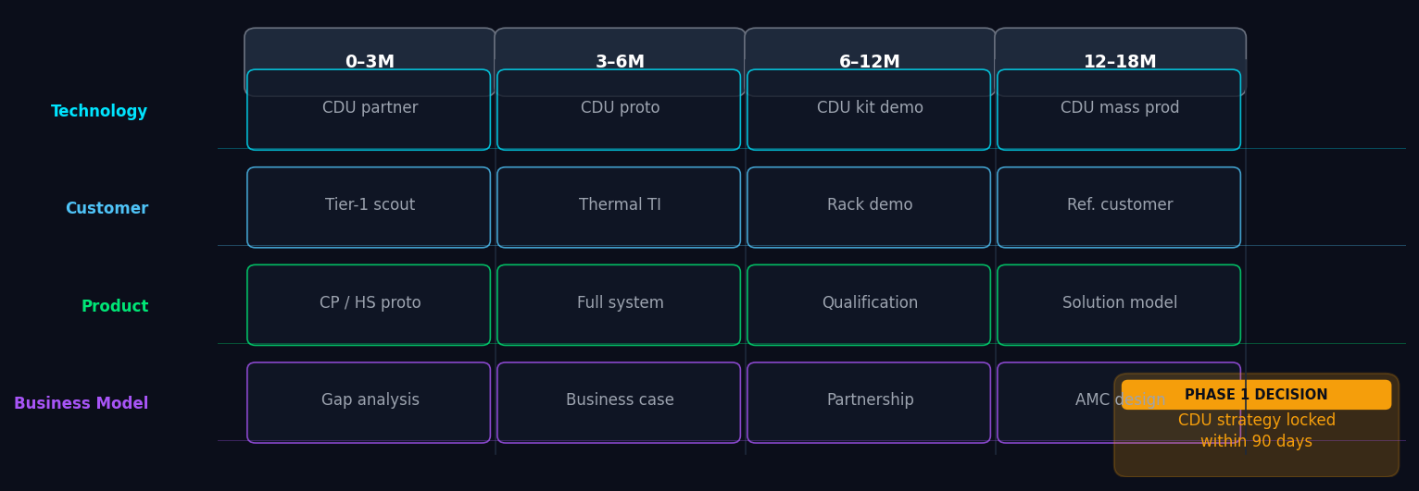
Strategic Roadmap & Recommended Actions
10
4 階段 6-18 個月 Roadmap：Phase 1 基礎 → Phase 4 規模化
KEY INSIGHTS
Phase 1 最關鍵決策：CDU 是內部開發 / 合作夥伴 / 併購？這將決定 TMSBU 液冷成敗
所有 Phase 終極目標：從 Component Supplier 轉型為 Thermal System Solution Provider
落後代價：失去 GB300/Rubin 平台供應商資格，影響未來 5-10 年競爭地位
Source: TMSBU strategic planning. Timelines indicative, subject to internal alignment.
Notes:
4-lane roadmap: Technology / Customer / Product / Business Model across 4 phases. Phase 1 (0-3M): Foundation — confirm target customers/platforms, benchmark thermal architectures, build product gap list, identify CDU/quick connector partners. Phase 2 (3-6M): Development — cold plate + hybrid module proto, establish thermal validation, start TI discussions, finalize TAM/SAM business case. Phase 3 (6-12M): Prototype & Engage — CDU/manifold kit proto, qualify connectors, create rack-level demo, engage Tier-1. Phase 4 (12-18M): Scale — solution selling model, annual maintenance design, first reference customer, mass production preparation. KEY: Every phase builds toward becoming the customer's indispensable Thermal System Partner.

