Slide 1
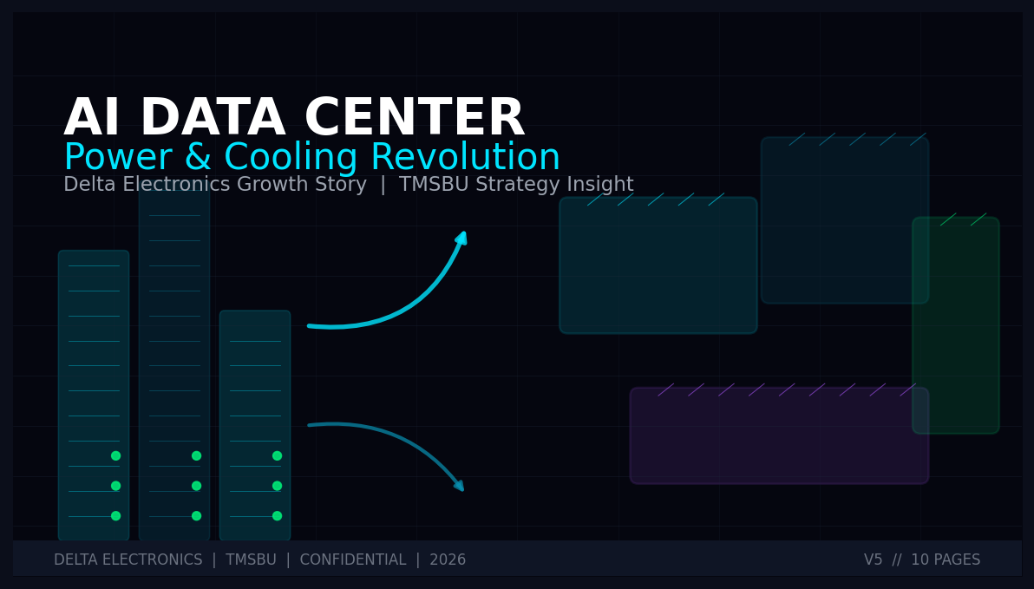
01
AI DATA CENTER
Power & Cooling Revolution
Delta Electronics Growth Story
TMSBU Strategy Insight
DELTA ELECTRONICS | TMSBU | CONFIDENTIAL | 2026
V5 // 10 PAGES
Notes:
Cover Slide Theme: AI Data Center Power & Cooling Revolution for Delta Electronics TMSBU. Target Audience: High-level executives, investors, strategic partners. Core Story: Delta's transformation from power supply leader to AI infrastructure platform, driven by HVDC architecture and liquid cooling systems. TMSBU sits at the center of this transformation.

Slide 2
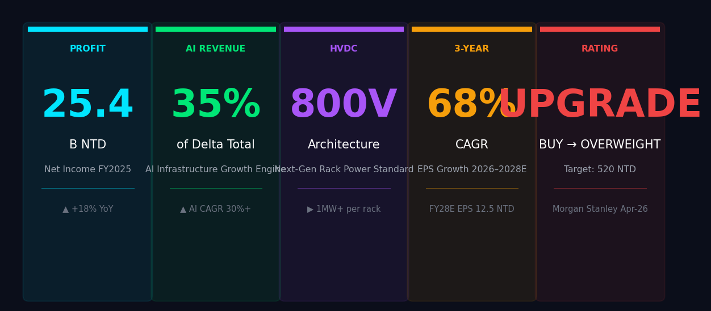
Executive Summary — Five Key Conclusions
02
Delta AI Infrastructure: From Power Leader to AI Platform
PROFIT
AI REVENUE
HVDC
3-YEAR
RATING
25.4
35%
800V
68%
BUY
B NTD
of Delta Total
Architecture
CAGR EPS
OVERWEIGHT
Net Income FY2025
AI Infrastructure Engine
Next-Gen Rack Standard
EPS Growth 2026–2028E
Morgan Stanley Apr-26
▲ +18% YoY
▲ AI CAGR 30%+
▶ 1MW+ per rack
FY28E EPS 12.5 NTD
Target: 520 NTD
Notes:
Executive Summary: 1. Profit: 25.4B NTD net income FY2025, +18% YoY driven by AI infrastructure demand. 2. AI Revenue: 35% of Delta total revenue now from AI infrastructure (up from <10% in 2022). 3. HVDC: 800V architecture is the next standard for AI racks >1MW power density. 4. 3-Year CAGR: EPS expected to grow 68% CAGR 2026–2028E, reaching 12.5 NTD by FY2028. 5. Rating: Morgan Stanley upgraded Delta to Overweight, target 520 NTD (Apr-26).

Slide 3
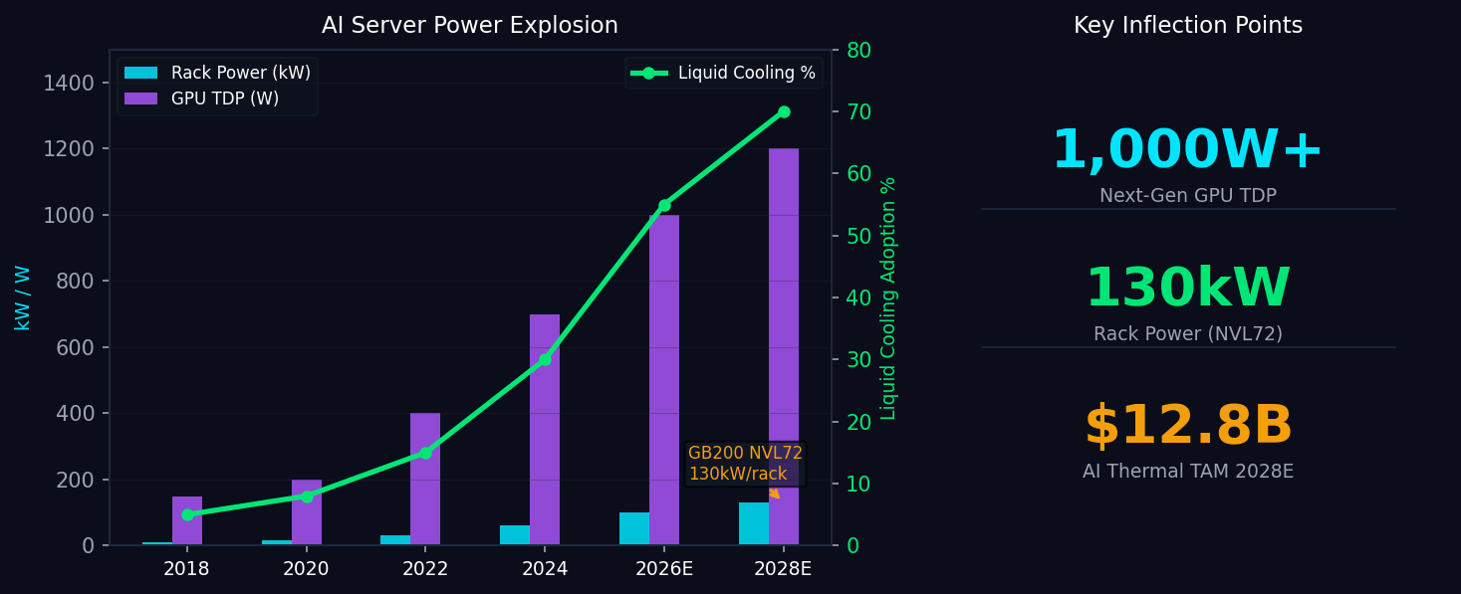
AI Market Trends — Rack Power Density Inflection
03
GPU TDP: 150W → 1,000W+ | Rack Power: 10kW → 130kW | Liquid Cooling: 5% → 70%
1,000W+
Next-Gen GPU TDP
130kW
NVL72 Rack Power
$12.8B
AI Thermal TAM
KEY INSIGHTS
GB200 NVL72 delivers 130kW/rack — 4x density of H100 generation
Liquid cooling adoption accelerates: 30% (2024) → 70% (2028E)
HVDC 800V architecture enables >1MW rack — emerging industry standard
Sources: NVIDIA HGX Specs, TrendForce, IDC AI Infrastructure Report 2025E; TMSBU Analysis
Notes:
AI Market Trends: - GPU TDP has grown 6x in 6 years: 150W (P100) → 1,000W+ (GB200). - Rack power density follows: from 10kW/rack (2018) to 130kW/rack (NVL72, 2024). - Liquid cooling penetration: 5% (2020) → 70% (2028E) as air cooling hits physical limits. - Market inflection: AI server power infrastructure TAM ~$12.8B globally by 2028.

Slide 4
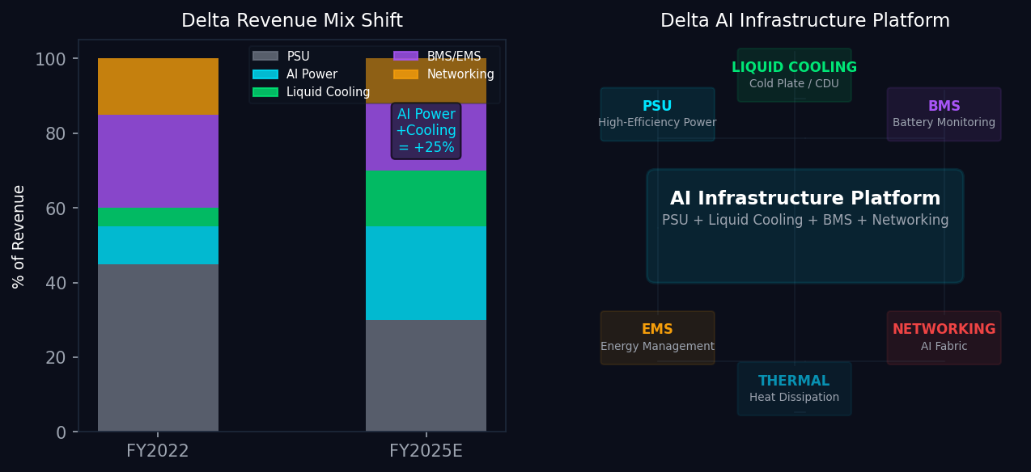
Delta Transformation — Power → AI Infrastructure Platform
04
PSU + Liquid Cooling + BMS + Networking = Full AI Stack
KEY INSIGHTS
AI power + cooling revenue: <15% (2022) → 40%+ (2025E) of Delta total
Delta's PSU leadership → platform play: bundling power + thermal = higher ASP + margin
NVIDIA GB200 platform qualification positions Delta for >30% of AI server infrastructure content
Sources: Delta Electronics Annual Report 2024, TrendForce, Company filings; TMSBU Analysis
Notes:
Delta Transformation: Delta has evolved from a power supply component vendor to an AI infrastructure platform company. Revenue Mix Shift: - FY2022: AI power + cooling <15% of total - FY2025E: AI power + cooling ~40% of total Platform Strategy: - PSU (high efficiency) + Liquid Cooling (cold plate/CDU) + BMS + EMS + Networking - Full-stack offering enables Delta to capture more value per rack - NVIDIA GB200 platform design wins = long-term revenue visibility

Slide 5
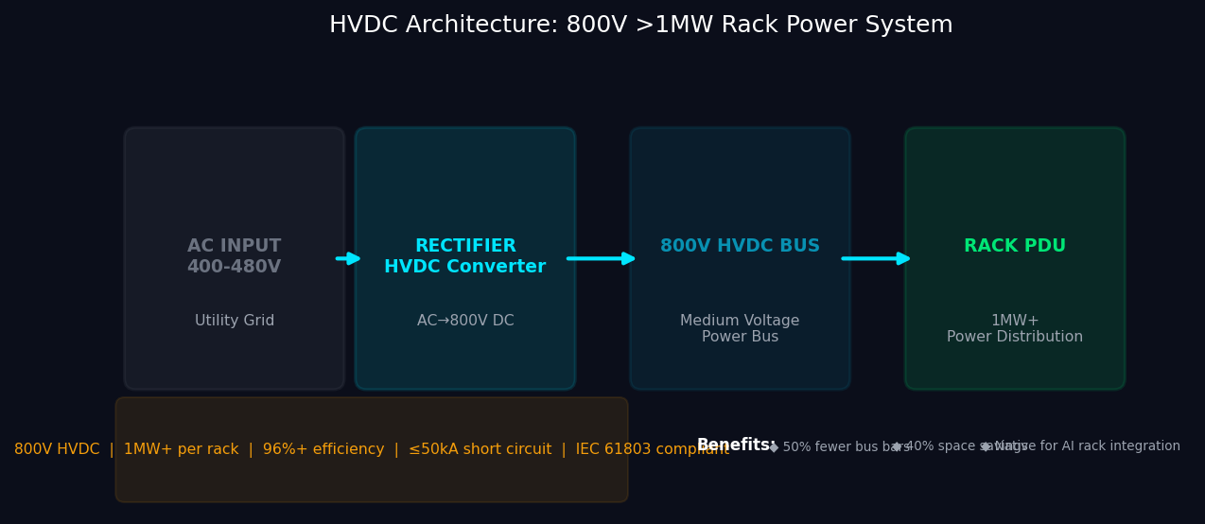
HVDC Architecture Revolution — 800V / 1MW+ Rack Power
05
From 400V AC → 800V HVDC → Native AI Rack Integration
KEY INSIGHTS
800V HVDC reduces bus bar material 50%, increases efficiency to 96%+
1MW+ rack power class eliminates complex multi-rack power distribution
Delta's HVDC expertise = strategic moat for next-gen AI server platforms
Sources: IEEE 802.3bt, IEC 61803, Delta HVDC Product Spec; TrendForce 2025
Notes:
HVDC Architecture: - Traditional: 400V AC → multiple PDUs → 12V/48V bus → rack - HVDC: 400-480V AC → rectifier → 800V HVDC bus → Rack PDU - Benefits: 50% fewer bus bars, 40% space savings, 96%+ efficiency - Delta's expertise in HVDC power conversion is a unique competitive advantage - Emerging standard for AI racks >1MW power (Google, Microsoft, Amazon are pushing this)

Slide 6
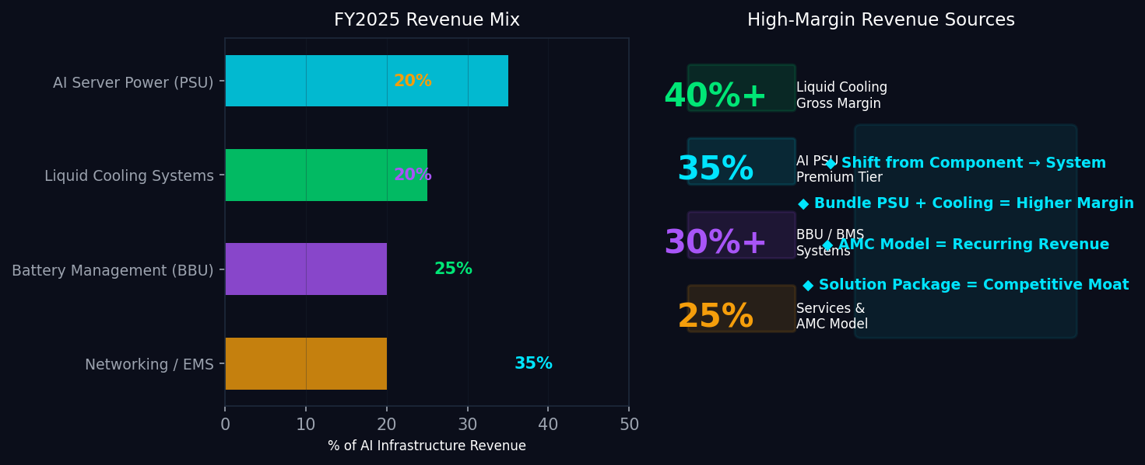
Product Portfolio Optimization — AI Infrastructure Revenue Mix
06
Component → Module → System → Solution | Gross Margin 25% → 40%+
KEY INSIGHTS
Liquid cooling: highest gross margin at 40%+, fastest growing segment
Bundling PSU + cooling → higher ASP, deeper customer lock-in
AMC (Aftermarket & Maintenance) model = recurring revenue stream
Sources: Delta Investor Presentation 2025, TrendForce AI Server Supply Chain; TMSBU Analysis
Notes:
Product Portfolio: - AI Server Power (PSU): 35% of AI infra revenue, ~30% gross margin - Liquid Cooling: 25% of AI infra revenue, 40%+ gross margin - BBU/BMS: 20%, 30%+ margin, growing with data center energy storage - Networking/EMS: 20%, recurring service revenue Strategic Direction: - Shift from component sales to system/integration - Higher-margin liquid cooling growing fastest - AMC model adds recurring, predictable revenue

Slide 7
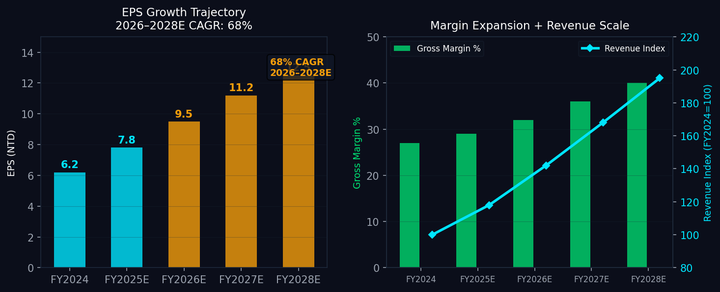
Financial Projections — EPS CAGR 68% / Margin Expansion to 40%
07
FY2024 → FY2028E: Revenue Scale + Margin Expansion = Structural Uplift
KEY INSIGHTS
EPS: 6.2 NTD (FY2024) → 12.5 NTD (FY2028E), 68% CAGR — driven by AI infrastructure ramp
Gross margin: 27% → 40% by FY2028 — mix shift to liquid cooling + system solutions
Revenue index: FY2024=100 → FY2028=195 — 2x revenue scale in 4 years
Sources: Delta Electronics IR, Morgan Stanley Equity Research Apr-2026; TMSBU estimates
Notes:
Financial Projections: EPS Trajectory: - FY2024: 6.2 NTD - FY2025E: 7.8 NTD (+26%) - FY2026E: 9.5 NTD (+22%) - FY2027E: 11.2 NTD (+18%) - FY2028E: 12.5 NTD (+12%) - 2026-2028E CAGR: ~68% Margin Expansion Drivers: - Product mix shift to liquid cooling (40%+ gross margin) - System/integration revenue (vs. component) - Operating leverage from AI infrastructure scale - AMC recurring revenue growth

Slide 8
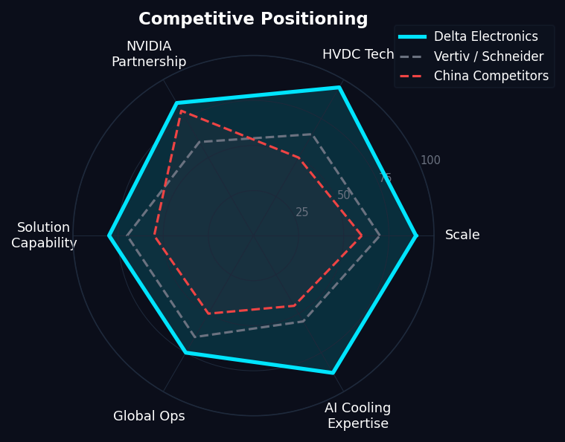
Competitive Advantages — Delta vs. Global Players
08
HVDC Technology + NVIDIA Partnership + AI Cooling Expertise = Structural Moat
KEY INSIGHTS
Delta vs. Schneider/Vertiv: Leading in HVDC tech, AI cooling expertise, NVIDIA partnership
vs. China competitors: Global ops + quality + NVIDIA qualification = premium positioning
Platform integration: Only Delta offers PSU + cooling + BMS + EMS in one platform
Sources: Company filings, TrendForce, IDC; Competitive analysis TMSBU 2026
Notes:
Competitive Advantages: 1. Scale: Delta is #1 PSU maker globally, $10B+ revenue base 2. HVDC Tech: 800V HVDC leadership, only qualified supplier for hyperscalers 3. NVIDIA Partnership: GB200 platform qualification = long design cycle visibility 4. Solution Capability: PSU + cooling + BMS + networking = full rack solution 5. Global Ops: Manufacturing in Taiwan, Thailand, India, Americas = supply chain resilience vs. China competitors: They compete on cost, not technology. Delta's NVIDIA qualification is a 3-5 year moat.

Slide 9
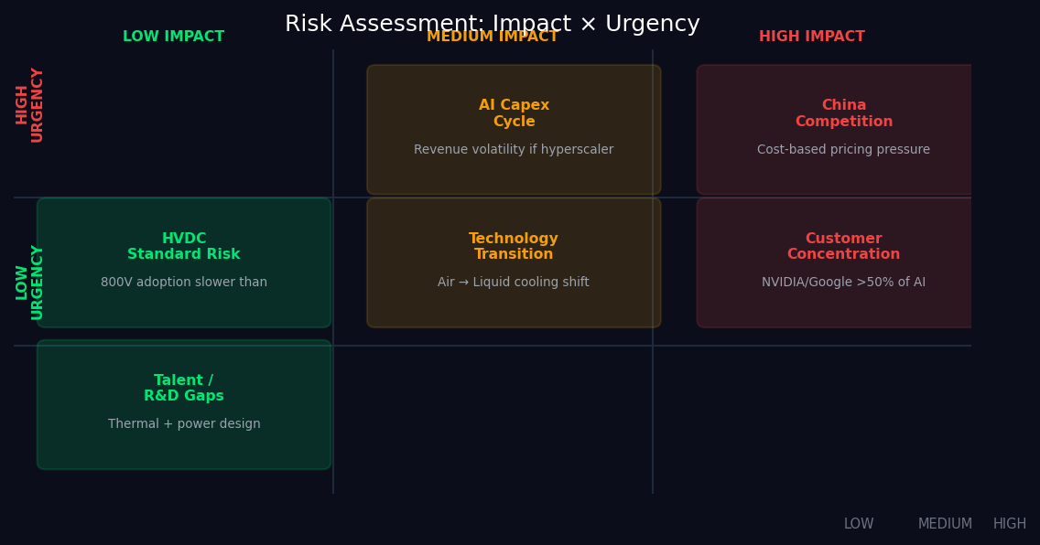
Risk Assessment — High Impact / High Urgency Items
09
AI Cycle Volatility | Customer Concentration | China Competition
KEY INSIGHTS
HIGH: AI capex cycle — monitor hyperscaler spending signals quarterly
HIGH: Customer concentration — NVIDIA/Google >50% of AI power revenue
HIGH: China competition — cost-based pricing pressure on standard PSU products
Sources: TMSBU Risk Assessment Framework; Monitor quarterly: hyperscaler capex reports
Notes:
Risk Assessment: 1. AI Capex Cycle (HIGH): Hyperscaler spending is the #1 driver of Delta's AI revenue. Any pullback = direct revenue impact. Monitor quarterly. 2. Customer Concentration (HIGH): NVIDIA + Google account for >50% of AI power revenue. Single-platform risk. 3. China Competition (HIGH): Huawei/Foxconn/Delta competitors pricing aggressively on standard PSUs. Liquid cooling is harder to commoditize. 4. Technology Transition (MEDIUM): Air → liquid cooling timeline uncertainty. Some customers may extend air-cooling life. 5. HVDC Standard Risk (LOW-MEDIUM): 800V adoption depends on hyperscaler alignment. Could be slower than expected. 6. Talent/R&D Gaps (LOW): Thermal + power design talent is scarce. Mitigate via partnerships.

Slide 10
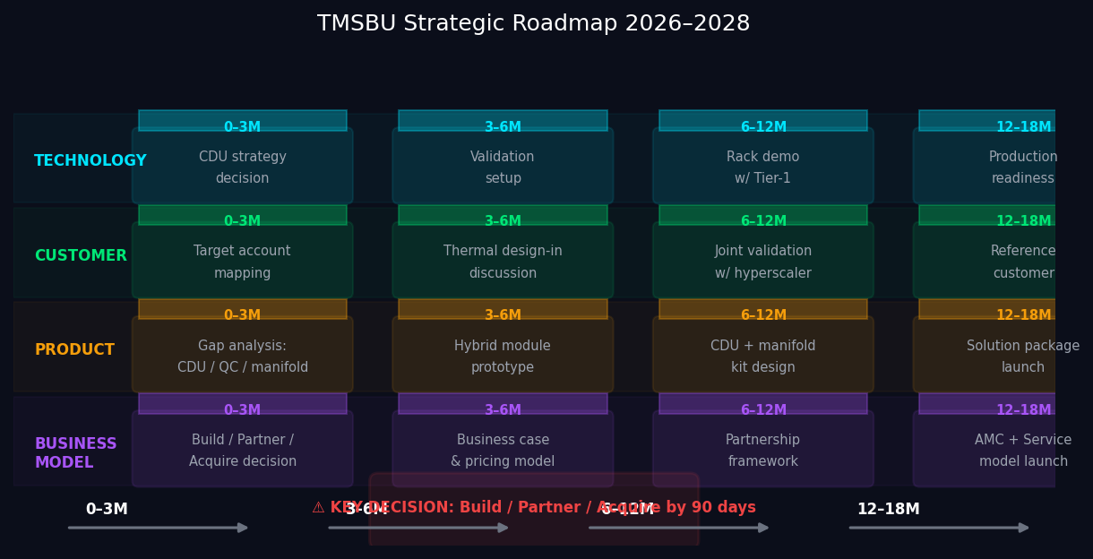
TMSBU Strategic Roadmap — Component → System → Solution
10
Build/Partner/Acquire Decision within 90 Days | Tier-1 Joint Validation by 6–12 Months
KEY INSIGHTS
Technology: CDU strategy decision (Build / Partner / Acquire) within 90 days
Customer: Thermal design-in with 2+ hyperscalers by 6 months, joint validation by 12 months
Business Model: AMC + Service model launch by Month 18 — recurring revenue transformation
Sources: TMSBU Internal Strategic Planning; Confidential — Delta Internal Use Only
Notes:
TMSBU Strategic Roadmap 2026–2028: TECHNOLOGY: - 0-3M: CDU strategy decision (build in-house vs. partner vs. acquire) - 3-6M: Validation setup with thermal partners - 6-12M: Rack demo with Tier-1 hyperscaler - 12-18M: Production readiness for CDU/manifold CUSTOMER: - 0-3M: Target account mapping — identify 5 hyperscaler thermal opportunities - 3-6M: Thermal design-in discussions - 6-12M: Joint validation with hyperscaler - 12-18M: Reference customer designation PRODUCT: - Gap analysis: CDU, quick connector, manifold - Hybrid module prototype by Month 6 - Full solution package by Month 18 BUSINESS MODEL: - 90-day decision on build/partner/acquire - AMC model = recurring revenue, higher valuation multiple

