Slide 1
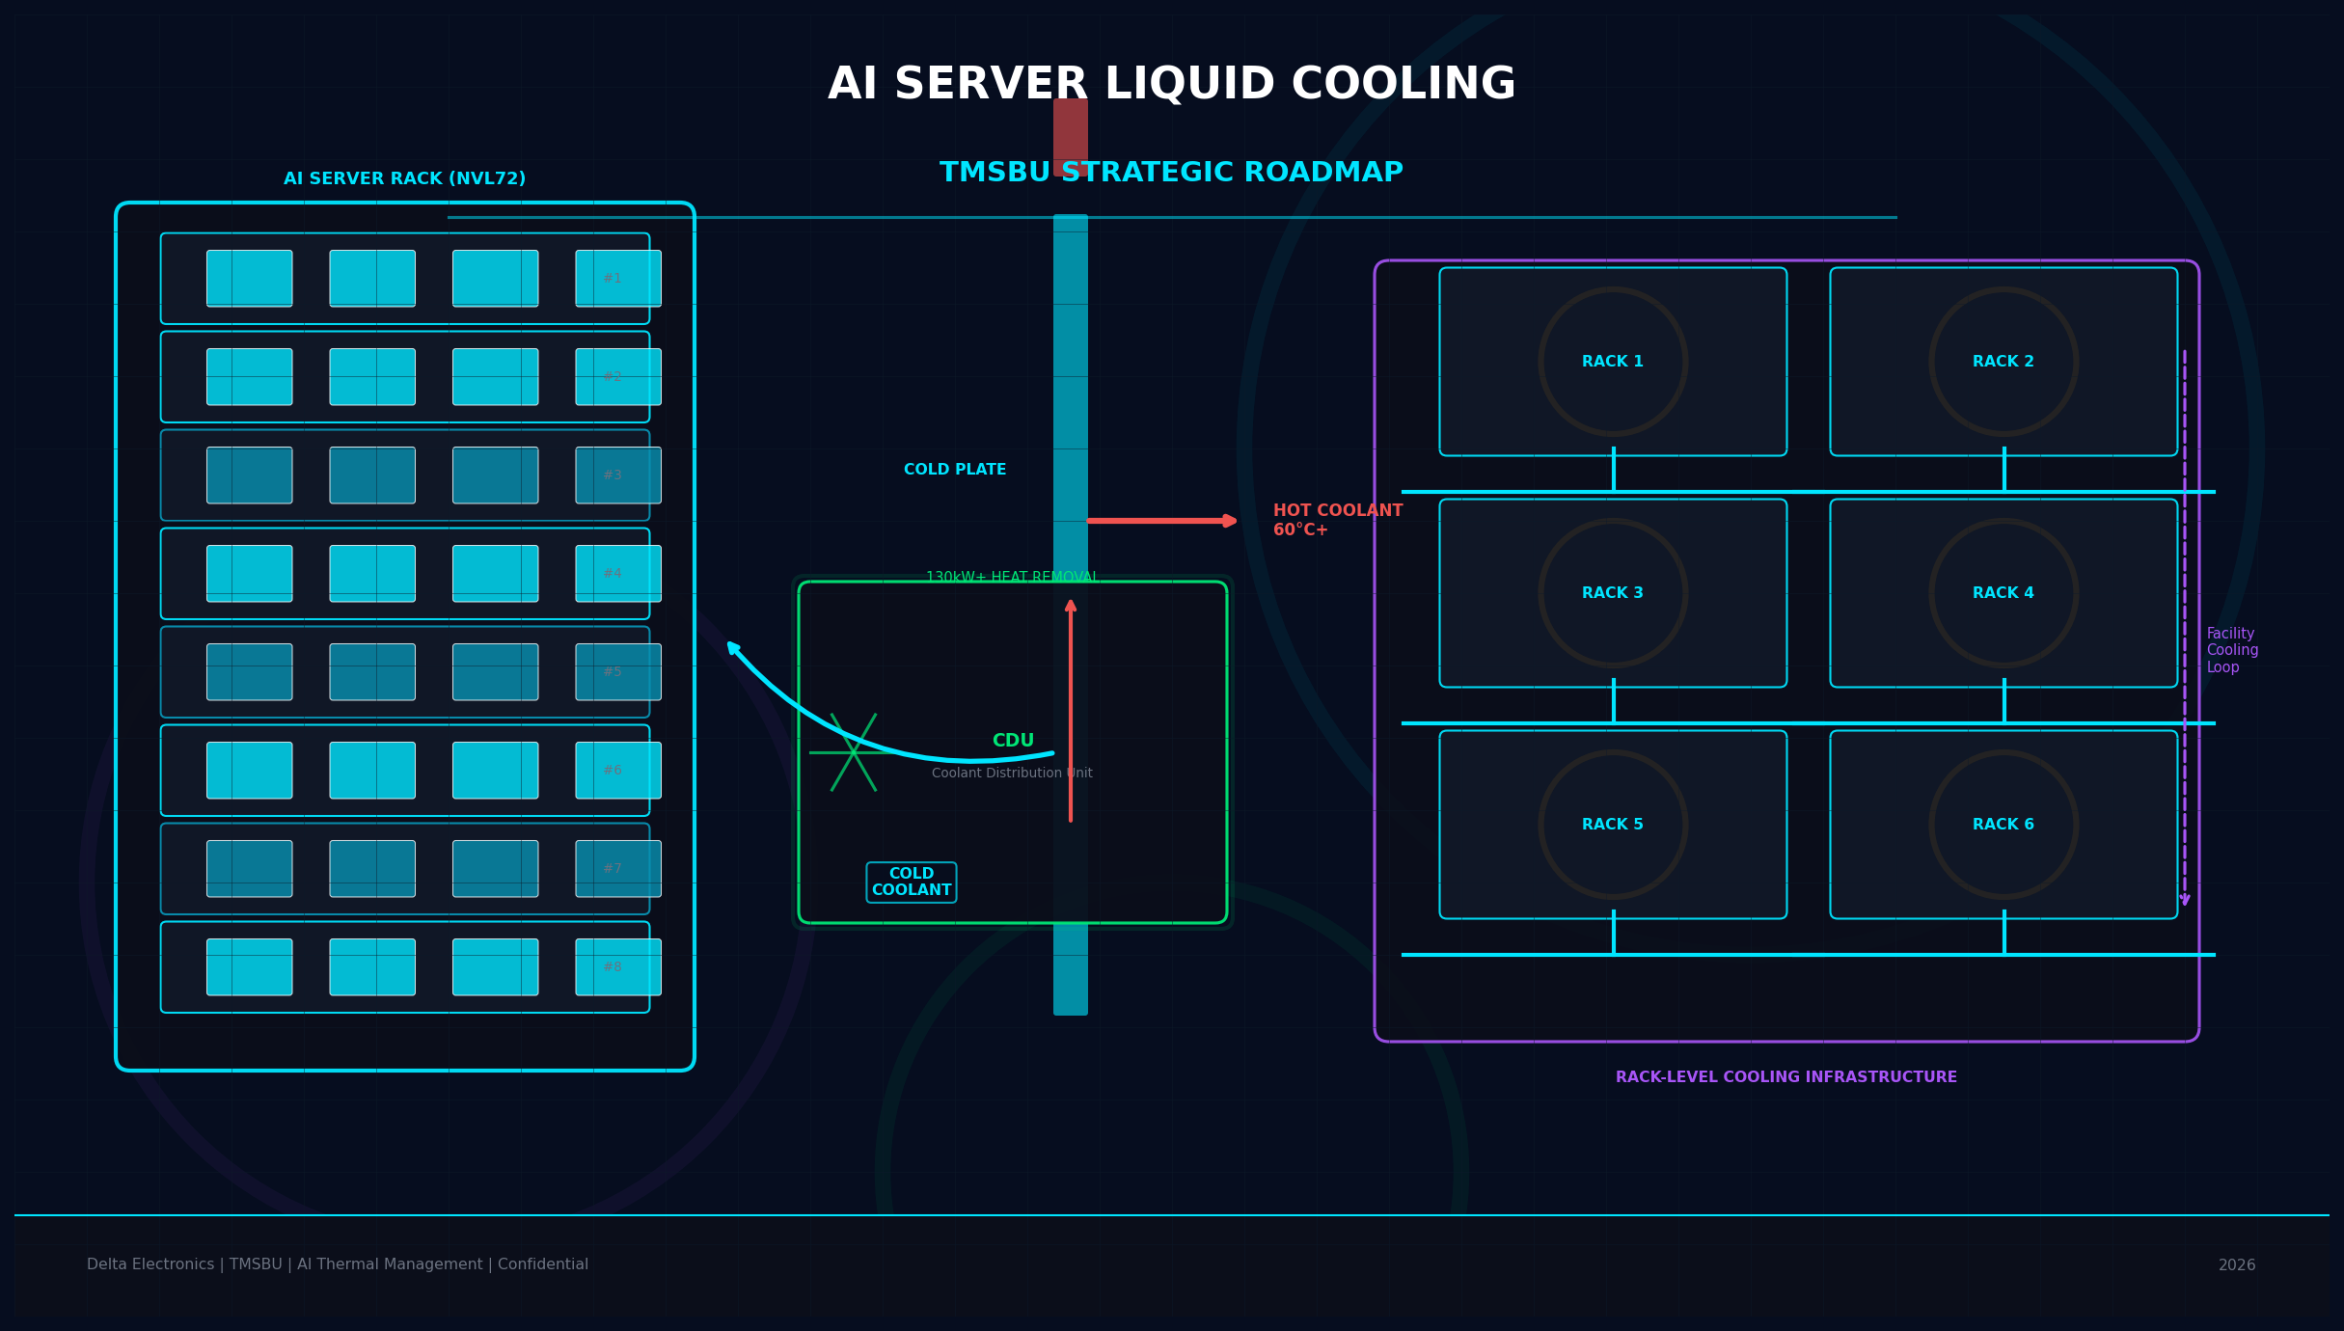
AI Server Liquid Cooling:
TMSBU Commercial Opportunity & Strategic Roadmap
From Component Supplier to Thermal System Solution Provider
Delta Electronics | TMSBU | Confidential | 2026
Notes:
This presentation covers the commercial opportunity and strategic roadmap for TMSBU in AI server liquid cooling. Target audience: TMSBU leadership, BU heads, group executives, and key customers. Key message: liquid cooling is not a product upgrade — it is a business model transition.

Slide 2
Executive Summary
02
液冷不是產品升級，而是商業模式的轉型
Liquid cooling is not only a product opportunity — it is a business model transition for TMSBU
01
TREND
02
MARKET
AI GPU / Rack Power Exceeds Air Cooling
Liquid Cooling Adoption Accelerating
GPU TDP突破700W，GB200 NVL72 rack power達130kW+。風冷已達物理瓶頸，散熱成為AI基礎建設擴張的硬約束。
液冷滲透率：2023年20% → 2026年60% → 2030年80%+。從選配變成新建AI資料中心的標準架構。
03
HYBRID
04
OPPORTUNITY
Hybrid Air + Liquid Remains Necessary
TMSBU Can Expand into Module & System
GPU本體用液冷，但memory、PCB、power delivery、networking仍需風冷。兩種散熱方式長期共存，TMSBU兩者皆受益。
Delta TMSBU已有Fan、HS、HP、VC、Cold Plate製造基礎。從零件供應商升級為模組與系統層級熱管理方案供應商。
05
ACTION
6–18 Months Are Critical
Notes:
Key executive message: Liquid cooling is not just a new product category — it requires TMSBU to transform from a component supplier (fan, heat sink, VC) into a thermal system solution provider. This involves new capabilities (CDU design, quick connectors, system integration), new customer relationships (direct engagement with server ODMs and hyperscalers), and a new business model (solution contracts vs. component pricing).

Slide 3
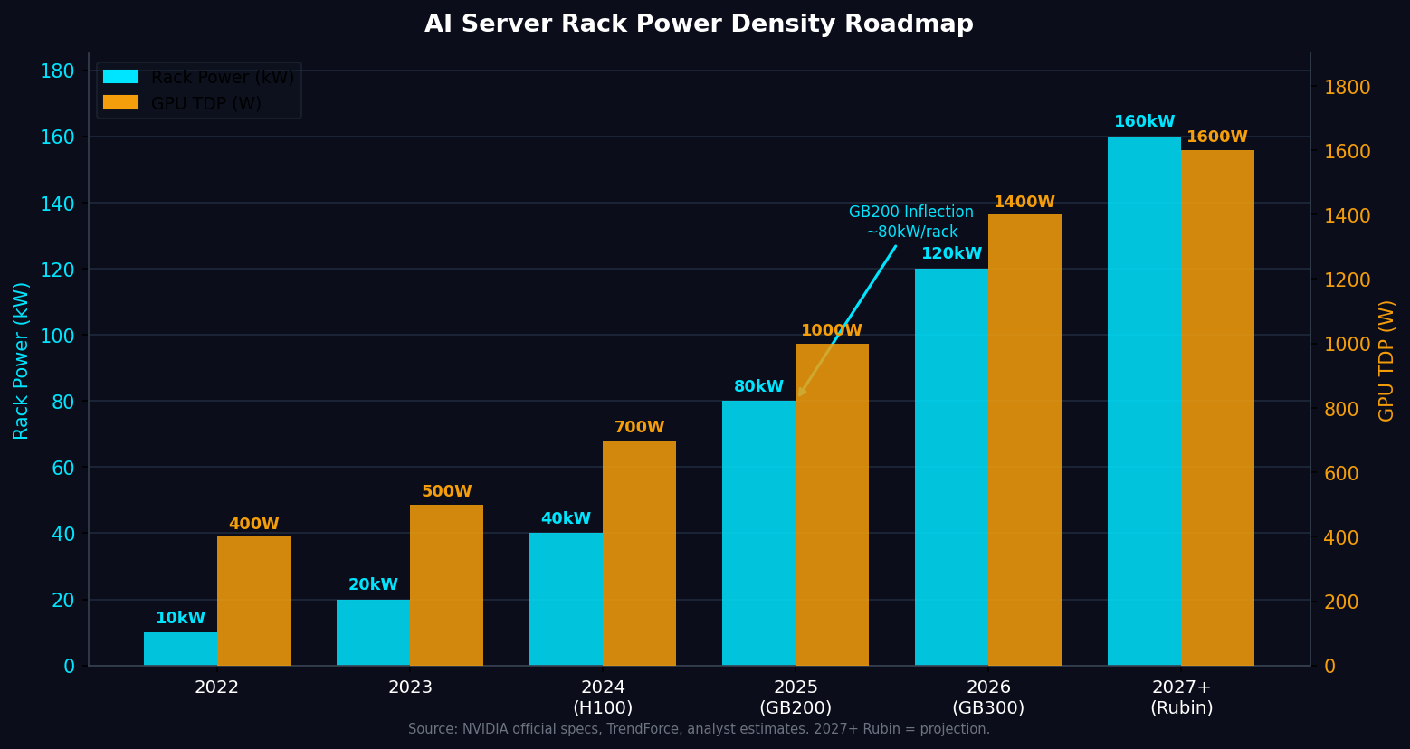
Market Inflection: AI Compute Density
Creates Thermal Bottleneck
03
AI compute density is growing faster than traditional thermal architecture can support
GPU TDP
400W → 1,400W
Per chip, 2022–2027+
Rack Power
10kW → 160kW
Per rack, 2022–2027+
Inflection
GB200 NVL72
~80–130kW/rack, liquid required
Market
$4.2B → $39.1B
Rubin (2027+): GPU TDP 1,400W+，Rack power 160kW+ — 風冷已物理不可行
散熱瓶頸成為AI基礎建設擴張的硬約束，而非成本問題
誰能解決散熱問題，誰就能贏得AI基礎建設的市佔率
Liquid cooling TAM by 2030 (M&M)
Notes:
The rack power density inflection point is GB200 NVL72 at 80-130kW per rack. This is 4-6x higher than traditional air-cooled racks. The consequence: liquid cooling shifts from optional to mandatory. Sources: NVIDIA GB200 NVL72 specs (public), TrendForce AI server rack power analysis, MarketsandMarkets liquid cooling market report. The Rubin generation (2027+) pushes to 160kW+/rack, making alternative cooling architectures (immersion) a potential next inflection.

Slide 4
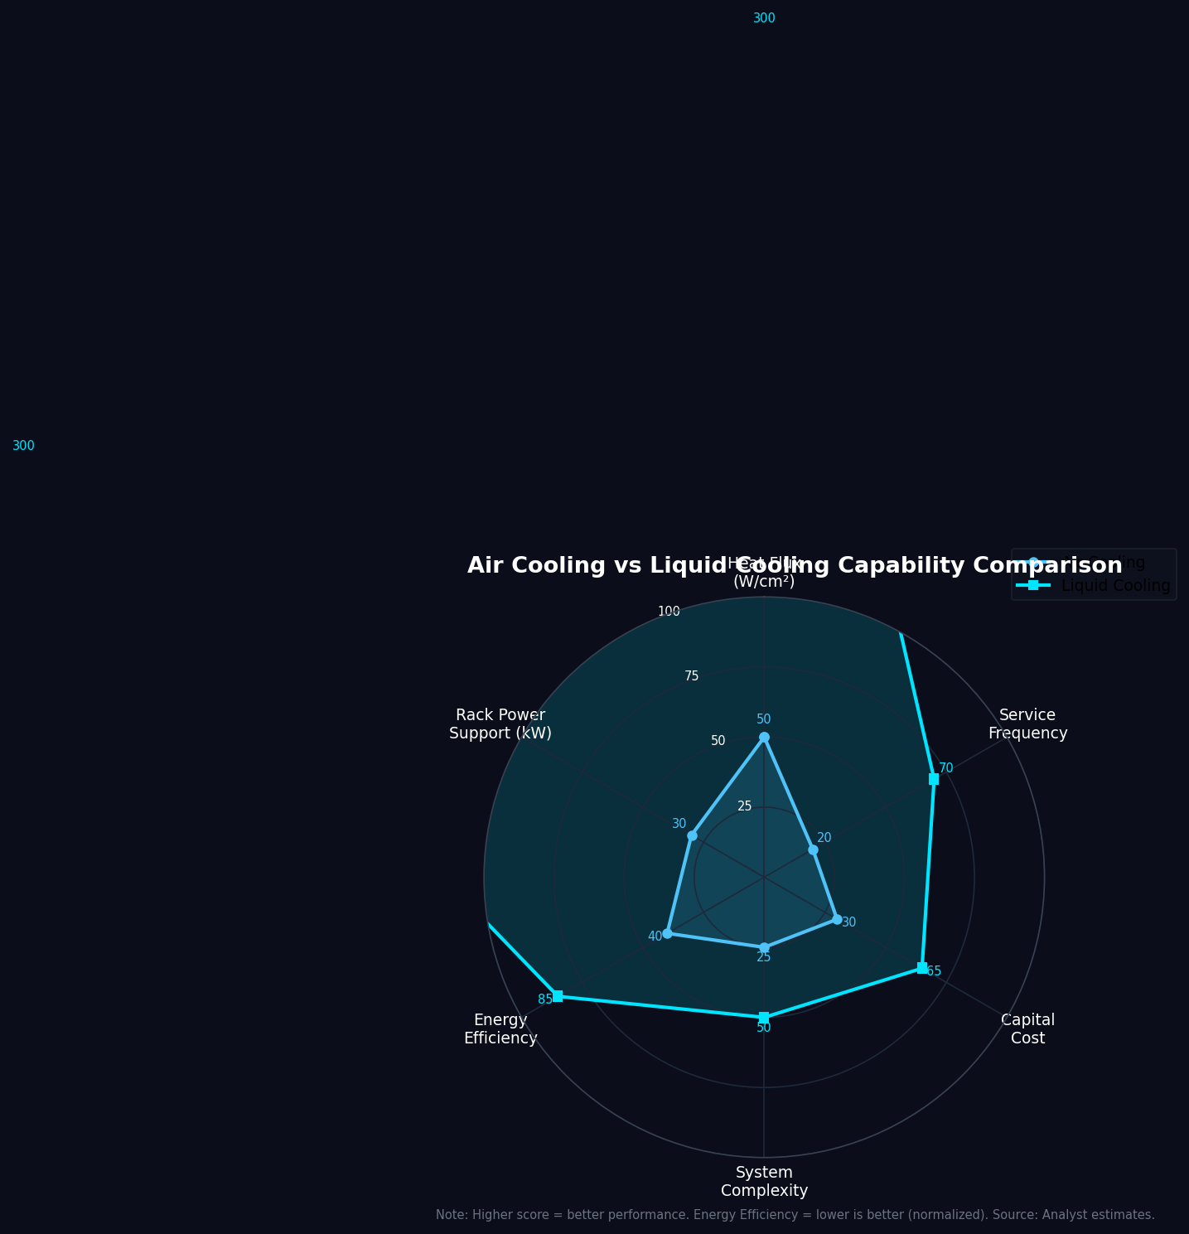
Why Air Cooling Alone Is No Longer Enough
04
Not air vs. liquid — but hybrid air + liquid is the new standard architecture
Air Cooling Still Required
Memory modules (HBM)
PCB / power delivery
Storage / networking
Low-power accessories
Air Cooling Limitations
Heat flux上限 ~50W/cm²，GPU已超標
Fan噪音與功耗隨密度非線性增加
Rack power > 30kW時，TCO急速上升
PUE penalty：高密度風冷機房PUE > 1.4
KEY INSIGHT: Hybrid = Liquid handles GPU/CPU hotspot + Air handles memory/PCB/power. TMSBU benefits from BOTH trends.
Notes:
The key insight is not 'air vs liquid' — it is 'air AND liquid.' Liquid cooling handles the high-power GPU/CPU thermal load. Air cooling remains essential for memory (HBM stacks at 1kW per module), PCBs, power delivery components, and networking. This means TMSBU's fan business does not decline with liquid cooling adoption — it grows because more air cooling is needed to support non-GPU components in liquid-cooled servers. The hybrid architecture is the new standard.

Slide 5
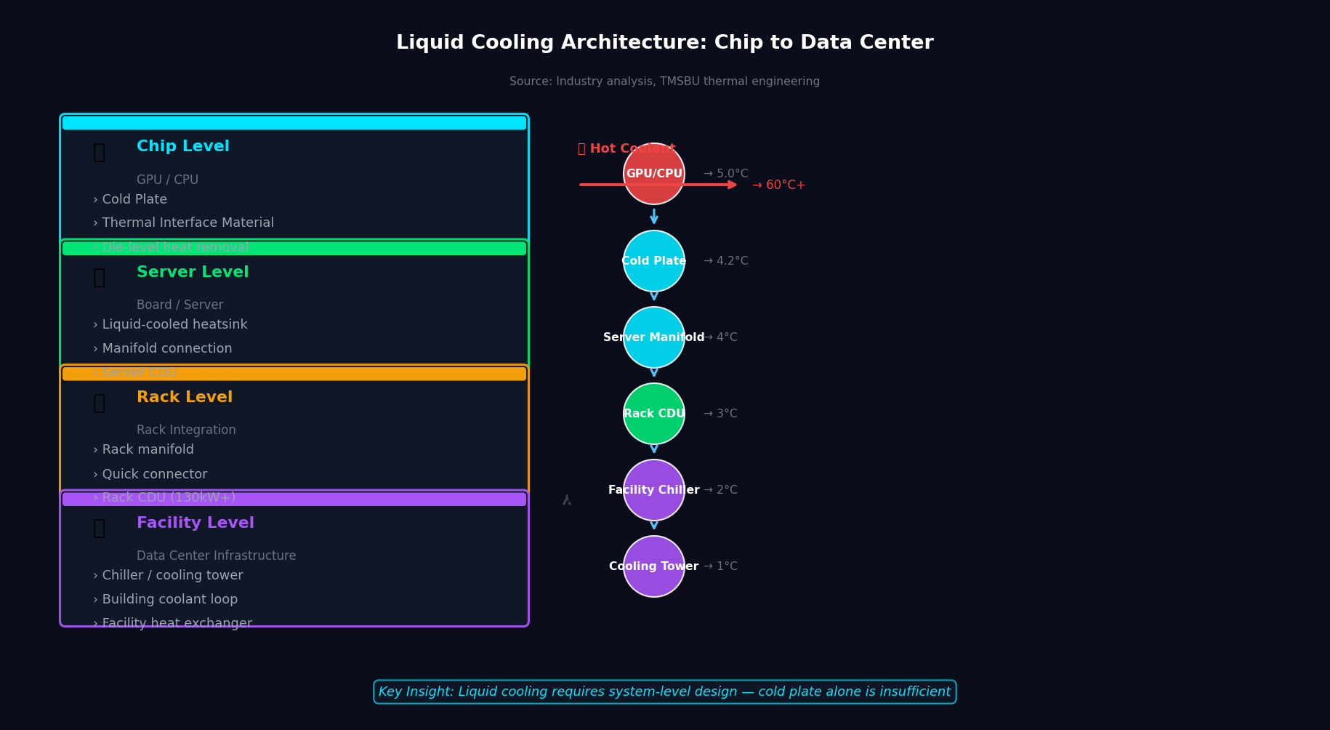
Liquid Cooling Architecture Becomes
the New Standard
05
液冷的價值不在冷板，在於完整系統整合：Cold Plate + CDU + Manifold + Quick Connector + Leak Detection
Source: Industry analysis, TMSBU thermal engineering. Cold Plate → Server CDU → Rack CDU → Facility Cooling = Full System Integration Value Chain
Notes:
Liquid cooling is not a single product — it is a system with 5 key components: (1) Cold Plates at chip level with direct contact cooling; (2) CDUs (Coolant Distribution Units) that circulate and reject heat at rack or row level; (3) Manifolds that distribute coolant to multiple servers; (4) Quick Connectors that enable hot-swap maintenance without draining the system; (5) Leak detection and monitoring for reliability. The system integration complexity is where the highest value resides. Vendors who can provide the complete system — not just components — will capture the majority of the value pool.

Slide 6
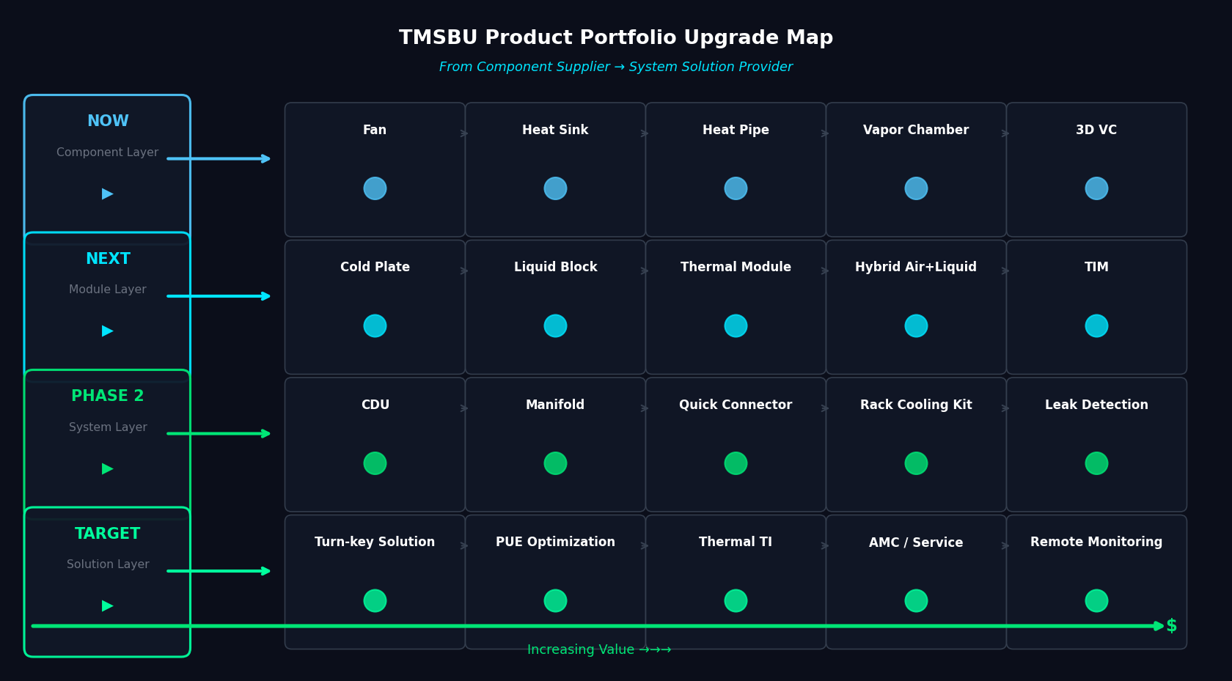
TMSBU Portfolio Mapping:
From Air Cooling to Liquid Cooling
06
Delta TMSBU has a natural expansion path from existing thermal components into liquid cooling modules and systems
NOW: Components → NEXT: Modules → PHASE 2: Systems → TARGET: Solutions
CDU + Quick Connector + Manifold = Highest Value Extension for TMSBU
Notes:
TMSBU's current product portfolio covers the component layer well: fans, heat sinks, heat pipes, vapor chambers, and 3D VCs. The natural next steps are: (1) Module layer — cold plates and liquid-cooled thermal modules; (2) System layer — CDU, manifolds, quick connectors, and rack cooling kits; (3) Solution layer — turn-key thermal solutions, PUE optimization services, thermal design-in partnerships, and annual maintenance contracts. The critical capability gaps to fill: CDU design and manufacturing, quick connector qualification, and leak detection. These can be built internally, acquired, or partnered.

Slide 7

TAM / SAM / SOM: Market Opportunity
for TMSBU
07
The addressable opportunity is larger than cold plates alone — system-level cooling multiplies TMSBU's reachable market
TAM
Total AI Data Center Liquid Cooling
$39.1B
by 2030
Cold Plate
Chip-level direct cooling
$5.2B
~13% of TAM
CDU
Coolant distribution + heat rejection
$3.8B
~10% of TAM
Manifold + QC
Rack distribution + connectors
$3.8B
~10% of TAM
Hybrid Air
Fan + HS + VC for non-GPU components
$4.5B
Additional market
SOM
$1.8B
Assumption-based
TMSBU realistic addressable (×14%)
⚠ SOM = Assumption-based. Needs TMSBU internal validation.
Notes:
Key assumptions: TAM $39.1B by 2030 (MarketsandMarkets, 2024). Cold plate, CDU, manifold+QC estimated at ~33% of TAM combined (analyst estimate — need validation). SOM (TMSBU addressable) assumed at 14% of SAM based on Delta's current thermal component share in server market. This is an assumption that requires validation through customer engagement and competitive analysis. The SOM estimate excludes potential new logo wins from system solution differentiation.

Slide 8
Competitive Positioning & Differentiation
08
Avoid competing as a low-margin component supplier — move toward differentiated thermal system partnership
Traditional Thermal Suppliers
+ Fans, HS, VC
− No liquid cooling system
TMSBU Differentiators
Nidec, Sunon, Global Sunon
Air + Liquid Hybrid
唯一同時具備兩種散熱技術的供應商
Delta Group Synergy
Fan + Power + Control + DC Infra
Manufacturing Scale
現有散熱零件製造基地，快速延伸
Chip to Rack Capability
VC/HP → Cold Plate → Rack CDU 全段覆蓋
Customer Relationships
現有服務服務器ODM/OEM的客戶基礎
Liquid Cooling Specialists
+ CDU, cold plate, manifold
− Limited air cooling synergy
CoolIT, Rittal, Avery Dennison
Server ODMs (In-house)
+ Full system integration
− Outsource thermal to TMSBU
Foxconn, Wistron, Inventec
Connector / CDU Specialists
+ Quick connector, CDU
− Narrow component focus
Staubli, Liiver, CPC
Integrated DC Infra
+ Full data center solutions
− Not chip-level thermal
Schneider, Vertiv, Rittal
Notes:
TMSBU's competitive advantage is its unique combination of: (1) Air cooling expertise and manufacturing scale (fans, heat sinks, vapor chambers); (2) Early entry into liquid cooling with existing cold plate capabilities; (3) Delta Group-level synergies in power delivery, control systems, and data center infrastructure; (4) Long-standing customer relationships with server ODMs and OEMs. The main competitive risk is Chinese thermal management suppliers (China液冷供应链) who are rapidly scaling and could compete on price in the cold plate and manifold market. Differentiation through system integration quality, reliability, and global support network is critical.

Slide 9
Capability Gap & Risk Assessment
09
The opportunity is attractive, but TMSBU must close key capability gaps before scaling
Risk Item
Impact
Urgency
Key Action
CDU Design & Manufacturing
HIGH
HIGH
Core system component. Partner or acquire.
Quick Connector Qualification
HIGH
MED
Reliability is critical. Staubli/Liiver partnership.
Leak Detection & Reliability
HIGH
HIGH
CDU failure = server damage. Must be bulletproof.
Coolant Compatibility
MED
MED
OEM-specific coolant specs. Early engagement needed.
System-Level Validation
HIGH
HIGH
Need rack-level thermal testing capability.
Thermal Simulation Tools
MED
MED
Chip-to-rack multi-physics simulation required.
Customer Qualification Cycle
MED
HIGH
12-18 month design-in cycles. Start NOW.
Price Competition (China)
MED
MED
Cost-down pressure on cold plates. Differentiate on quality.
Integration Responsibility
HIGH
MED
Warranty boundary unclear in system selling.
Global Support Network
MED
LOW
Needed for Tier-1 hyperscaler contracts.
BOTTOM LINE: Highest priority risks are CDU capability, leak reliability, and customer qualification cycle. All three must be addressed in Phase 1 (0-3 months).
Notes:
The top 3 risks requiring immediate action: (1) CDU capability — TMSBU does not currently have CDU design/manufacturing. Options: partner with CDU specialists (CoolIT, Condair), acquire a CDU company, or develop in-house. Decision needed in Phase 1. (2) Leak reliability — a single leak incident can destroy a $500K server. Quick connector qualification and leak detection are non-negotiable. (3) Customer qualification cycle — Tier-1 server OEMs and hyperscalers have 12-18 month design-in cycles. Starting NOW is essential to be considered for GB300/Rubin platforms.

Slide 10
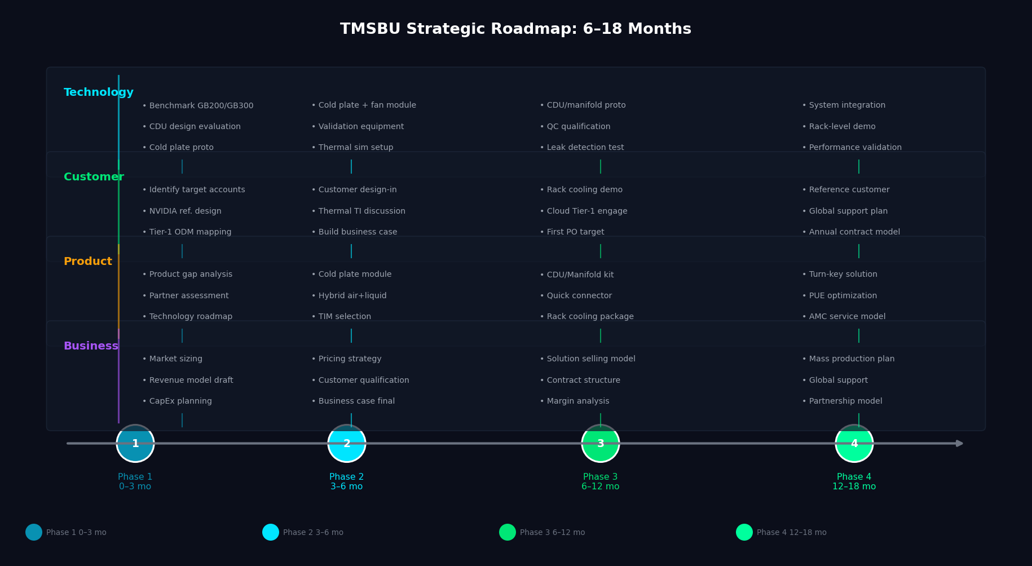
Strategic Roadmap & Recommended Actions
(6–18 Months)
10
Execute a phased roadmap: Component expansion → Module development → System integration → Solution business
Phase 1
0–3 mo
Phase 2
3–6 mo
Phase 3
6–12 mo
Phase 4
12–18 mo
Notes:
The 6-18 month roadmap has 4 phases: Phase 1 (0-3 months): Foundation — confirm target customers, benchmark GB200/GB300 thermal architecture, identify CDU and quick connector partners, build a complete product gap list. Phase 2 (3-6 months): Development — develop cold plate + hybrid air/liquid reference module, establish thermal validation capability, start thermal design-in discussions with customers, finalize the TAM/SAM business case. Phase 3 (6-12 months): Proto & Engage — prototype CDU/manifold system kit, qualify quick connectors and leak detection, create rack-level demo system, engage Tier-1 server OEM/ODM and cloud customers. Phase 4 (12-18 months): Scale — transition from product selling to solution selling, design annual maintenance/service model, establish first reference customer, prepare for mass production and global support.

