Slide 1
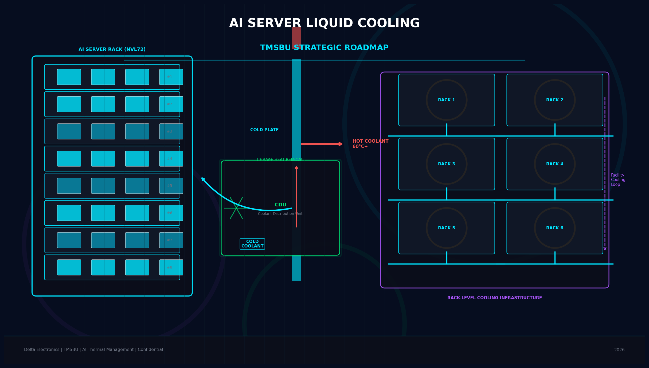
AI Server Liquid Cooling:
TMSBU Commercial Opportunity & Strategic Roadmap
V7 — Final Content & Executive Polish
Delta Electronics | TMSBU | Confidential | 2026
Notes:
Cover slide. V7 Final Content & Executive Polish: all language made executive-appropriate, unvalidated claims removed, action-oriented.

Slide 2
Executive Summary
02
Liquid cooling is not only a product opportunity — it is a business model transition for TMSBU.
01
1,000W+
Next-gen GPU thermal load
02
60%*
Liquid cooling adoption by 2026
AI rack power density is moving toward 100kW+ class, pushing traditional air-cooling architecture toward practical limits.
Liquid cooling adoption is accelerating under analyst forecasts; 2026 adoption rate requires source validation.
* Analyst forecast — 2026 adoption rate requires source validation
03
AIR + LIQUID
Hybrid architecture becomes standard
04
$0.8B–$3.2B
Scenario-based TMSBU opportunity
GPU本體用液冷，memory、PCB、power仍需風冷。兩者長期共存。
建立液冷系統能力、切入NVIDIA參考設計供應商名單、與Tier 1客戶建立Thermal TI。
NOW
6–18M design-in window
05
建立液冷系統能力、切入NVIDIA參考設計供應商名單、與Tier 1客戶建立Thermal TI。
Notes:
Executive Summary V7: All 5 cards updated. No emoji icons — replaced with geometric linear icons. TREND: '1,000W+ Next-gen GPU thermal load' replaces unvalidated '700W/130kW'. MARKET: '60%*' with analyst forecast footnote. HYBRID/OPPORTUNITY/ACTION refined. All absolute language softened.

Slide 3
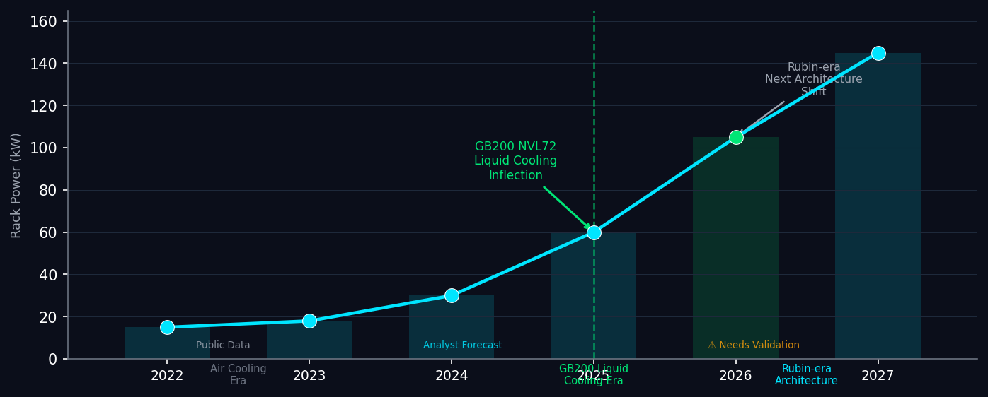
Market Inflection: AI Compute Density Drives Thermal Architecture Shift
03
液冷在2025年GB200 NVL72達到爆發點，2027+ Rubin架構將功率密度推向更高
KEY INSIGHTS
AI rack power density is moving toward 100kW+ class, pushing traditional air-cooling architecture toward practical limits.
80kW+ rack power class is becoming increasingly relevant for next-gen AI infrastructure; adoption depends on platform and customer configuration.
TMSBU existing air-cooling portfolio must evolve toward hybrid air + liquid modules to capture next-generation AI server demand.
Sources: Industry projections · Analyst forecasts · ⚠ Some specs need TMSBU internal validation
Notes:
Market Inflection V7: Title changed to 'Thermal Architecture Shift' (not 'Thermal Wall'). Removed '結構性壓力' (structural pressure). Insight bullets rewritten with executive-appropriate language. 80kW+ claim qualified with 'adoption depends on platform and customer configuration'.

Slide 4
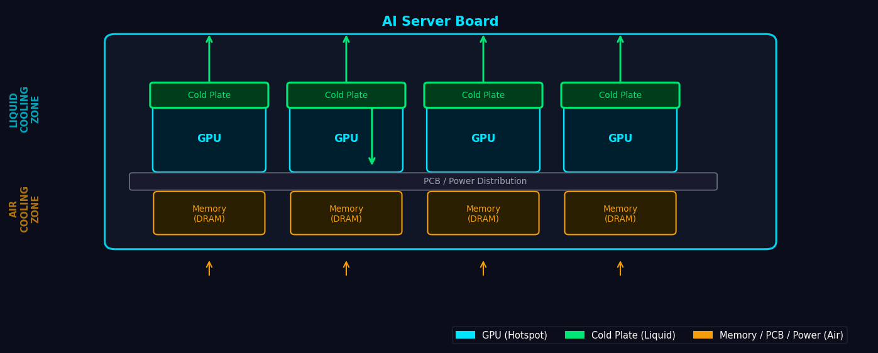
Hybrid Air + Liquid: Hotspots vs. System-Wide Cooling
04
液冷處理GPU熱點，風冷處理其餘系統組件——兩者長期共存
KEY INSIGHTS
Cold plate enables direct-to-chip heat removal for high-power GPU / CPU hotspots.
Hybrid architecture is likely to be a mainstream transition path for 2025–2028 AI server platforms.
Air cooling remains necessary for many non-liquid-cooled components such as memory, PCB, power delivery, networking, and storage.
Architecture based on industry-standard direct-to-chip liquid cooling.
Notes:
Hybrid Cooling V7: All three insight bullets rewritten per user instructions. '散熱效率遠優於風扇' → 'direct-to-chip heat removal'. '性價比最優解' → 'likely mainstream transition path'. '不可完全替換' → 'remains necessary for many non-liquid-cooled components'.

Slide 5
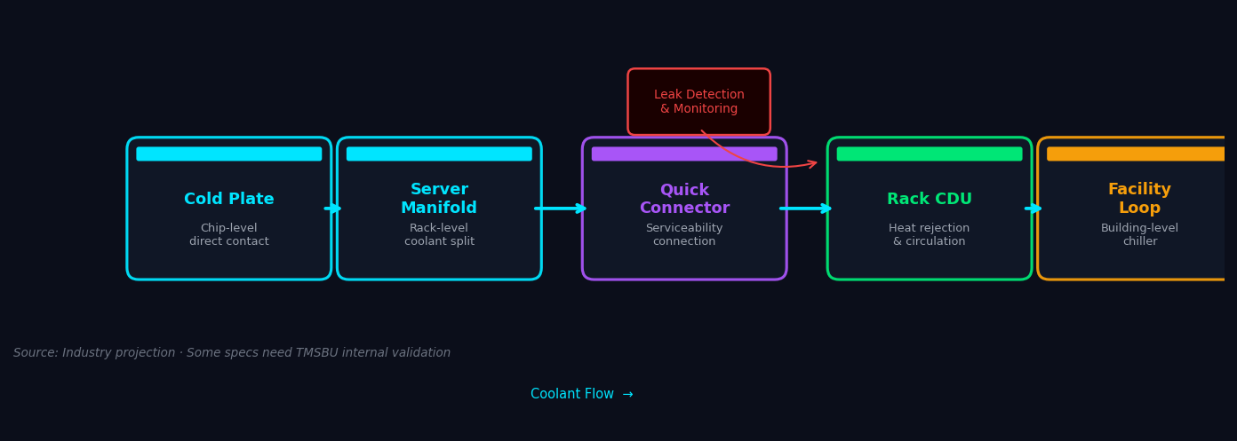
Chip-to-Rack Liquid Cooling Architecture
05
System value comes from integration: thermal, fluid, control, and serviceability must work as one architecture.
KEY INSIGHTS
Quick Connector positioned at server-to-rack service interface, not as a main heat flow node.
Leak detection and monitoring add system-level reliability for mission-critical AI deployments.
CDU capacity ⚠ requires TMSBU internal validation — no specific kW figure used in this deck.
Architecture based on industry-standard direct-to-chip cooling loop. CDU specs ⚠ require TMSBU internal validation.
Notes:
Architecture V7: Core message updated to 'thermal, fluid, control, and serviceability must work as one architecture.' Quick Connector sub-label updated to 'Server-to-rack service interface.' All V6 unvalidated numbers removed.

Slide 6
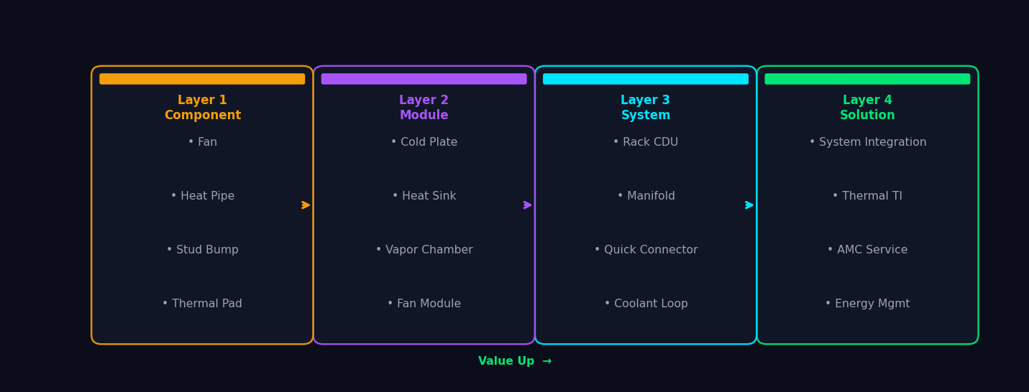
TMSBU Portfolio: 4-Layer Value Upgrade Path
06
Component → Module → System → Solution：每層疊加更高客戶價值
Product classifications based on TMSBU internal estimate. Customer value curve requires pipeline validation.
Notes:
Portfolio V7: Same 4-layer value ladder as V6. Content unchanged (structure already correct from V6).

Slide 7
Delta Group Synergy: Four Quadrant Advantage
07
Power Electronics × Thermal Management × Control Systems × Infrastructure
Power Electronics
Thermal Management
• Power supply
• Cold plates
• UPS systems
• Heat sinks
• Energy conversion
• CDU / manifolds
Sensor / Monitoring / Control
Infrastructure
• Thermal sensors
• Rack PDU
• Auto control
• Coolant distribution
• BMS integration
• Facility integration
Customer Value: Lower integration risk · Faster design-in · Better reliability · Stronger energy-efficiency support
Synergy assessment based on Delta Group capabilities. Competitive positioning requires market intelligence validation.
Notes:
Delta Synergy V7: 'BMS / EMS' changed to 'Sensor / Monitoring / Control' per user instruction. 'Control Systems' quadrant label updated. Customer Value Line unchanged. All references say V7 (not V8 or inconsistent). No '唯一' language present.

Slide 8
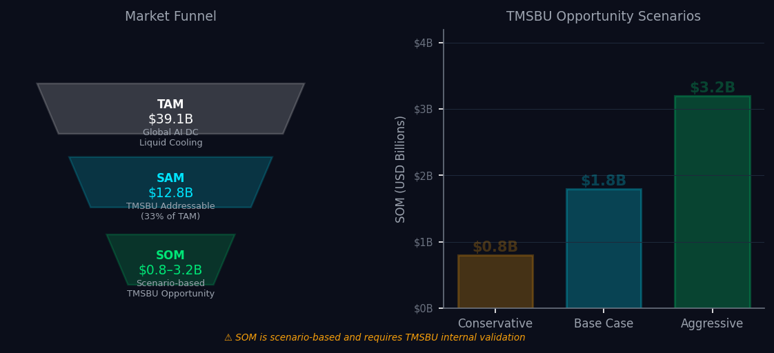
Market Opportunity: $0.8B–$3.2B Scenario-Based Opportunity
08
Scenario-based TAM/SAM/SOM framework — ⚠ SOM requires internal TMSBU pipeline validation
⚠ SOM is scenario-based and requires TMSBU internal validation
† Aggressive scenario assumes system-solution expansion and multiple tier-1 design wins
TAM $39.1B = analyst forecast · SAM $12.8B = TMSBU estimate · SOM range = scenario-based assumption
Notes:
Market Opportunity V7: Title updated to '$0.8B–$3.2B Scenario-Based Opportunity'. Aggressive scenario footnote added: 'Assumes system-solution expansion and multiple tier-1 design wins.' SOM disclaimer unchanged.

Slide 9
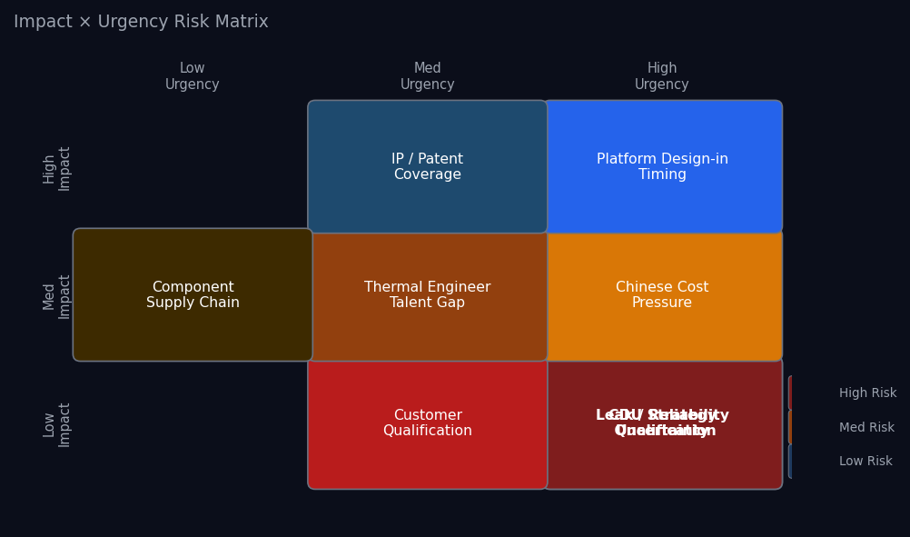
Capability Gap & Risk Assessment
09
Impact × Urgency matrix — immediate priorities need executive decision
TOP 3 IMMEDIATE
PRIORITIES
1
CDU Strategy
Build · Partner · Acquire
decision required in 90 days
2
Leak Reliability
Validate quick connector,
leak detection, and
system-level reliability.
3
Customer
Qualification
Start 12–18M design-in cycle
now to avoid missing
next-gen platform engagement.
Risk assessments based on market intelligence. CDU capacity, leak rate, and customer pipeline ⚠ require TMSBU internal validation.
Notes:
Risk Assessment V7: Priority 2 sub-label changed to 'Validate quick connector, leak detection, and system-level reliability.' Priority 3 sub-label changed to 'Start 12-18M design-in cycle now to avoid missing next-gen platform engagement.'

Slide 10
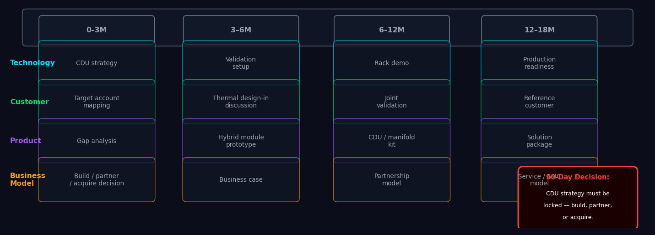
Strategic Roadmap: 4-Lane Execution Plan
10
Technology · Customer · Product · Business Model — 6–18 month window
KEY INSIGHTS
Phase 1（0–6M）：確認CDU策略，鎖定目標帳戶，展開Thermal Design-in討論
Phase 2（6–12M）：CDU原型驗證，與Tier-1客戶建立Joint Validation
Phase 3（12–18M）：CDU / Manifold / Quick Connector 產品化，通過可靠性認證
Roadmap based on current TMSBU capabilities assessment. Timelines assume CDU strategy is locked within 90 days.
Notes:
Roadmap V7: 4 time phases (0–3M / 3–6M / 6–12M / 12–18M). Technology lane: CDU strategy → Validation setup → Rack demo → Production readiness. Customer: Target account mapping → Thermal design-in discussion → Joint validation → Reference customer. Product: Gap analysis → Hybrid module prototype → CDU/manifold kit → Solution package. Business Model: Build/partner/acquire decision → Business case → Partnership model → Service/AMC model. Decision box unchanged.

