Slide 1
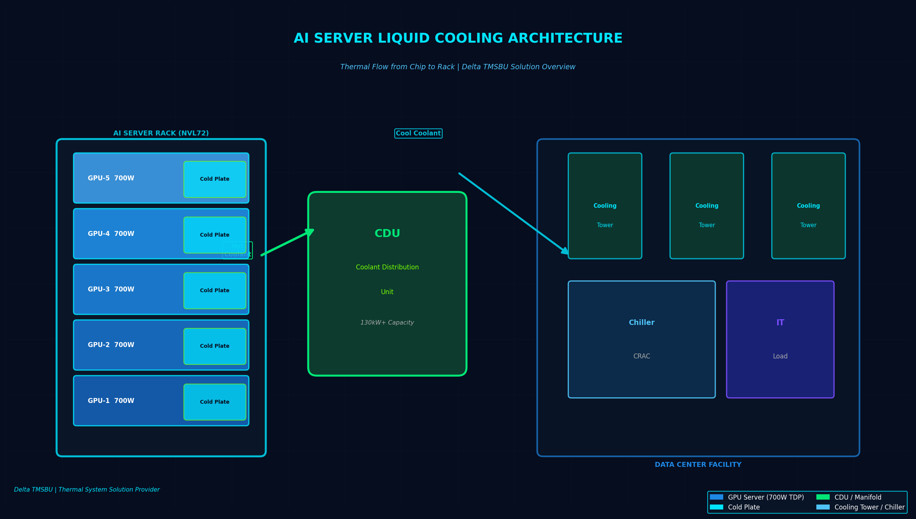
01
AI Compute Growth Is Creating
a Thermal Bottleneck
GPU TDP 突破 700W、Rack 功率密度達 130kW+，風冷已達物理瓶頸
AI Data Center Liquid Cooling Market (USD Billion)
$4.2B→$39.1B
60%
130kW+
液冷市場規模
2024→2030
2026年新AI資料中心
採用液冷比例
GB200 NVL72
Rack功率密度
NVIDIA GB200 TDP 700W，2025年量產，Rubin 將突破 1,000W
GB200 NVL72 72-GPU 系統總功率突破 130kW/rack
散熱瓶頸成為 AI 基礎建設擴張的物理限制條件
Gartner：2026 年 60% 新 AI 資料中心將採用液冷
Notes:
Key message: AI compute density is growing faster than air cooling can handle. GB200 NVL72 at 130kW/rack represents the inflection point where liquid cooling shifts from optional to mandatory. Sources: MarketsandMarkets ($4.2B→$39.1B by 2030, 45.2% CAGR), Gartner (60% new AI data centers liquid-cooled by 2026 vs. 20% in 2023).

Slide 2
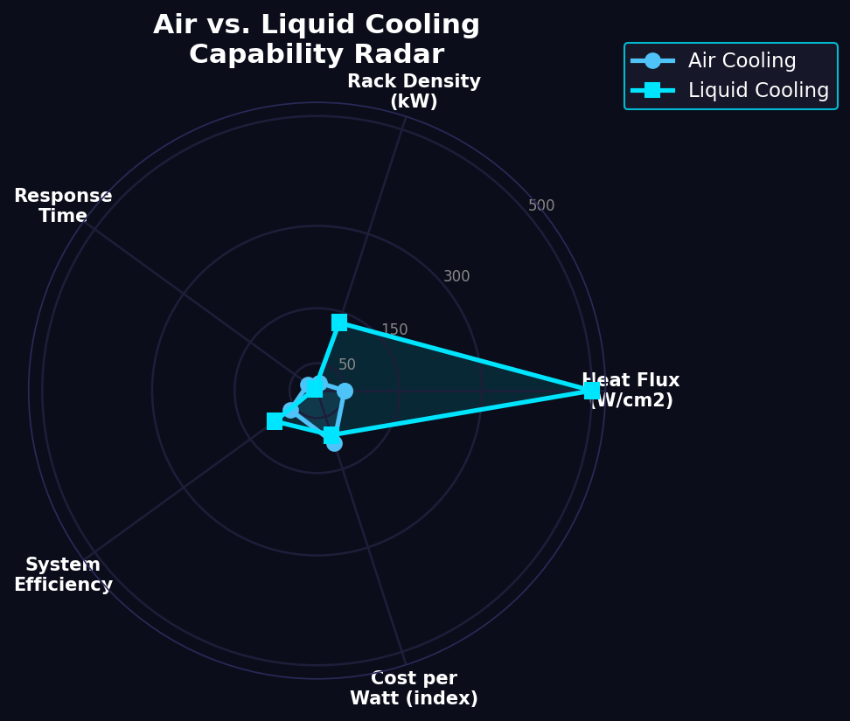
02
Air Cooling Is Reaching
Its Practical Limit
風冷散熱能力上限約 50W/cm²，AI GPU 已超越此臨界點
Air Cooling Limitations
熱通量上限 ~50W/cm²，GPU 已達 200W+
Fan 噪音與功耗隨密度非線性增加
Rack power > 30kW 時 air cooling TCO 急速上升
Non-Liquid Components Still Needed
Power delivery, PCB, memory 仍需 air cooling
Fan, heat sink, vapor chamber 需求反而增加
Hybrid cooling architecture 成為新標準
Notes:
Air cooling still plays a critical role for non-GPU components (power modules, memory, PCBs). The key insight is not 'air vs liquid' but hybrid: liquid handles high-power chip thermal load while air cooling supports the rest of the system. TMSBU benefits from BOTH trends - more liquid cooling modules AND sustained demand for advanced air cooling components like vapor chambers and 3D VC.

Slide 3
03
Liquid Cooling Becomes
the New Standard Architecture
Cold Plate + CDU + Manifold + Quick Connector = Rack-Level Liquid Cooling System
Cold Plate
CDU
Manifold
Quick Connector
直接接觸 GPU/CPU
導熱效率 > 95%
客製化流道設計
Coolant Distribution
130kW+ 熱移除能力
循環與熱交換
多路分流/合流
Rack 內均溫設計
快速維修対応
熱插拔設計
Leak-free 接頭
降低服務停機
→
→
→
液冷滲透率趨勢
2023
2025
2026
2030
20% 滲透率
40% 滲透率
60% 滲透率
80%+ 滲透率
Notes:
Liquid cooling architecture is not just cold plates. It requires a complete system: cold plates at chip level, manifolds for distribution, CDU for heat rejection, and quick connectors for serviceability. The system integration complexity is where the highest value resides. Key insight: 60% of new AI data centers will be liquid-cooled by 2026 (Gartner), up from only 20% in 2023. This represents a fundamental architecture shift, not a marginal improvement.

Slide 4
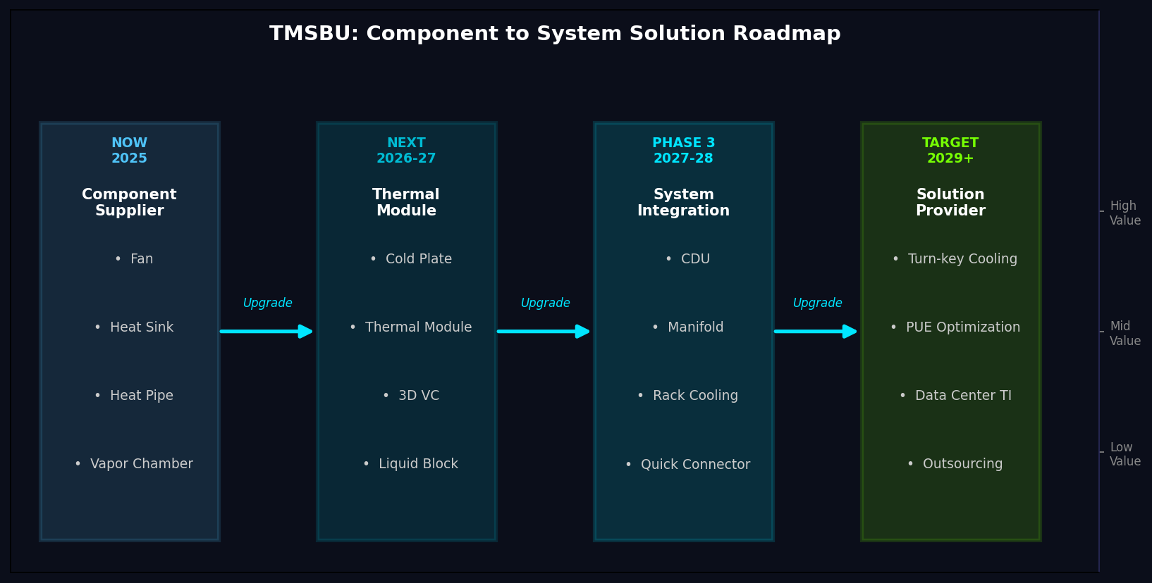
04
TMSBU Opportunity:
From Components to System Solutions
Delta TMSBU = 從 Fan 到 Rack Cooling 的全段熱管理解決方案供應商
NOW (Component)
• Fan
• Heat Sink
• Heat Pipe
• Vapor Chamber
NEXT (Module)
• Cold Plate
• Thermal Module
• 3D VC
• Liquid Block
PHASE 3 (System)
• CDU
• Manifold
• Rack Cooling
• Quick Connector
TARGET (Solution)
• Turn-key Cooling
• PUE Optimization
• Data Center TI
• Outsourcing
Notes:
TMSBU's competitive advantage: we already manufacture fans, heat sinks, heat pipes, vapor chambers, and cold plates - we have the thermal engineering expertise and manufacturing base. The strategic opportunity is to bundle these components into higher-value thermal modules and eventually system-level solutions. Key capability gaps to fill: CDU design/manufacturing, manifold integration, quick connector qualification, system-level thermal simulation. This is not a product roadmap - it is a business model upgrade from component supplier to thermal system partner.

Slide 5
05
Recommended Actions
for TMSBU (6-12 Months)
立即行動：驗證液冷能力 → 建立標竿客戶 → 擴大系統解決方案範疇
技術 (Technology)
客戶 (Customer)
建立 Cold Plate 與 CDU 設計與驗證能力
收購或合作快速接頭（Quick Connector）供應商
投資系統級熱流模擬軟體與驗證設備
鎖定 NVIDIA GB200 / Rubin 公版冷却供應商名單
與 Tier 1 雲端客戶（AWS/Azure/GCP）建立 Thermal TI 合作
優先切入台灣與亞太 AI Server ODM/OEM
產品 (Product)
商業模式 (Business)
上半年：Cold Plate + Fan Module 組合方案
Q3：CDU + Manifold + Quick Connector 系統套件
Q4：Rack-Level Cooling Turn-key 方案
從 Component 報價 → System Solution 統包報價
建立 TAM 從散熱零件 → 熱管理系統服務
評估售後服務與 Annual Maintenance Contract (AMC) 模式
2025 Q2-Q3
2025 Q4
2026 H1
2026 H2
Notes:
Summary: The liquid cooling transition is not a product opportunity - it is a strategic inflection point. TMSBU must move on 4 fronts simultaneously: (1) Technology - build CDU and quick connector capabilities; (2) Customer - get on NVIDIA reference design vendor lists and approach hyperscalers; (3) Product - bundle components into modules, modules into systems; (4) Business - shift from component pricing to system solution contracts. The 6-12 month window is critical: early mover advantage in becoming the 'thermal system solution provider' for AI infrastructure will determine TMSBU's competitive position for the next decade.

