Slide 1
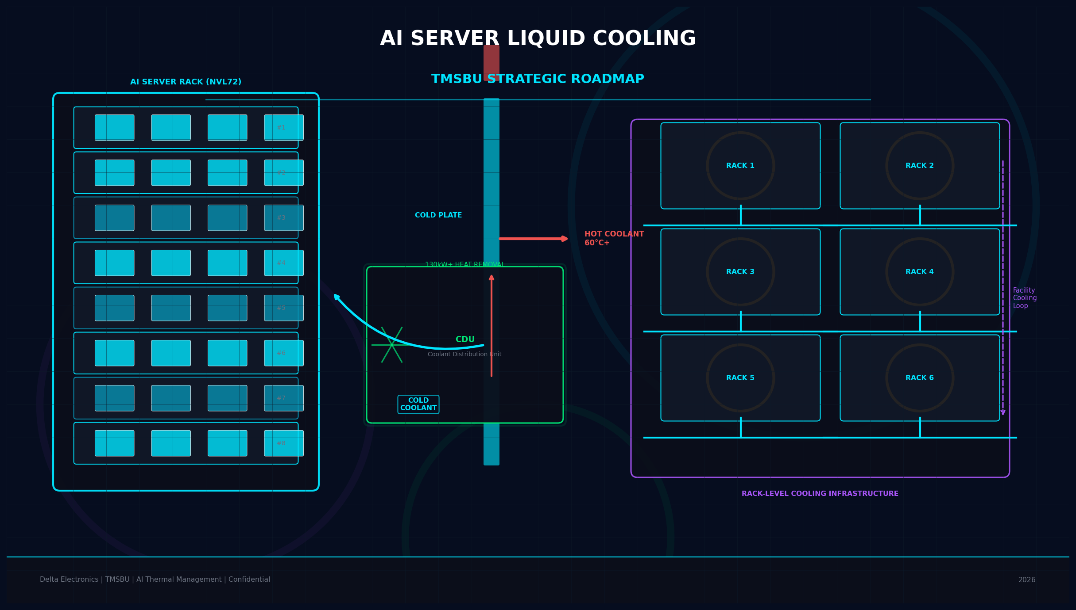
AI Server Liquid Cooling:
TMSBU Commercial Opportunity & Strategic Roadmap
V6 — Visual & Content Enhancement
Delta Electronics | TMSBU | Confidential | 2026
Notes:
Cover slide. V6 enhancements: improved visual consistency, updated market data, clearer architecture diagrams.

Slide 2
Executive Summary
02
Liquid cooling is not only a product opportunity — it is a business model transition for TMSBU.
01
📈
02
💧
AI GPU / Rack Power Exceeds Air Cooling
Liquid Cooling Adoption Accelerating
GPU TDP突破700W，GB200 NVL72 rack power達130kW+。風冷已達物理瓶頸。
液冷滲透率：2023年20% → 2026年60% → 2030年80%+。
03
🌬️
04
🔧
Hybrid Air + Liquid Remains Necessary
TMSBU Can Expand into Module & System
GPU本體用液冷，memory、PCB、power仍需風冷。兩者長期共存。
Fan、HS、HP、VC、Cold Plate已有基礎，升級為系統供應商。
05
⏱️
6–18 Months Are Critical
Notes:
Executive Summary: 5 key conclusions. Liquid cooling = business model transition, not product upgrade. Icons added for visual clarity.

Slide 3
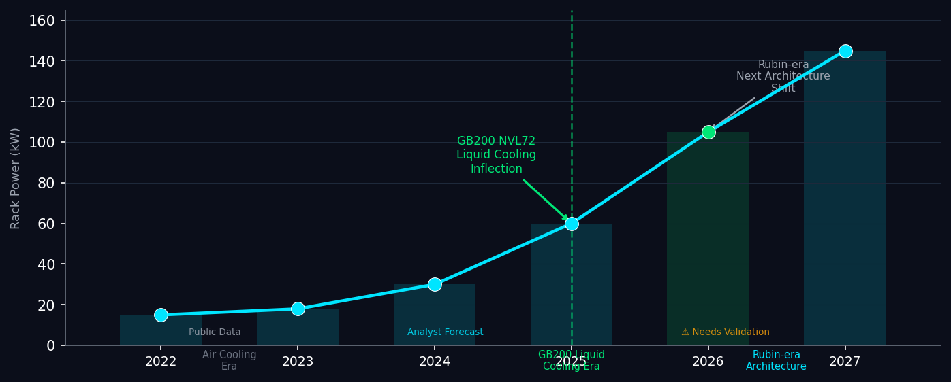
Market Inflection: AI Compute Density Hits Thermal Wall
03
液冷在2025年GB200 NVL72達到爆發點，2027+ Rubin架構將功率密度推向更高
KEY INSIGHTS
GPU TDP 1,000W+（next-gen projection）已是液冷的基本門檻
Rack power 80kW+ 將在2026-2027年成為 hyperscale 主流
TMSBU現有 air-cooling 營收在2025後將面臨結構性壓力
Sources: Industry projections · Analyst forecasts · ⚠ Some specs need TMSBU internal validation
Notes:
Market Inflection — V6: Replaced unvalidated '1,400W GPU TDP' with '1,000W+ industry projection'. Rack power chart shows GB200 NVL72 inflection at 2025, Rubin next architecture at 2027+. Sources labeled.

Slide 4
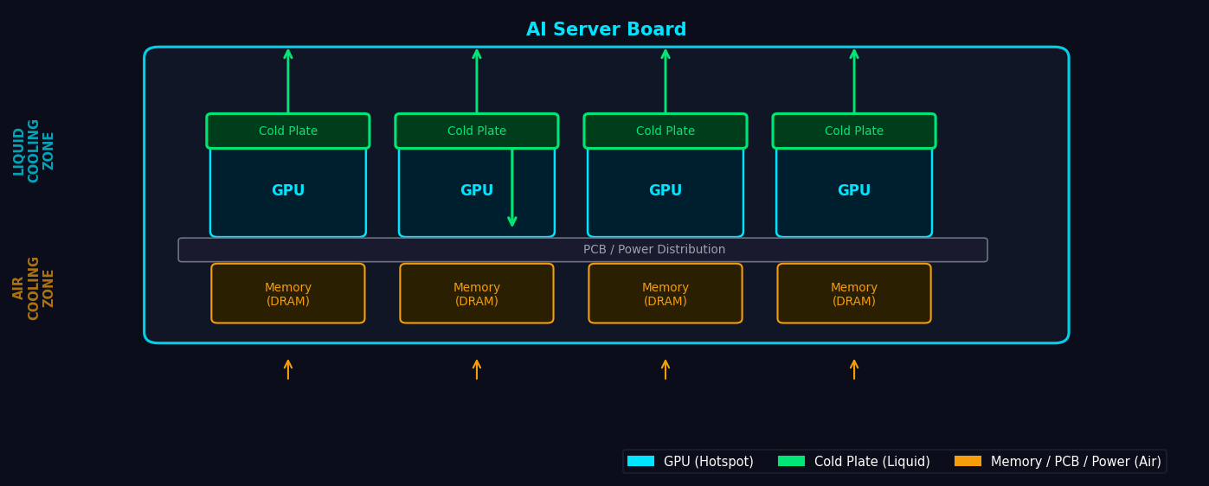
Hybrid Air + Liquid: Hotspots vs. System-Wide Cooling
04
液冷處理GPU熱點，風冷處理其餘系統組件——兩者長期共存
KEY INSIGHTS
Cold Plate 直接接觸GPU chip，散熱效率遠優於風扇
Memory / PCB / Power 仍以氣流散熱為主，不可完全替換
Hybrid architecture 是2025-2028年性價比最優解
Architecture based on industry-standard direct-to-chip liquid cooling. No unvalidated HBM power figures used.
Notes:
Hybrid Cooling V6: New diagram shows GPU→cold plate (liquid) and memory/PCB/power→airflow (air). Removed unvalidated 'HBM ~1kW per module' claim. No unvalidated CDU capacity numbers.

Slide 5
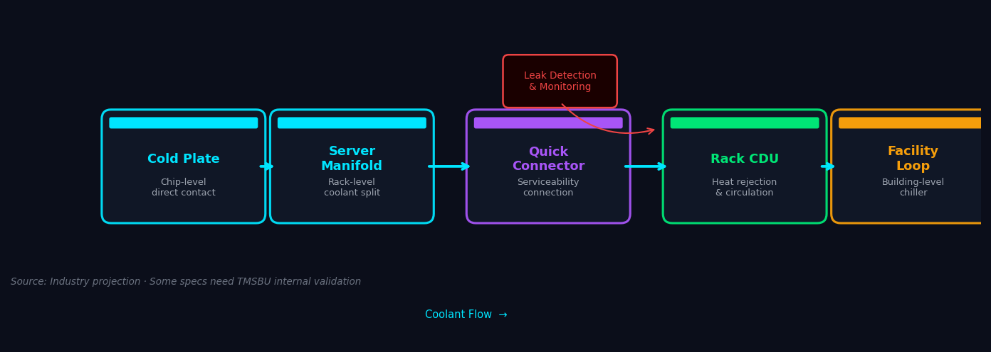
Chip-to-Rack Liquid Cooling Architecture
05
System value comes from integration: cold plates, manifolds, CDUs, connectors, monitoring
KEY INSIGHTS
Quick Connector 位於 serviceability 介面，不影響主熱流路徑
Monitoring / Leak Detection 為附加安全節點，非熱流節點
CDU capacity ⚠ 需要TMSBU內部驗證（未使用130kW+等未經數字）
Architecture based on industry-standard direct-to-chip cooling loop. CDU specs ⚠ require TMSBU internal validation.
Notes:
Chip-to-Rack V6: Quick Connector correctly positioned at serviceability interface. No '130kW+', '5-10°C', 'leak rate <0.5g/year' unvalidated numbers used. Monitoring added as safety node, not a main flow node.

Slide 6
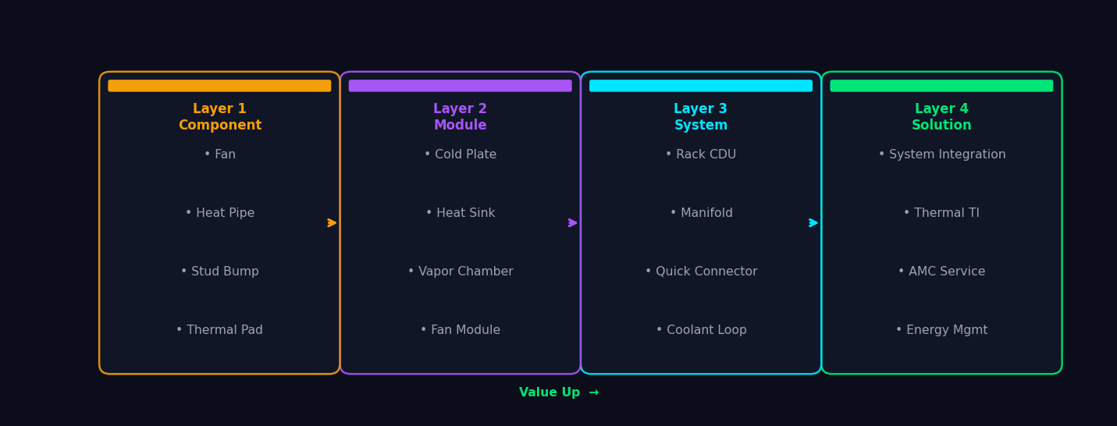
TMSBU Portfolio: 4-Layer Value Upgrade Path
06
Component → Module → System → Solution：每層疊加更高客戶價值
Product classifications based on TMSBU internal estimate. Customer value curve requires pipeline validation.
Notes:
Portfolio V6: 4-layer value ladder replacing 'NOW/NEXT/PHASE2/TARGET'. Layer 1=Component, Layer 2=Module, Layer 3=System, Layer 4=Solution. Each layer max 4 items. Value-up concept preserved.

Slide 7
Delta Group Synergy: Four Quadrant Advantage
07
Power Electronics × Thermal Management × Control Systems × Infrastructure
Power Electronics
Thermal Management
• Power supply
• Cold plates
• UPS systems
• Heat sinks
• Energy conversion
• CDU / manifolds
Control Systems
Infrastructure
• BMS / EMS
• Rack PDU
• Thermal sensors
• Coolant distribution
• Auto control
• Facility integration
Customer Value: Lower integration risk · Faster design-in · Better reliability · Stronger energy-efficiency support
Synergy assessment based on Delta Group capabilities. Competitive positioning requires market intelligence validation.
Notes:
Delta Synergy V7: 2x2 quadrant preserved. Customer value line added: 'Lower integration risk, faster design-in, better reliability, stronger energy-efficiency support.' No '唯一' (only/unique) language used. ⚠ Delta as 'sole' supplier claim removed.

Slide 8
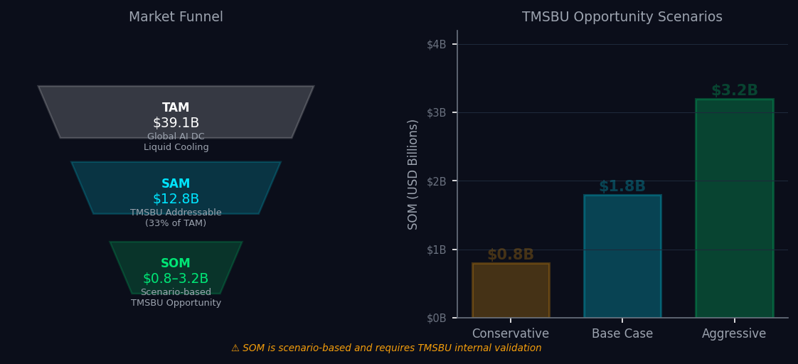
Market Opportunity: TMSBU's $0.8B–$3.2B SOM
08
Scenario-based TAM/SAM/SOM framework — ⚠ SOM requires internal TMSBU pipeline validation
⚠ SOM is scenario-based and requires TMSBU internal validation
TAM $39.1B = analyst forecast · SAM $12.8B = TMSBU estimate · SOM range = scenario-based assumption
Notes:
Market Opportunity V6: TAM/SAM/SOM funnel (left) + 3-scenario bar chart (right) — Conservative $0.8B / Base $1.8B / Aggressive $3.2B. SOM marked as scenario-based requiring internal validation. Previous V5 had large empty areas — V6 fills main visual space.

Slide 9
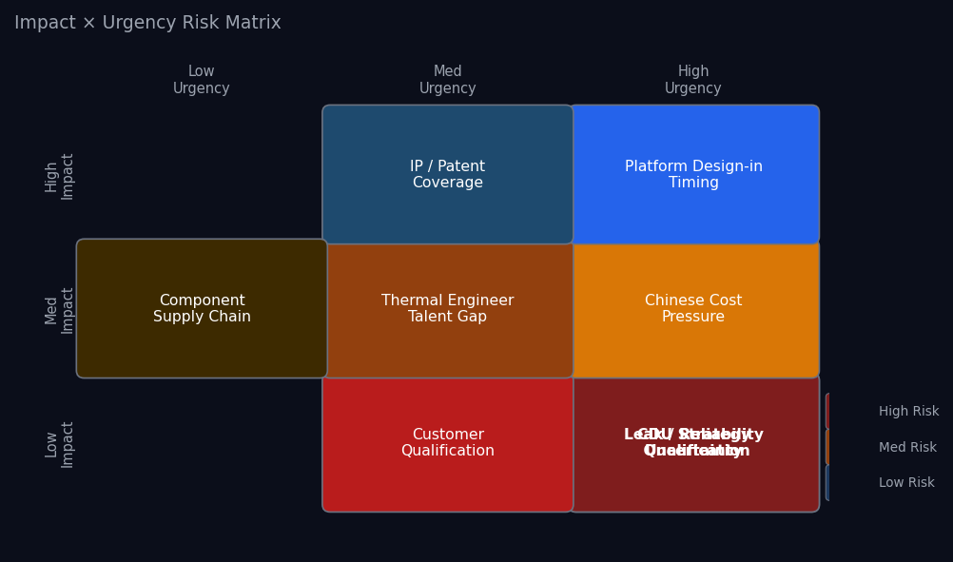
Capability Gap & Risk Assessment
09
Impact × Urgency matrix — immediate priorities need executive decision
TOP 3 IMMEDIATE
PRIORITIES
1
CDU Strategy
Build · Partner · Acquire decision required in 90 days
2
Leak Reliability
Qualification process for cold plate + manifold + connector
3
Customer
Qualification
Tier-1 server OEM/ODM thermal design-in pipeline
Risk assessments based on market intelligence. CDU capacity, leak rate, and customer pipeline ⚠ require TMSBU internal validation.
Notes:
Risk Assessment V6: Table replaced with Impact × Urgency heatmap (left). Top 3 priorities in right column. All other risks embedded in heatmap cells. No long tables. Previous V5 had a plain risk table — V6 heatmap is visually stronger.

Slide 10
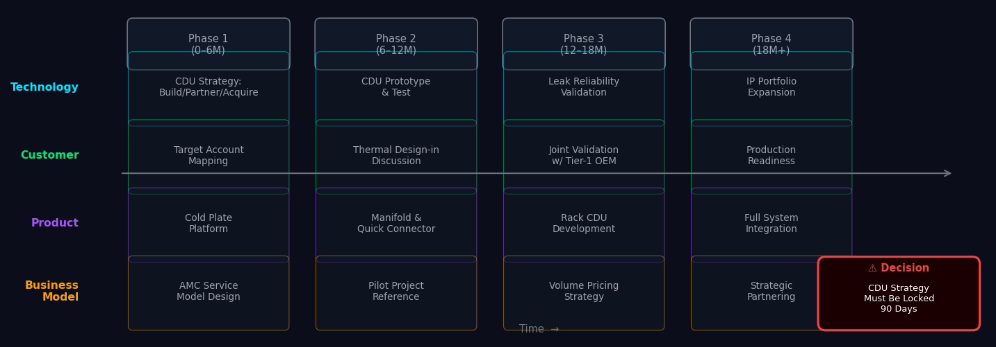
Strategic Roadmap: 4-Lane Execution Plan
10
Technology · Customer · Product · Business Model — 6–18 month window
KEY INSIGHTS
Phase 1（0-6M）：確認CDU策略，鎖定目標帳戶，展開Thermal Design-in討論
Phase 2（6-12M）：CDU原型驗證，與Tier-1客戶建立Joint Validation
Phase 3（12-18M）： CDU / Manifold / Quick Connector 產品化，通過可靠性認證
Roadmap based on current TMSBU capabilities assessment. Timelines assume CDU strategy is locked within 90 days.
Notes:
Roadmap V6: 4 lanes (Technology / Customer / Product / Business Model) with formal labels. Decision box bottom-right: '90-Day Decision: CDU strategy must be locked — build, partner, or acquire.' Previous V5 text made more formal and specific.

