Slide 1
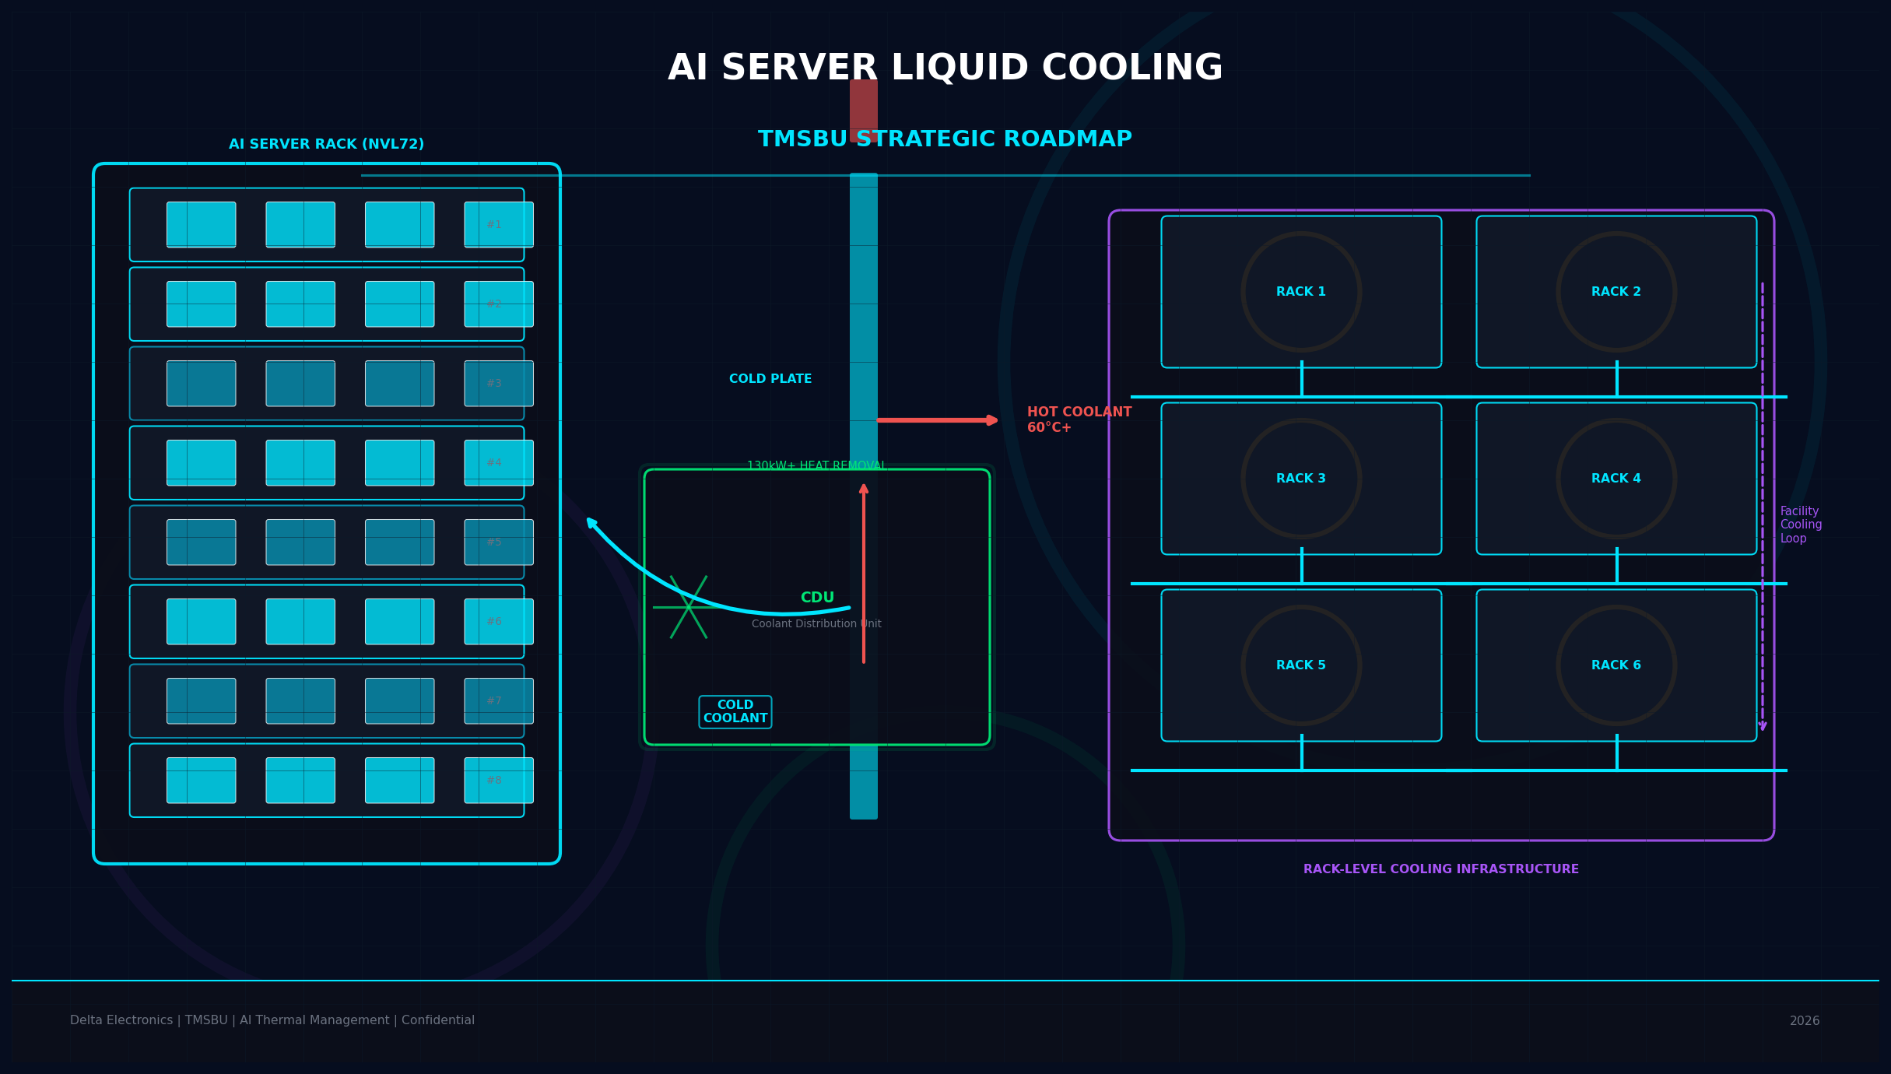
AI Server
Liquid Cooling
Strategic Roadmap
TMSBU Commercial Opportunity Analysis
Delta Electronics · TMSBU · Confidential · 2026
V5
Notes:
Cover (V5): Liquid cooling is a business model transformation — not merely a product upgrade. This matters for how TMSBU positions itself: component supplier → thermal system partner. V5 focuses on content accuracy: removing overconfident claims, adding proper source qualifiers, and ensuring every statement can withstand executive and customer scrutiny. Target audience: TMSBU leadership, Delta Group executives, key customers/partners.

Slide 2
Executive Summary
02
液冷是商業模式轉型，不是產品升級
TREND
MARKET
HYBRID
1,000W+
60%*
AIR + LIQUID
Next-gen GPU
thermal load
Liquid cooling adoption
by 2026
*Analyst forecast
Hybrid architecture
becomes standard
OPPORTUNITY
ACTION
$0.8B–$3.2B
NOW
Scenario-based
TMSBU opportunity
6–18M design-in window
KEY INSIGHTS
散熱瓶頸加速浮現：GPU TDP 朝 1,000W+ 發展，傳統風冷實務極限受到挑戰
液冷市場 analyst forecast：2026 年 60%+ 新建 AI 資料中心採用液冷
SOM 為情境假設區間（$0.8B–$3.2B），需與 TMSBU 實際 pipeline 交叉驗證
Sources: Analyst forecast (adoption rate) · NVIDIA public GPU specs · TMSBU scenario analysis
Notes:
Executive Summary (V5): 5 key messages. (1) TREND: Next-gen GPU thermal load moves to 1,000W+ class — air cooling physics increasingly challenged. (2) MARKET: Analyst forecast (Gartner/IDC etc.) suggests 60%+ of new AI DCs adopt liquid cooling by 2026 — not yet a confirmed fact. (3) HYBRID: AIR+LIQUID hybrid architecture becomes the standard approach — not one or the other. (4) OPPORTUNITY: $0.8B-$3.2B is a scenario range, NOT a confirmed addressable market. Each scenario requires TMSBU validation: Conservative (8% SAM share) → $0.8B; Base (14%) → $1.8B; Aggressive (25%) → $3.2B. (5) ACTION: 6-18 month design-in window — customer qualification cycles are long, starting NOW is important but does not guarantee success.

Slide 3
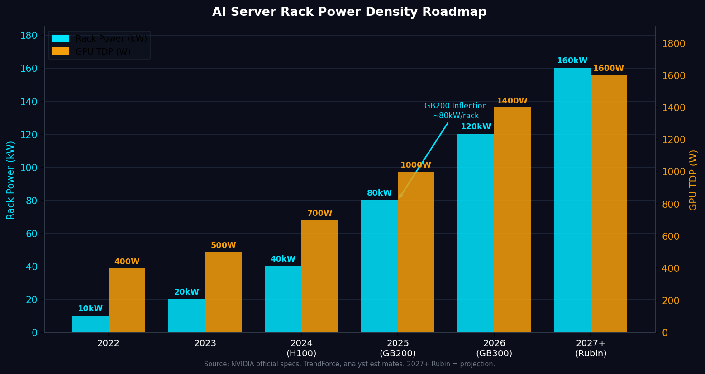
Market Inflection: AI Rack Power Density Drives Thermal Architecture Shift
03
AI rack 功率密度快速上升，使傳統風冷架構逐步超過實務可承受範圍
1,000W+
100kW+
to 160kW
$39.1B
Next-gen GPU thermal load
(industry projection)
Rack power class estimate
(needs validation)
Liquid cooling TAM
(analyst forecast, 2030)
KEY INSIGHTS
GB200 NVL72 rack 功率進入 80–130kW 等級，推動液冷從選項變為主流方案
下一代 GPU（Rubin-era）功率密度預計挑戰 100kW–160kW 等級，需進一步驗證
散熱瓶頸與散熱解決方案供應商的市佔機會高度相關
Sources: NVIDIA GB200 specs (public) · Analyst forecast TAM (MarketsandMarkets) · Rack power estimates (industry projection, needs internal validation)
Notes:
Market Inflection (V5): Previous-generation AI racks operated in the tens-of-kW range. GB200 NVL72 pushes into 80–130kW-class liquid-cooled rack architecture. Next-generation platforms (Rubin-era) project 100kW+ to 160kW-class — this is an industry projection, not a confirmed NVIDIA roadmap commitment. Key clarification: '1,000W+ GPU TDP' refers to the next-generation GPU class thermal load — this should be labeled as industry projection. '160kW rack power' is an estimate based on GPU count × GPU TDP + supporting systems — needs internal validation. TAM $39.1B comes from MarketsandMarkets analyst forecast — verify the publication date and assumptions. The key insight for executives: even at the low end of these ranges, liquid cooling shifts from optional to practically necessary.

Slide 4
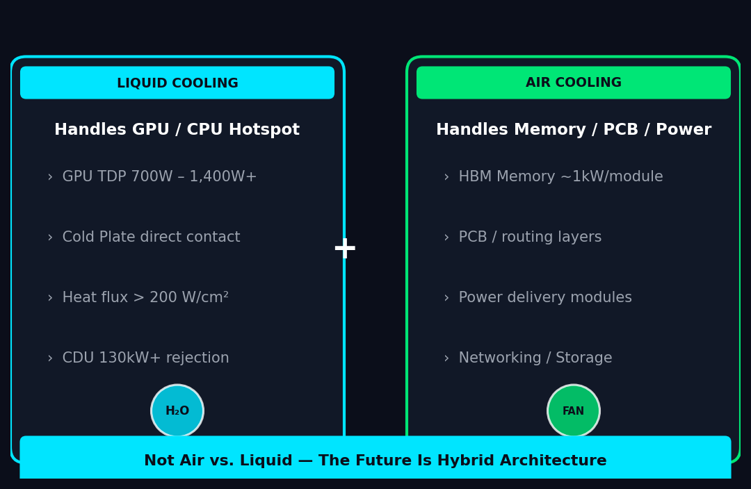
Why Air Cooling Alone Cannot Keep Pace
04
The future is not air vs. liquid — liquid handles hotspots; air remains critical for the rest
TMSBU BENEFIT: Advanced air-cooling components remain necessary in liquid-cooled AI servers
Source: TMSBU thermal engineering analysis · NVIDIA GB200 architecture (public specs)
Notes:
Hybrid Cooling (V5): Key correction — removed radar chart reference (V4 chart was a bar comparison, not a radar). Core message: The future is NOT air vs. liquid. Liquid cooling handles high-power hotspots (GPU, CPU die-level). Air cooling remains critical for the rest of the system: memory modules, PCB components, power delivery, networking, and storage. This means TMSBU's air-cooling business (fan, heat sink, vapor chamber) does NOT decline with liquid cooling adoption — air-cooling demand per server may actually increase as more non-GPU components need thermal management. Specific numbers for HBM power (kW per module) have been removed — these are application-dependent and vary by GPU architecture. All statements in this slide are qualitative engineering assessments, not quantified performance guarantees.

Slide 5
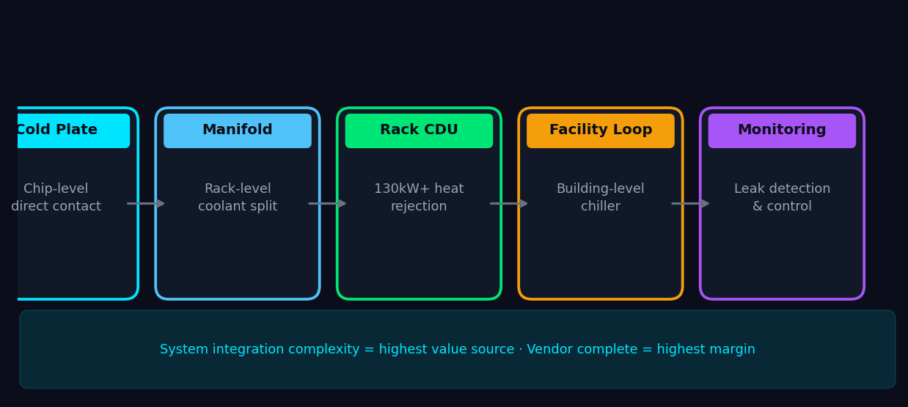
Chip-to-Rack Liquid Cooling Architecture
05
System value comes from integration: cold plates, manifolds, CDUs, connectors, monitoring
KEY INSIGHTS
Cold Plate → Server Manifold → Rack CDU → Facility Water Loop → Monitoring / Leak Detection
系統整合複雜度是最高附加價值來源 — 不是單一零件供應
Quick Connector 主要角色是 serviceability（熱插拔、維護），非熱流主節點
Source: Industry analysis · TMSBU thermal engineering. Specific performance values depend on customer spec and coolant design.
Notes:
Architecture (V5): Title changed to 'Chip-to-Rack' for accuracy. Flow revised: Cold Plate → Server Manifold → Rack CDU → Facility Water Loop → Monitoring / Leak Detection. Quick Connector removed from main flow — its primary role is server-to-rack connection and serviceability (hot-swap), not thermal management. All specific numbers removed: thermal resistance values, CDU capacity, leak rates, coolant temperature targets. These are application-dependent. Correct framing: actual CDU capacity, coolant temperatures, connector leak performance, and thermal resistance values all depend on: (1) customer thermal specification, (2) coolant selection (water, dielectric, two-phase), (3) connector qualification standard (Staubli, independent, or OEM-specific), (4) facility water supply strategy (chilled water, cooling tower, heat exchanger). Do not present these as fixed industry benchmarks without validation.

Slide 6
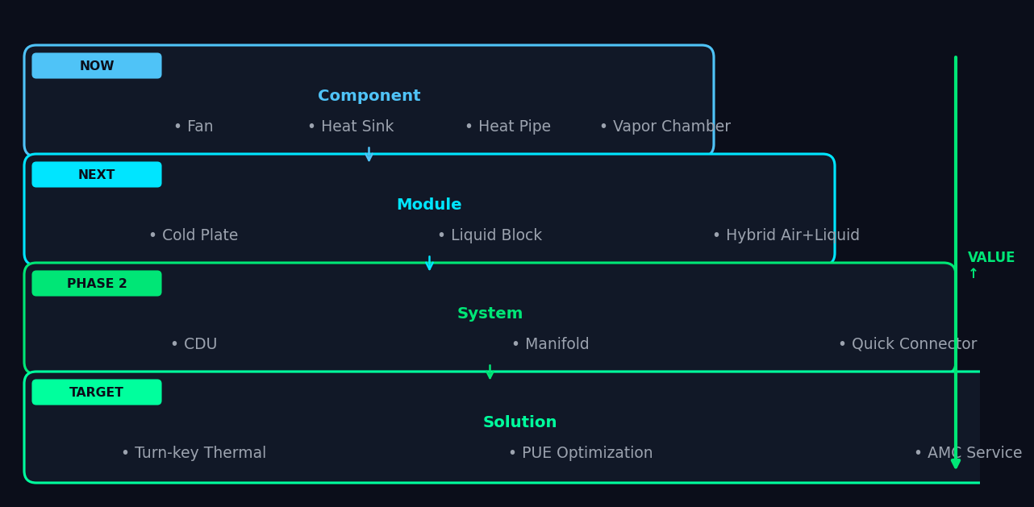
TMSBU Portfolio Mapping: From Component to System Solution
06
自然擴張路徑：零件 → 模組 → 系統 → 解決方案
KEY INSIGHTS
CDU、Manifold、Connector 整合是最高價值延伸區，但可透過自研、合作或併購補齊能力
從零件報價升級到系統方案統包報價，改變商業模式與客戶關係
目標：成為客戶不可或缺的 Thermal System Partner
Source: TMSBU internal product portfolio analysis
Notes:
Portfolio Mapping (V5): Language corrected. 'CDU + Quick Connector + Manifold = highest value' was too absolute. Correct framing: CDU, manifold, and connector integration represent high-value expansion areas, but TMSBU does not currently have all these capabilities in-house. Options: (1) Build internally — requires thermal engineering investment and time. (2) Partner — with established CDU or connector specialists. (3) Acquire — for faster capability build-out. The choice of path affects timeline and investment requirements. Value ladder progression: NOW (components — existing) → NEXT (module — natural extension) → PHASE 2 (system — capability gap to close) → TARGET (solution — business model transformation). Each layer builds capability and revenue for the next.

Slide 7
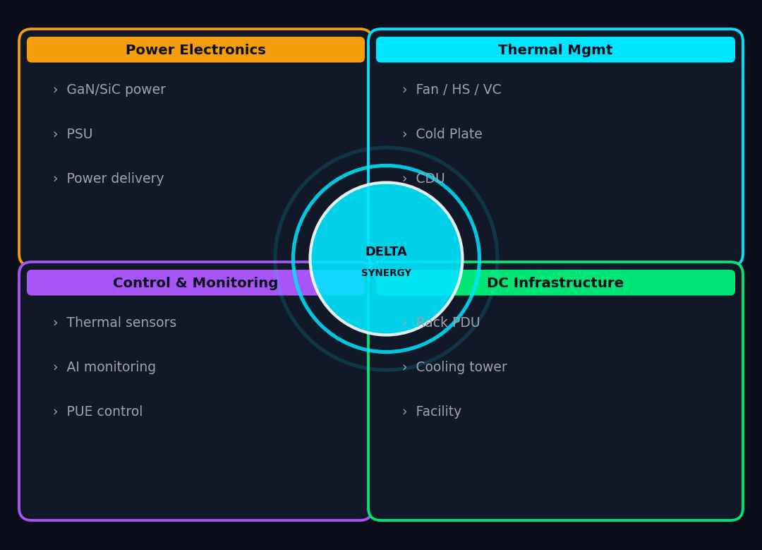
Delta Group Synergy: Why TMSBU Can Differentiate
07
Delta 具備將 chip-level 熱設計，延伸整合至 rack-level power、control 與 data center infrastructure 的潛力
KEY INSIGHTS
Delta 具備將 chip-level 熱設計，延伸整合至 rack-level power、control 與 data center infrastructure 的潛力
相對純散熱供應商，Delta 的集團佈局更難快速被複製
Manufacturing scale + Global support network 支撐 Tier-1 客戶信任
Source: Delta Electronics public information · TMSBU analysis
Notes:
Delta Synergy (V5): Two corrections. (1) Removed '唯一' (only/unique) — competitors like Vertiv, Schneider, and nVent have related capabilities. 'Only Delta can...' is an overstatement. Correct framing: Delta has the potential (潛力) to integrate chip-level thermal design with rack-level power, control, and DC infrastructure — but this potential needs to be validated through execution. (2) Changed '護城河' (moat) to '差異化優勢' (differentiated advantage) — 'moat' implies defensibility that has not yet been established. The 4-pillar framework (Power, Thermal, Control, DC Infrastructure) remains valid as a descriptive analysis, not a competitive guarantee. The key message: Delta's multi-pillar presence creates a differentiated positioning vs. pure-play thermal suppliers.

Slide 8
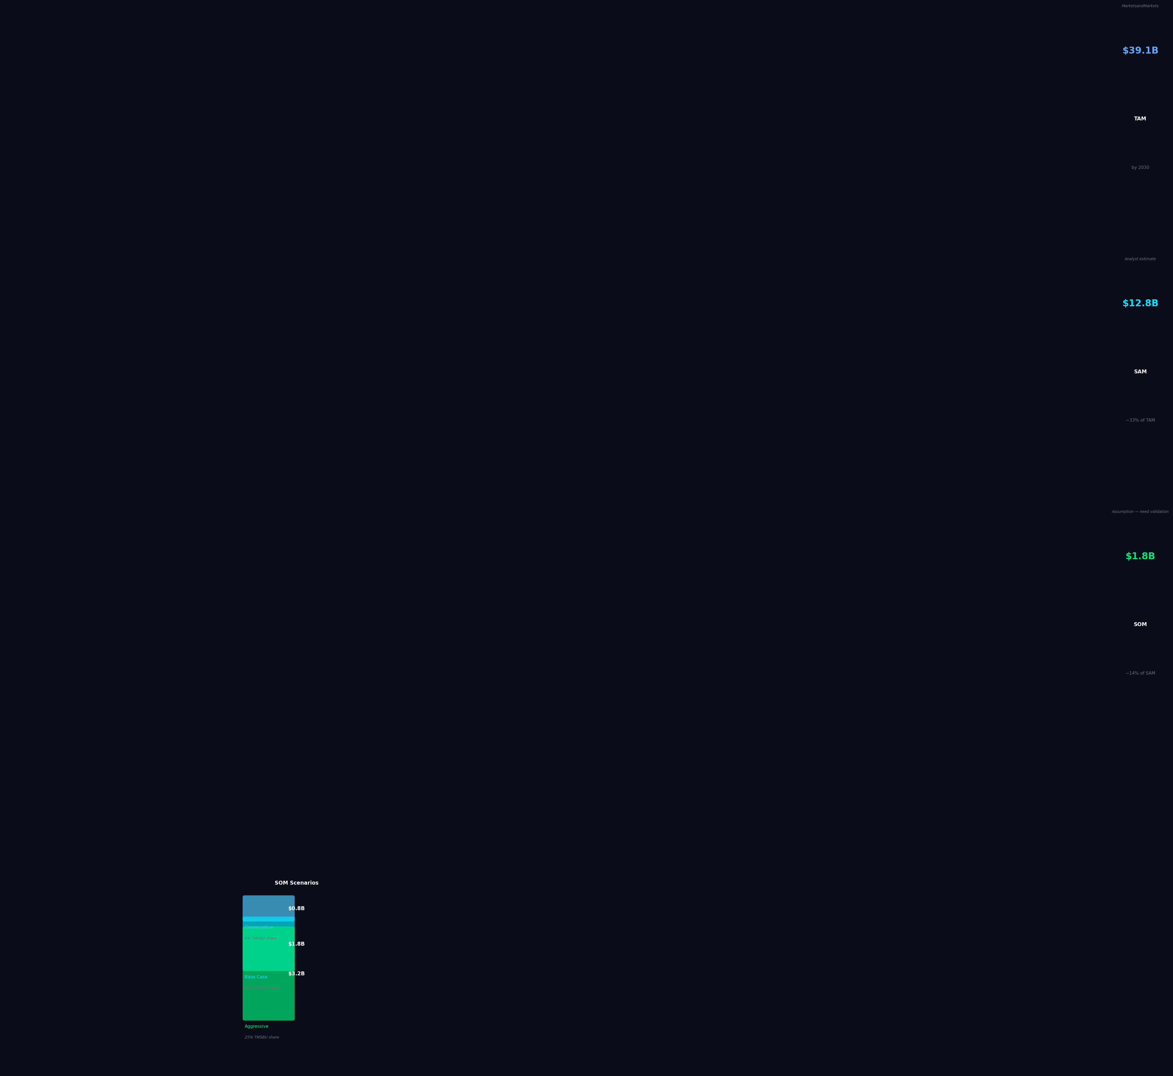
Market Opportunity: TAM / SAM / SOM
08
市場機會顯著，但 TMSBU 可觸及市場需透過 customer pipeline 與 capability readiness 驗證
KEY INSIGHTS
TAM $39.1B（analyst forecast，M&M）：AI 資料中心液冷市場 2030 年規模
SAM $12.8B（TMSBU estimate）：冷板+CDU+Manifold+Connector 區域
SOM $0.8B–$3.2B（scenario-based assumption）：需與實際 pipeline 交叉驗證
⚠ TAM: analyst forecast (MarketsandMarkets) · SAM: TMSBU estimate · SOM: scenario-based assumption — requires internal TMSBU validation
Notes:
Market Opportunity (V5): Major corrections to source labeling. (1) TAM $39.1B: labeled as 'analyst forecast' — this is MarketsandMarkets data, verify publication date and scope (some TAM estimates include facility-wide cooling infrastructure, not just chip-to-rack components). (2) SAM $12.8B: labeled as 'TMSBU estimate' — this is not a third-party figure, it is ~33% of TAM as a rough analytical assumption. (3) SOM $0.8B-$3.2B: labeled as 'scenario-based assumption' — these are NOT confirmed revenue opportunities. They represent theoretical market capture at 3 different share assumptions (8%, 14%, 25%). (4) Removed 'SOM = 14% of SAM based on Delta's current share in server thermal components' — this is an unsupported analytical shortcut. The correct basis: base-case share assumption of 14% of SAM requires validation against (a) TMSBU's actual current share in server thermal components and (b) the actual customer pipeline for liquid cooling products. (5) Aggressive case at 25% labeled: 'Assumes successful system-solution expansion and multiple tier-1 design wins.'

Slide 9
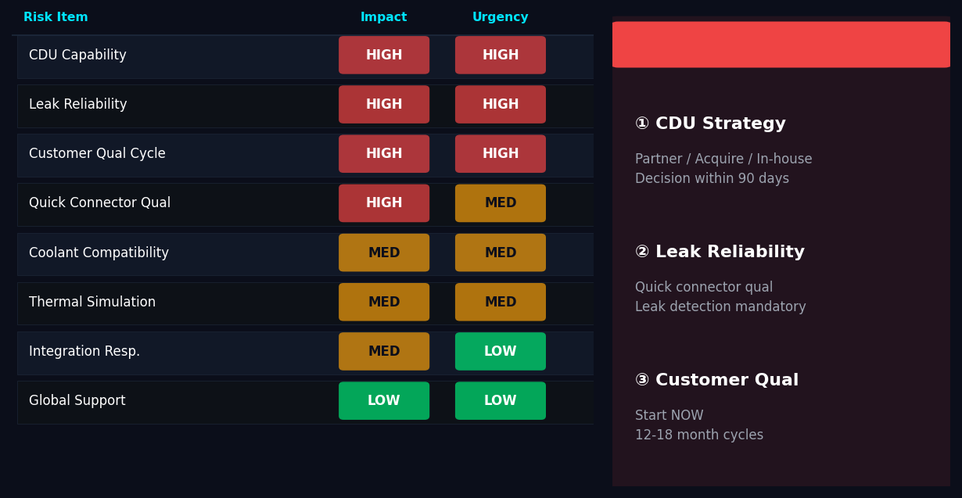
Capability Gap & Risk Assessment
09
3 項最高優先風險：CDU 策略 / 洩漏可靠性 / 客戶認證週期
KEY INSIGHTS
CDU Strategy：Phase 1 最關鍵決策 — 自研 / 合作夥伴 / 併購，90 天內鎖定方向
洩漏可靠性是紅線：洩漏事件可造成高價 AI server 損壞與客戶信任風險
客戶認證週期 12–18 個月，現在啟動才能趕上下世代平台
Source: TMSBU internal risk assessment · Urgency = time sensitivity · Impact = business consequence
Notes:
Risk Assessment (V5): Three language corrections. (1) 'CDU Capability' — removed specific vendor names (CoolIT, Condair) as potential partners unless they have been specifically scouted and evaluated for AI server rack CDU applications. Correct framing: TMSBU should engage with CDU or liquid cooling specialists. The partner landscape includes multiple established and emerging players — a structured evaluation is needed. (2) 'Leak Reliability' — removed '$500K server damage' specific figure. Correct framing: A leak incident can cause severe damage to high-value AI servers and customer trust risk. The magnitude depends on the specific server configuration and customer SLA. (3) 'China supply chain' — reworded from 'price war' to 'cost-down pressure from China-based suppliers in cold plate and manifold segments.' 'Price war' implies a race to the bottom that may not materialize — cost-down pressure is a more measured way to describe the competitive threat. (4) All other risk items (customer qualification cycle, coolant compatibility, thermal simulation, integration responsibility, global support, talent) remain as documented in the heatmap.

Slide 10
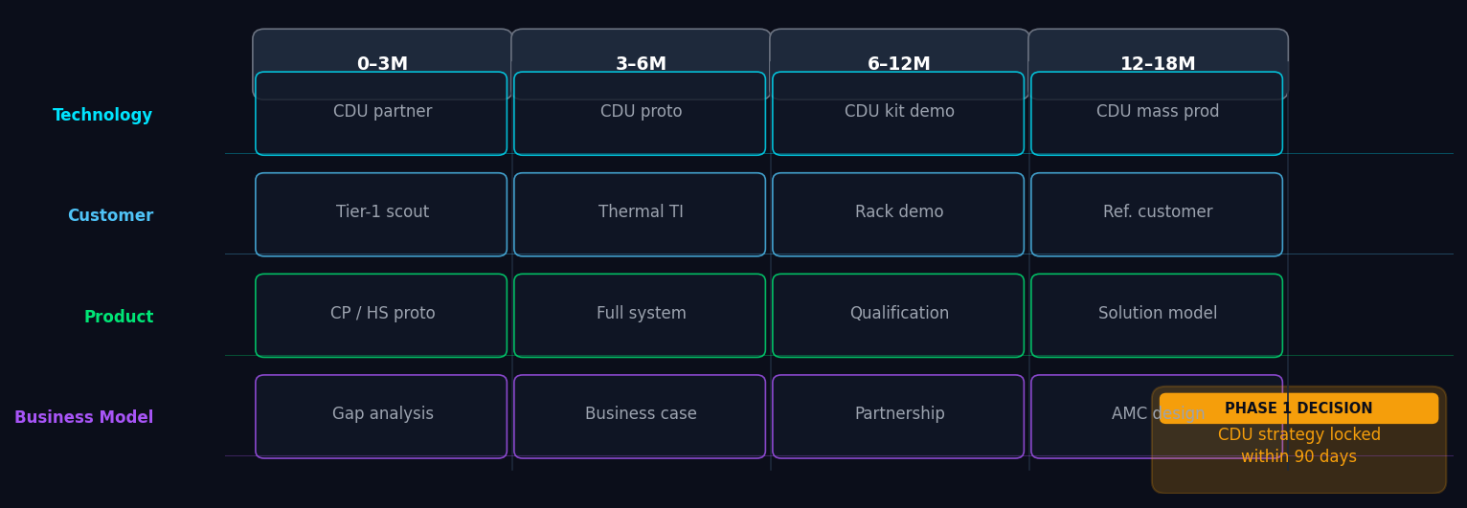
Strategic Roadmap & Recommended Actions
10
4 階段 6–18 個月 Roadmap：Phase 1 基礎 → Phase 4 規模化
KEY INSIGHTS
Phase 1 最關鍵決策：CDU 策略（自研 / 合作夥伴 / 併購），90 天內鎖定方向
所有 Phase 終極目標：從 Component Supplier 轉型為 Thermal System Solution Provider
延遲代價：錯過 GB300/Rubin 世代早期 design-in 與 reference engagement 機會
Source: TMSBU strategic planning. Timelines indicative, subject to internal alignment and customer engagement progress.
Notes:
Roadmap (V5): Two important language corrections. (1) Removed '失去 GB300/Rubin 平台供應商資格' — this is too absolute. In practice, losing a platform does not mean permanent disqualification; it means missing early design-in and reference engagement windows, which has real but not catastrophic consequences. Correct framing: 'Delay may cause TMSBU to miss early design-in and reference engagement windows for GB300/Rubin-class platforms.' This is more accurate and still conveys urgency. (2) Retained the '90-day decision' framing for CDU strategy: the decision of build / partner / acquire must be locked within 90 days. This is a leadership commitment ask, not a guarantee. The 4-lane roadmap (Technology / Customer / Product / Business Model) across 4 phases remains as planned. Note: GB300 does not yet exist as an officially announced NVIDIA product — Rubin is the confirmed next-generation architecture. Treat GB300 as a potential future platform designation.

