Slide 1
High-Level Synthesis Final project: OFDM system
Presenter：Yu-Chen Chang, Chia-Wei Hsu, Shih-Feng Yeh
Advisor：Jiin Lai
24th, Jun, 2022

Slide 2
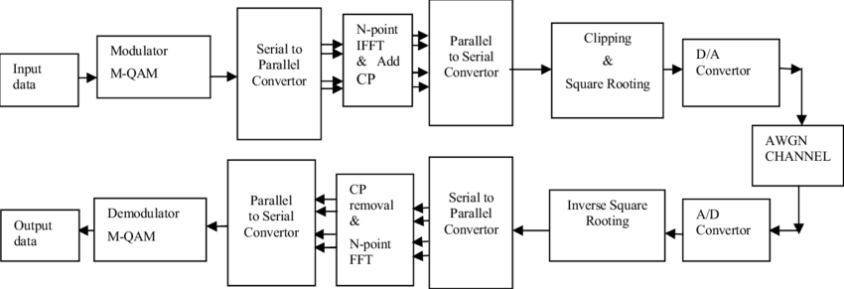
OFDM System Block Diagram

Slide 3
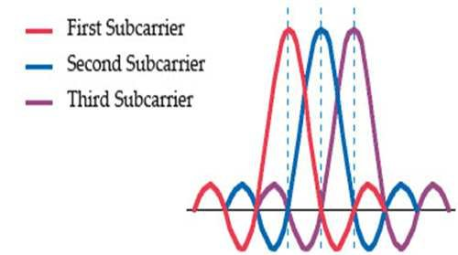
OFDM Concept and Spectra

Slide 4
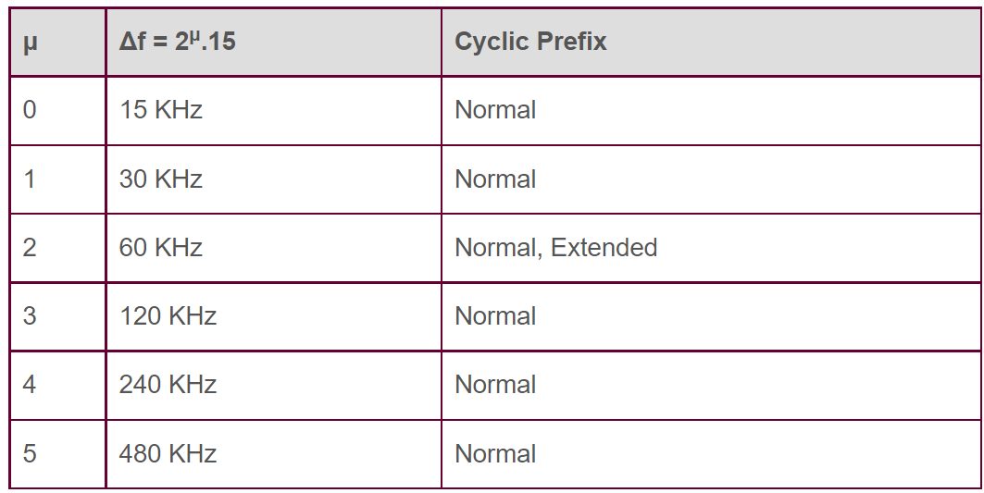
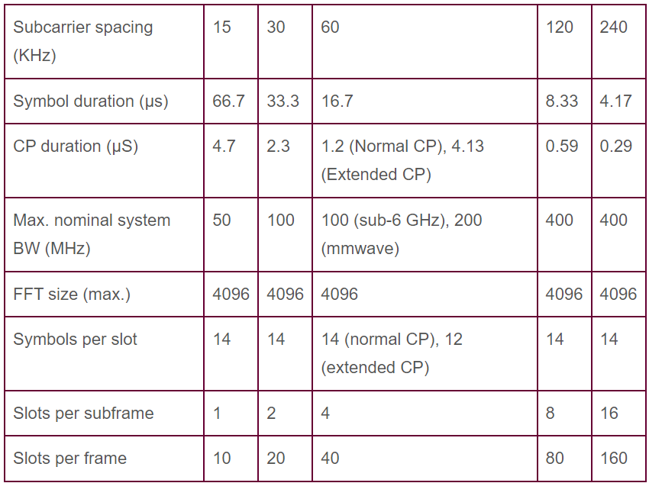
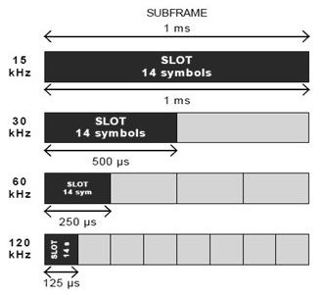
5G NR OFDM Physical Layer

Slide 5

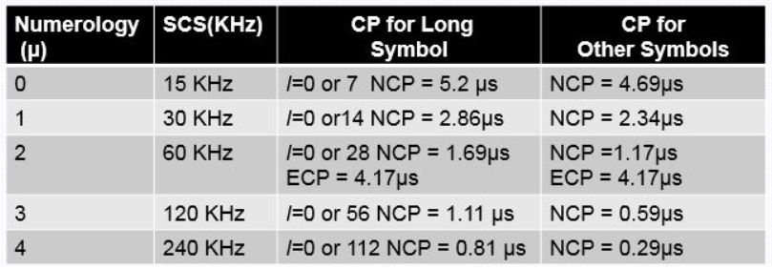
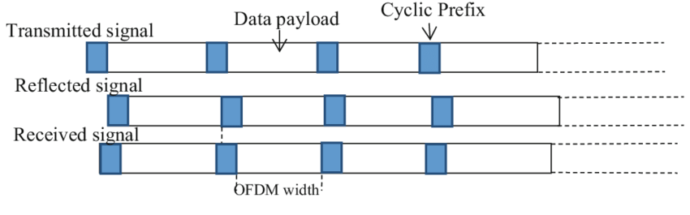
Cyclic prefix

Slide 6
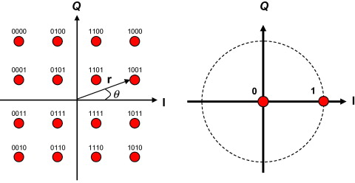
Modulation
Quadrature amplitude modulation(QAM)
16 points
Mapping

Slide 7
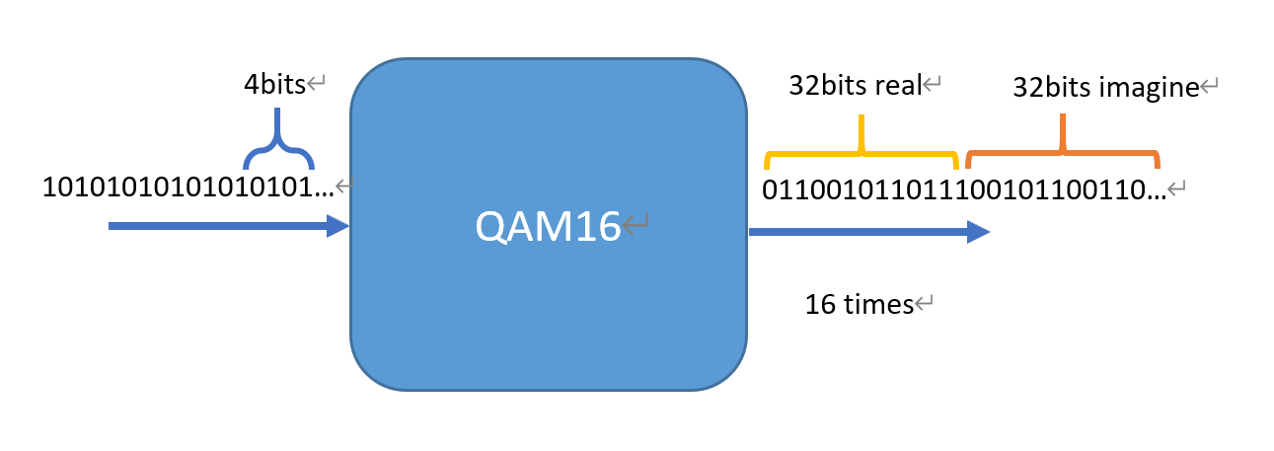
Modulation
Normalize
Bit section
Input:64 bit integer
Output:32bit real part+32bit imaginary part

Slide 8
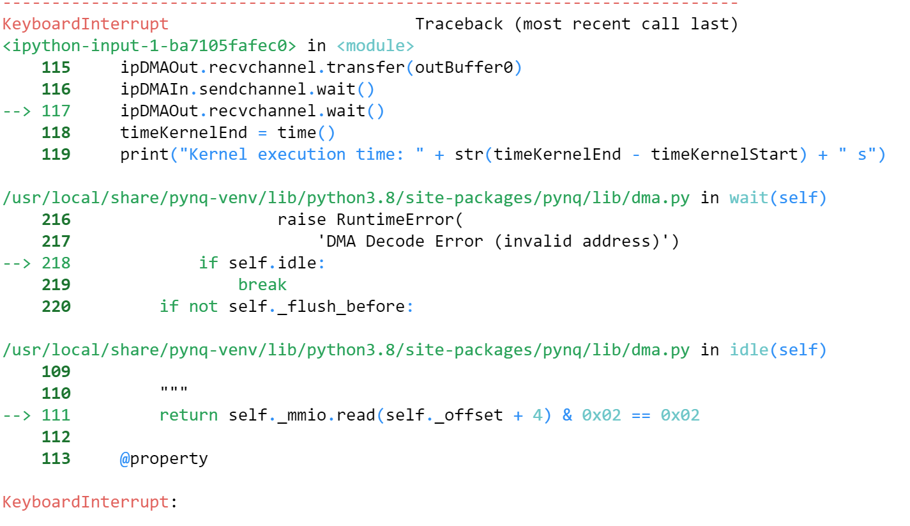
Modulation: Challenge
IP not start
Using wrong setting
ap_axiu keep not assign

Slide 9
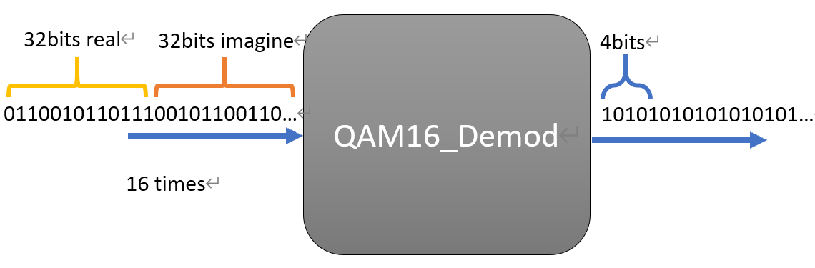
Demodulation
Bits reorganization
Find the point with the minimum distance
Input: 32bit real part+32bit imaginary part
Output: 64bits integer
LSB: First data

Slide 10
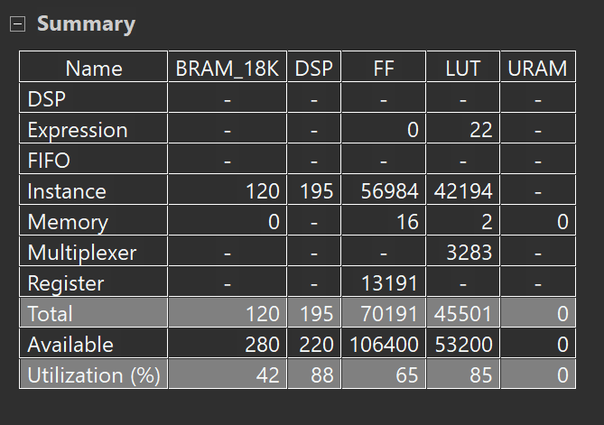
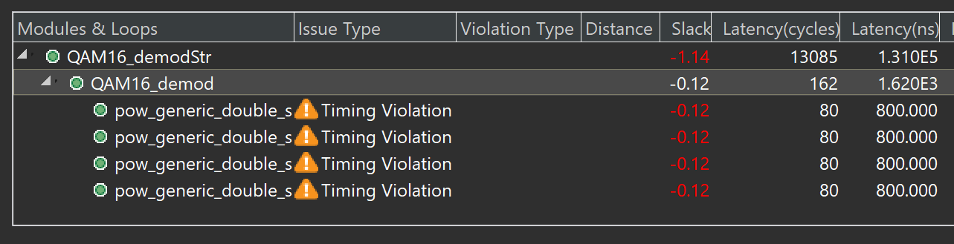
Demodulation: Challenge
Wrong setting
Slack
Resources
Data type
Output is null

Slide 11
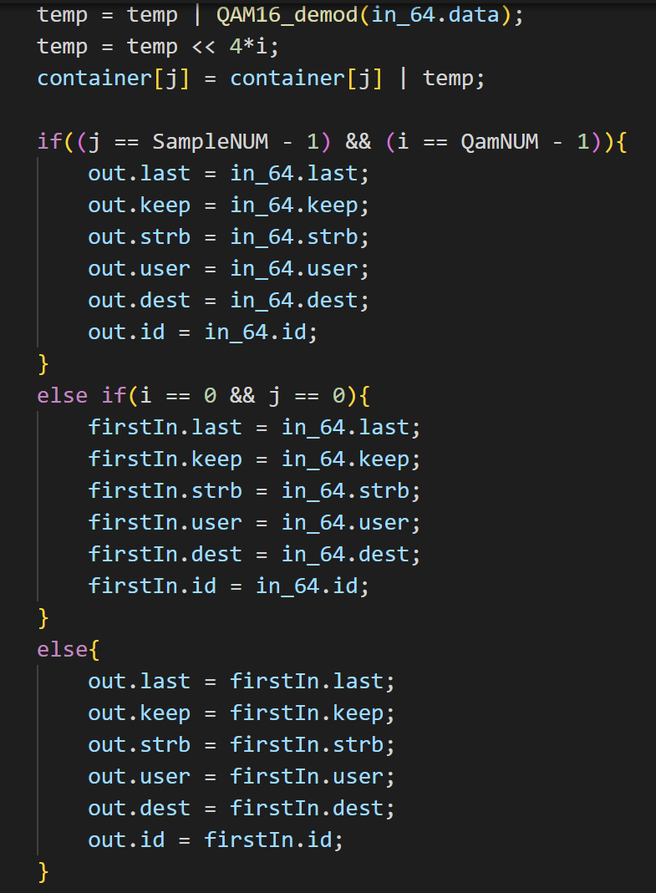
Demodulation: solution
Do not use C++ pow function
Simplify calculating of distance
Reduce the amount of buffer
Using board file to synthesis
Using union
ap_axiu keep assign

Slide 12
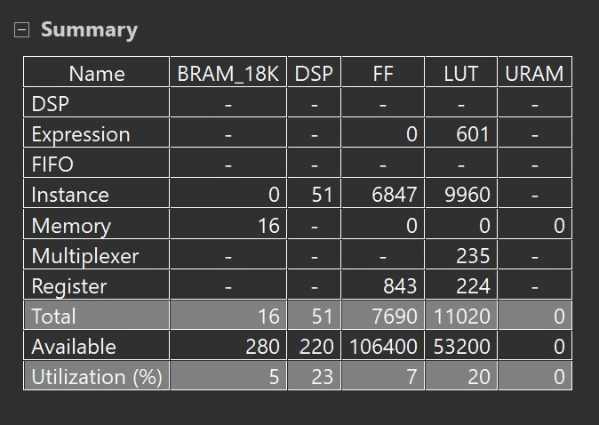
Demodulation Resources

Slide 13
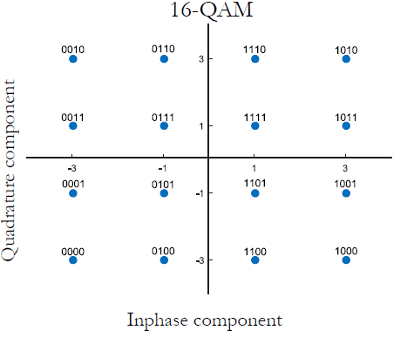
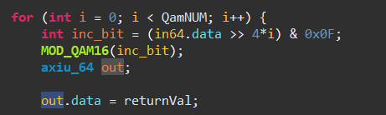
Modulation Implementation
Right Shift
Data Stream 01011011011…10101001
Mask 0000000…000000001111
MOD_QAM16 (000000000000000…1001)

Slide 14
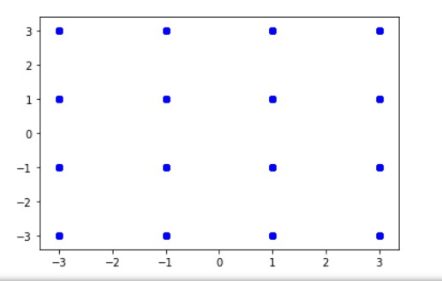
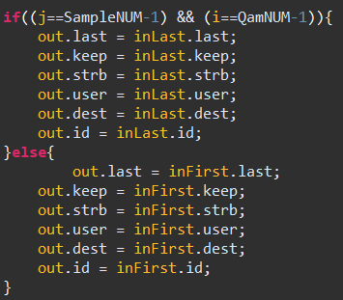
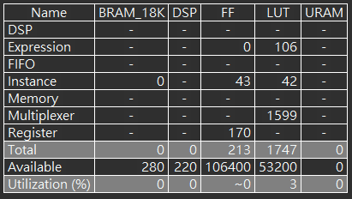
Modulation Implementation (Cont.)

Slide 15
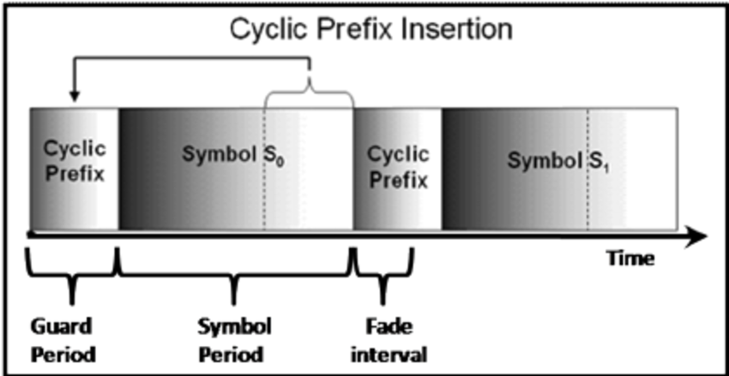
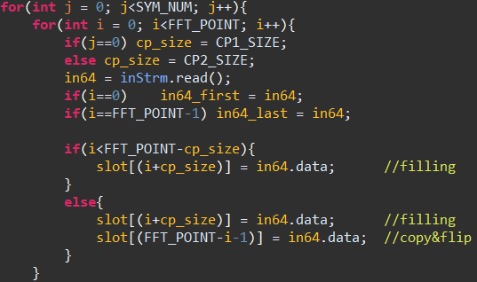
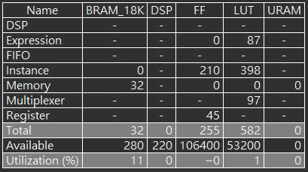
Cyclic Prefix Implementation
flip

Slide 16
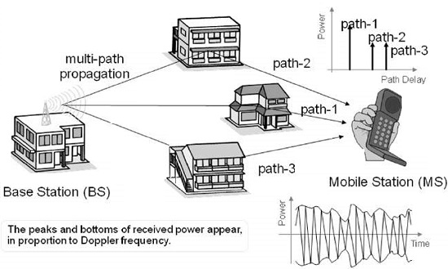
Channel Model - Rayleigh and AWGN
Notes:
左邊的Base Station是transmitter，右邊的mobile station就是receiver。信號透過好幾個路徑傳播，不同路徑的信號在傳送途中可能經過反射吸收之類的，到達receiver的時候會有不同的magnitude和phase，我們Rayleigh Fading 的IP就是在模擬這件事。
那在傳遞的途中一定會遇到雜訊的干擾，AWGN的IP就在用來產生功率頻譜符合uniform distribution而雜訊振幅符合Gaussian distribution的white gaussian noise。

Slide 17
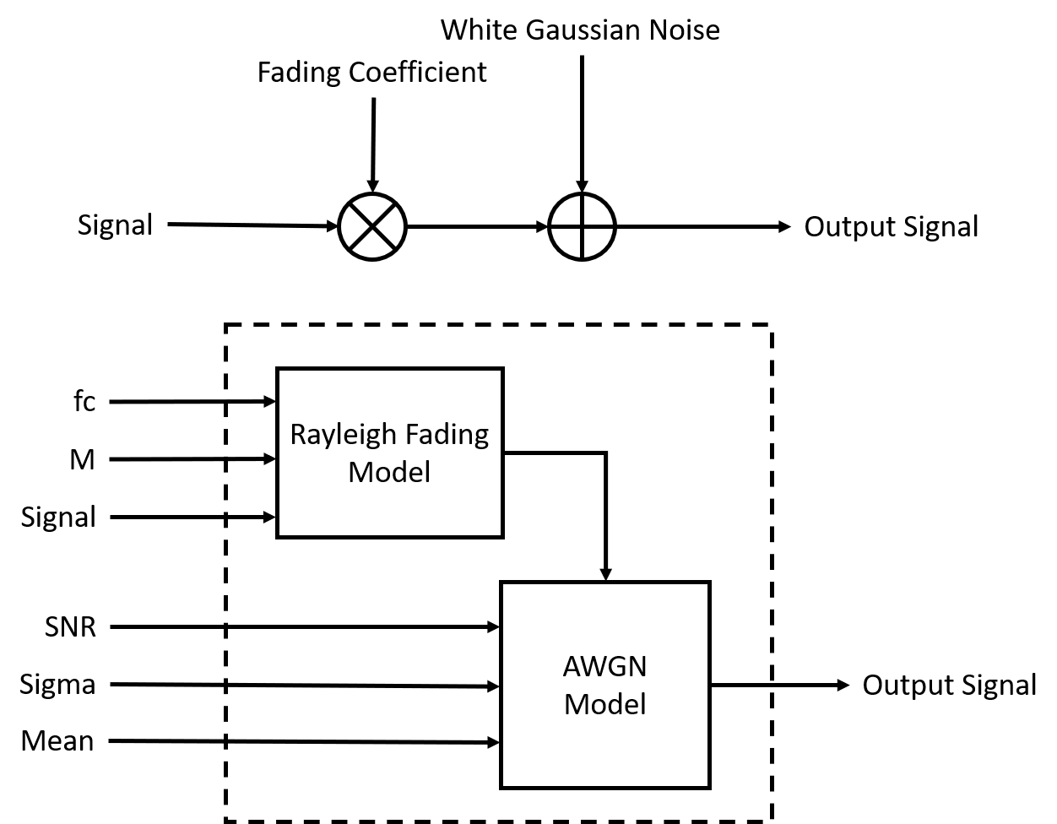
Architecture of the Channel Model

Slide 18
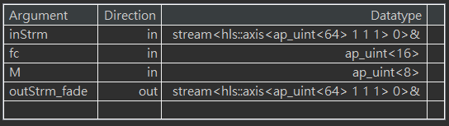
Rayleigh Channel Implementation
Carrier Frequency: 2.4GHz
M: 8 (34 sinusoids)
Max. Doppler Frequency: Velocity(60km/h)/Wave length
Rayleigh Fading
Model
fc
M
outStrm_fade
inStrem

Slide 19
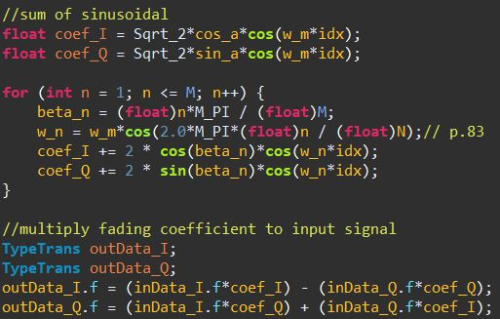
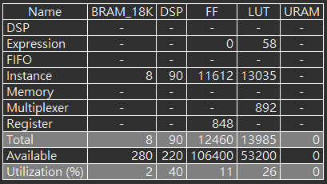
Rayleigh Channel Implementation (Cont.)

Slide 20
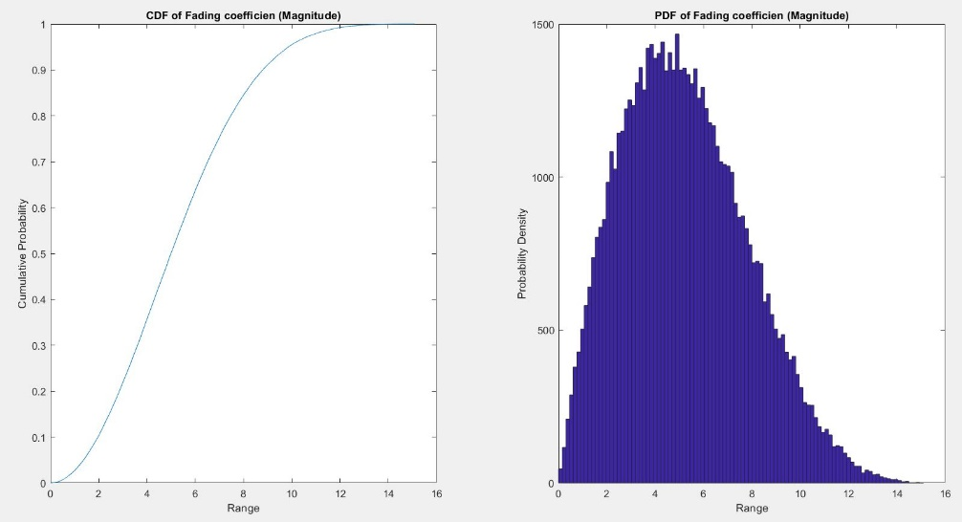
Rayleigh Channel Implementation (Cont.)

Slide 21
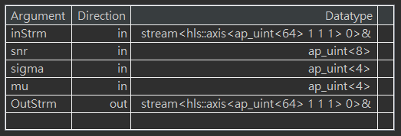
AWGN Channel Implementation
inStrm
AWGN
Model
snr
OutStrm
sigma
mu

Slide 22
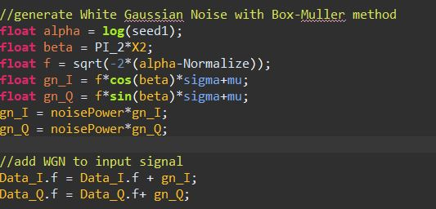
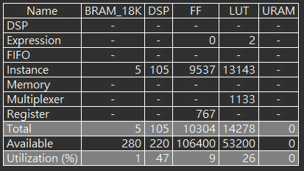
AWGN Channel Implementation (Cont.)

Slide 23
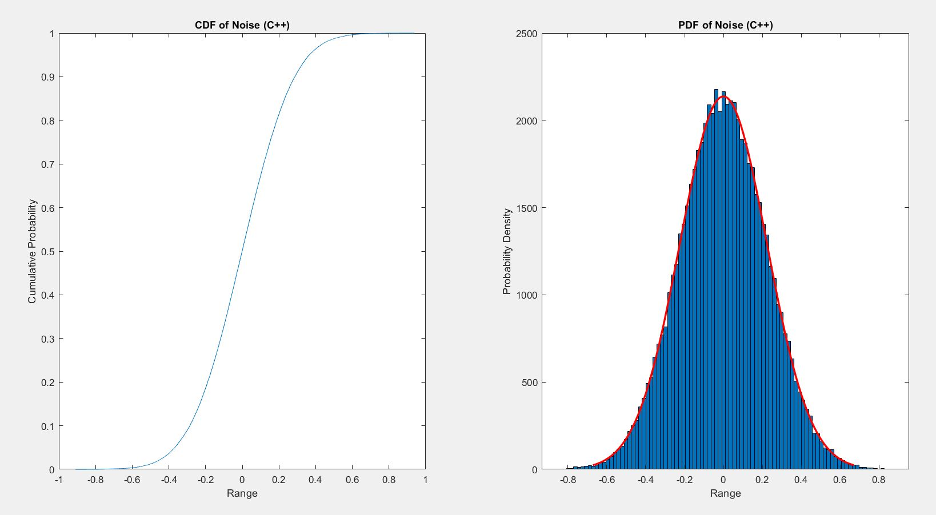
AWGN Channel Implementation (Cont.)

Slide 24
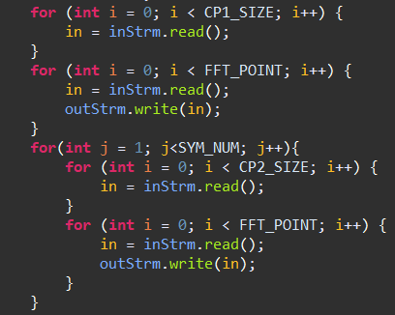
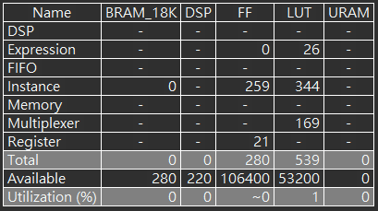
Remove Cyclic Prefix Implementation

Slide 25
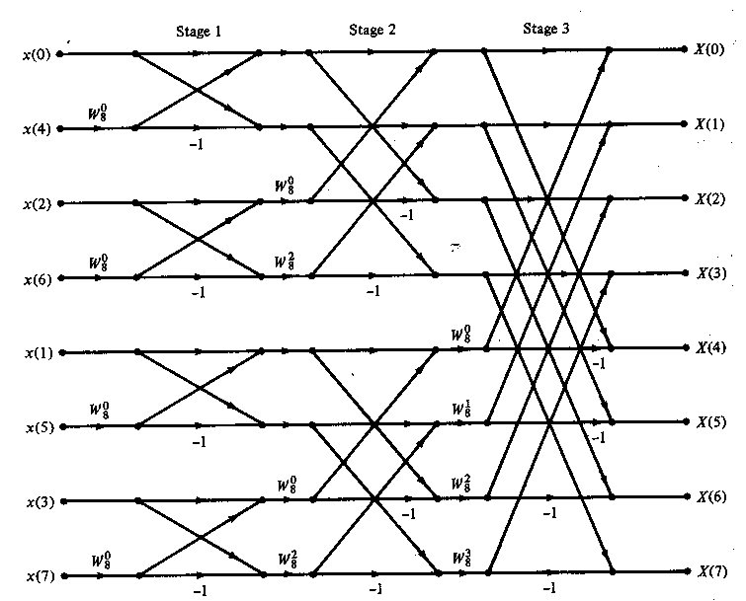
FFT IFFT implementation

Slide 26
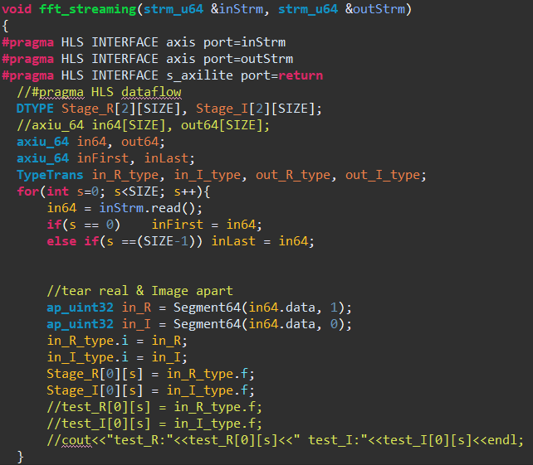
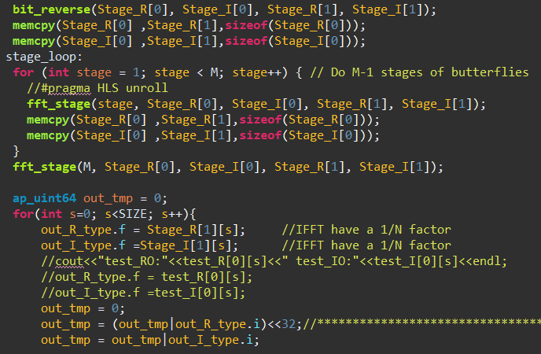
IFFT FFT Optimization

Slide 27
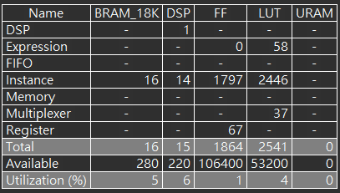
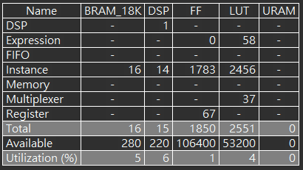
IFFT FFT Optimization (Cont.)

Slide 28
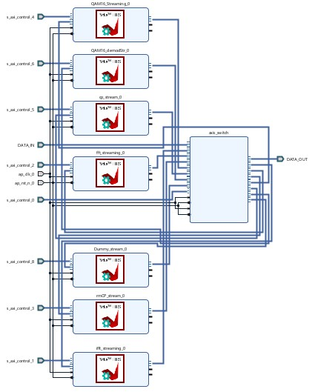
Composable Pipeline and System Integrated

Slide 29
16 QAM Constellation Diagram

Slide 30
Thanks For Your Attention.

