Slide 1
The MEAN Stack: How MongoDB, Express, Angular, and Node communicate to form a single-page web application
Ben Bae, Jason Liu, Sujay Ratna, and Daniel Yang

Slide 2
Overview
History & definition
Benefits of MEAN
MongoDB
Express JS
Angular JS/SPA
Node JS
MEAN Data Flow/MVC architecture

Slide 3
History
Early web applications could be developed by using a programming language such as Perl and adding HTML.
Desire for more complicated front-end implementations, web application needed to work right and look right.
Led to distinction between Front End and Back End
Notes:
Ben

Slide 4
What is a “stack”
Solution(software) stack - software subsystems or components needed to create a complete platform
Results in frontend/backend processing.
MERN | Mean | Express | React.js | Node.js
LAMP | Linux | Apache | MySQL | Perl/PHP/Python
WAMP | Windows | Apache | MySQL/MariaDB | PHP
WISA | Windows Server | Internet Information Systems (IIS) | SQL | ASP.NET
Notes:
Jason

Slide 5
Back End and Front End
Back End
“Behind the scenes” development
Front End
Develops good user experience
Higher expectations for front-end and back-end development led to divergence between the two, since these developers needed to specialize in areas of higher complexity.
Notes:
sujay

Slide 6
Libraries and Frameworks
Despite divergence between Front-end and Back-end developers, Frameworks took away complexities of development
Example: Dojo and JQuery for front-end Javascript
Frameworks:
Before, programmers would create their own frameworks to work around bugs
These programmers then started to share these frameworks for free.
Thus, Full-stack developers emerged once again

Slide 7
Benefits of MEAN stack
Pulls together modern web technologies in flexible stack
Uses javascript not only in the browser, but throughout
Back end and Front end is coded in the same language
Node.js utilizes an asynchronous event loop
All open source and free
Notes:
sujay

Slide 8
Components
MongoDB- considered leading NoSQL database, open source/free
Express- enables routes and API, helps organize application into MVC
AngularJS- maintained by Google, acts as frontend (client side MVC)
Node.js- creates lightweight web server, allows for modules
Notes:
Jason

Slide 9
MongoDB
Schema-less
Collections can hold different documents (size, # of fields, content)
Mongoose
Horizontal scaling (sharding)
Uses JSON/BSON to hold records
Notes:
Jason

Slide 10
AngularJS
Javascript framework that deals with data in the front end.
an application framework consists of a software framework used by software developers to implement the standard structure of an application
AJAX: set of web development techniques using many web technologies on the client-side to create asynchronous Web applications.
Templates: written with HTML that contains Angular-specific elements and attributes, combination of model and controller
Notes:
sujay

Slide 11
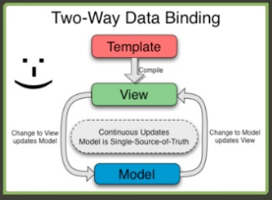
Why use Angular?
uses HTML to define the app’s user interface
Data models are plain old JavaScript objects
Utilizes Two Way Data Binding
In One Way data binding, webpage templates and data are compiled on server, sent to browser
In Two Way data binding, Browser compiles the web page template and data together. The webpage and the data can then update each other automatically.
Web application never has to be reloaded. Results in a Single Page Application

Slide 12
Express
Acts as backend framework for Node.js (organizes app into MVC)
Sets up web server and gathers requests made by clients
Returns responses to these clients
Handles cookies, parsing the request body, forming the response and handling routes.
Notes:
Jason

Slide 13
Node.js
Software Platform
Allows developers to create web server and build applications on top of it
Contains built in HTTP server library
No separate web server program required
Asynchronous Callbacks
Before, programs would have synchronous code, meaning if a function took a long time, every function written after that line of code would have to wait.
With Node.js, “blocks” are prevented.
If a function is taking a long time, the program will move to other lines of code below, without the initial function actually finishing.
Notes:
ben

Slide 14
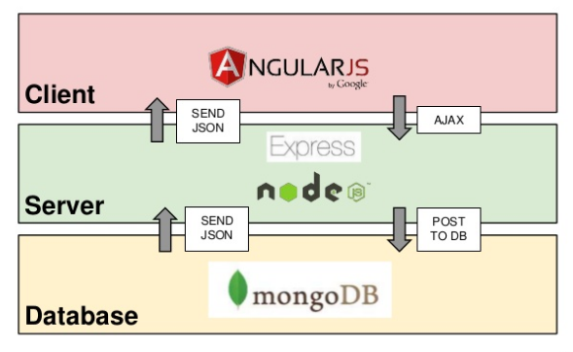
Data Flow
sujay
HTML rendering, Decorative JavaScript, HTML Generation
Authentication, Authorization, Validation
Data storage and retrieval
Notes:
sujay

Slide 15

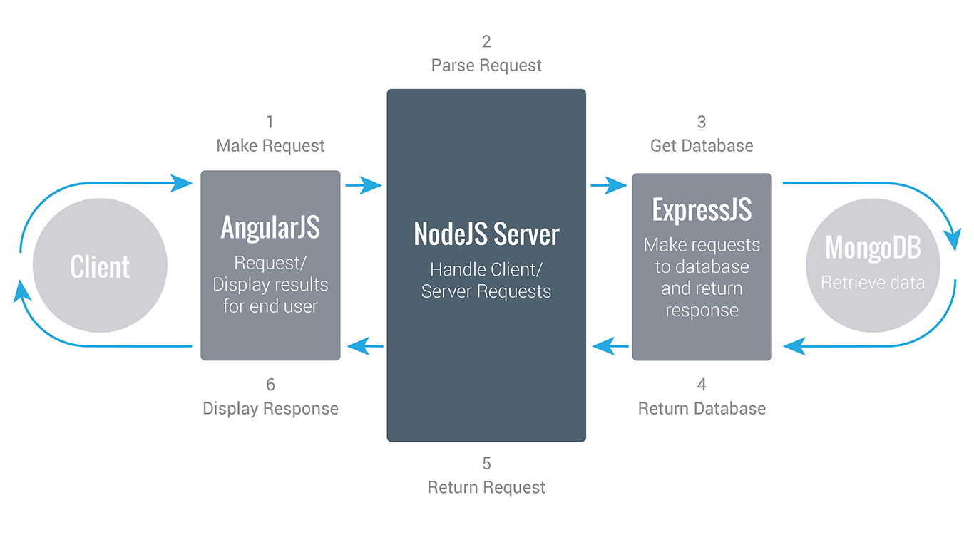
MVC Architecture
Client sends request into application
Request is sent to a controller
Controller sends request to model
Model sends back data to controller
Controller sends data for client to view
Notes:
sujay

Slide 16
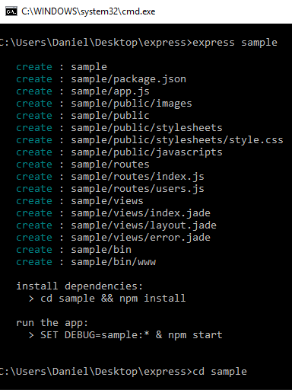
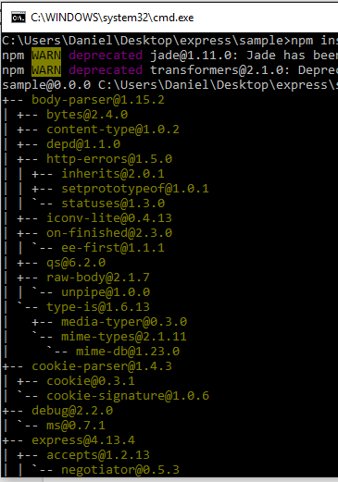
Explaining through example
In terminal:
Express nameOfApp
Cd nameOfApp
Npm install

Slide 17
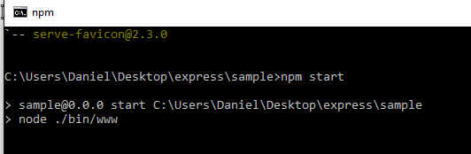
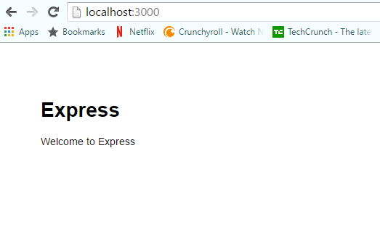
Explaining through example
Npm start

Slide 18
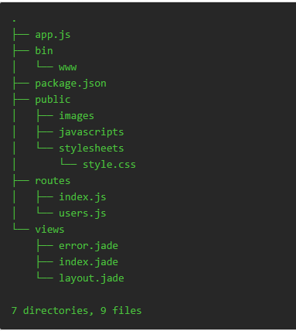
Looking at directories
Bin is where start-up scripts are located, including which port to run on
Public is where styling and images are stored.
Routes are where additional functions are routed to the webpage.
Views are where instructions for what the user views are stored.

Slide 19
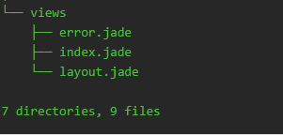
Views Folder
Contains all the “pages” that the client will see on the web browser

Slide 20

Routes Folder
Contains “actions” to be carried out at a certain location within the web application. In other words, a “router” tells what function is to be carried out at a certain url.
Example.
router.post('/locations', ctrlLocations.locationsCreate);
Function locationsCreate would be carried out at localhost:3000/locations.
Notes:
ben

Slide 21
Controllers Folder
Routers link to controllers in order to carry out functions at a specific url.
Within the controller, all functions that will be carried out in the web applications are defined.
Important: Routers “require” controllers:
var ctrlLocations = require('../controllers/locations');
Here, the router file requires ctrlLocations, which is located within the “reviews” file inside of the “controllers” directory inside the project.
Notes:
ben

Slide 22
Conclusion
MongoDB holds data, Angular.js responsible for front end that client sees, Node.js provides the back end processing within the webapp, while Express gathers outside requests and returns responses to the client.
MEAN stack utilizes MVC architecture
Angular allows the web application to become a dynamic, single page application that does not need reloads.

Slide 23
References
“Getting MEAN” by Simon Holmes
“Express Application Generator” by ExpressJS
http://www.tutorialspoint.com//angularjs/angularjs_overview.htm
http://stackoverflow.com/questions/20283098/what-is-the-difference-between-javascript-and-jquery
https://docs.angularjs.org/guide/
https://en.wikipedia.org/wiki/Model%E2%80%93view%E2%80%93controller
https://www.google.com/url?sa=i&rct=j&q=&esrc=s&source=images&cd=&cad=rja&uact=8&ved=0ahUKEwjK4ey4kbrOAhVGRyYKHal2AlAQjRwIBw&url=http%3A%2F%2Fwww.bacancytechnology.com%2Fhire-mean-stack-developer&psig=AFQjCNHkfmdZSCTmTbvSAp-Z064Nudjctg&ust=1471031477815887

