Slide 1
Mongoose and MongoDB Implementation of NPDS
Jason Liu

Slide 2
MongoDB
MongoDB | Standard SQL
Database | Database
Collection | Table
Document | Row
Field | Column
Index | Index
Embedding Document | Table Joins
_id | Primary Key
Schema-less: no rigid structure
Tables → Collections
Rows → Documents
Each documents has _id (forced key)

Slide 3
Mongoose
Object Document Mapper (ODM) vs Object Relation Mapper (ORM)
Helps define schema
http://mongoosejs.com/docs/guide.html
Enables connecting, inserting/retrieving data, and querying to MongoDB in Javascript

Slide 4
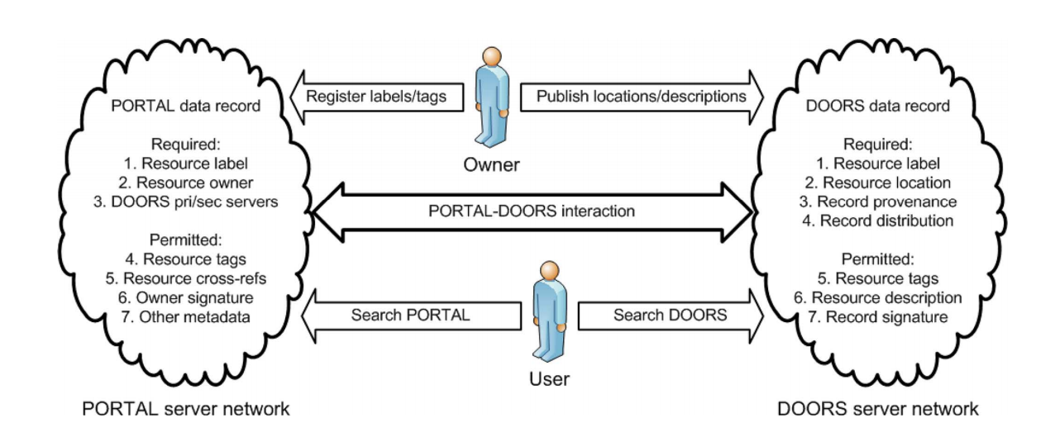
Format
Records stored as JSON

Slide 5
NPDS Resources
Entity Metadata: information about object itself
Record Metadata: information about entity for storage
Infoset Metadata : information for management and analyzation
Representation Metadata : assembled from entity, record, and infoset
Message Metadata (not implemented) : message between servers or client

Slide 6
NPM Packages
Mongoose
Xml2js
Jsontoxml

Slide 7
Entity Metadata
Record Metadata
Representation
Metadata
Message Metadata
Resource
Information
XML
Record
JSON
Record
MongoDB

