Slide 1

SEISMIC FACIES CLASSIFICATION
SCS UofT - 3546 – TERM PROJECT
Jaspreet Bhatia

Slide 2
Seismic Facies Classification
Problem Statement.
Exploratory Data Analysis.
Data Pre-processing.
Model compilation.
Model Analysis.
Predictions.
Recommendations and Future Work.
References.

Slide 3
Problem Statement.
Earthquakes around the world have been a cause of major destruction and loss of life and property.
Seismic reflection data are a key source of information in numerous fields of geoscience.
However, the often subjective and nonunique interpretation of seismic reflection data has led to longstanding debates based on contrasting geologic interpretations of the same or similar data sets
Moreover, seismic interpretations require significant amounts of time, experience, and expertise from interpreters.
The earthquake stations continuously collect data even when there is no event. From this data, we need to distinguish earthquake and non-earthquake.
An early detection and prediction system using classification models can prove to be very useful for disaster management teams.
To build a machine-learning model that can predict the facies classifications for each pixel.

Slide 4
Exploratory Data Analysis
Seismic data is publicly available and provided by New Zealand Petroleum and Minerals (NZPM).
DATA – Train Images, Train Image Labels, Test Image 1, Test Image 2 ( in SEG-Y format).
LABELS:
1) Basement/Other: Basement - Low S/N;
Few internal Reflections; May contain volcanics in places
2) Slope Mudstone A: Slope to Basin Floor Mudstones;
High Amplitude Upper and Lower Boundaries; Low Amplitude Continuous/Semi-Continuous Internal Reflectors
3) Mass Transport Deposit: Mix of Chaotic Facies and Low Amplitude Parallel Reflections
4) Slope Mudstone B: Slope to Basin Floor Mudstones and Sandstones;
High Amplitude Parallel Reflectors; Low Continuity Scour Surfaces
5) Slope Valley: High Amplitude Incised Channels/Valleys;
Relatively low relief
6) Submarine Canyon System: Erosional Base is U shaped with high local relief.
Internal fill is low amplitude mix of parallel inclined surfaces and chaotic disrupted reflectors.
Mostly deformed slope mudstone filled with isolated sinuous sand-filled channels near the basal surface.
A 3D seismic data volume and an accompanying "label" volume consisting of a seismic facies interpretation.
Each pixel in the label volume is assigned a value from 1 to 6, denoting its facies classification.

Slide 5
Contd.
Image was loaded in Seg-Y format followed by conversion in Numpy format.
Labels were converted to Integer Data-Type (Range 1-6).
We have 3D datasets both ( features X, and labels Y ) with shape for X in 1006 × 782 × 590, in axis corresponding Z, X, Y and Y in 1006 × 782 × 590 in also axis corresponsing Z, X, Y.
We have total of 2,378 training images with their corresponding labels in Seg-Y format and 2 test images in Seg-Y format.
Test Image 1 – (251, 782, 1006)
Test Image 2 – (841, 334, 1006)

Slide 6
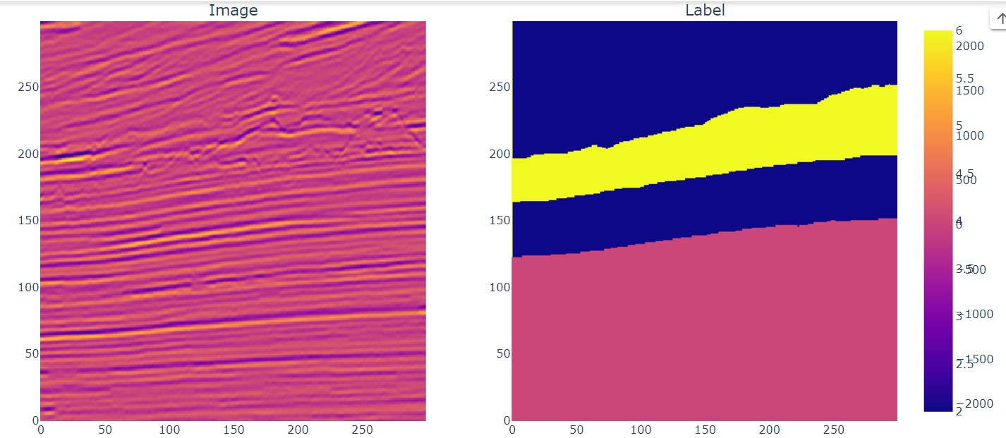
Seismic Image and Label in 2D

Slide 7
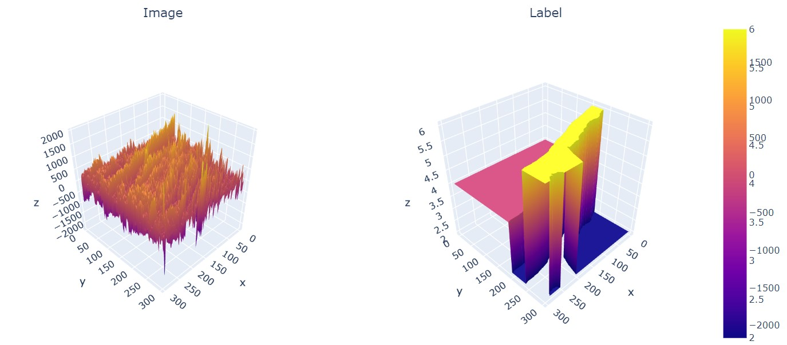
Seismic Image and Label in 3D

Slide 8
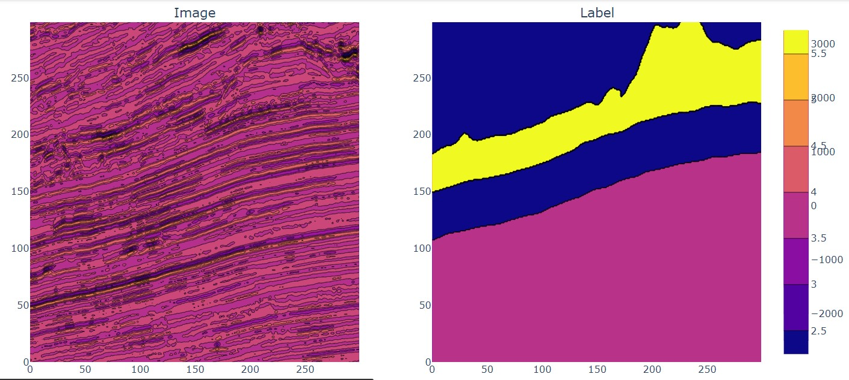
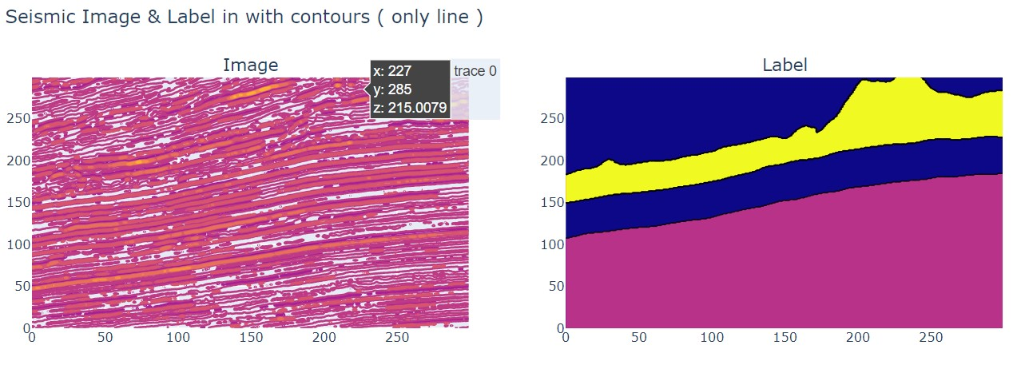
Data Pre-processing: Seismic Image and Labels in Contours

Slide 9
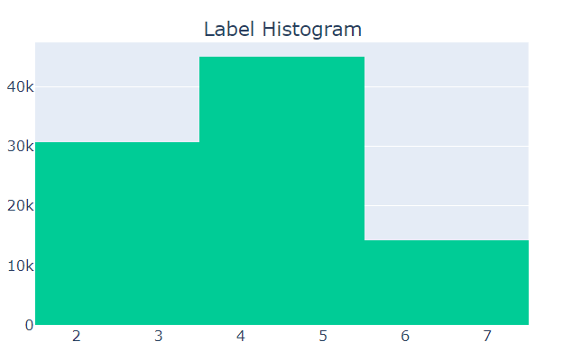
Label Distribution

Slide 10
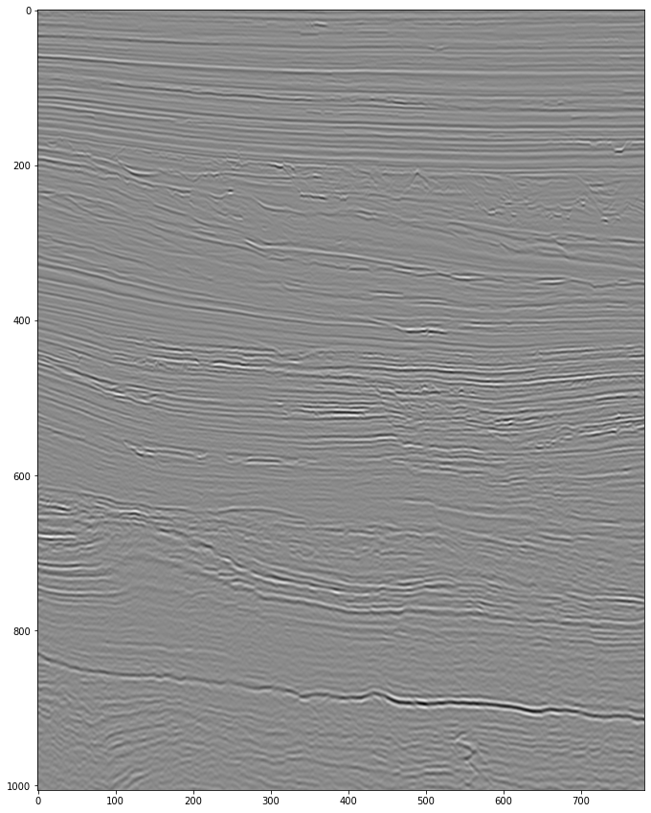
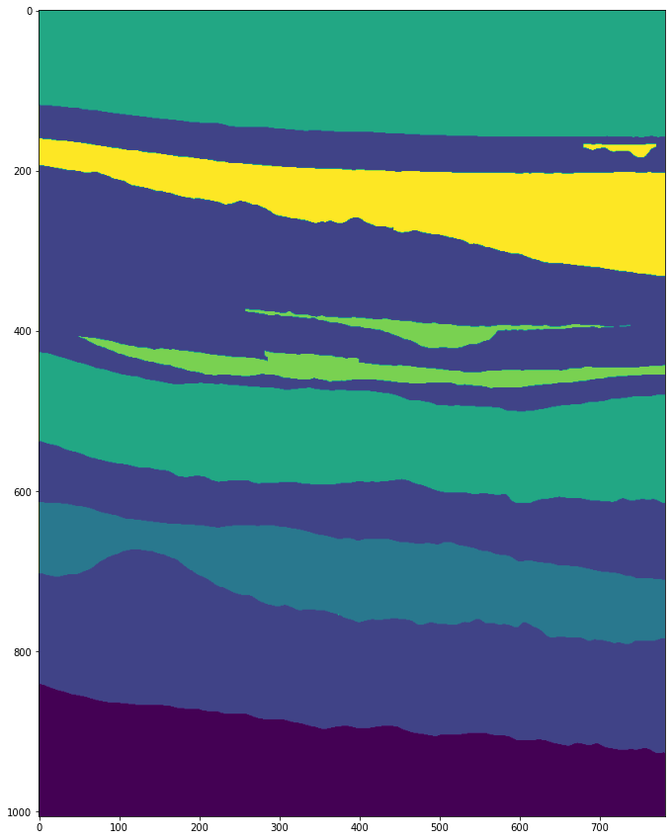
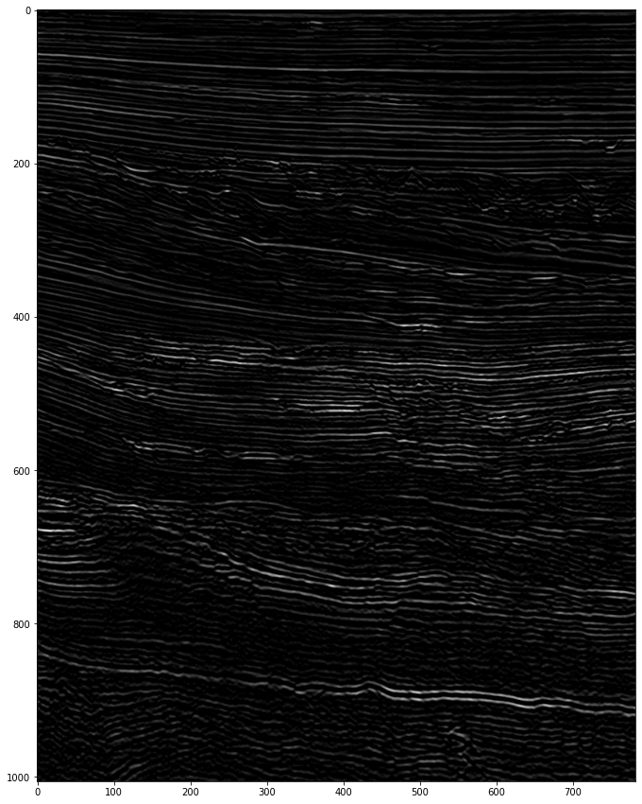
Data Exploration.
GRAY IMAGE
IMAGE LABEL
THRESHOLD IMAGE

Slide 11
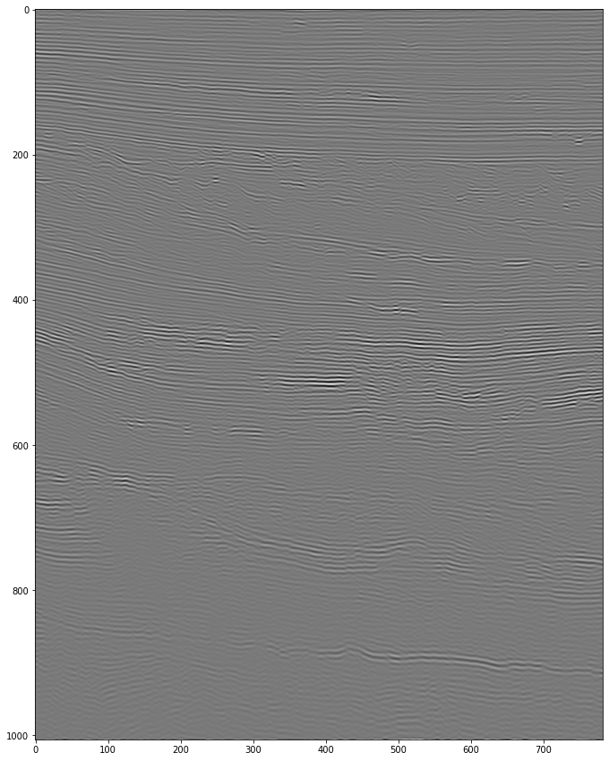
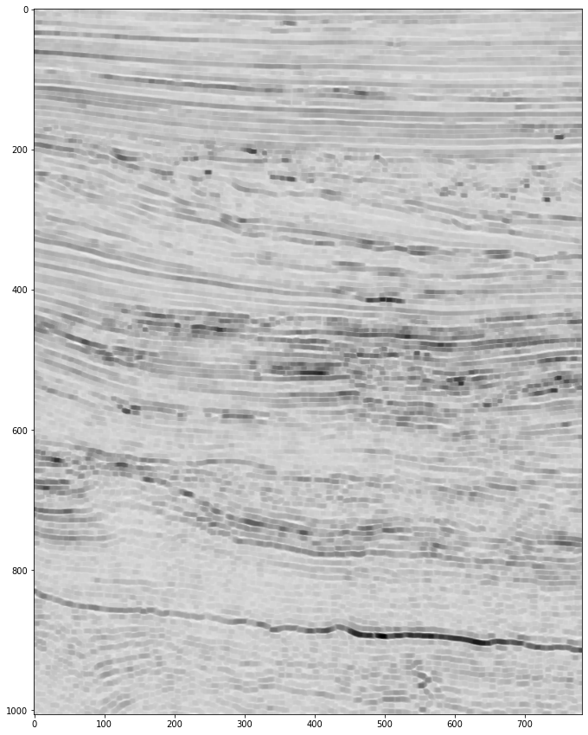
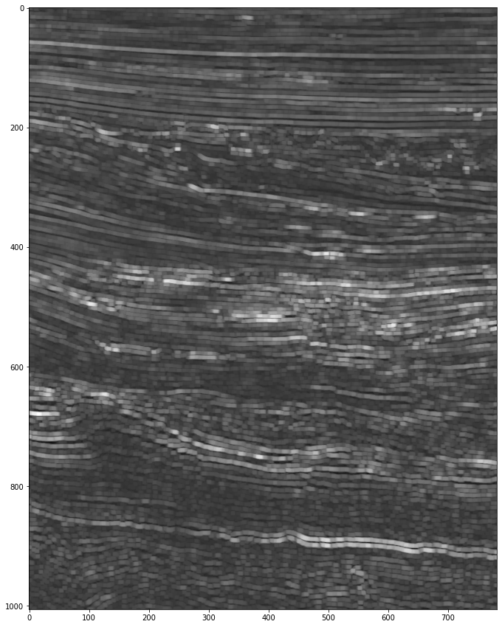
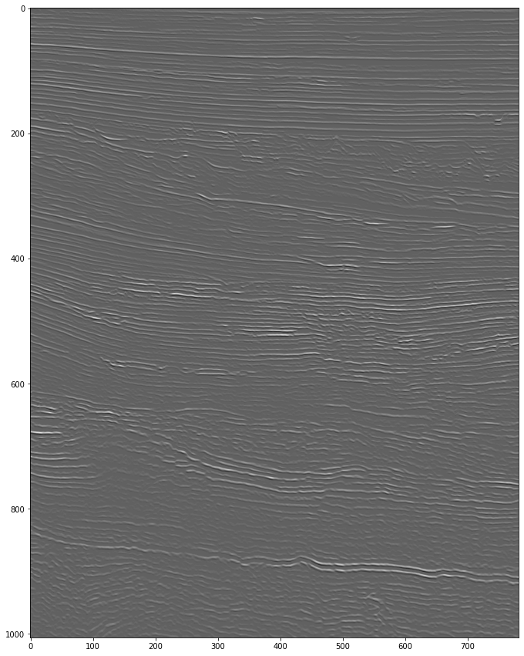
Contd.
FILTERED IMAGE- SOBEL
ERODED IMAGE
DILATED IMAGE
SHARPENED IMAGE

Slide 12
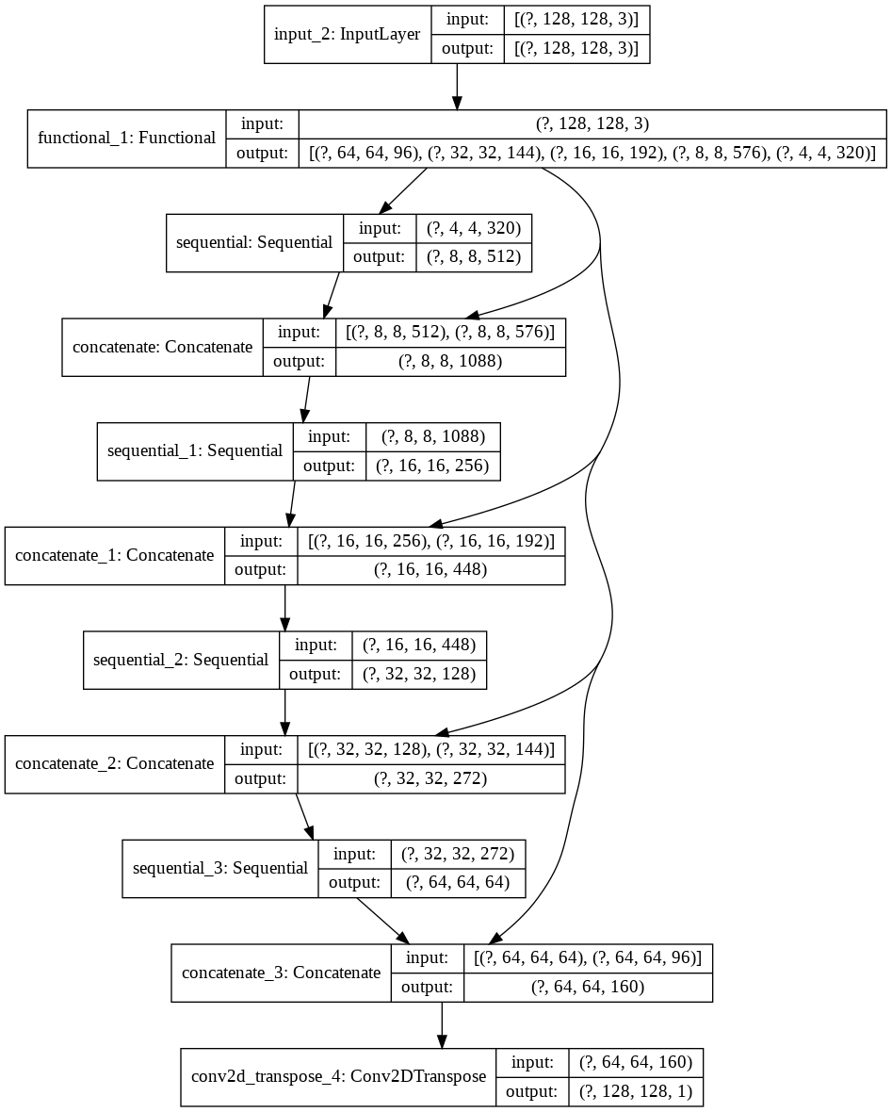
Model Design
Pre-trained MobileNetV2 model was chosen for Transfer Learning.
Modified U-Net was designed using MobileNet V2 as Encoder and Upsampler using pix2pix as Decoder.
Input shape=[128, 128, 3]
Down Stack layer train was set to False.
The following layers were chosen:
'block_1_expand_relu 64x64
'block_3_expand_relu’ 32x32
'block_6_expand_relu’ 16x16
'block_13_expand_relu 8x8
'block_16_project', 4x4

Slide 13
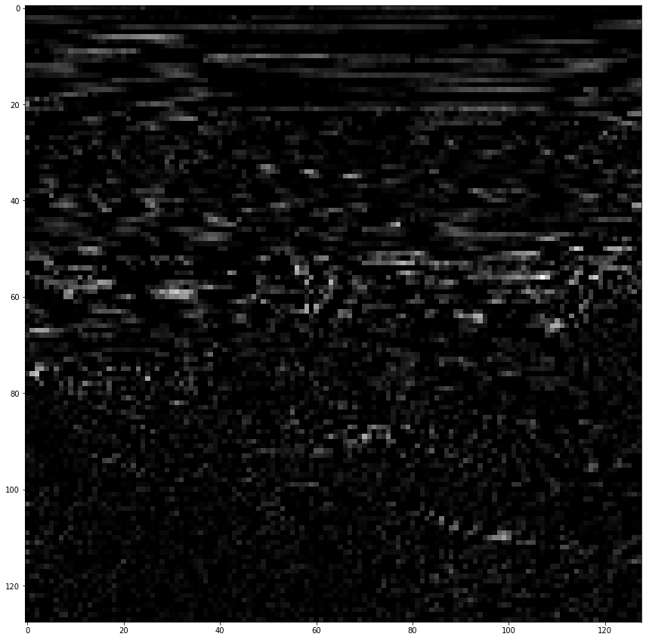
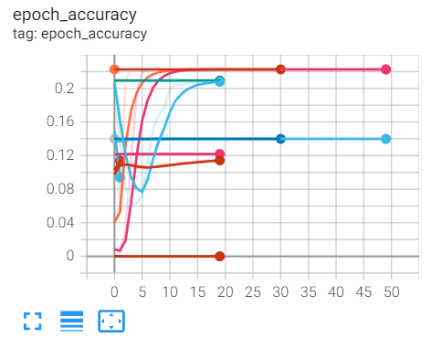
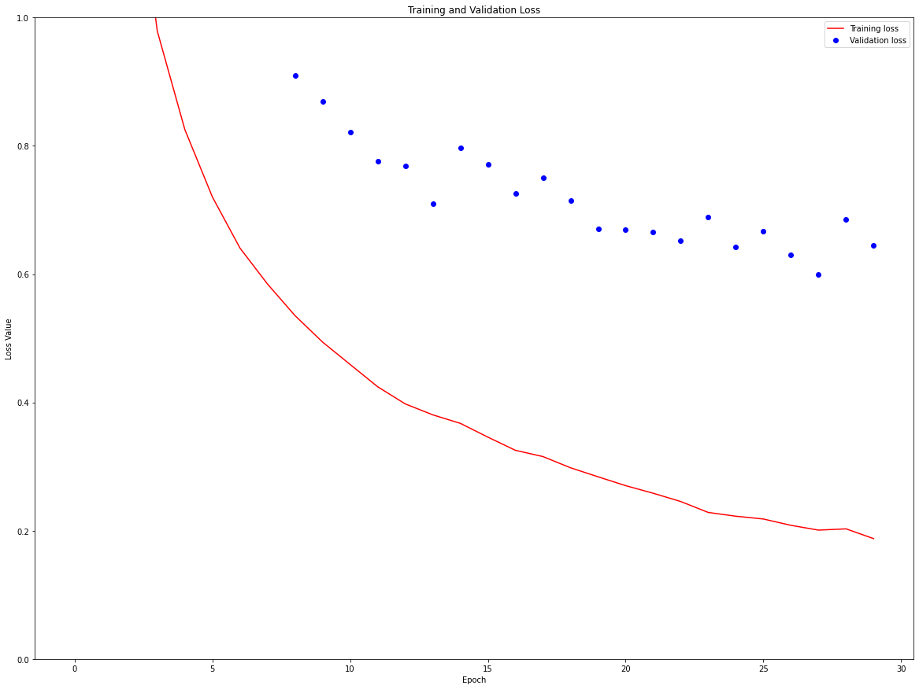
Model Compilation
Epoch Accuracy
Sample Train Image
Val Vs Train Accuracy
MODEL OVERFITTING
Optimizer - ADAM
Loss- MSE
Metrics- Accuracy
Epochs – 30
Validation Split-0.2

Slide 14
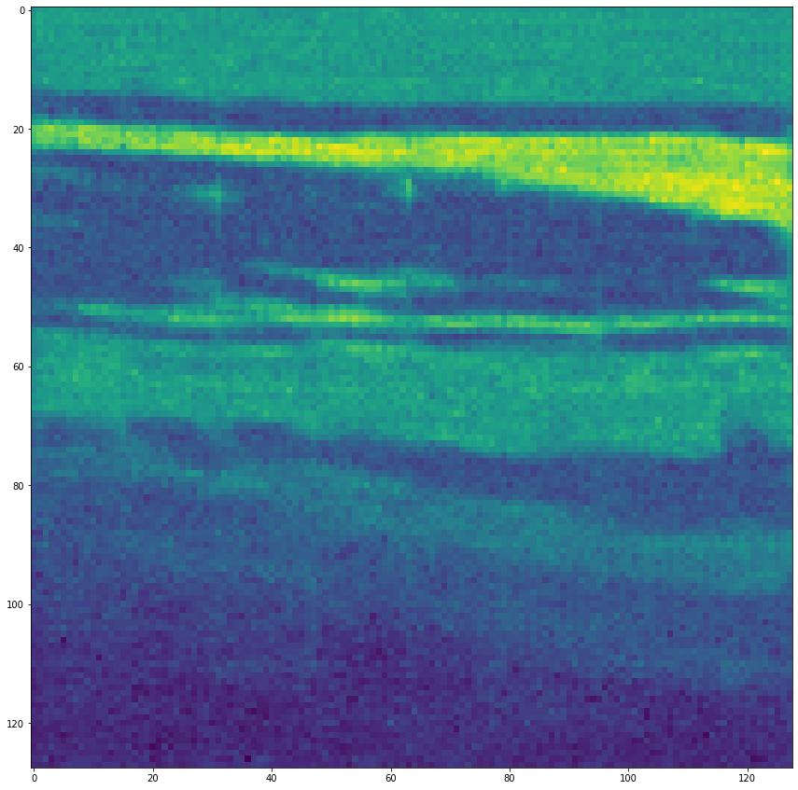
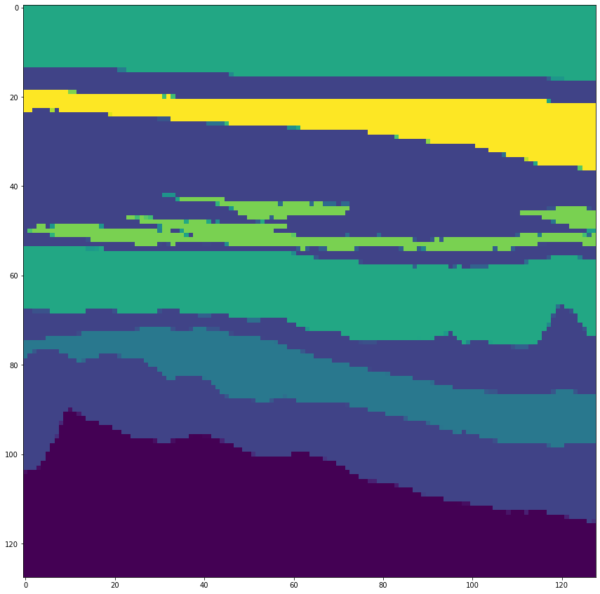
Predictions
Predicted Image Mask
Predicted Image Label

Slide 15
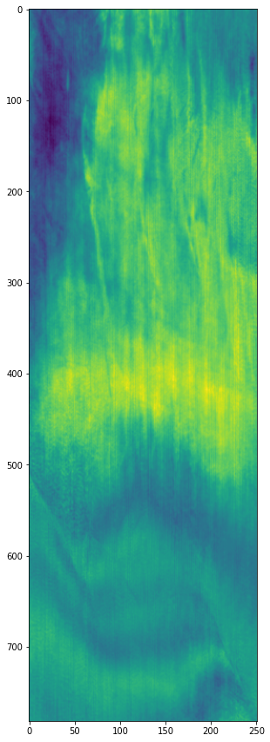
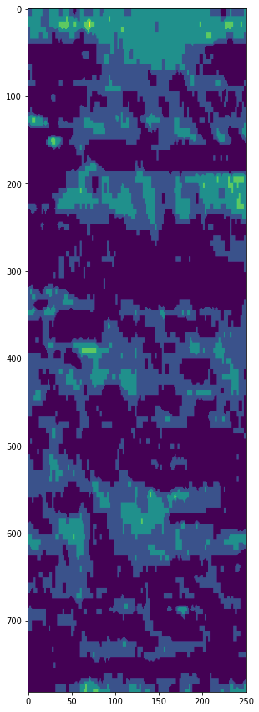
Test Image 1
Test Image Mask
Test Image Mask

Slide 16
Recommendations and Future work.
Application of Data Augmentation – Rotation of images (0, 45, 90, 135 , 180), Contrast changes, Flip the images.
Evaluating using DICE as an evaluation metric.
Applying changes in the layers of Unet.

Slide 17
References.
2020 SEG Annual Meeting Machine Learning Interpretation - https://public.3.basecamp.com/p/JyT276MM7krjYrMoLqLQ6xST
Seismic data is publicly available and provided by New Zealand Petroleum and Minerals (NZPM).Dataset - https://www.nzpam.govt.nz/maps-geoscience/exploration-database/
Machine learning challenge on this data organized by SEG- https://wiki.seg.org/wiki/Open_data
UNet Model - https://www.tensorflow.org/tutorials/images/segmentation
Tensorboard
Deep Learning Assignment on Transfer Learning.

