Slide 1

University of Toronto
School of Continuing Studies
Machine Learning - 3253
Group F
December 09, 2021
Team:
Anand Rangarajan
Chetan Choudhary
Christopher Fernandez
Dashmeet Mayal
Jaspreet Bhatia

Slide 2
PROJECT TOPIC
Cost Prediction for Logistic Company
Building a model that predicts the cost of deliveries

Slide 3
Agenda
01
Problem Statement
04
Training the Model
ML Project Objectives
Model Experimentation
Model Selection
Hyperparameter Tuning
02
Data
05
Evaluate the Model
Description of Data
Exploring Data
Understanding Features
Results
Model Performance
03
Process/Methodology
06
Conclusions
Data Preparation
Data Transformation
Feature Engineering
Challenges Faced
Key Learnings

Slide 4
Process
Train a model
Start Baseline Model
Data Exploration
Data Preparation
Data Exploration and Cleaning
Data Transformation
Normalization
Evaluate the model
Improve
Final Model for Prediction
Evaluate the model using the RMSE Scores
Feature Engineering
Hyperparameter tuning
Exploring more models
Notes:
General ML Flow

Slide 5
Process
1. Data Collection
2. Problem Statement
Predicting Cost for a Logistics Company
Source: Kaggle
Training Set
Test Set
3. Proposed Approach
4. Testing
Supervised Learning
Regression
Evaluation Metric: RMSE
Training the Model
Hyperparameter Tuning
Verification and Validation of Results
K-fold cross validation
Notes:
ML Proces with respect to our problem

Slide 6

Data Description: Summary
Training Set | 38999 rows 11 Features + 1 Target
Test Set | 802 rows
Target | Cost (numerical)
Features (Dtype) | Description | Training Set Values
Trip (id) | Trip ID | Discrete
Date (temporal) | Date, when trip was made | January 2017- December 2019 (3 years’ data)
dayPart (categorical) | Day or Night | night 25904, day 13095
exWeatherTag (categorical) | Heat / Snow | snow 3286, heat 1596
originLocation (categorical) | Source location | S1-S9
destinationLocation (categorical) | Destination location | D1-D9
distance (numerical) | Distance traveled | Range: 400-3600
type (categorical) | Expedited or Not | expedited 3748
weight (numerical) | Weight carried by carrier | Range: 1-500
packageType (categorical) | Type of packages | TT 2500
Carrier (categorical) | Name of the carriers | B 29813 D 3748 C 3060 A 2378
Notes:
Overview of data from Kaggle

Slide 7
Data Exploration: Analysis of Nulls
 | Count of Nulls | Percentage of Nulls
trip | 0 | 0.00%
date | 0 | 0.00%
dayPart | 0 | 0.00%
exWeatherTag | 34117 | 87.48%
originLocation | 0 | 0.00%
destinationLocation | 0 | 0.00%
distance | 0 | 0.00%
type | 35251 | 90.39%
weight | 0 | 0.00%
packageType | 36499 | 93.59%
carrier | 0 | 0.00%
cost | 0 | 0.00%

Slide 8
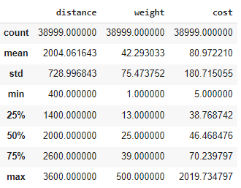
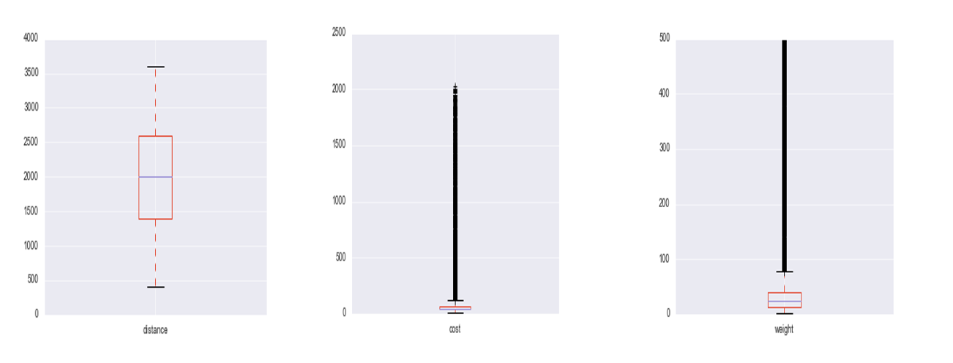
Data Description: Distribution of Numerical Fields
Raw Data
Distance is normally distributed
Cost (target), Weight (most correlated to cost) highly skewed, non-normal distributions
Excluding outliers likely to cause loss of information. All data was kept for the training.

Slide 9
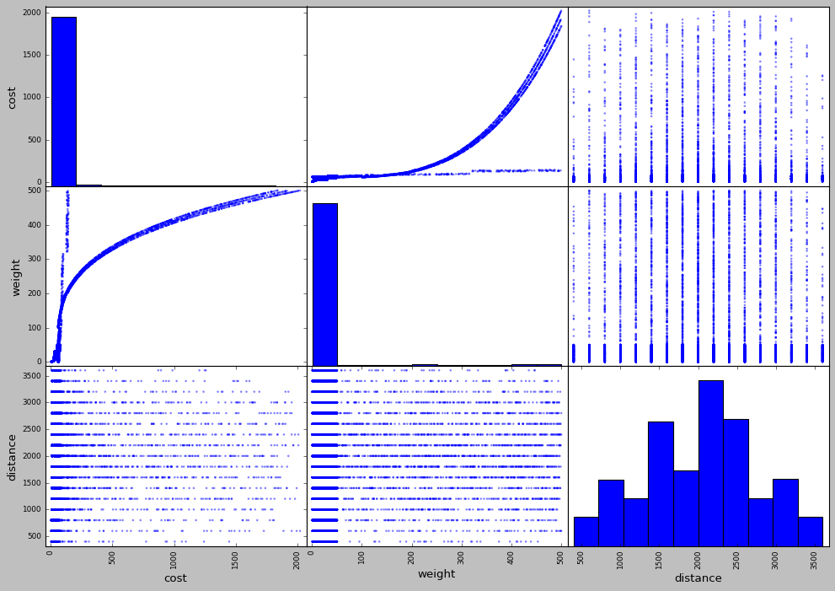
Data Exploration: Scatterplots of numerical features vs cost
Notes:
Chetan to update

Slide 10
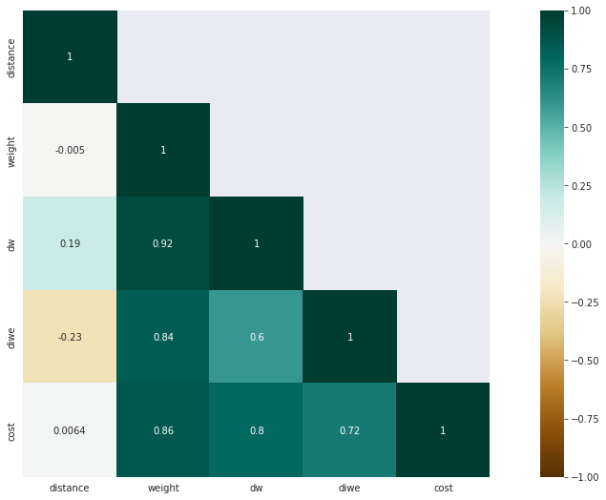
Data Exploration: Correlation Matrix
Notes:
Jaspreet to update

Slide 11
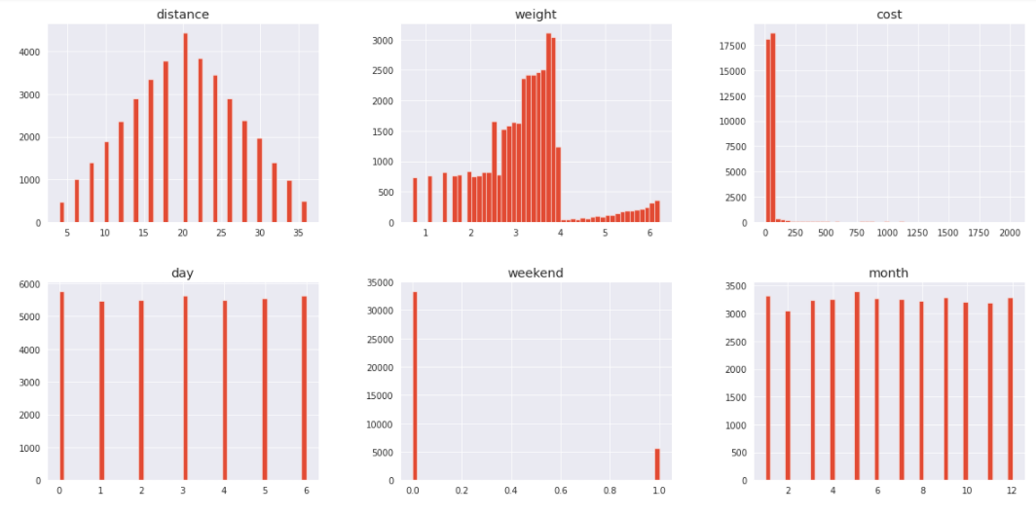
Data Exploration

Slide 12
Data Exploration - Observations
Exponential relationship between Weight vs. Cost
Cost has high correlations with:
Weight
Expedited type
Cost has low correlation with:
Distance
In this context/scenario, distance is discrete (9 Sources and 9 Destinations), varying from S1-D1 400, to S9-D9 3600.
If weight > 100
carriers are C, D only
weight type is TT
exWeather tag reveals
Snow in December, Heat in June (In line with real life scenarios), Null in other cases
For Categorical values, we checked for number of values missing. So three variables below have more than 85% of missing values
exWeather
Type
packageType
Notes:
Team to add more observations

Slide 13
Feature Engineering
Drop Trip ID column
No impact on target variable
Keep all outliers given non-normal distributions for target variable
Extract from date column
Day
Weekends
Month (Seasonality)
Year (To track change in Cost YoY)
Interactions between subsets of features
Source + Destination : combined features as new column
Transforms explored (across various models)
Distance x weight
Distance x (Weight squared)
Weight squared
Distance / Weight
Log ( weight )
Log ( cost )
Notes:
Handling of NaN
Handling of Outliers
Dropping features that won’t have an impact on the target variable. Eg. Trip ID
Converted data into date format for further transformation into day, weekday, month and year
Any other Data cleaning Mechanisms used

Slide 14
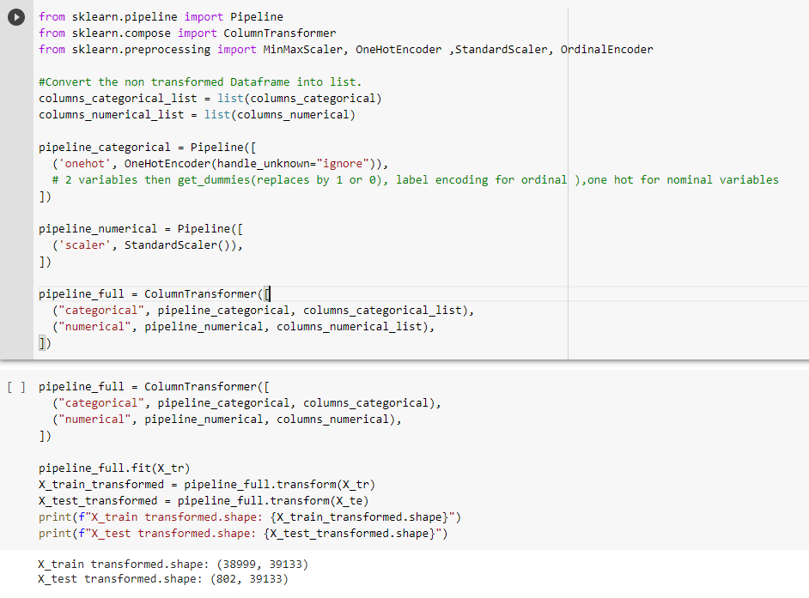
Feature Engineering: Transformations & Pipeline
Transformation:
All Numerical features
MixMax Scaler
Standard Scaler
For Categorical Features
One Hot Encoding
Ordinal Encoder

Slide 15
Regression Models Experimented
Models (RMSE - Kaggle Test)
Linear Regression | 85.6 | RMSE scores were too high
Lasso/Ridge/Elastic Net | 53 | RMSE scores improved with penalty functions
Random Forest | 7.0 | RF improved our RMSE scores to below 10
SVM | 20.2 | We tried SVM regressors but didn’t get much success
AdaBoost | 43.63 | Adaboost didn't help with RMSE.
Gradient Boosting | 7.7 | Improvement over SVM
XGB Regressor | 1.2 | With some additional Feature Engineering and applying XGB we got our breakthrough RMSE scores
LGBM, Blending LGBM and XGB | 0.8 | While researching XGB, we came across LGBM which was more efficient (parallel processing). Our results improved with LGBM and we decided to use it for our final submission
Neural Network | 10.6 | We did a lot of work trying Neural Nets using Keras but for some reason we didn’t had a lot of success
Notes:
We started with Linear Regression models but our RMSE scores were too high (in the range of 85)
We then tried Lasso and Ridge regression with different regularization parameters and best CV RMSE improved to 58.53 for Lasso and 58.59 for Ridge
We then tried Elastic Net with different Alpha and L1 ratios. But results were in the same ballpark of RMSE of 58
Then we tried Random Forest Regressor and got an improvement with a RMSE score of under 10
We then tried XGBoost with some feature engineering which got our scores to under RMSE of 3
Finally, we used LGBM which turned out to be our best model and got us a score of under 1 on Public Leaderboard.
Lasso: CV results:
print(grid_search_lasso.best_params_)
print(np.sqrt(-grid_search_lasso.best_score_))
{'alpha': 0.04}
58.536514969351416
Ridge:
print(grid_search_rr.best_params_)
print(np.sqrt(-grid_search_rr.best_score_))
{'alpha': 1}
58.59800672803949
Elastic Net:
print(randomized_search_elastic_net.best_params_)
print(np.sqrt(-randomized_search_elastic_net.best_score_))
{'l1_ratio': 1, 'alpha': 0.005}
58.58212551865749
Random Forest:TRAIN : Root Mean Square Error:
1.0366906741756865

Slide 16
Hyperparameter Tuning
01
02
Learning Rate
Max Depth
Hyperparameters
Grid Search CV
03
04
n_estimators
reg_lambda
Notes:
Reg_lambda: L2 regularization; increasing value makes model more conservative ( specific to XG boost )
Learning rate: Step size, shrinks feature weights in each boosting step; (larger step => higher rmse) ; (smaller step => longer training time). Values between 0, 1. Default 0.1
N_estimators: number of trees boosted
Max_depth: maximum tree depth

Slide 17
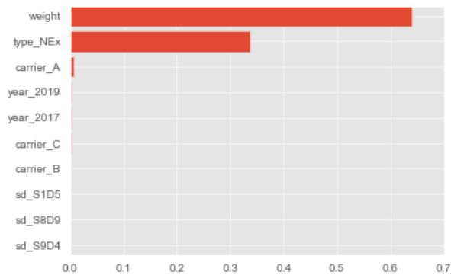
Feature Importance and Testing
Feature Importance
Validation Set
Cross Validation
Performed feature importance for XGBoost models
Split Kaggle training set into 80/20% to create local validation set
Performed cross validation over hyperparameters using RMSE

Slide 18
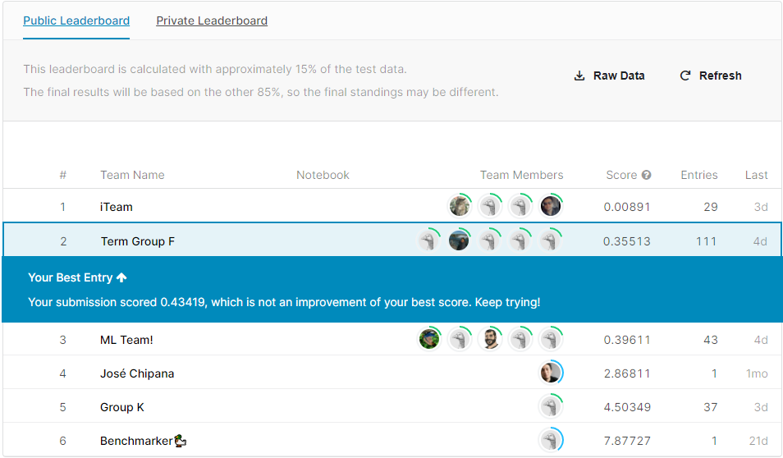
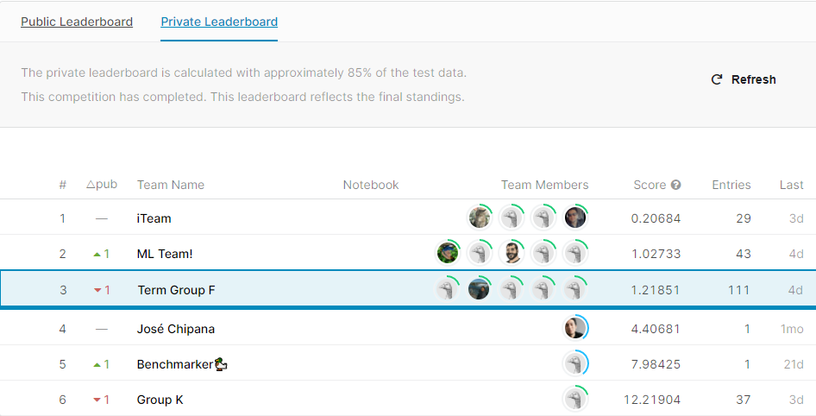
Results and Interpretation of Results
Based on our initially chosen model (Extreme Gradient Boosting), Predicted Cost had the following RMSE scores:
Kaggle Scores(RMSE)
Public Leaderboard: 0.35 (On 15% of Test Data)
Private Leaderboard: 1.2 (On 85% of Test Data)
Ensemble methods proved to be most effective at prediction for regression
Model that gave us the least score was Light Gradient Boosting
RMSE Score of 0.8
Predicted Cost Curve from the Test Data(Histograms- Cost vs Numerical Features) replicated the Training set Cost Curve to some extent

Slide 19
Conclusions
Challenges
Key Learnings
Processing times for a few models on Google Colab
Cross-validation
Overfitting i.e. getting a good RMSE score in CV but when uploading to Kaggle for test data, our scores were very different at times
Version control, replicability and collaboration across team members
Understanding of Business is important while handling data and features
Data Science, human judgement, and statistics, all contribute towards training a Model
Handling NaNs in real life
Models can help us only so much. It’s important to get the feature engineering right before apply different models
Use proper version control so that the code which gets you the best results can be replicated efficiently
Higher dimensionality is not necessarily a good thing if its redundant or incomplete

Slide 20
References
TA Sessions https://www.analyticsvidhya.com
https://medium.com/
https://towardsdatascience.com/
https://machinelearningmastery.com/
https://stackoverflow.com/
https://scikit-learn.org/stable/index.html
Hands-On Machine Learning with Scikit-Learn, Keras, and TensorFlow: Concepts, Tools, and Techniques to Build Intelligent Systems 2nd Edition

