Slide 1
Insertion Example
Insert 65
47
32
71
93

Slide 2
Insertion Example
Insert 65
47
32
71
65
93

Slide 3
Insertion Example
Insert 65
Insert 82
47
32
71
65
93

Slide 4
Insertion Example
Insert 65
Insert 82
47
32
71
65
93
82

Slide 5
Insertion Example
Insert 65
Insert 82
47
32
71
71
65
93
65
93
change nodes’ colors
82

Slide 6
Insertion Example
Insert 65
Insert 82
47
Insert 87
32
71
65
93
82

Slide 7
Insertion Example
Insert 65
Insert 82
47
Insert 87
32
71
65
93
82
87

Slide 8
Insertion Example
Insert 65
Insert 82
47
Insert 87
32
71
65
93
82
87

Slide 9
Insertion Example
Insert 65
Insert 82
47
Insert 87
32
71
65
93
87
82

Slide 10
Insertion Example
Insert 65
Insert 82
47
Insert 87
32
71
65
93
93
change nodes’ colors
87
87
82

Slide 11
Insertion Example
Insert 65
Insert 82
47
Insert 87
32
71
65
87
82
93

Slide 12
Left Rotation:
Modified algorithm
TreeNode<T> leftRotate(TreeNode<T> root,TreeNode<T> x)
//returns a new root; Pre: right child of x is a proper node (with value)
{
TreeNode<T> z = x.getRight();
x.setRight(z.getLeft());
// Set parent reference
if (z.getLeft() != null)
z.getLeft().setParent(x);
z.setLeft(x); //move x down
z.setParent(x.getParent());
// Set parent reference of x
if (x.getParent() != null) //x is not the root
if (x == x.getParent().getLeft()) //left child
x.getParent().setLeft(z);
else
x.getParent().setRight(z);
else
root=z;
x.setParent(z);
return root;
}

Slide 13
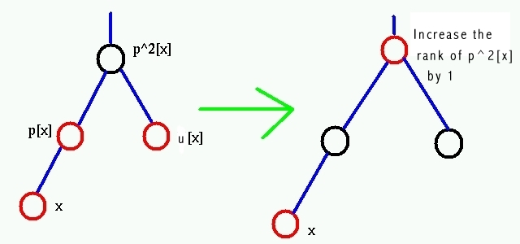
RB Tree: Insertion Algorithm
TreeNode<T> rbInsert(TreeNode<T> root,TreeNode<T> x)
// returns a new root
{
root=bstInsert(root,x); // a modification of BST insertItem
x.setColor(red);
while (x != root and x.getParent().getColor() == red) {
if (x.getParent() == x.getParent().getParent().getLeft()) {
//parent is left child
y = x.getParent().getParent().getRight() //uncle of x
if (y.getColor() == red) {// uncle is red
x.getParent().setColor(black);
y.setColor(black);
x.getParent().getParent().setColor(red);
x = x.getParent().getParent();
} else { // uncle is black
// ................
}
} else
// ... symmetric to if
} // end while
root.setColor(black);
return root;
}

Slide 14
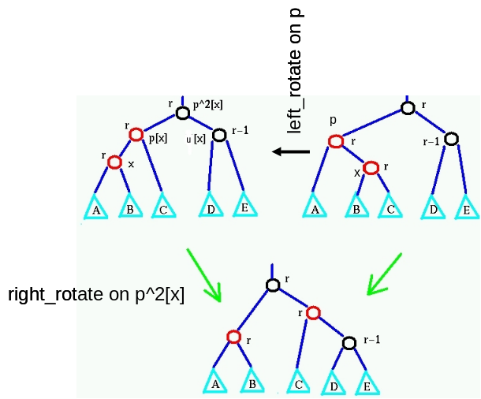
RB Tree: Insertion Algorithm
TreeNode<T> rbInsert(TreeNode<T> root,TreeNode<T> newNode)
// returns a new root
{
root=bstInsert(root,newNode); // a modification of BST insertItem
x.setColor(red);
while (x != root and x.getParent().getColor() == red) {
if (x.getParent() == x.getParent().getParent().getLeft()) {
//parent is left
y = x.getParent().getParent().getRight() //uncle of x
if (y.getColor() == red) {// uncle is red
// ................
} else { // uncle is black
if (x == x.getParent().getRight()) {
x = x.getParent();
root = left_rotate(root,x);
}
x.getParent().setColor(black);
x.getParent().getParent().setColor(red);
root = right_rotate(root,x.getParent().getParent());
}
} else
// ... symmetric to if
} // end while
root.setColor(black);
return root;
}

Slide 15
Red-black Tree Deletion
First use the standard BST tree deletion algorithm
  If the node to be deleted is replaced by its successor/predecessor (if it has two non-null children), consider the deleted node’s data as being replaced by it’s successor/predecessor's, and its color remaining the same
    The successor/predecessor node is then removed
Let y be the node to be removed
If the removed node was red, no property could get violated, so just remove it.
Otherwise, remove it and call the tree-fix algorithm on y’s child x (the node which replaced the position of y)
  Remember, the removed node can have at most one real (non-null) child
  If it has one real child, call the tree-fix algorithm on it
  If it has no real children (both children are null), Note that this child may be a (black) pretend (null) child

Slide 16
Fixing a red-black Tree
The tree-fix algorithm considers the parameter (x) as having an “extra” black token
  This corrects the violation of property 4 caused by removing a black node
If x is red, just color it black
But if x is black then it becomes “doubly black”
  This is a violation of property 1
  The extra black token is pushed up the tree until
    a red node is reached, when it is made black
    the root node is reached or
    it can be removed by rotating and recoloring

Slide 17
Deletion Example 1
Delete 87
47
32
71
65
87
82
93

Slide 18
Deletion Example 1
Delete 87
47
32
71
65
87
82
Replace data with predecessor
Predecessor red: no violation
82
93

Slide 19
Deletion Example 2
Delete 71
47
32
71
65
87
51
82
93

Slide 20
Deletion Example 2
Delete 71
47
32
71
65
65
87
Replace with predecessor
Attach predecessor’s child
51
82
93

Slide 21
Deletion Example 2
Delete 71
47
32
65
87
Replace with predecessor
Attach predecessor’s child
Fix tree by coloring predecessor’s child black
51
51
82
93

Slide 22
Deletion Example 3
Delete 32
47
32
71
65
87
82
93

Slide 23
Deletion Example 3
Delete 32
47
32
x
71
x
65
87
Identify x – the removed node’s left child
Remove target node
Attach x to parent of target
82
93

Slide 24
Deletion Example 3
Delete 32
47
x
71
65
87
Identify x – the removed node’s left child
Remove target node
Attach x to parent of target
82
93
Call rbTreeFix on x

Slide 25
RB Tree Deletion Algorithm
TreeNode<T> rbDelete(TreeNode<T> root,TreeNode<T> z)
//return new root, z contains item to be deleted
{
TreeNode<T> x,y;
// find node y, which is going to be removed
if (z.getLeft() == null || z.getRight() == null)
y = z;
else {
y = successor(z); // or predecessor
z.setItem(y.getItem); // move data from y to z
}
// find child x of y
if (y.getRight() != null)
x = y.getRight();
else
x = y.getLeft();
// Note x might be null; create a pretend node
if (x == null) {
x = new TreeNode<T>(null);
x.setColor(black);
}

Slide 26
RB Tree Deletion Algorithm
x.setParent(y.getParent()); // detach x from y
if (y.getParent() == null)
// if y was the root, x is a new root
root = x;
else
// Atttach x to y’s parent
if (y == y.getParent().getLeft()) // left child
y.getParent().setLeft(x);
else
y.getParent().setRight(x);
if (y.getColor() == black)
root=rbTreeFix(root,x);
if (x.getItem() == null) // x is a pretend node
if (x==x.getParent().getLeft())
x.getParent().setLeft(null);
else
x.getParent().setRight(null);
return root;
}

Slide 27
Deletion Example 3 (continued)
After deleting 32, x is a node with black token
47
47
y
x
71
71
65
87
Identify y, x’s sibling
Make y black and y’s parent red
82
93
Left rotate x’s parent

Slide 28
Deletion Example 3
After deleting 32, x is a node with black token
y
71
47
87
x
new y
65
82
93
Identify y, x’s sibling
Make y black and y’s parent red
Left rotate x’s parent
Identify y – x’s new sibling

Slide 29
Deletion Example 3
After deleting 32, x is a node with black token
71
new x
47
47
87
x
y
65
65
82
93
Identify y, x’s sibling
Make y black and y’s parent red
Left rotate x’s parent
Identify y – x’s new sibling
Color y red
Assign x it’s parent, and color it black

Slide 30
Tree Fix algorithm cases: case (1) x is red
The simplest case
x has a black token and is colored red, so just color it black and remove token a we are done!
In the remaining cases, assume x is black (and has the black token, i.e., it’s double black)

Slide 31
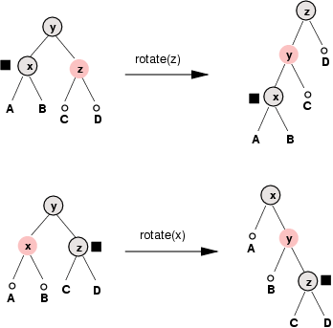
Tree Fix algorithm cases: case (2) x’s sibling is red
Colors of y and z
were swapped
Left_rotate(y)
Colors of x and y
were swapped
Right_rotate(y)
Remarks:
the roots of subtrees C and D are black
the second is the symmetric case, when x is the right child
in the next step (case (3) or (4)) the algorithm will finish!

Slide 32
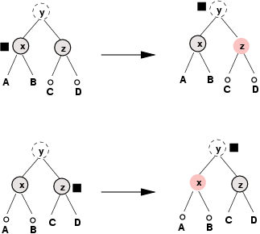
Tree Fix algorithm cases: case (3) x’s sibling is black and both nephews are black
Remarks:
nephews are roots of subtrees C and D
the black token is passed one level up

Slide 33
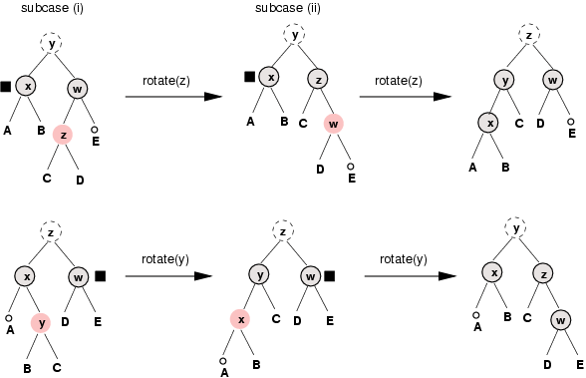
Tree Fix algorithm cases: case (4) x’s sibling is black and at least one nephew is red
Right_rotate(w)
Left_rotate(y)
Colors of y and z
were swapped.
Far nephew is
colored black and
black token is removed.
Colors of z and w
were swapped
Left_rotate(x)
Right_rotate(z)
Colors of z and y
were swapped.
Far nephew is
colored black and
black token is removed.
Colors of x and y
were swapped
Remarks:
in this case, the black token is removed completely
if the “far” nephew is black (subcase (i)), rotate its parent, so that a new “far” nephew is red; otherwise start in subcase(ii)

Slide 34
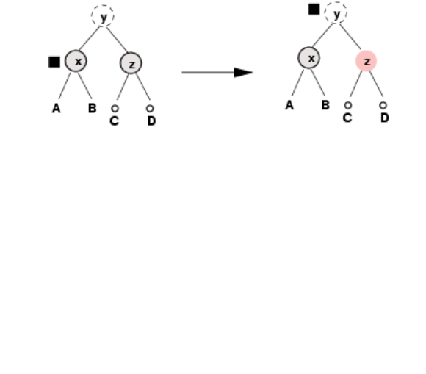
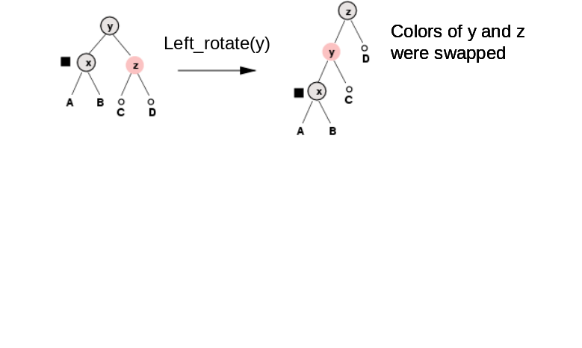
Tree Fix Algorithm
TreeNode<T> rbTreeFix(TreeNode<T> root,TreeNode<T> x)
//return new root; x is a node with the black token
{
while (x != root && x.getColor() == black) // not case (1)
if (x == x.getParent().getLeft()) { // x is left child
y = x.getParent().getRight(); // y is x’s sibling
if (y.getColor() == red) { // case (2)
y.setColor(black);
x.getParent().setColor(red); // p was black
root = left_rotate(root,x.getParent());
y = x.getParent().getRight(); // new sibling
}
if (y.getLeft().getColor() == black &&
y.getRight().getColor() == black) {
// nephews are black - case (3)
y.setColor(red);
x = x.getParent();
} else { // case (4)
// ..........
}
} else {
… // x is right child - symmetric
}
// end while loop
x.setColor(black);
return root;
}

Slide 35
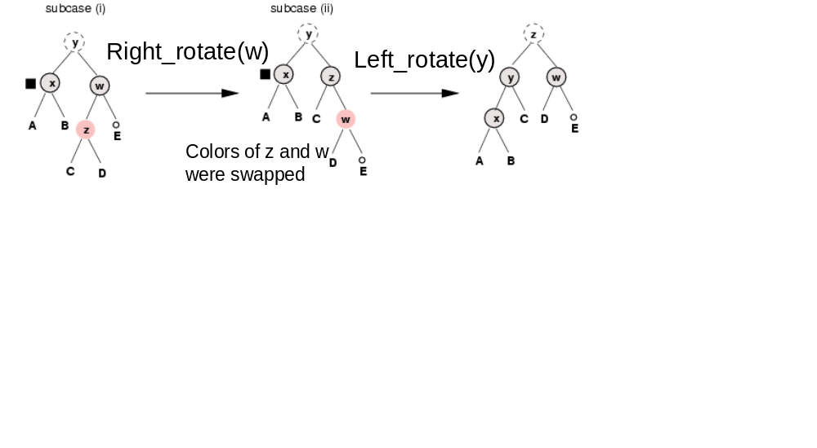
Tree Fix Algorithm (continued)
} else { // case (4)
if (y.getRight().getColor() == black) {
// subcase (i)
y.getLeft().setColor(black);
y.setColor(red);
root = right_rotate(root,y);
y = x.getParent().getRight();
}
// subcase (ii)
y.setColor(x.getParent().getColor());
x.getParent().setColor(black);
y.getRight().setColor(black);
root = left_rotate(root, x.getParent());
x = root; // we can finish
}

Slide 36
RB Trees efficiency
All operations work in time O(height)
and we have proved that heigh is O(log n)
hence, all operations work in time O(log n)! – much more efficient than linked list or arrays implementation of sorted list!
Sorted List | Search | Insertion | Deletion
with arrays | O(log n) | O(n) | O(n)
with linked list | O(n) | O(n) | O(n)
with RB trees | O(log n) | O(log n) | O(log n)

