Slide 1
My name // do you have kids ?
How to become a super hero to them
Intro
I’ve been interested in environmental care for a long time
We should stop sending greenhouse emissions to the atmosphere soon (2050, … )
Then I realize about the impact of our diets on it
Did you know that 26% of the total emissions come from agriculture, etc..?
Let’s dive into this
// Streamlit //
Conclusions
Shade because someone planted a tree
Iron man quote: a superhero is his choices

Slide 2
Jonathan Suárez

Slide 3
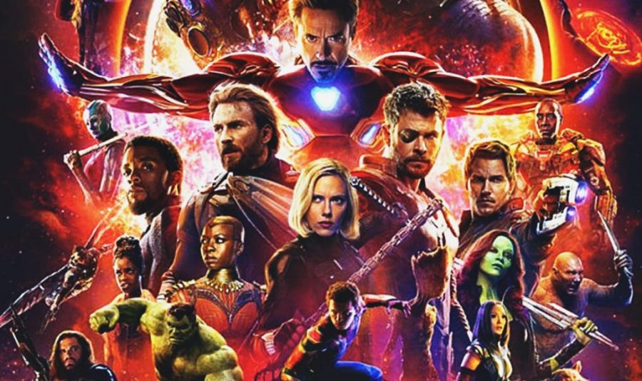
How to become a super hero

Slide 4
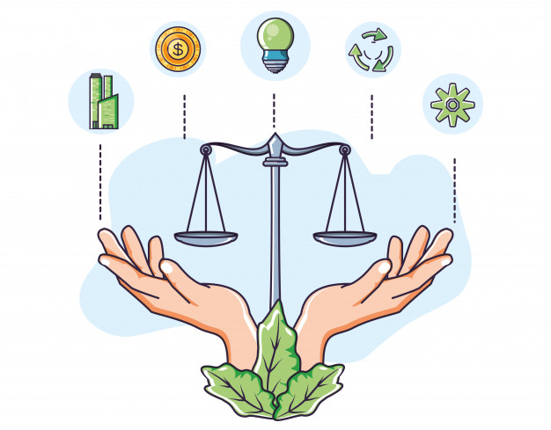

Slide 5
Some facts
26% of global greenhouse gas emissions
Half of the world’s habitable (ice- and desert-free) land
70% of global freshwater withdrawals
78% of global ocean and freshwater eutrophication (the pollution of waterways with nutrient-rich pollutants) is caused by agriculture
94% of mammal biomass (excluding humans) is livestock.
Data source: https://ourworldindata.org/environmental-impacts-of-food?country=#distribution-of-land-use-for-foods

Slide 7
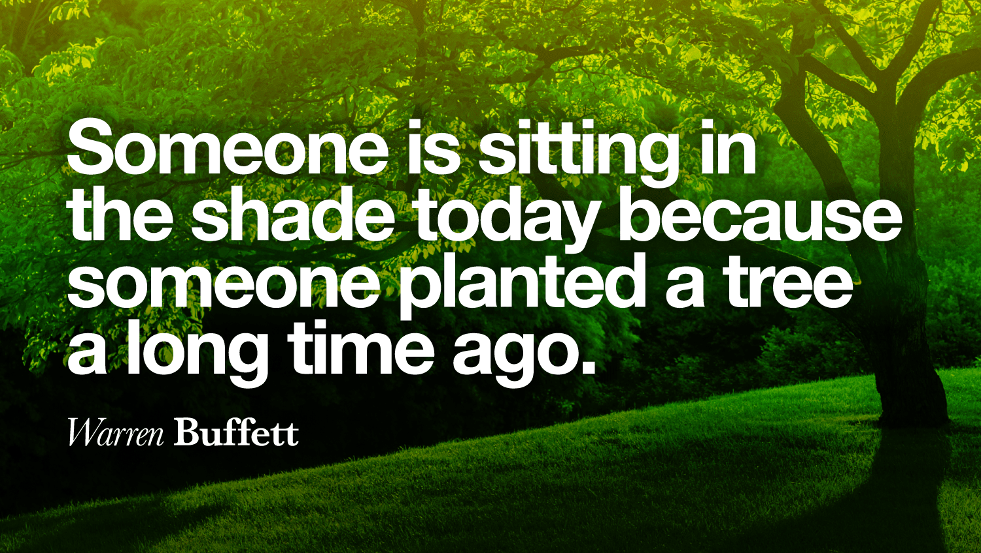

Slide 8
