Slide 1
Jonathan Suárez

Slide 2
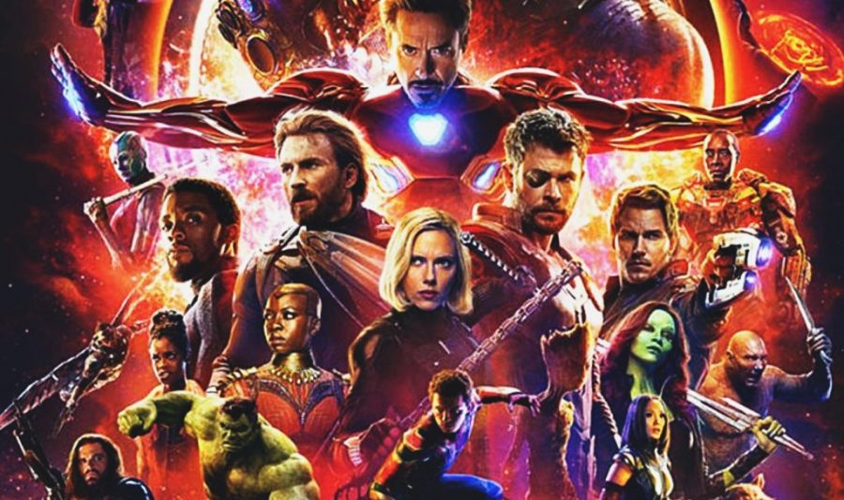
How to become a super hero

Slide 3


Slide 4
Some facts
26% of global greenhouse gas emissions
Half of the world’s habitable (ice- and desert-free) land
70% of global freshwater withdrawals
Data source: https://ourworldindata.org/environmental-impacts-of-food?country=#distribution-of-land-use-for-foods

Slide 5
Is our diet efficient?

Slide 6
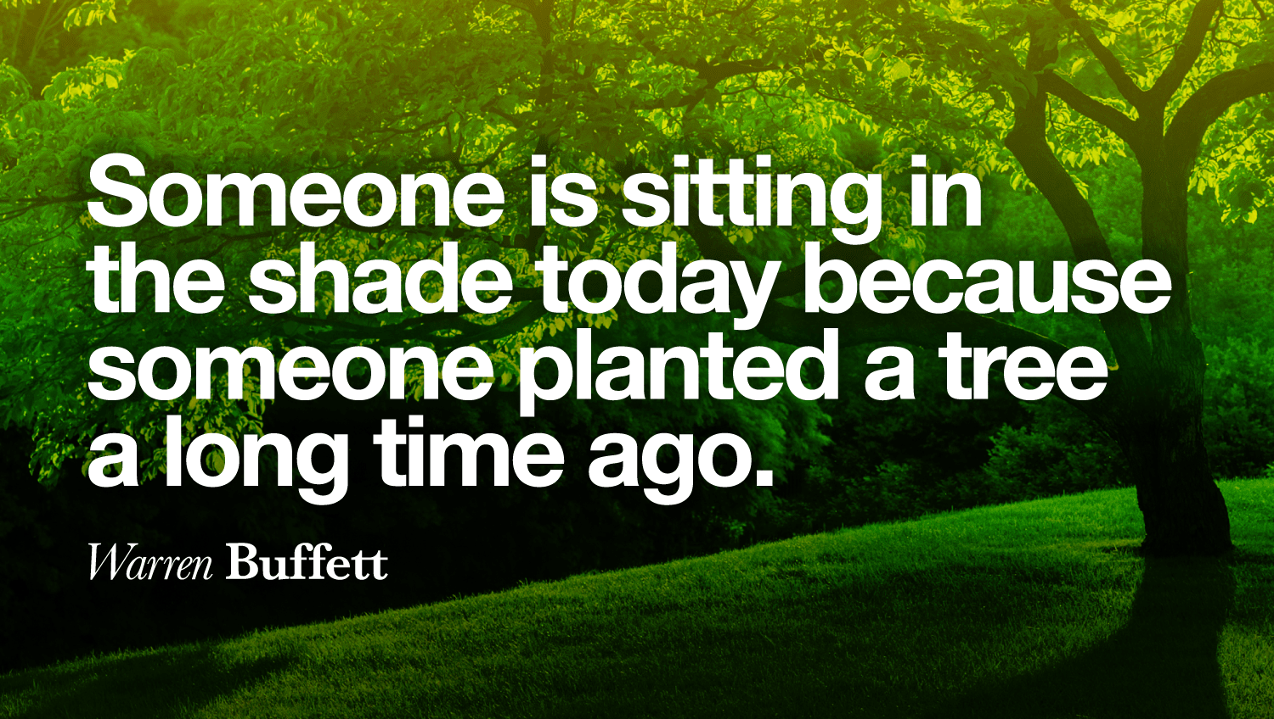

Slide 7
