Slide 1
Computational Solution of A Generalized Orr-Sommerfeld Equation for Active Fluids Under External Shear

Slide 2
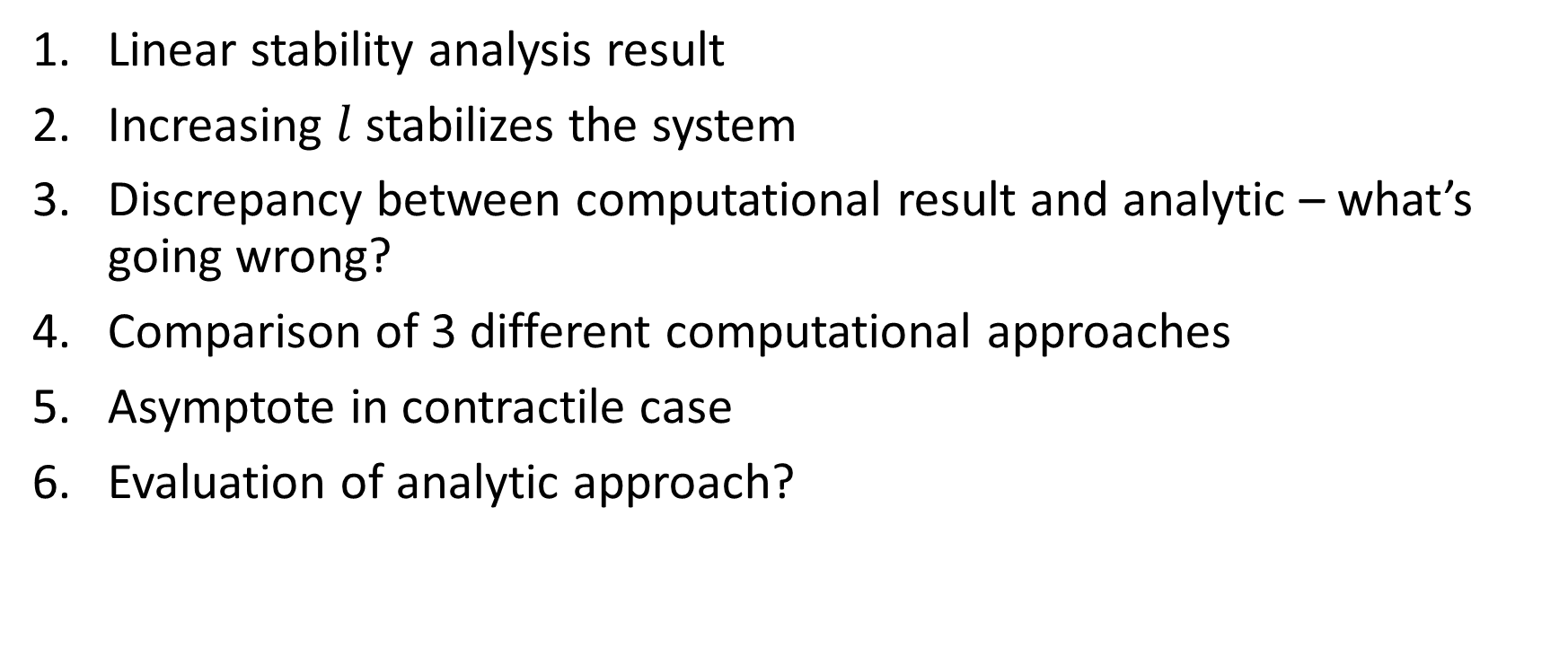
1/18/2023
Linear stability analysis result
Increasing $l$ stabilizes the system
Discrepancy between computational result and analytic – what’s going wrong?
Comparison of 3 different computational approaches
Asymptote in contractile case
Evaluation of analytic approach?

Slide 3
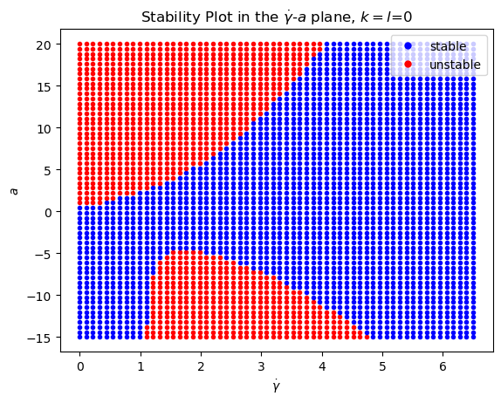
Linear Stability Analysis Result
All other parameters were set to 1

Slide 4
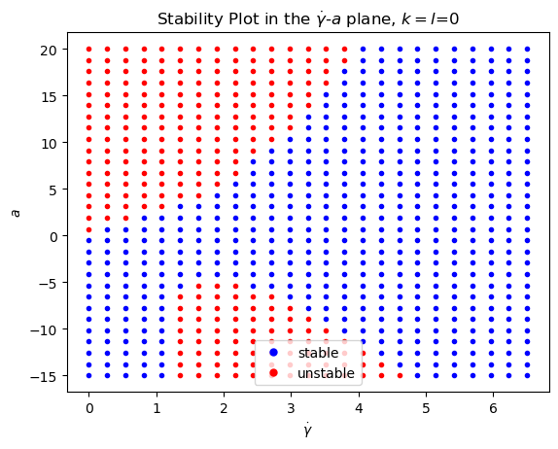
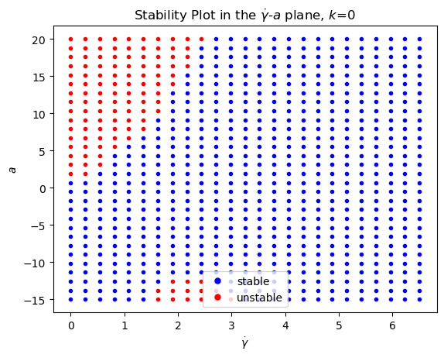



Increasing the correlation length $l$ stabilizes system
$$l^{2}/W^{2}=0$$
$$l^{2}/W^{2}=0.01$$

Slide 5
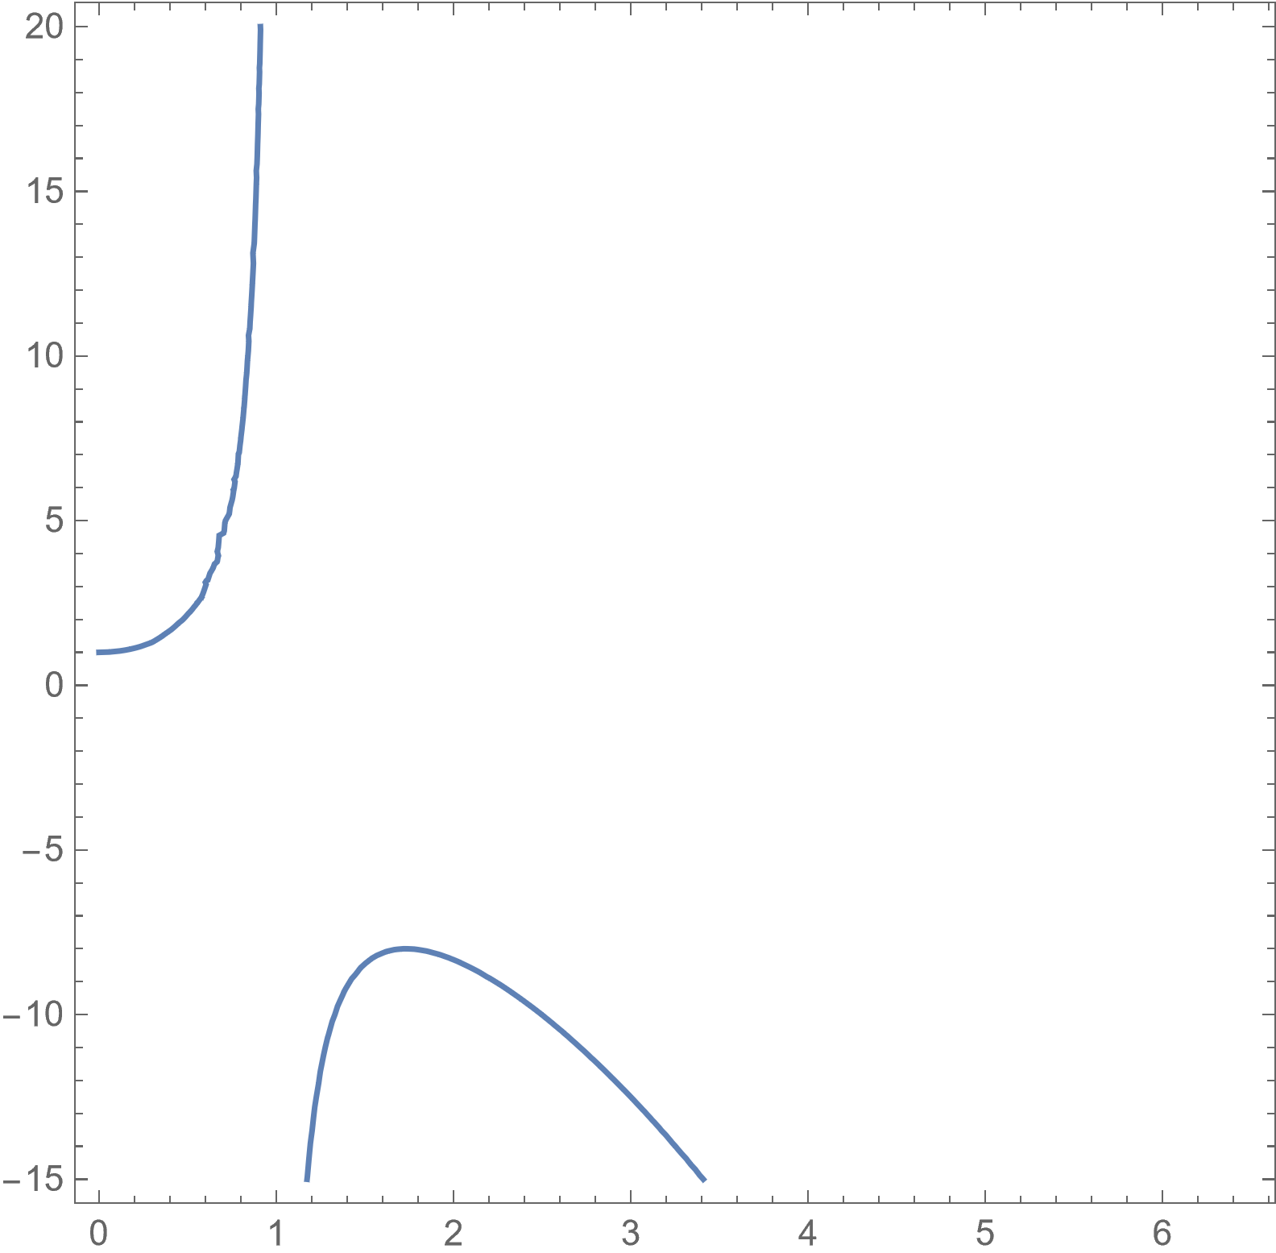
Discrepancy Between Computational and Analytic Results
1. Numerical difference – reasonable
2. Qualitative difference, analytic result predicts asymptote for both extensile and contractile

Slide 6
Comparison of Three Computational Approaches
Set $k=l=0$
Set 𝑘=𝑙=0
Simply ignore all terms with $k$ and $l$
Simply ignore all terms with 𝑘 and 𝑙
Dedalus 2
Looks fine

Slide 7
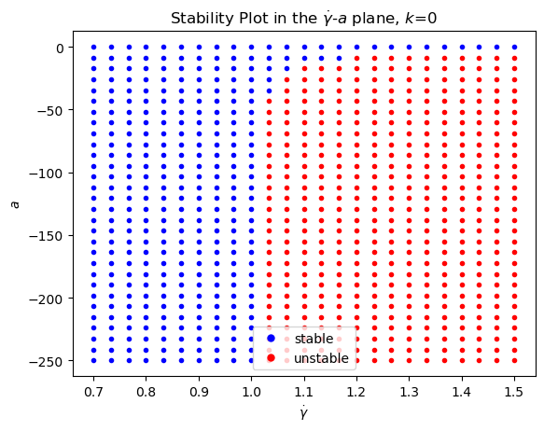
Asymptote in Contractile Case
Does asymptotic behavior at finite shear make sense?

Slide 8
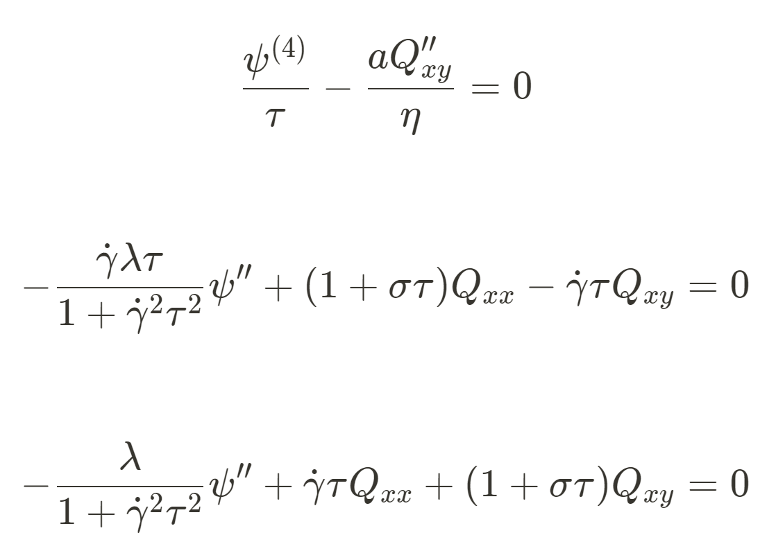

Analytic Approach
If we set $k=0$ and $l=0$, we get these equations

Slide 9
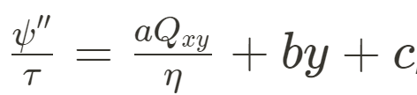
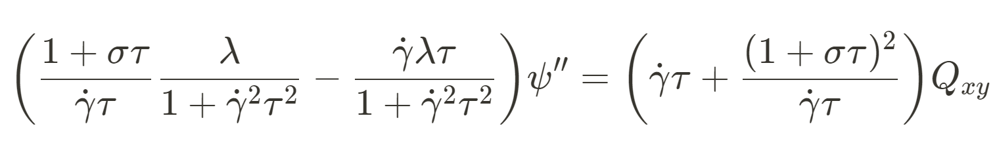
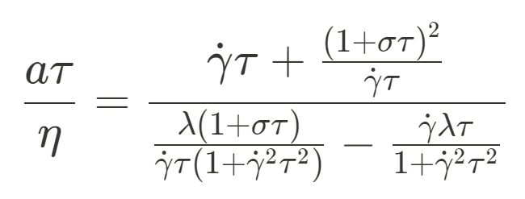
Analytic Approach Cont.
Integrating the first equation gives
We can also eliminate $Q_{xx}$ from the 2nd and 3rd equations to get
Comparing the two equations, conclude that $b=c=0$, and that
Notes:
1/26/2023 Meeting
Plot numerical and analytic results on the same plot
Comparing Dedalus and Alex results
Any other tests for numerical results? Talk to Wan about comparison (Overlap our simulation data)?
Tom and grad students going to MRSEC winter school, can present my slides here – prepare slides so they can use

Slide 10
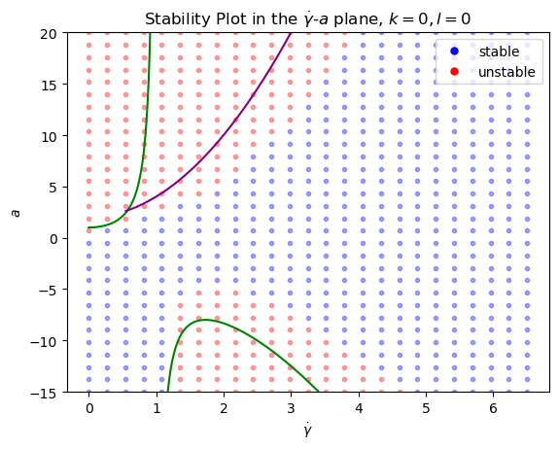
Comparison of Computational and Analytic Results
Analytic results are plotted as curves
Purple: Real part of sigma is 0
Green: Sigma is 0
Computational results are plotted as grid points in the background
Notes:
What accounts for the branching behavior?

Slide 11
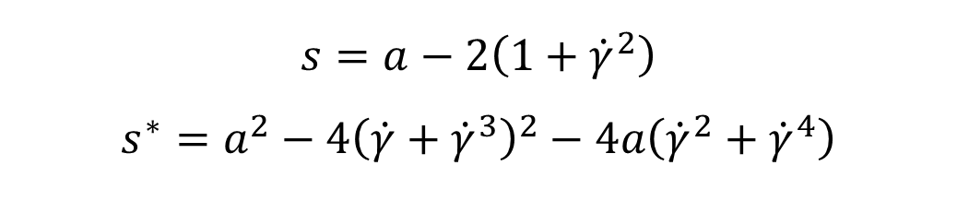
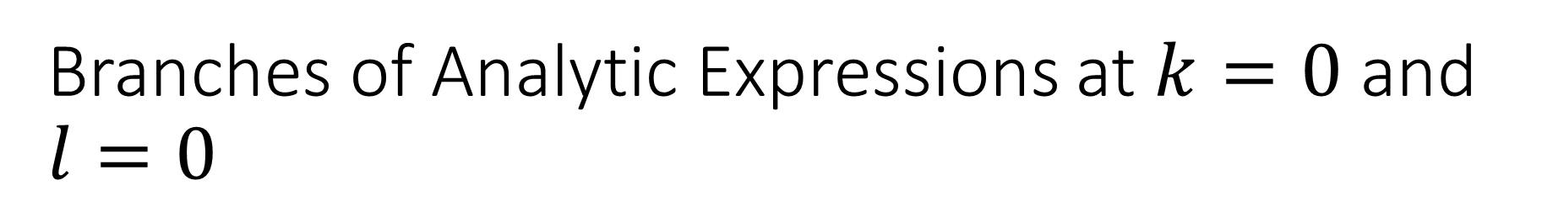

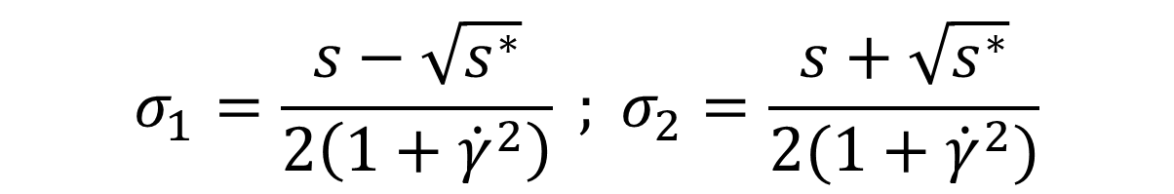
Branches of Analytic Expressions at $k=0$ and $l=0$
$$s=a−2\left(1+{\dot{γ}}^{2}\right)$$
$$s^{∗}=a^{2}−4{\left(\dot{γ}+{\dot{γ}}^{3}\right)}^{2}−4a\left({\dot{γ}}^{2}+{\dot{γ}}^{4}\right)$$
Define:
Then analytic solutions for $σ$ are given by:
$$σ_{1}=\frac{s−\sqrt{s^{∗}}}{2\left(1+{\dot{γ}}^{2}\right)} ; σ_{2}=\frac{s+\sqrt{s^{∗}}}{2(1+{\dot{γ}}^{2})}$$

Slide 12
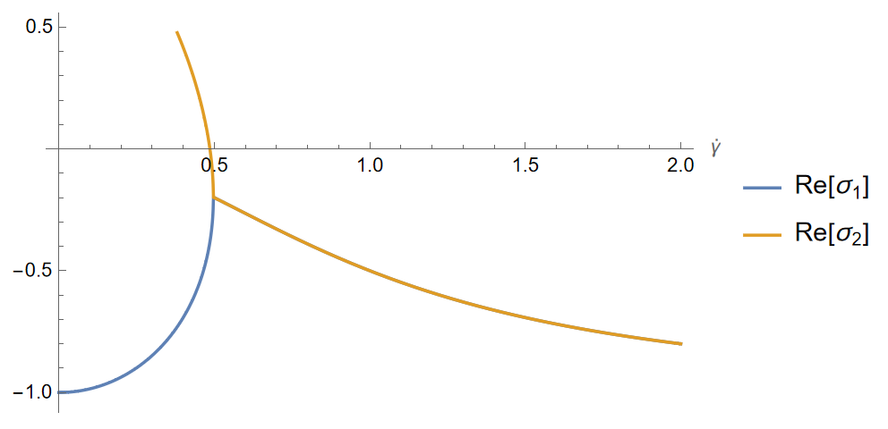

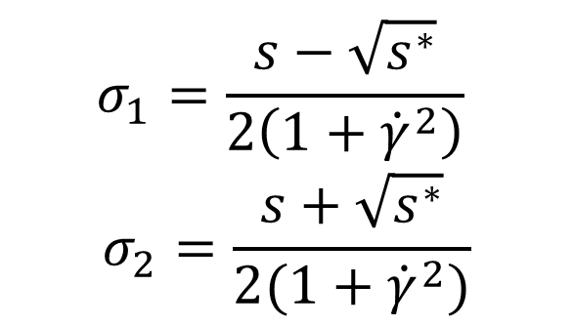
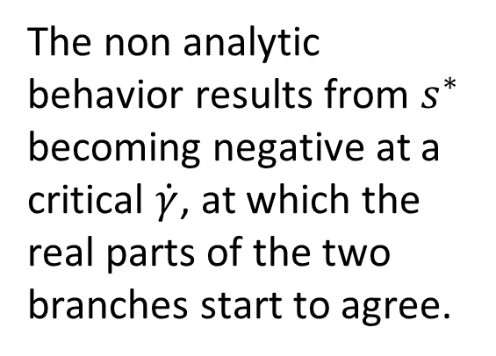
Branches of Analytic Solution Cont.
$$σ_{1}=\frac{s−\sqrt{s^{∗}}}{2\left(1+{\dot{γ}}^{2}\right)}$$
$$σ_{2}=\frac{s+\sqrt{s^{∗}}}{2(1+{\dot{γ}}^{2})}$$
The non analytic behavior results from $s^{∗}$ becoming negative at a critical $\dot{γ}$, at which the real parts of the two branches start to agree.
Representative plot for given $a$
Notes:
Increasing $a$ serves to shift this curve up, after a critical value two zeros can be possible. This accounts for the branching behavior in the extensile case.

Slide 13

The Effects of Varying the $k$ value

Slide 14
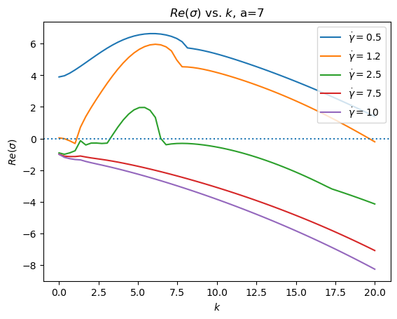

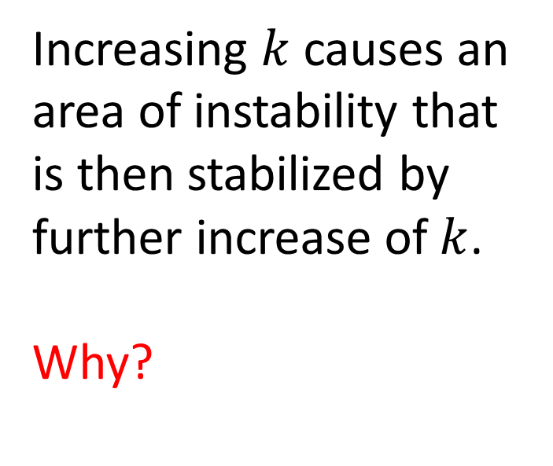
The effect of increasing the perturbation wavevector $k$
Increasing $k$ causes an area of instability that is then stabilized by further increase of $k$.
Why?

Slide 15
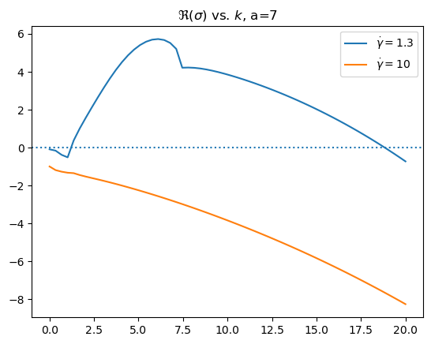
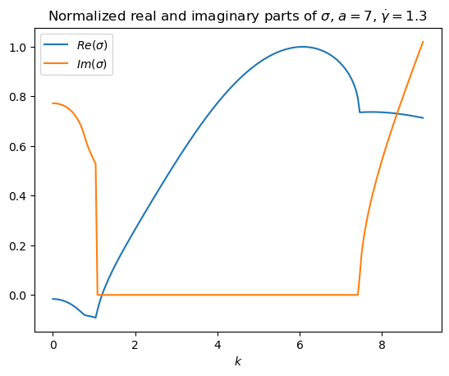
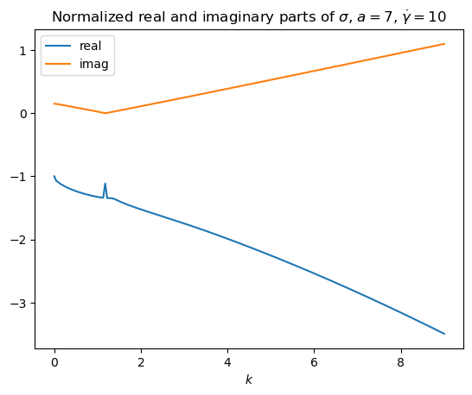

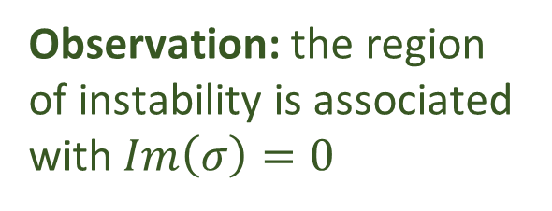
Mathematical Answer: Imaginary Part of the growth rate $σ$
Observation: the region of instability is associated with $Im\left(σ\right)=0$
Notes:
Oops should have changed the colors

Slide 16
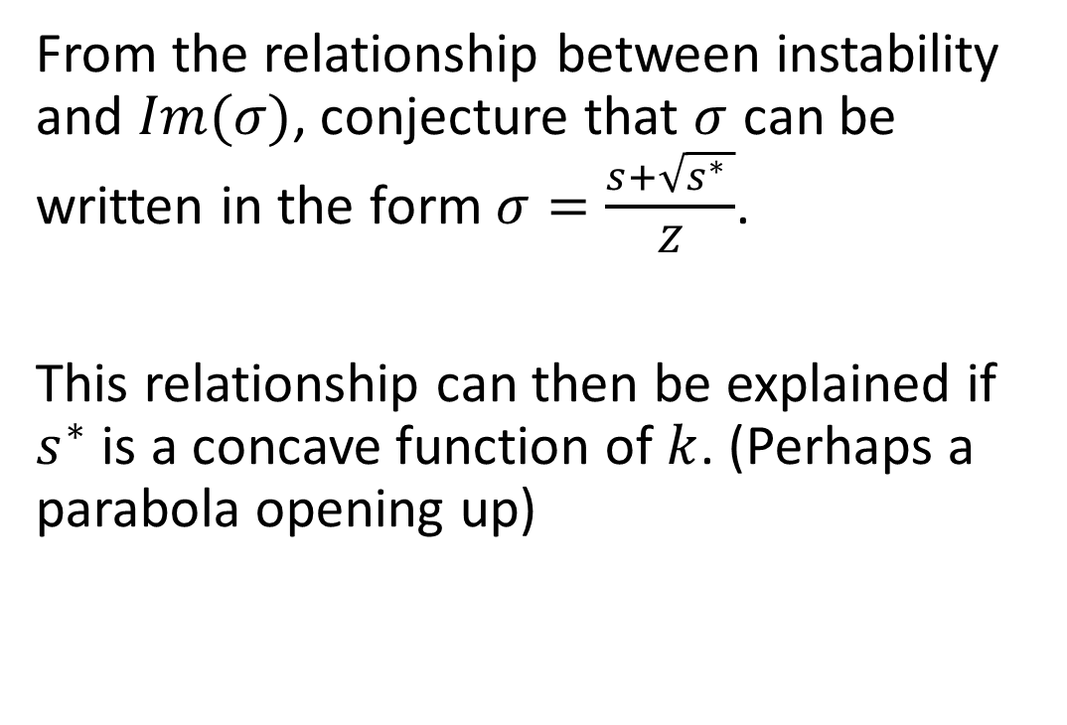
Mathematical Answer Cont.
From the relationship between instability and $Im(σ)$, conjecture that $σ$ can be written in the form $σ=\frac{s+\sqrt{s^{∗} }}{Z}$.
This relationship can then be explained if $s^{∗}$ is a concave function of $k$. (Perhaps a parabola opening up)

Slide 17

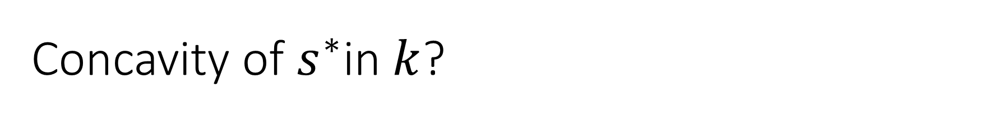



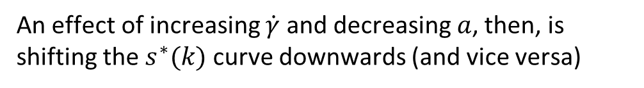
Concavity of $s^{∗}$in $k$?
$s^{∗}≥0, Im(σ)$=0, and $\sqrt{s^{∗}}$ is contributing to $Re(σ)$
$$s^{∗}$$
$$k$$
$Im\left(σ\right)>0$ and increasing
An effect of increasing $\dot{γ}$ and decreasing $a$, then, is shifting the $s^{∗}(k)$ curve downwards (and vice versa)
$Im\left(σ\right)>0$ and decreasing

Slide 18
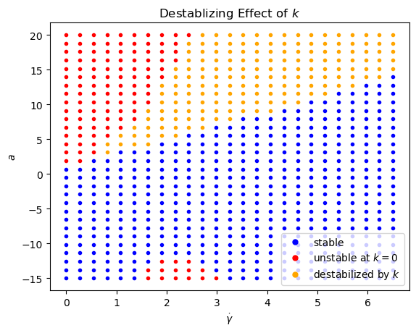

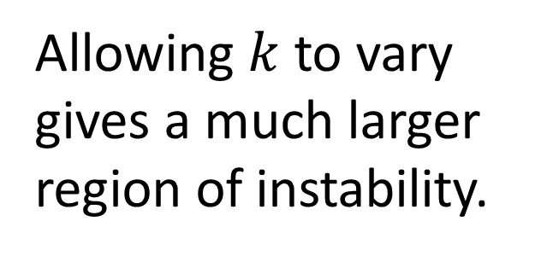

Computational Analysis of Varying $k$
Allowing $k$ to vary gives a much larger region of instability.
$k$ was allowed to vary in the interval $[0,20]$.

Slide 19
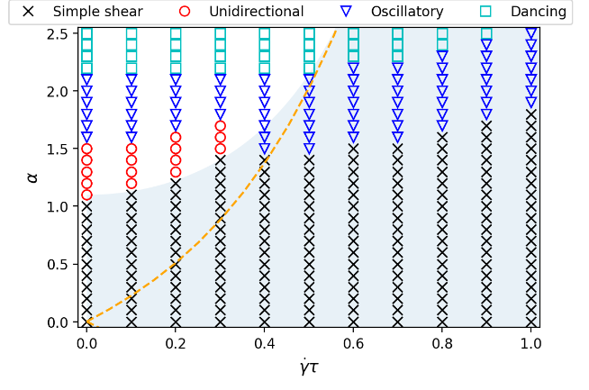
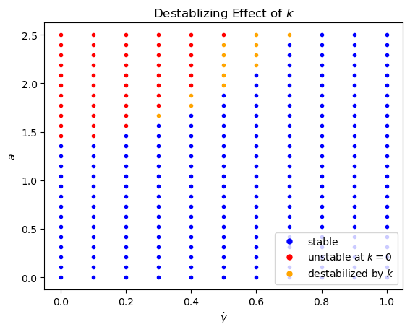

Zoomed-in Comparison of the Extensile Case
There is a discrepancy at $\dot{γ}=0$…

Slide 20
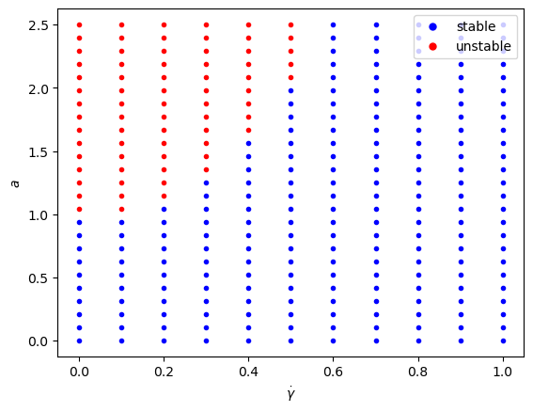
(NEW) Dedalus Results Agree
Conclusion: Might want to use Dedalus for zoomed-in plots

Slide 21
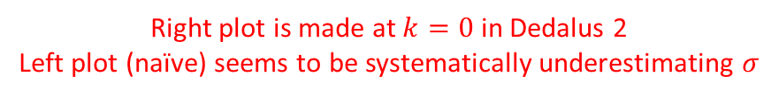
Comparing Dedalus and Naïve Results
Right plot is made at $k=0$ in Dedalus 2
Left plot (naïve) seems to be systematically underestimating $σ$

Slide 22
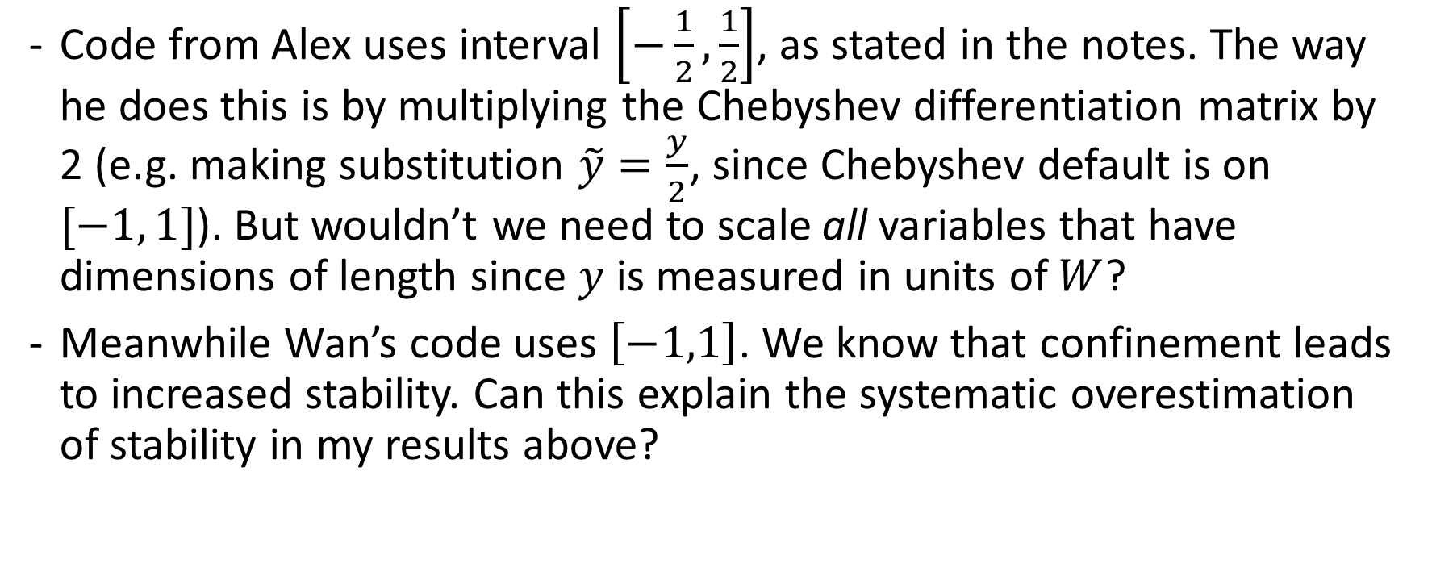
Some Questions
Code from Alex uses interval $\left[−\frac{1}{2},\frac{1}{2}\right]$, as stated in the notes. The way he does this is by multiplying the Chebyshev differentiation matrix by 2 (e.g. making substitution $\tilde{y}=\frac{y}{2}$, since Chebyshev default is on $[−1, 1]$). But wouldn’t we need to scale all variables that have dimensions of length since $y$ is measured in units of $W$?
Meanwhile Wan’s code uses $\left[−1,1\right]$. We know that confinement leads to increased stability. Can this explain the systematic overestimation of stability in my results above?

Slide 23
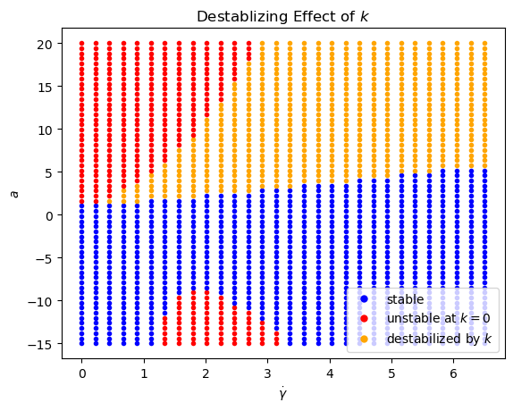

Comparison of $[−\frac{1}{2},\frac{1}{2}]$ Results and $[−1,1]$ Results

Slide 24
Three Dimensions

Slide 25
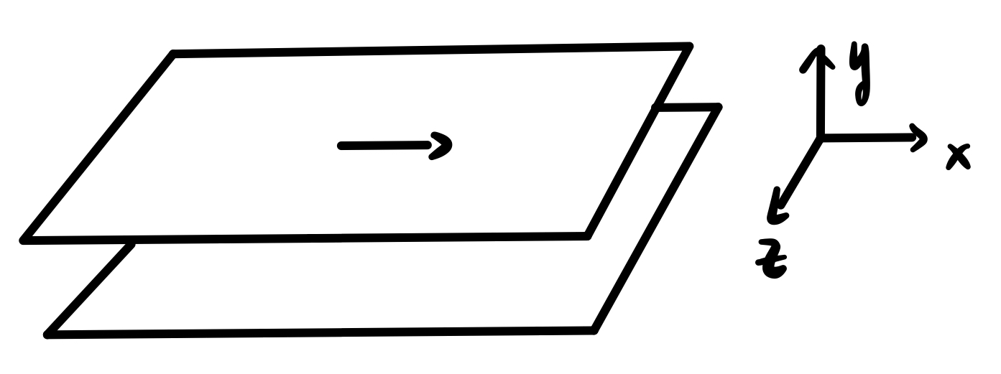
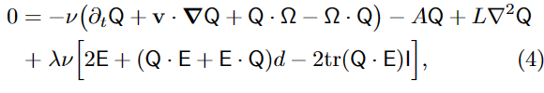
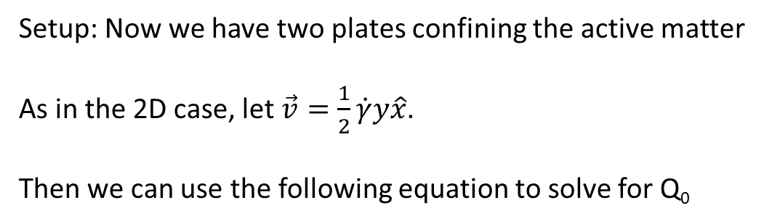
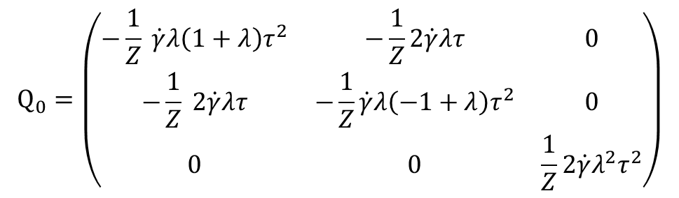

Base State Q
Setup: Now we have two plates confining the active matter
As in the 2D case, let $\vec{v}=\frac{1}{2}\dot{γ}y\hat{x}$.
Then we can use the following equation to solve for Q₀
$${\text{Q}}_{0}=\left(\begin{matrix}−\frac{1}{Z} \dot{γ}λ\left(1+λ\right)τ^{2} & −\frac{1}{Z}2\dot{γ}λτ & 0 \\ −\frac{1}{Z} 2\dot{γ}λτ & −\frac{1}{Z}\dot{γ}λ\left(−1+λ\right)τ^{2} & 0 \\ 0 & 0 & \frac{1}{Z}2\dot{γ}λ^{2}τ^{2}\end{matrix}\right)$$
Define $Z=−4+γd2 (−1+3 λ2) τ2$, then

Slide 26
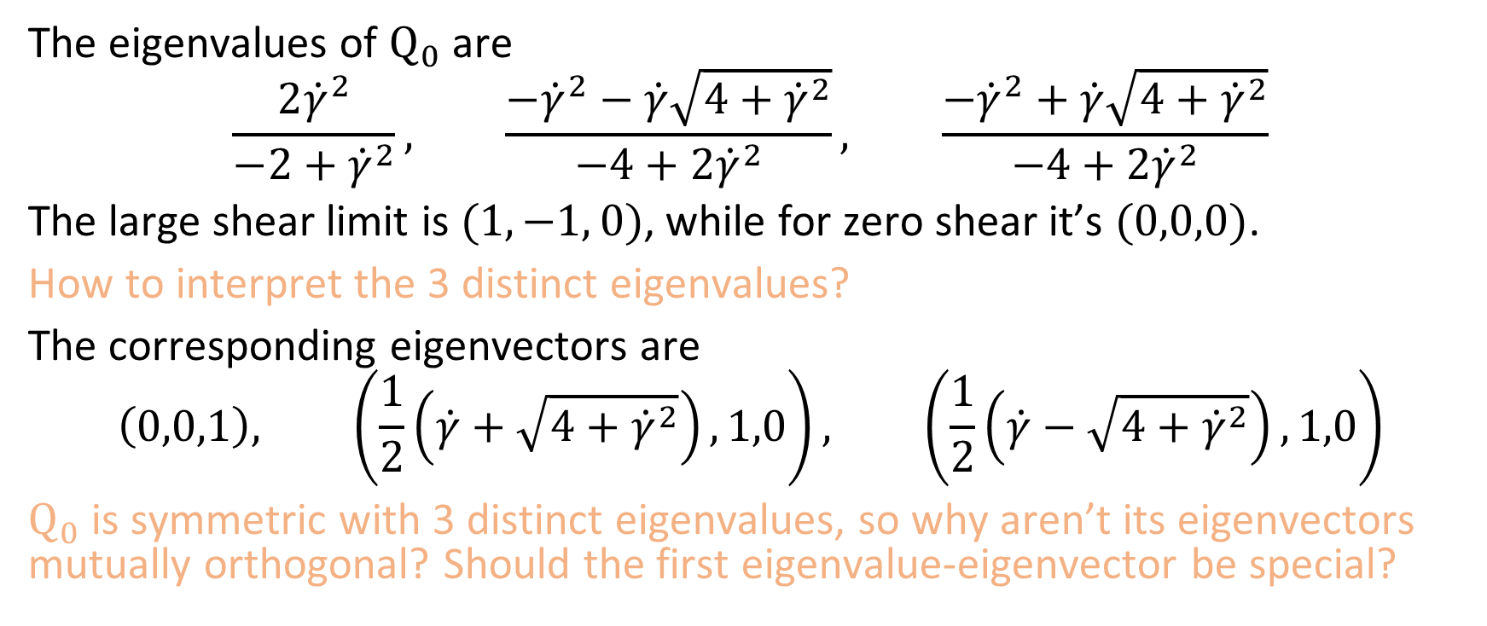
Base Q Continued
The eigenvalues of ${\text{Q}}_{0}$ are
$$\frac{2{\dot{γ}}^{2}}{−2+{\dot{γ}}^{2}}, \frac{−{\dot{γ}}^{2}−\dot{γ}\sqrt{4+{\dot{γ}}^{2}}}{−4+2{\dot{γ}}^{2}}, \frac{−{\dot{γ}}^{2}+\dot{γ}\sqrt{4+{\dot{γ}}^{2}}}{−4+2{\dot{γ}}^{2}}$$
The large shear limit is $(1, −1, 0)$, while for zero shear it’s $(0,0,0)$.
How to interpret the 3 distinct eigenvalues?
The corresponding eigenvectors are
$$\left(0,0,1\right), \left(\frac{1}{2}\left(\dot{γ}+\sqrt{4+{\dot{γ}}^{2}}\right),1,0\right), \left(\frac{1}{2}\left(\dot{γ}−\sqrt{4+{\dot{γ}}^{2}}\right),1,0\right)$$
${\text{Q}}_{0}$ is symmetric with 3 distinct eigenvalues, so why aren’t its eigenvectors mutually orthogonal? Should the first eigenvalue-eigenvector be special?

Slide 27
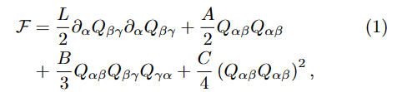
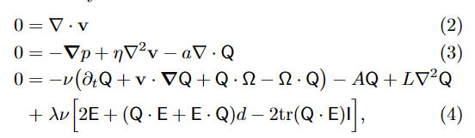

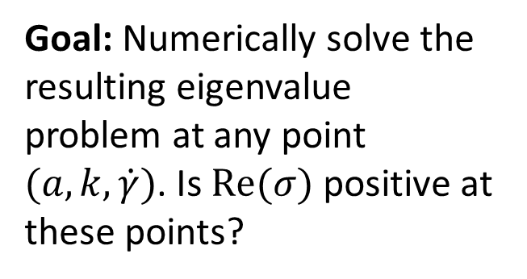
Review of Progress 8/10/2023
Free Energy
Goal: Numerically solve the resulting eigenvalue problem at any point $(a,k,\dot{γ})$. Is $Re(σ)$ positive at these points?
Hydrodynamic Model
2D Perturbation
Notes:
k in [0,20]

Slide 28
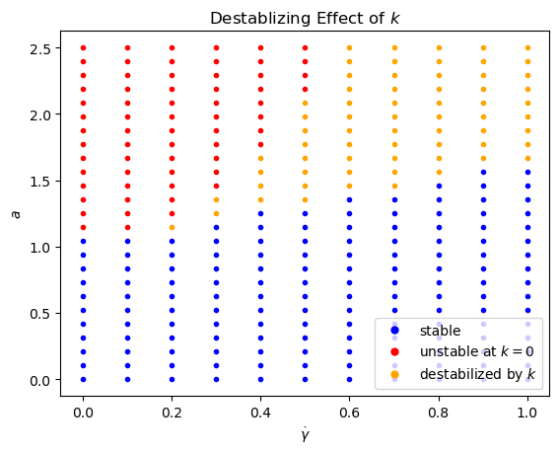
Review of Progress
Full implementation of Chebyshev spectral methods for 2D perturbation
Notes:
Something to say: The red points are unstable at k=0, but the yellow points are unstable at a non-zero k – this shows that the method captures the stabilizing effect of shear.
k in [0,20]

Slide 29
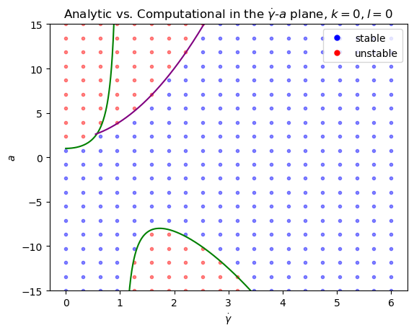
Review of Progress
Validation Against Analytical Result at k=0 and l=0
Notes:
We have good agreement with analytical results in this limiting case.

Slide 30
Review of Progress
How k destabilizes the 2D system
Notes:
Here’s an example of how shear stabilizes the system by suppressing the largest wavelength deformations

Slide 31
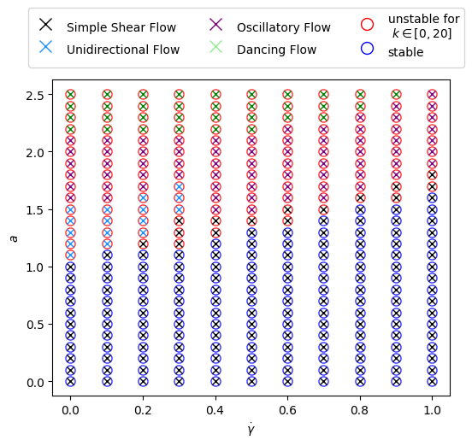
Review of Progress
Comparison with Wan’s results using finite-length channels
Circle – Infinite Channel Length
Cross – Finite Channel Length (From Wan’s paper)

Slide 32
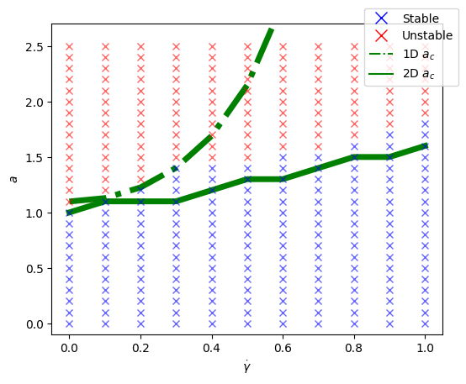
Review of Progress
Comparison with Wan’s full nonlinear solutions with finite-length channels
Notes:
The selling point is that the qualitative behavior is captured by Chebyshev, while the computation time is orders of magnitude smaller (? Need confirmation on this)

Slide 33
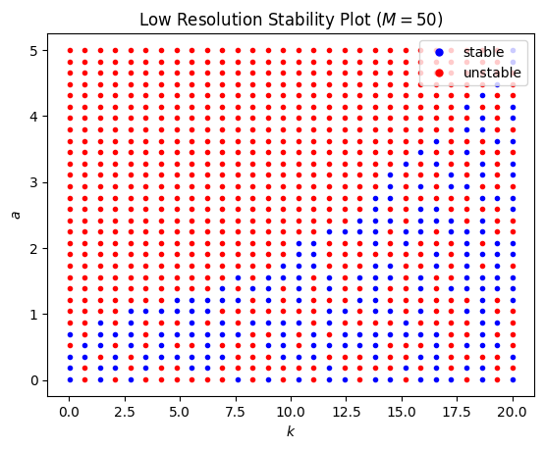
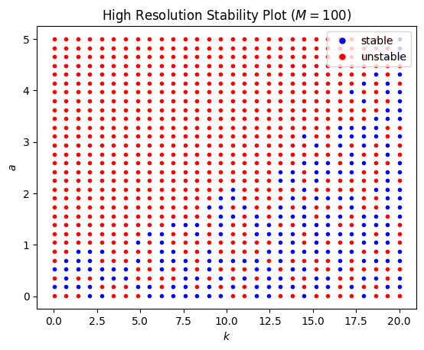
Review of Progress
Noise in the zero-shear 3D implementation and its resolution
M = Number of Chebyshev grid points used in spectral method
Notes:
The noise could be coming from how large and sparse the matrices are. Dawkins et al. (1998) suggests that these unusually large spurious eigenvalues are approximations to infinite eigenvalues of nearby solutions. Perhaps, somehow, the larger, sparser matrix promotes this approximation behavior. (More numerical error?)

Slide 34
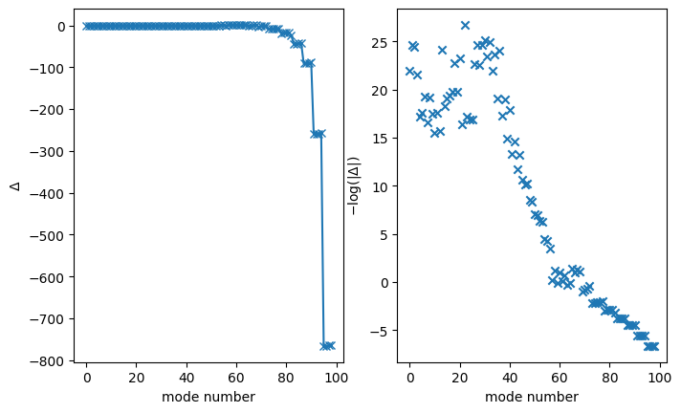

Review of Progress
Result
Particular example of how spectra computed from M=50 and M=100 Chebyshev grid points can disagree
Attempt at Solution
Compute the spectrum with two (or more) values of Chebyshev grid point number M
Sort* both spectra in descending order by the real parts of eigenvalues
Iterate over the two sorted lists from the start. Accept only eigenvalues that are present in both spectra
* Instead of sorting, we can also just do a simple quadratic search over the two spectra. This method is used because it runs more efficiently in O(nlogn).
If it does make an error, we know that this solution results in overestimation of the stable region

Slide 35

Comparison Between 2D and 3D Critical Activities at Zero Shear
Probably need to compute
at finer resolution to better see the behavior of 2D vs. 3D
Should these agree this well?
What is going on here?

Slide 36



Instabilities at 2D and 3D
What are the effects of the term that vanishes in 2D but not 3D?

Slide 37


Instabilities in 2D and 3D

Slide 38






$k_{z}≠0$ leads to numerical instability in 3D calculation
Recall: Perturbation is of the form $\vec{v}\left(x,y,z,t\right)=\left(v_{x}\left(y\right),v_{y}\left(y\right), v_{z}\left(y\right)\right)∗\exp{(k_{x}x+k_{z}z+σt)}$
$$k_{x}=1.6 \left| \dot{γ}=0.6 \right| a=1.0$$
$$k_{z}=0.0$$
$$k_{z}=0.1$$

Slide 39




A Full 3D Calculation at $k_{z}=0$
Imposing shear destabilizes the system, in contrast to 2D

Slide 40


New comparison using appropriate $l^{2}/W^{2}$
Note the disagreement at small shear values
Notes:
Intuitively, what the correlation is at zero shear should not matter?

