Slide 1

Shared Counters and Parallelism
Companion slides for
The Art of Multiprocessor Programming
by Maurice Herlihy & Nir Shavit

Slide 2
A Shared Pool
public interface Pool {
public void put(Object x);
public Object remove();
}
Unordered set of objects
Put
  Inserts object
  blocks if full
Remove
  Removes & returns an object
  blocks if empty
Notes:
A pool is a set of objects. The pool interface provides Put() and Remove() methods that respectively insert and remove items from the pool. Familiar classes such as stacks and queues can be viewed as pools that provide additional ordering guarantees.

Slide 3
Simple Locking Implementation
put
put
Notes:
One natural way to implement a shared pool is to have each method lock the pool, perhaps by making both Put() and Remove() synchronized methods.

Slide 4
Simple Locking Implementation
put
Problem: hot-spot contention
put
Notes:
The problem, of course, is that such an approach is too heavy-handed, because the lock itself would become a hot-spop. We would prefer an implementation in which Pool methods could work in parallel.

Slide 5
Simple Locking Implementation
put
Problem: hot-spot contention
put
Problem: Counter is sequential bottleneck
Notes:
A second problem is whether it is even possible to do counting in parallel.

Slide 6
Simple Locking Implementation
Solution: Queue Lock
put
Problem: hot-spot contention
put
Problem: sequential bottleneck
Notes:
The memory contention problem can be solved by using a scalable lock, such as one of the queue locks studied earlier.

Slide 7
Simple Locking Implementation
Solution: Queue Lock
put
Problem: hot-spot contention
put
Problem: sequential bottleneck
Solution???
Notes:
We are still faced with a much harder problem: can we parallelize counting, is is counting inherently sequential?

Slide 8
Counting Implementation
put
19
19
20
remove
20
21
21
Notes:
Consider the following alternative. The pool itself is an array of items, where each array element either contains an item, or is \Jnull. We route threads through two GetAndIncrement() counters. Threads calling Put() increment one counter to choose an array index into which the new item should be placed. (If that slot is full, the thread waits until it becomes empty.) Similarly, threads calling Remove() increment another counter to choose an array index from which the new item should be removed. (If that slot is empty, the thread waits until it becomes full.)

Slide 9
Counting Implementation
put
19
19
20
remove
20
21
21
Only the counters are sequential
Notes:
This approach replaces one bottleneck, the lock, with two, the counters. Naturally, two bottlenecks are better than one (think about that claim for a second). But are shared counters necessarily bottlenecks? Can we implement highly-concurrent shared counters?

Slide 10
Shared Counter
0
1
3
2
3
2
1
Notes:
The problem of building a concurrent pool reduces to the problem of building a concurrent counter. But what do we mean by a couner?

Slide 11
Shared Counter
No duplication
0
1
3
2
3
2
1
Notes:
Well, first, we want to be sure that two threads never take the same value.

Slide 12
Shared Counter
No duplication
No Omission
0
1
3
2
3
2
1
Notes:
Second, we want to make sure that the threads do not collectively skip a value.

Slide 13
Shared Counter
No duplication
No Omission
0
1
3
2
3
2
1
Not necessarily linearizable
Notes:
Finally, we will not insist that counters be linarizable. Later on, we will see that linearizable counters are much more expensive than non-linearizable counters. You get what you pay for, and you pay for what you get.

Slide 14
Shared Counters
Can we build a shared counter with
  Low memory contention, and
  Real parallelism?
Locking
  Can use queue locks to reduce contention
  No help with parallelism issue …
Notes:
We face two challenges.
Can we avoid memory contention, where too many threads try to access the same
memory location, stressing the underlying communication network and cache
coherence protocols?
Can we achieve real parallelism? Is incrementing a counter an inherently sequential operation, or is it possible for $n$ threads to increment a counter in time less than it takes for one thread to increment a counter $n$ times?

Slide 15
Software Combining Tree
4
Contention:
All spinning local
Parallelism:
Potential n/log n speedup
Notes:
A combining tree is a tree of nodes, where each node contains bookkeeping information. The counter's value is stored at the root. Each thread is assigned a leaf, and at most two threads share a leaf. To increment the counter, a thread starts at its leaf, and works its way up the tree to the root. If two threads reach a node at approximately the same time, then they combine their increments by adding them together. One thread, the first thread, propagates their combined increments up the tree, while the other, second thread, waits for the first thread to complete their combined work..

Slide 16
Combining Trees
0
Notes:
Here, the counter is zero, and the blue and yellow processors are about to add to the counter.

Slide 17
Combining Trees
0
+3
Notes:
Blue registers it’s request to add three at its leaf.

Slide 18
Combining Trees
0
+3
+2
Notes:
At about the same time, yellow adds two to the clunters

Slide 19
Combining Trees
0
+3
Two threads meet, combine sums
+2
Notes:
These two requests meet at the shared node, and are combined ..

Slide 20
Combining Trees
0
+5
+3
Two threads meet, combine sums
+2
Notes:
the blue three and the yellow two are combined into a green five

Slide 21
Combining Trees
5
Combined sum added to root
+5
+3
+2
Notes:
These combined requests are added to the root …

Slide 22
Combining Trees
5
Result returned to children
0
+3
+2

Slide 23
Combining Trees
5
0
0
Results returned to threads
0
3
Notes:
Each node remembers enough bookkeeping information to distribute correct results among the callers.

Slide 24
Devil in the Details
What if
  threads don’t arrive at the same time?
Wait for a partner to show up?
  How long to wait?
  Waiting times add up …
Instead
  Use multi-phase algorithm
  Try to wait in parallel …

Slide 25
Combining Status
enum CStatus{
IDLE, FIRST, SECOND, DONE, ROOT};

Slide 26
Combining Status
enum CStatus{
IDLE, FIRST, SECOND, DONE, ROOT};
Nothing going on

Slide 27
Combining Status
enum CStatus{
IDLE, FIRST, SECOND, DONE, ROOT};
1st thread in search of partner for combining, will return soon to check for 2nd thread

Slide 28
Combining Status
enum CStatus{
IDLE, FIRST, SECOND, DONE, ROOT};
2nd thread arrived with value for combining

Slide 29
Combining Status
enum CStatus{
IDLE, FIRST, SECOND, DONE, ROOT};
1st thread has completed operation & deposited result for 2nd thread

Slide 30
Combining Status
enum CStatus{
IDLE, FIRST, SECOND, DONE, ROOT};
Special case: root node

Slide 31
Node Synchronization
Short-term
  Synchronized methods
  Consistency during method call
Long-term
  Boolean locked field
  Consistency across calls

Slide 32
Phases
Precombining
  Set up combining rendez-vous
Combining
  Collect and combine operations
Operation
  Hand off to higher thread
Distribution
  Distribute results to waiting threads

Slide 33
Precombining Phase
0
IDLE
Examine status

Slide 34
Precombining Phase
0
If IDLE, promise to return to look for partner
FIRST
0

Slide 35
Precombining Phase
At ROOT, turn back
0
FIRST

Slide 36
Precombining Phase
0
FIRST

Slide 37
Precombining Phase
0
If FIRST, I’m willing to combine, but lock for now
SECOND
0

Slide 38
Code
Tree class
  In charge of navigation
Node class
  Combining state
  Synchronization state
  Bookkeeping

Slide 39
Combining Phase
0
1st thread locked out until 2nd provides value
SECOND
0
+3

Slide 40
Combining Phase
0
2nd thread deposits value to be combined, unlocks node, & waits …
SECOND
0
2
+3
zzz

Slide 41
Combining Phase
0
+5
1st thread moves up the tree with combined value …
SECOND
2
+3
+2
zzz

Slide 42
Combining (reloaded)
0
FIRST
0
2nd thread has not yet deposited value …

Slide 43
Combining (reloaded)
0
1st thread is alone, locks out late partner
FIRST
+3

Slide 44
Combining (reloaded)
Stop at root
0
+3
FIRST
+3

Slide 45
Combining (reloaded)
0
+3
FIRST
2nd thread’s phase 1 visit locked out
+3

Slide 46
Operation Phase
5
+5
Add combined value to root, start back down (phase 4)
+3
+2
zzz

Slide 47
Operation Phase (reloaded)
5
Leave value to be combined …
SECOND
2

Slide 48
Operation Phase (reloaded)
5
Unlock, and wait …
SECOND
2
+2
zzz

Slide 49
Distribution Phase
5
0
Move down with result
SECOND
zzz

Slide 50
Distribution Phase
5
Leave result for 2nd thread & lock node
SECOND
2
zzz

Slide 51
Distribution Phase
5
Move result back down tree
SECOND
2
0
zzz

Slide 52
Distribution Phase
5
2nd thread awakens, unlocks, takes value
IDLE
3

Slide 53
Bad News: High Latency
+5
Log n
+2
+3

Slide 54
Good News: Real Parallelism
1 thread
+5
+2
+3
2 threads

Slide 55
Throughput Puzzles
Ideal circumstances
  All n threads move together, combine
  n increments in O(log n) time
Worst circumstances
  All n threads slightly skewed, locked out
  n increments in O(n · log n) time

Slide 56
Index Distribution Benchmark
void indexBench(int iters, int work) {
while (int i < iters) {
i = r.getAndIncrement();
Thread.sleep(random() % work);
}}

Slide 57
Index Distribution Benchmark
void indexBench(int iters, int work) {
while (int i < iters) {
i = r.getAndIncrement();
Thread.sleep(random() % work);
}}
How many iterations

Slide 58
Index Distribution Benchmark
void indexBench(int iters, int work) {
while (int i < iters) {
i = r.getAndIncrement();
Thread.sleep(random() % work);
}}
Expected time between incrementing counter

Slide 59
Index Distribution Benchmark
void indexBench(int iters, int work) {
while (int i < iters) {
i = r.getAndIncrement();
Thread.sleep(random() % work);
}}
Take a number

Slide 60
Index Distribution Benchmark
void indexBench(int iters, int work) {
while (int i < iters) {
i = r.getAndIncrement();
Thread.sleep(random() % work);
}}
Pretend to work
(more work, less concurrency)

Slide 61

Performance Benchmarks
Alewife
  NUMA architecture
  Simulated
Throughput:
  average number of inc operations in 1 million cycle period.
Latency:
  average number of simulator cycles per inc operation.

Slide 62
Performance
cycles
per
operation
operations
per million
cycles
Latency:
Throughput:
90000
90000
80000
80000
Splock
70000
60000
Ctree[n]
60000
50000
50000
40000
30000
30000
Ctree[n]
20000
20000
10000
Splock
0
0
0
50
100
150
200
250
300
0
50
100
150
200
250
300
num of processors
num of processors
work = 0

Slide 63
The Combining Paradigm
Implements any RMW operation
When tree is loaded
  Takes 2 log n steps
  for n requests
Very sensitive to load fluctuations:
  if the arrival rates drop
  the combining rates drop
  overall performance deteriorates!

Slide 64
Combining Load Sensitivity
Throughput
Notice Load Fluctuations
processors

Slide 65
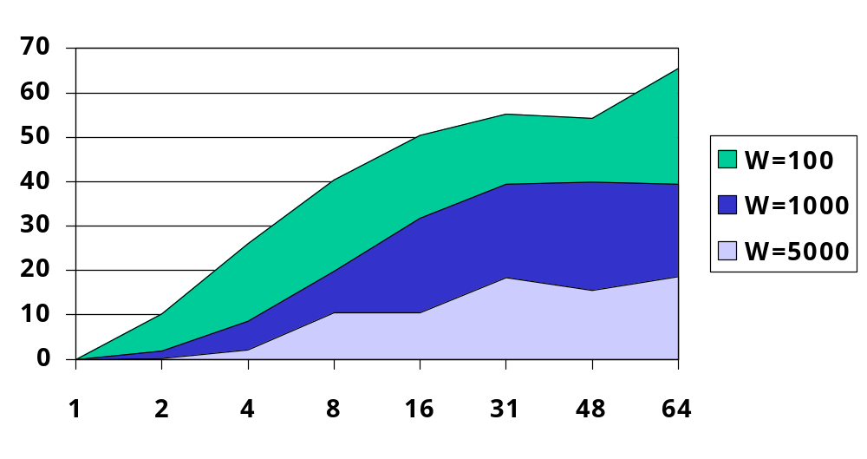
Combining Rate vs Work

Slide 66
Better to Wait Longer
Short wait
Throughput
Medium wait
processors
Indefinite wait
Notes:
Figure~\ref{fig: ctree wait}
compares combining tree latency when {\tt work} is high using 3
waiting policies: wait 16 cycles, wait 256 cycles, and wait
indefinitely. When the number of processors is larger than 64,
indefinite waiting is by far the best policy. This follows since an
un-combined token message locks later received token messages from
progressing until it returns from traversing the root, so a large performance penalty
is paid for each un-combined message. Because the chances of combining are
good at higher arrival rates we found that when {\tt work = 0},
simulation using more than four processors justify indefinite waiting.

Slide 67
Conclusions
Combining Trees
  Work well under high contention
  Sensitive to load fluctuations
  Can be used for getAndMumble() ops
Next
  Counting networks
  A different approach …

Slide 68
This work is licensed under a Creative Commons Attribution-ShareAlike 2.5 License.
You are free:
  to Share — to copy, distribute and transmit the work
  to Remix — to adapt the work
Under the following conditions:
  Attribution. You must attribute the work to “The Art of Multiprocessor Programming” (but not in any way that suggests that the authors endorse you or your use of the work).
  Share Alike. If you alter, transform, or build upon this work, you may distribute the resulting work only under the same, similar or a compatible license.
For any reuse or distribution, you must make clear to others the license terms of this work. The best way to do this is with a link to
  http://creativecommons.org/licenses/by-sa/3.0/.
Any of the above conditions can be waived if you get permission from the copyright holder.
Nothing in this license impairs or restricts the author's moral rights.

