Slide 1


Actions in the Twilight
Ein Erweiterung für
Software Transactional Memory
Annette Bieniusa Peter Thiemann
Universität Freiburg
Arie Middelkoop
Universiteit Utrecht

Slide 2
Scenario: Counting Transactions
0 finished at position 1.
1 finished at position 1.
10 finished at position 2.
4 finished at position 2.
3 finished at position 2.
9 finished at position 2.
2 finished at position 2.
5 finished at position 2.
8 finished at position 2.
7 finished at position 2.
17 finished at position 3.
11 finished at position 3.
5 finished at position 3.
3 finished at position 3.
15 finished at position 3.
12 finished at position 3.
16 finished at position 3
....
volatile int counter;
void threadWorker() {
stm_begin();
// complex computation
// update counter
int position = stm_read(counter) + 1;
stm_write(counter, position);
printf("%i finished at %i",tid,position);
stm_end();
}

Slide 3
Scenario: Counting Transactions
7 finished at position 37.
17 finished at position 41.
57 finished at position 46.
12 finished at position 53.
92 finished at position 58.
42 finished at position 62.
62 finished at position 66.
6 finished at position 2.
16 finished at position 3.
87 finished at position 78.
91 finished at position 14.
1 finished at position 18.
67 finished at position 83.
66 finished at position 25.
72 finished at position 88.
51 finished at position 27.
36 finished at position 29.
....
volatile int counter;
void threadWorker() {
stm_begin();
// complex computation
// update counter
int position = stm_read(counter) + 1;
stm_write(counter, position);
stm_end();
printf("%i finished at %i",tid,position);
}

Slide 4
Scenario: Counting Transactions
volatile int counter;
void threadWorker() {
stm_begin();
// complex computation
// update counter
int position = stm_read(counter) + 1;
stm_write(counter, position);
stm_end();
printf("%i finished at %i",tid,position);
}

Slide 5
Related Work
Irrevocable / inevitable transactions (Welc et al., Spear et al.)
  Dynamic switch to single-transaction mode
  No abort
  Reduces concurrency
  No information exchange possible between transactions
Two-phase commits
  Escape actions run on successful commit or on rollback
  Order of escape actions not specified
  No possibility to ”revive” an aborted transaction

Slide 6

Solution: Twilight Zones!
volatile int counter;
void threadWorker() {
stm_begin();
// complex computation
int position = stm_read(counter) + 1;
stm_write(counter, position);
boolean succeeded = stm_prepare();
if (!succeeded) {
stm_atomize();
for (incoherence: stm_incoherences())
if (incoherence.Addr != &counter)
stm_restart();
// the counter was the only problem, so update it
position = stm_read(counter) + 1;
stm_write(counter, position);
}
printf("%i finished at %i",tid,position);|
stm_finalize();
}
1 finished at position 1.
2 finished at position 2.
3 finished at position 3.
0 finished at position 4.
4 finished at position 5.
7 finished at position 6.
9 finished at position 7.
8 finished at position 8.
11 finished at position 9.
14 finished at position 10.
13 finished at position 11.
12 finished at position 12.
5 finished at position 13.
6 finished at position 14.
24 finished at position 15.
23 finished at position 16.
....

Slide 7
The TL2 Algorithm
Run through a speculative execution
Conflict detected
Lock the write set
Validate the read set
Commit and release the locks

Slide 8
The Twilight Algorithm
Run through a speculative execution
Conflict detected
Lock the write set
Validate the read set
Twilight Zone
or user abort
Commit and release the locks

Slide 9
Twilight API
stm_begin()
  Starts a transaction
stm_prepare()
  Obtains lock on vars in write set, validates the read set
stm_atomize()
  Reloads the read set
stm_incoherences()
  Returns an iterator through the incoherent vars
stm_restart
  Performs a roll-back
stm_finalize()
  Publishes the vars in the write set and releases all locks

Slide 10
Twilight API (2)
stm_read(var)
  Reads the value of var from shared memory first time, later from the read set (or write set)
stm_write(var,val)
  Writes the value to var in the write set
In the Twilight zone:
Vars must already be recorded in the respective sets!
Extension of the write set is not safe!

Slide 11
Locking protocols in Twilight
Handshake-protocols can be used
  Communication between transactions possible
stm_pre_acquire()
  Must be invoked before accessing non-transactional memory or other resources that may require waiting on other transactions.
  Ensures that the transactions can be ordered in such a way that deadlocks due to dependencies on transactional variables through external synchronization cannot occur.
  Must be followed up by stm_atomize() after access to the non-transactional resources has been obtained.

Slide 12
Locking protocols in Twilight
void transaction(client c, t_info[] transfers) {
stm_begin();
// change in-memory model
for (t_info t: transfers) {
transfer(c, t.recipient, t.amount);
add_to_summary(t.recipient, t.amount);}
stm_prepare();
// obtain a lock on the client's file
stm_pre_acquire();
lock_file(c);
stm_atomize();
// restart the transaction if there was a conflict
if (size(stm_incoherences()) > 0) {
unlock_file(c);
stm_restart();
}
write_summary_to_file(c);
unlock_file(c);
store_location_info(c); // update in-memory model
stm_finalize(); // complete the transaction
}

Slide 13
Theory: Semantics
Weak Atomicity
  All transactional read and writes take place at a global time t_{commit}, at which no other transaction reads or writes.
Exposure
  A transactional read may return an out-dated value, yet the actual value at t_{commit} is known at some point.
Coherence
  The values in the read set are coherent with respect to some global time.

Slide 14
Theory: Semantics
Progress
  All Twilight API operations terminate, if the execution of all other code in the twilight zone either does not involve waiting on other transactions or invokes stm_pre_acquire() before doing so.
Irrevocability
  A transaction executing the twilight zone can always finish successfully.
Independence
  Transactions executing the twilight zone concurrently have disjoint write sets.

Slide 15
Practice: Implementation
Java Implementation
  Library including all operations mentioned
  Implemented using Java Concurrency API
  Support for open nested transactions
  Reference implementation, not optimized for speed

Slide 16
Practice: Implementation
final GlobalVar<Number> x = new GlobalVar<Number>(42);
final GlobalVar<Integer> y = new GlobalVar<Integer>(10);
final GlobalVar<String> z = new GlobalVar<String>("Blub");
JTwilight.atomic(new JTwilight.TransactionBody() {
int a;
public void transactional() {
a = stm.read(y);
stm.write(z, "Blah");
JTwilight.atomic(new JTwilight.TransactionBody() {
String b;
public void transactional() {
stm.write(y, a + 1);
b = stm.read(z);}
public JTwilight.Void twilight() {
System.out.println("z was changed by parent, but I wasn't told: " + b);
return null;}
}, stm);}
public JTwilight.Void twilight() {
System.out.println("y has become: " + stm.read(y));
System.out.println("z has become: " + stm.read(z));
return null;}
}, null);

Slide 17
Practice: Implementation
Java Implementation
  Library including all operations mentioned
  Implemented using Java Concurrency API
  Support for open nested transactions
  Reference implementation, not optimized for speed
C Implementation
  Based on TL2 implementation by SUN
  Benchmarks for the vacation application from the STAMP benchmark
  Twilight zones used for debugging and contention detection

Slide 18
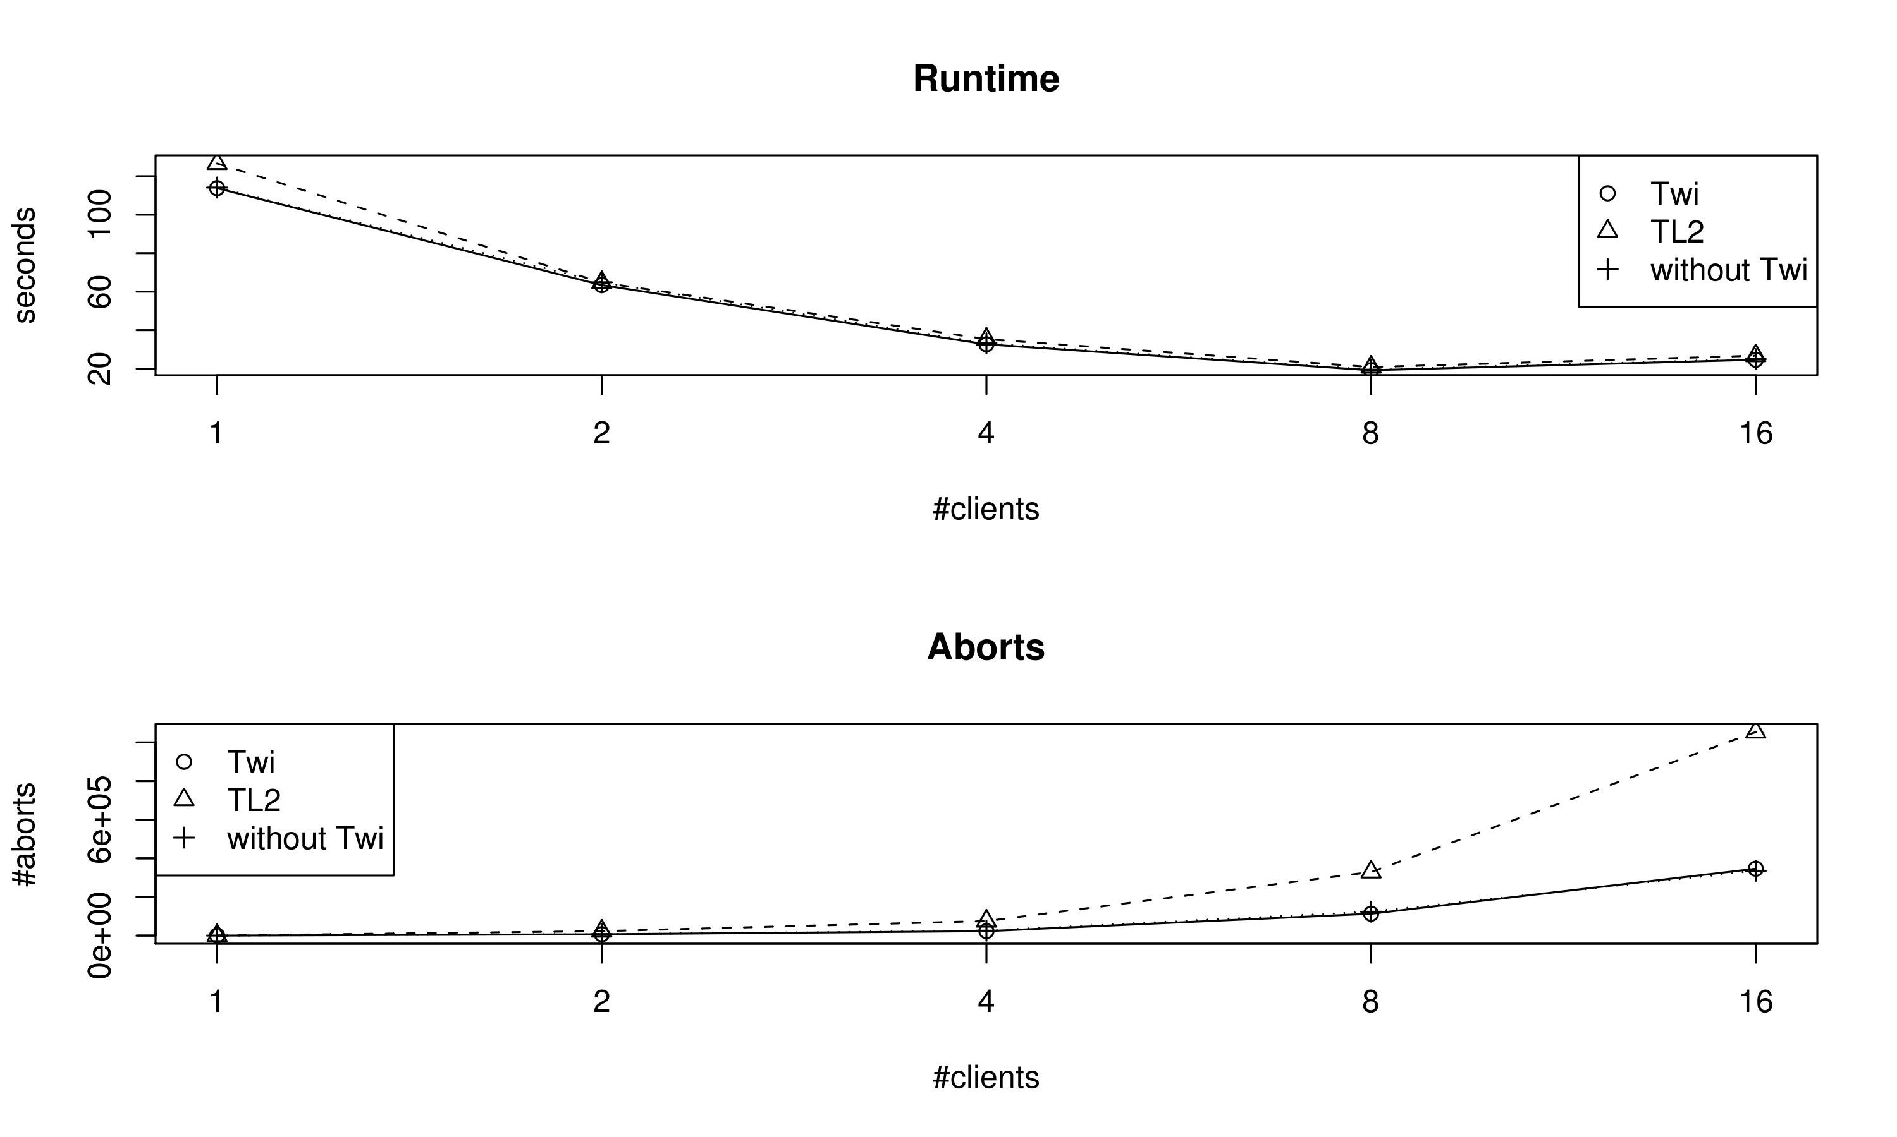
Practice: Benchmark
Vacation benchmark with parameters -n4 -q60 -u90 -r1048576 -t4194304

Slide 19
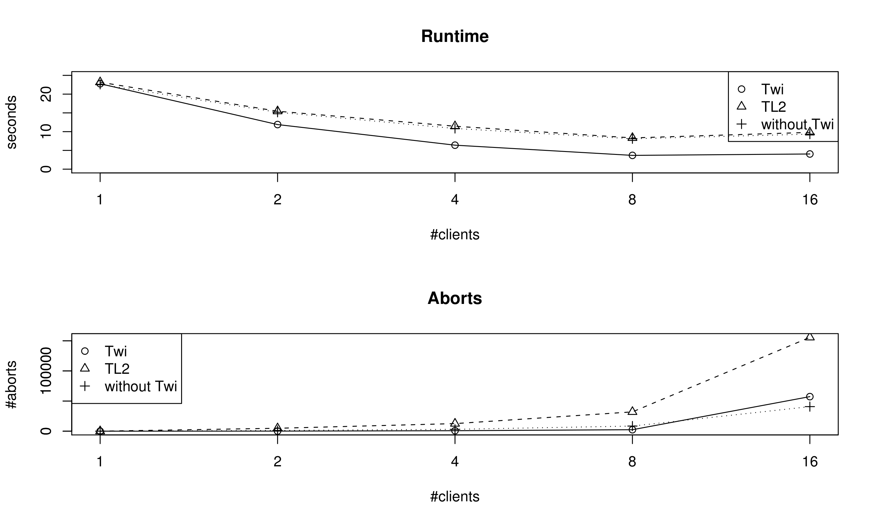
Practice: Benchmark
Vacation benchmark with parameters -n100 -q90 -u90 -r200 -t4194 and loop

Slide 20
Summary
Twilight STM is a powerful STM implementation
  Twilight zones execute concurrently with other transactions
  I/O, system calls, ... at commit time
  repair mechanism for invalidated reads
Features
  clear and unambigious semantics
  Java / C implementations with benchmarks and examples
Application areas
  debugging
  applications featuring ”precise” I/O
  applications with contention spots

