Slide 1
Introduction
Companion slides for
The Art of Multiprocessor Programming
by Maurice Herlihy & Nir Shavit

Slide 2
Concurrent Programming is Necessary
The real world is concurrent
  Systems must handle multiple issues
  Systems must be responsive (GUI)
The real world is not patient
  Performance demands no longer met by scaling hardware
  New multicore hardware is parallel

Slide 3
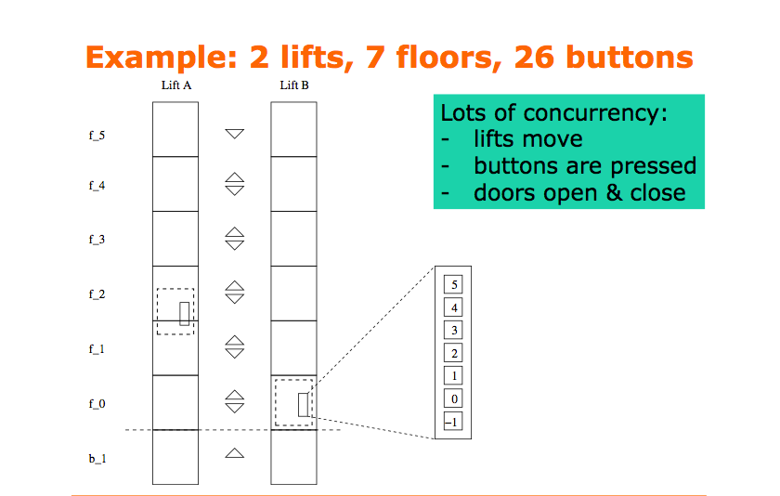

Slide 4
Concurrent Programming is Easy ... to Get Wrong
Subtle interaction between
  Concurrent execution
  Memory architecture (caches)
  Processor features (out-of-order execution)
Correctness hard to guarantee
  Safety? Liveness?
  Bug hunting aggravated (Heisenbugs)

Slide 5
Concurrent Programming is Easy ... to Get Slow
Sequential Code => Parallel Code
  Slows down sequential speed
  Almost never yields n-fold speedup
  Exception: “embarrassingly parallel” problems
No free lunch anymore

Slide 6
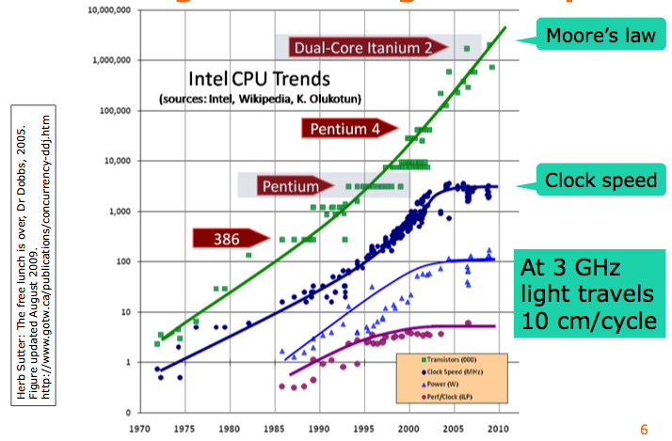
Moore’s Law
Art of Multiprocessor Programming
Notes:
Most of you have probably heard of Moore’s law, which states that the number of transistors on a chip tends to double about every two years. Moore’s law has been the engine of growth for our field, and the reason you can buy a laptop for a few thousand dollars that would have cost millions a decade earlier. The green dots on this graph show

Slide 7
Goal of the Course
Learn the underlying principles
Learn patterns for writing correct code
Recognize and avoid anti-patterns
Learn how to avoid speed pitfalls
Vehicle: Java, mostly

Slide 8
A Dying Species:
The Uniprocessor
cpu
memory
Art of Multiprocessor Programming
Notes:
Traditionally, we have had inexpensive single processor with an associated memory on a chip, which we call a uniprocessor.

Slide 9
In the Enterprise:
The Shared Memory Multiprocessor
(SMP)
cache
cache
cache
Bus
Bus
shared memory
Art of Multiprocessor Programming
Notes:
And we had expensive multiprocessor chips in the enterprise, that is, in server farms, high performance computing centers and so on. The
Shared memory multiprocessor (SMP) consists of multiple CPUs connected by a bus or interconnect network to a shared memory.

Slide 10
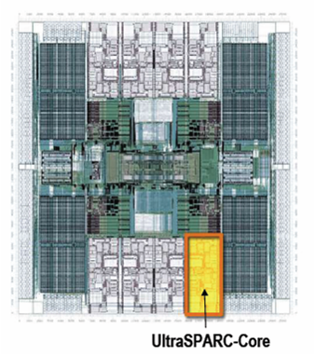
Your New Desktop:
The Multicore Processor
(CMP)
All on the
same chip
Intel Core i3-
Core i7
cache
cache
cache
Bus
Bus
shared memory
Art of Multiprocessor Programming
Notes:
The revolution we are going through is that the desktop is now becoming a multiprocessor also. We call this type of processor a system-on-a-chip or a multicore machine or a chip multiprocessor (CMP). The chip you see here is the Sun T2000 Niagara CMP that has 8 cores and shared cache and memory. We will learn about the Niagara in more detail later. It is the machine you will be using for your homework assignments.

Slide 11
Multicores Are Here
AMD: Athlon, Opteron, Phenom, Radeon (GPU)
IBM: Power4-8, Xenon
Intel: Core, Xeon, Teraflops (80 core)
Nvidia: Tesla (10x24 processors)
Sun: SPARC T5 (16 core, 128 thread)
...
Art of Multiprocessor Programming
Notes:
Not only Sun in Building CMPs, everyone is, and Intel is shipping 4-core chips.

Slide 12
Why do we care?
Time no longer cures software bloat
  The “free lunch” is over
When you double your program’s path length
  You can’t just wait 6 months
  Your software must somehow exploit twice as much concurrency
Art of Multiprocessor Programming
Notes:
Why do you care? Because the way you wrote software until now will disappear in the next few years. The free ride where you write software once and trust Intel, Sun, IBM, and AMD to make it faster is no longer valid.

Slide 13
Traditional Scaling Process
7x
Speedup
3.6x
1.8x
User code
Traditional
Uniprocessor
Time: Moore’s law
Art of Multiprocessor Programming
Notes:
Recall the traditional scaling process for software: write it once, trust Intel to make the CPU faster to improve performance.

Slide 14
Multicore Scaling Process
7x
3.6x
Speedup
1.8x
User code
Multicore
Unfortunately, not so simple…
Art of Multiprocessor Programming
Notes:
With multicores, we will have to parallelize the code to make software faster, and we cannot do this automatically (except in a limited way on the level of individual instructions).

Slide 15
Real-World Scaling Process
Speedup
2x
2.9x
1.8x
User code
Multicore
Parallelization and Synchronization
require great care…
Art of Multiprocessor Programming
Notes:
This is because splitting the application up to utilize the cores is not simple, and coordination among the various code parts requires care.

Slide 16
Multicore Programming: Course Overview
Fundamentals
  Models, algorithms, impossibility
Real-World programming
  Architectures
  Techniques
Art of Multiprocessor Programming
Notes:
Here is our course overview. (at the end, we aim to give you a basic understanding of the issues, not to make you exerts) [[Lecturer can tell
Mongolian Expert on the Montain Joke]].
In this course, we will study a variety of synchronization algorithms,
with an emphasis on informal reasoning about correctness.
Reasoning about multiprocessor programs is different in many ways from the more
familiar style of reasoning about sequential programs.
Sequential correctness is mostly concerned with safety properties,
that is, ensuing that a program transforms each before-state to the correct
after-state.
Naturally, concurrent correctness is also concerned with safety,
but the problem is much, much harder,
because safety must be ensured despite the vast number of ways steps of
concurrent threads can be be interleaved.
Equally important, concurrent correctness encompasses a variety of
\emph{liveness} properties that have no counterparts in the sequential world.
The second part of the book concerns performance.
Analyzing the performance of synchronization algorithms is also different
in flavor from analyzing the performance of sequential programs.
Sequential programming is based on a collection of well-established and
well-understood abstractions.
When you write a sequential program,
you usually do not need to be aware that underneath it all,
pages are being swapped from disk to memory,
and smaller units of memory are being moved in and out of a hierarchy of
processor caches.
This complex memory hierarchy is essentially invisible,
hiding behind a simple programming abstraction.
In the multiprocessor context, this abstraction breaks down,
at least from a performance perspective.
To achieve adequate performance,
the programmer must sometimes ``outwit'' the underlying memory system,
writing programs that would seem bizarre to someone unfamiliar with
multiprocessor architectures.
Someday, perhaps, concurrent architectures will provide the same degree of
efficient abstraction now provided by sequential architectures,
but in the meantime, programmers should beware.
We start then with fundamentals, trying to understand what is and is not computable before we try and write programs. This is similar to the process you have probably gone through with sequential computation of learning computability and complexity theory so that you will not try and solve unsolvable problems. There are many such computational pitfals when programming multiprocessors.

Slide 17
Multicore Programming: Course Overview
Fundamentals
  Models, algorithms, impossibility
Real-World programming
  Architectures
  Techniques
We don’t necessarily
want to make
you experts…
Art of Multiprocessor Programming
Notes:
Here is our course overview. (at the end, we aim to give you a basic understanding of the issues, not to make you experts)
In this course, we will study a variety of synchronization algorithms,
with an emphasis on informal reasoning about correctness.
Reasoning about multiprocessor programs is different in many ways from the more
familiar style of reasoning about sequential programs.
Sequential correctness is mostly concerned with safety properties,
that is, ensuing that a program transforms each before-state to the correct
after-state.
Naturally, concurrent correctness is also concerned with safety,
but the problem is much, much harder,
because safety must be ensured despite the vast number of ways steps of
concurrent threads can be be interleaved.
Equally important, concurrent correctness encompasses a variety of
\emph{liveness} properties that have no counterparts in the sequential world.
The second part of the book concerns performance.
Analyzing the performance of synchronization algorithms is also different
in flavor from analyzing the performance of sequential programs.
Sequential programming is based on a collection of well-established and
well-understood abstractions.
When you write a sequential program,
you usually do not need to be aware that underneath it all,
pages are being swapped from disk to memory,
and smaller units of memory are being moved in and out of a hierarchy of
processor caches.
This complex memory hierarchy is essentially invisible,
hiding behind a simple programming abstraction.
In the multiprocessor context, this abstraction breaks down,
at least from a performance perspective.
To achieve adequate performance,
the programmer must sometimes ``outwit'' the underlying memory system,
writing programs that would seem bizarre to someone unfamiliar with
multiprocessor architectures.
Someday, perhaps, concurrent architectures will provide the same degree of
efficient abstraction now provided by sequential architectures,
but in the meantime, programmers should beware.
We start then with fundamentals, trying to understand what is and is not computable before we try and write programs. This is similar to the process you have probably gone through with sequential computation of learning computability and complexity theory so that you will not try and solve unsolvable problems. There are many such computational pitfals when programming multiprocessors.

Slide 18
Road Map
We are going to focus on principles first, then practice
  Start with idealized models
  Look at simplistic problems
  Emphasize correctness over pragmatism
  “Correctness may be theoretical, but incorrectness has practical impact”
Art of Multiprocessor Programming
Notes:
We want to understand what we can and cannot compute before we try and write code. In fact, as we will see there are problems that are Turing computable but not asynchronously computable.

Slide 19
Sequential Computation
thread
memory
object
object
Art of Multiprocessor Programming

Slide 20
Concurrent Computation
threads
memory
object
object
Art of Multiprocessor Programming

Slide 21
Asynchrony
Sudden unpredictable delays
  Cache misses (short)
  Page faults (long)
  Scheduling quantum used up (really long)
Art of Multiprocessor Programming

Slide 22
Model Summary
Multiple threads
  Sometimes called processes
Single shared memory
Objects live in memory
Unpredictable asynchronous delays
Art of Multiprocessor Programming

Slide 23
Concurrency Jargon
Hardware
  Processors
Software
  Threads, processes
Sometimes OK to confuse them, sometimes not.
Art of Multiprocessor Programming
Notes:
We will use the terms above, even though there are also terms like strands, CPUs, chips etc also…

Slide 24

An Example Problem:
Primality Testing

Slide 25
Parallel Primality Testing
Challenge
  Print primes from 1 to 10¹⁰
Given
  Ten-processor multiprocessor
  One thread per processor
Goal
  Get ten-fold speedup (or close)
Art of Multiprocessor Programming
Notes:
We want to look at the problem of printing the primes from 1 to 10^10 in some arbitrary order.

Slide 26
Load Balancing
1
10⁹
2·10⁹
…
10¹⁰
P₀
P₁
…
P₉
Split the work evenly
Each thread tests range of 10⁹
Art of Multiprocessor Programming
Notes:
Split the range ahead of time

Slide 27
Procedure for Thread i
void primePrint() {
int i = ThreadID.get(); // IDs in {0..9}
for (j = i*10⁹+1, j<(i+1)*10⁹; j++) {
if (isPrime(j))
print(j);
}
}
Art of Multiprocessor Programming
Notes:
Code matches code in Chapter 1 of book.

Slide 28
Issues
Higher ranges have fewer primes
Yet larger numbers harder to test
Thread workloads
  Uneven
  Hard to predict
Art of Multiprocessor Programming
Notes:
You can mention that the use of prime() is a bit artificial since it makes sense to use earlier numbers detected as prime in testing whether a
later number is prime.

Slide 29
Issues
Higher ranges have fewer primes
Yet larger numbers harder to test
Thread workloads
  Uneven
  Hard to predict
Need dynamic load balancing
rejected
Art of Multiprocessor Programming
Notes:
You can mention that the use of prime() is a bit artificial since it makes sense to use earlier numbers detected as prime in testing whether a
later number is prime.

Slide 30
Shared Counter
19
each thread takes a number
18
17
Art of Multiprocessor Programming

Slide 31
Procedure for Thread i
int counter = new Counter(1);
void primePrint() {
long j = 0;
while (j < 10¹⁰) {
j = counter.getAndIncrement();
if (isPrime(j))
print(j);
}
}
Art of Multiprocessor Programming

Slide 32
Procedure for Thread i
Counter counter = new Counter(1);
void primePrint() {
long j = 0;
while (j < 10¹⁰) {
j = counter.getAndIncrement();
if (isPrime(j))
print(j);
}
}
Shared counter
object
Art of Multiprocessor Programming

Slide 33
Where Things Reside
void primePrint {
int i = ThreadID.get(); // IDs in {0..9}
for (j = i*10⁹+1, j<(i+1)*10⁹; j++) {
if (isPrime(j))
print(j);
}
}
Local
variables
code
cache
cache
cache
Bus
Bus
shared
memory
1
shared counter
Art of Multiprocessor Programming
Notes:
Need this slide since some students do not understand where the counter resides, where the shared variables reside, and where the code resides etc. This is our opportunity to explain.

Slide 34
Procedure for Thread i
Counter counter = new Counter(1);
void primePrint() {
long j = 0;
while (j < 10¹⁰) {
j = counter.getAndIncrement();
if (isPrime(j))
print(j);
}
}
Stop when every value taken
Art of Multiprocessor Programming

Slide 35
Procedure for Thread i
Counter counter = new Counter(1);
void primePrint() {
long j = 0;
while (j < 10¹⁰) {
j = counter.getAndIncrement();
if (isPrime(j))
print(j);
}
}
Increment & return each new value
Art of Multiprocessor Programming

Slide 36
Counter Implementation
public class Counter {
private long value;
public long getAndIncrement() {
return value++;
}
}
Art of Multiprocessor Programming

Slide 37
Counter Implementation
public class Counter {
private long value;
public long getAndIncrement() {
return value++;
}
}
OK for single thread,
not for concurrent threads
Art of Multiprocessor Programming

Slide 38
What It Means
public class Counter {
private long value;
public long getAndIncrement() {
return value++;
}
}
Art of Multiprocessor Programming

Slide 39
What It Means
public class Counter {
private long value;
public long getAndIncrement() {
return value++;
}
}
temp = value;
value = value + 1;
return temp;
Art of Multiprocessor Programming

Slide 40
Not so good…
Value… 1
2
3
2
read
1
write
2
read
2
write
3
read
1
write
2
time
Art of Multiprocessor Programming
Notes:
Time goes from left to right. The Blue thread might read 1 from \fValue{}, but before
it sets \fValue{} to 2, the Red thread would go through the
increment loop several times, reading 1 and setting to 2, reading
2 and setting to 3. When the Blue thread finally completes its
operation and sets \fValue{} to 2, it will actually be setting
the counter back from 3 to 2.

Slide 41
Is this problem inherent?
write
read
read
write
If we could only glue reads and writes…
Art of Multiprocessor Programming
Notes:
Is this phenomena inherent or is there a better implementation we are missing?
To understand why such bad interleavings can always happen, consider
the following situation that all of us run into every once in a while.
You are walking down the street, and
suddenly someone is coming straight at you. You move to the right, and they
move to the right, so you move to the left, and they happen to do the
same, now you try and make a final break to either left or right, many
times you manage not to bump, but sometimes you do. Are these
collisions avoidable? Can we think of a protocol to follow in order to
prevent people from ever colliding?
The answer is NO! \footnote{One might think that you
can agree to always move to the right, to which you can answer ``but
what if the other person is British?'' Alternately,
think of Atlantis and Mir flying one towards the other in space, where
the is no predefined ``right side.''} It can be mathematically shown
that there is always a sequence of moves that will result in people
bumping (this is the famous result of Fischer, Lynch, and Paterson we will
Study later in the course).
The problem arises from the fact that ``looking'' at the other person
and ``moving'' aside to avoid him are two separate operations. If one
could ``look-and-jump'' instantaneously the problem could be avoided.
In the same way that people compete for the right to pass, computers
compete to gain access to shared locations in memory. In the case of
our {\tt shared-counter}, processors are in a competition where the
winner gets the lower counter value and the looser gets the higher
one. The moral of the ``people in the street'' example is that we need
to ``glue together'' the {\tt get} and {\tt increment} operations to
get an ``instantaneous'' {\tt get-and-increment}. This operation
would execute the {\tt get} and the {\tt increment} instructions
like one indivisible operation with no other operation taking place
between the start of the {\tt get} and the end of the {\tt
increment}. If we have such an operation then the following is a
correct and efficient solution to the prime printing problem.

Slide 42
Challenge
public class Counter {
private long value;
public long getAndIncrement() {
temp = value;
value = temp + 1;
return temp;
}
}
Art of Multiprocessor Programming

Slide 43
Challenge
public class Counter {
private long value;
public long getAndIncrement() {
temp = value;
value = temp + 1;
return temp;
}
}
Make these steps atomic (indivisible)
Art of Multiprocessor Programming

Slide 44
Hardware Solution
public class Counter {
private long value;
public long getAndIncrement() {
temp = value;
value = temp + 1;
return temp;
}
}
ReadModifyWrite()
instruction
Art of Multiprocessor Programming
Notes:
We will see later that modern multiprcessors provide special types of readModiftWrite() instructions to allow us to overcome the
problem at hand. But how do we solve this problem in software?

Slide 45
An Aside: Java™
public class Counter {
private long value;
public long getAndIncrement() {
synchronized (this) {
temp = value;
value = temp + 1;
}
return temp;
}
}
Art of Multiprocessor Programming

Slide 46
An Aside: Java™
public class Counter {
private long value;
public long getAndIncrement() {
synchronized (this) {
temp = value;
value = temp + 1;
}
return temp;
}
}
Synchronized block
Art of Multiprocessor Programming

Slide 47
An Aside: Java™
public class Counter {
private long value;
public long getAndIncrement() {
synchronized (this) {
temp = value;
value = temp + 1;
}
return temp;
}
}
Critical Region
Art of Multiprocessor Programming
Notes:
Java provides us with a solution: mutual exclusion in software…lets try and understand how this is done

Slide 48
Wanted
Mutual exclusion in critical region
==
Only one thread at a time executes inside a critical region

Slide 49
Mutual Exclusion or “Alice & Bob share a pond”
A
B
Art of Multiprocessor Programming
Notes:
We now present a sequence of fables, illustrating some of the basic problems.
Like most authors of fables, we retell stories mostly invented by others. The following story was told by a famous
Multiprocessing pioneer, Leslie Lamport.
See story outline in the Introduction Chapter of the Book.

Slide 50
Alice has a pet
A
B
Art of Multiprocessor Programming

Slide 51
Bob has a pet
A
B
Art of Multiprocessor Programming

Slide 52
The Problem
A
B
The pets don’t
get along
Art of Multiprocessor Programming

Slide 53
Formalizing the Problem
Two types of formal properties in asynchronous computation:
Safety Properties
  Nothing bad happens ever
Liveness Properties
  Something good happens eventually
Art of Multiprocessor Programming

Slide 54
Formalizing our Problem
Mutual Exclusion
  Both pets never in pond simultaneously
  This is a safety property
No Deadlock
  if only one wants in, it gets in
  if both want in, one gets in.
  This is a liveness property
Art of Multiprocessor Programming
Notes:
Notice that we use the term deadlock and not livelock though some people would use both to describe the
Requirement. They are not the same thing. Deadlock is used to denote that Alice and Bob are stuck and no amount of retry (backoff) will help, while livelock means backoff can help. In any case both are different from “no starvation” which is the stronger requirement that means that every request always succeeds.

Slide 55
Simple Protocol
Idea
  Just look at the pond
Gotcha
  Trees obscure the view
Art of Multiprocessor Programming
Notes:
In the following versions of the protocol, we try and show the students which solutions will not work.
Can ask students for help in the solution by showing the first part of the slide (the Idea part) and then show the
Gotcha part once they have suggested solutions. This is true for all the next set of suggested solutions.

Slide 56
Interpretation
Threads can’t “see” what other threads are doing
Explicit communication required for coordination
Art of Multiprocessor Programming

Slide 57
Cell Phone Protocol
Idea
  Bob calls Alice (or vice-versa)
Gotcha
  Bob takes shower
  Alice recharges battery
  Bob out shopping for pet food …
Art of Multiprocessor Programming

Slide 58
Interpretation
Message-passing doesn’t work
Recipient might not be
  Listening
  There at all
Communication must be
  Persistent (like writing)
  Not transient (like speaking)
Art of Multiprocessor Programming

Slide 59
Can Protocol
cola
cola
Art of Multiprocessor Programming

Slide 60
Bob conveys a bit
A
B
cola
Art of Multiprocessor Programming

Slide 61
Bob conveys a bit
A
B
cola
Art of Multiprocessor Programming

Slide 62
Can Protocol
Idea
  Cans on Alice’s windowsill
  Strings lead to Bob’s house
  Bob pulls strings, knocks over cans
Gotcha
  Cans cannot be reused
  Bob runs out of cans
Art of Multiprocessor Programming

Slide 63
Interpretation
Cannot solve mutual exclusion with interrupts
  Sender sets fixed bit in receiver’s space
  Receiver resets bit when ready
  Requires unbounded number of interrupt bits
Art of Multiprocessor Programming
Notes:
Notice that the point here is that it can be used as a solution but takes an unbounded number of inturrupt bits. This is not the case with the next solution…

Slide 64
Flag Protocol
A
B
Art of Multiprocessor Programming
Notes:
Here is a solution that does not suffer from the problems of the former ones…

Slide 65
Alice’s Protocol (sort of)
A
B
Art of Multiprocessor Programming

Slide 66
Bob’s Protocol (sort of)
A
B
Art of Multiprocessor Programming

Slide 67
Alice’s Protocol
Raise flag
Wait until Bob’s flag is down
Unleash pet
Lower flag when pet returns
Art of Multiprocessor Programming

Slide 68
Bob’s Protocol
Raise flag
Wait until Alice’s flag is down
Unleash pet
Lower flag when pet returns
danger!
Art of Multiprocessor Programming
Notes:
Does not meet our requirement of no deadlock. Need to improve the protocol. Can ask students for help.

Slide 69
Bob’s Protocol (2nd try)
Raise flag
While Alice’s flag is up
  Lower flag
  Wait for Alice’s flag to go down
  Raise flag
Unleash pet
Lower flag when pet returns
Art of Multiprocessor Programming

Slide 70
Bob’s Protocol
Bob defers to Alice
Raise flag
While Alice’s flag is up
  Lower flag
  Wait for Alice’s flag to go down
  Raise flag
Unleash pet
Lower flag when pet returns
Art of Multiprocessor Programming

Slide 71
The Flag Principle
Raise the flag
Look at other’s flag
Flag Principle:
  If each raises and looks, then
  Last to look must see both flags up
Art of Multiprocessor Programming
Notes:
This intuitively explains implies why at least one of them will not
enter the critical section if both are trying at the same time. Many coordination protocols use falg raising and
The flag principle to guarantee that threads notice each other.
The following proof of mutual exclusion will not be
presented in class, but we provide it just to give you some intuition
about how one reasons about concurrent programs. Lets prove that if
they follow the algorithm the dogs will never be together in the yard.
Assume by way contradiction that this is not the case. We are assuming
that both dogs are in the yard. Therefore both Alice and Bob had a
last ``looking'' action before they let their dog enter the yard. Lets
take a look at the one who finished this looking action first. When he
(she) looked, he (she) saw that the other one's flag was down. Without
loss of generality let's assume it was Bob, so he had {\tt (=
Alice-flag 'down)} as true, otherwise he couldn't have entered the
critical section. So it follows that Alice's flag was up {\em after}
Bob finished his looking action. Therefore, Alice's looking was {\em
completely after} the end of Bob's raising of his flag, so Alice must
have seen this flag up and could not have entered the critical
section, a contradiction.

Slide 72
Proof of Mutual Exclusion
Assume both pets in pond
  Derive a contradiction
  By reasoning backwards
Consider the last time Alice and Bob each looked before letting the pets in
Without loss of generality assume Alice was the last to look…
Art of Multiprocessor Programming
Notes:
If both look at the same time, then its OK to assume that Alice looked last. They both have different protocols but the part of the protocols that raises the flag for the last time and looks if the other’s flag is raised is the same.

Slide 73
Proof
Bob last raised flag
Alice last raised her flag
Alice’s last look
Bob’s last look
QED
time
Alice must have seen Bob’s Flag. A Contradiction
Art of Multiprocessor Programming
Notes:
Explanation: assume without loss of generality that Alice was the last to look in the last look each performed before they both let their animals in the pond concurrently. Then Bob’s last look must have been
before Alice’s last flag raising since Bob let his pet into the pond. But since Bob raised his flag before he looked, it follows that Alice must have seen Bob’s flag raised, a contradiction.

Slide 74
Proof of No Deadlock
If only one pet wants in, it gets in.
Art of Multiprocessor Programming

Slide 75
Proof of No Deadlock
If only one pet wants in, it gets in.
Deadlock requires both continually trying to get in.
Art of Multiprocessor Programming

Slide 76
Proof of No Deadlock
If only one pet wants in, it gets in.
Deadlock requires both continually trying to get in.
If Bob sees Alice’s flag, he gives her priority (a gentleman…)
QED
Art of Multiprocessor Programming

Slide 77
Remarks
Protocol is unfair
  Bob’s pet might never get in
Protocol uses waiting
  If Bob is eaten by his pet, Alice’s pet might never get in
Art of Multiprocessor Programming
Notes:
The protocol is unfair. Another property of compelling interest above no-deadlock is no-starvation:
if a pet wants to enter the yard, will it eventually succeed?
Here, Alice and Bob's protocol performs poorly. Whenever Alice and
Bob conflict, Bob defers to Alice, so it is possible that Alice's
pet can use the pond over and over again, while Bob's pet becomes
increasing uncomfortable. Later on, we will see how to make
protocols prevent starvation.
Waiting is problematic in terms of performance as we will explain in more detail later in the lecture

Slide 78
Moral of Story
Mutual Exclusion cannot be solved by
  transient communication (cell phones)
  interrupts (cans)
It can be solved by
  one-bit shared variables
  that can be read or written
Art of Multiprocessor Programming
Notes:
During the course we will devote quite a bit of effort to understanding the tradeoffs that have to do with the use of mutual exclusion.

Slide 79
The Arbiter Problem (an aside)
Pick a point
Pick a point
Art of Multiprocessor Programming
Notes:
Notice that when Alice or Bob look at the otehrs flag, it might be in the process of being raised, which
Means we need to decide from what point on the flag is up or down. We essentially want to turn a continuous process of raising the flag into a discrete process in which it only has two states and we never have an intermediate “undefined” state. The same issue arises in memory. Bits of memory are in many cases electrical units called flip-flops. If a current representing a bit of either 0 or 1 is entered into a flip-flops input wires, we would like to think of the output as either 0 or 1. But this process takes time, and the current coming out of the
flip-flop is not discrete, if we measure it at different times, especially if we measure it before the output current has stabilized, we will not get a guaranteed correct behaviour. In other words, as with the flags, we might be catching it while the bit is being raised or lowered. What hardware manufacturers do is decide on a time when they believe the current on the output will be stable. However, as the lower figure shows, picking such a point is a probabilistic event, that is, if we test the gate after 5 nano-seconds, there is always a probability that it will not give us the correct corresponding output given the inputs because the gate is unstable. However, this time is chosen so that the probability is small enough that other failure probabilities (like the probability that a spec of dust will neutralize a flip-flop) are higher.

Slide 80
The Fable Continues
Alice and Bob fall in love & marry
Art of Multiprocessor Programming

Slide 81
The Fable Continues
Alice and Bob fall in love & marry
Then they fall out of love & divorce
  She gets the pets
  He has to feed them
Art of Multiprocessor Programming
Notes:
Joke: say that with a probability of 50% they divorce.

Slide 82
The Fable Continues
Alice and Bob fall in love & marry
Then they fall out of love & divorce
  She gets the pets
  He has to feed them
Leading to a new coordination problem: Producer-Consumer
Art of Multiprocessor Programming
Notes:
Joke: say that with a probability of 50% they divorce.

Slide 83
Bob Puts Food in the Pond
A
Art of Multiprocessor Programming

Slide 84
Alice releases her pets to Feed
mmm…
B
mmm…
Art of Multiprocessor Programming

Slide 85
Producer/Consumer
Alice and Bob can’t meet
  Each has restraining order on other
  So he puts food in the pond
  And later, she releases the pets
Avoid
  Releasing pets when there’s no food
  Putting out food if uneaten food remains
Art of Multiprocessor Programming
Notes:
Many coordination problems are producer consumer problems, in fact, whenever an algorith involves the word “buffer” chances are high that we are talking about a producer consumer algorithm.

Slide 86
Producer/Consumer
Need a mechanism so that
  Bob lets Alice know when food has been put out
  Alice lets Bob know when to put out more food
Art of Multiprocessor Programming

Slide 87
Surprise Solution
A
B
cola
Art of Multiprocessor Programming

Slide 88
Bob puts food in Pond
A
B
cola
Art of Multiprocessor Programming

Slide 89
Bob knocks over Can
A
B
cola
Art of Multiprocessor Programming

Slide 90
Alice Releases Pets
yum…
A
B
B
yum…
cola
Art of Multiprocessor Programming

Slide 91
Alice Resets Can when Pets are Fed
A
B
cola
Art of Multiprocessor Programming

Slide 92
Pseudocode
while (true) {
while (can.isUp()){};
pet.release();
pet.recapture();
can.reset();
}
Alice’s code
Art of Multiprocessor Programming

Slide 93
Pseudocode
while (true) {
while (can.isUp()){};
pet.release();
pet.recapture();
can.reset();
}
Bob’s code
while (true) {
while (can.isDown()){};
pond.stockWithFood();
can.knockOver();
}
Alice’s code
Art of Multiprocessor Programming

Slide 94
Correctness
Mutual Exclusion
  Pets and Bob never together in pond
Art of Multiprocessor Programming
Notes:
Mutual Exclusion: Bob and the pets are never in the yard together.

Slide 95
Correctness
Mutual Exclusion
  Pets and Bob never together in pond
No Starvation
  if Bob always willing to feed, and pets always famished, then pets eat infinitely often.
Art of Multiprocessor Programming
Notes:
No-Starvation: if Bob is always willing to feed, and
the pets are always famished, then the pets will eat infinitely
often.

Slide 96
Correctness
safety
Mutual Exclusion
  Pets and Bob never together in pond
No Starvation
  if Bob always willing to feed, and pets always famished, then pets eat infinitely often.
Producer/Consumer
  The pets never enter pond unless there is food, and Bob never provides food if there is unconsumed food.
liveness
safety
Art of Multiprocessor Programming
Notes:
Producer/Consumer:
The pets will not enter the yard unless there is food, and Bob
will never provide more food if there is unconsumed food.
Let the students guess which property is a safety property and which is a liveness property.

Slide 97
Could Also Solve Using Flags
A
B
Art of Multiprocessor Programming

Slide 98
Waiting
Both solutions use waiting
  while(mumble){}
Waiting is problematic
  If one participant is delayed
  So is everyone else
  But delays are common & unpredictable
Art of Multiprocessor Programming
Notes:
Again, waiting si problematic as one delays all causing the computation to proceed in a sequential manner.

Slide 99
The Fable drags on …
Bob and Alice still have issues
Art of Multiprocessor Programming

Slide 100
The Fable drags on …
Bob and Alice still have issues
So they need to communicate
Art of Multiprocessor Programming

Slide 101
The Fable drags on …
Bob and Alice still have issues
So they need to communicate
So they agree to use billboards …
Art of Multiprocessor Programming

Slide 102
Billboards are Large
B
D
Letter
Tiles
From Scrabble™ box
A
C
2
3
E
1
3
1
Art of Multiprocessor Programming
Notes:
One tile at a time.

Slide 103
Write One Letter at a Time …
W
A
S
4
1
1
H
4
B
D
A
C
2
3
E
1
3
1
Art of Multiprocessor Programming

Slide 104
To post a message
W
A
S
H
T
H
E
C
A
R
4
1
1
4
1
4
1
3
1
1
whew
Art of Multiprocessor Programming

Slide 105
Let’s send another message
L
A
S
E
L
L
L
A
V
A
1
1
S
1
1
1
1
1
1
4
1
M
P
3
3
1
Art of Multiprocessor Programming

Slide 106
Uh-Oh
S
E
L
L
T
H
E
C
A
R
1
1
1
1
1
4
1
3
1
1
L
1
OK
Art of Multiprocessor Programming

Slide 107
Readers/Writers
Devise a protocol so that
  Writer writes one letter at a time
  Reader reads one letter at a time
  Reader sees
    Old message or new message
    No mixed messages
Art of Multiprocessor Programming
Notes:
This is a classical problem that captures how our machines memory really behaves. Memory consists of individual words that can be read or written one at a time, want if we read what is being written one word at a time while others are writing memory one word at a time, how can we guarantee to see correct values.

Slide 108
Readers/Writers (continued)
Easy with mutual exclusion
But mutual exclusion requires waiting
  One waits for the other
  Everyone executes sequentially
Remarkably
  We can solve R/W without mutual exclusion
Art of Multiprocessor Programming
Notes:
Its also easy with producer-consumer interrupt bit based solution if we have one producer and one consumer.
Using Mutex for large chunks of memory introduces performance problems. The surprising thing is that we can actually provide a “snapshot” of memory by reading memory locations one at a time, and while others are continuously writing it, all this WITHOUT mutual exclusion. Stay tuned to see how we do this.

Slide 109
Why do we care?
As much of the code as possible should execute in parallel
Even a “smallish” sequential part implies reduced performance
Amdahl’s law: this relation is not linear…
Art of Multiprocessor Programming
Notes:
Mutual exclusion and waiting imply that code is essentially executed sequentially, while one is executing it others spin doing nothing useful. The larger these sequential parts, the worst our utilization of the multiple processors on our machine. Moreover, this relation is not linear: if 25% of the code is sequential, it does not mean that on a ten processor machine we will see a 25% loss of speedup…to understand the real realation, we need to understand
Amdahl’s law. Gene Amdahl was a computer science pioneer.

Slide 110
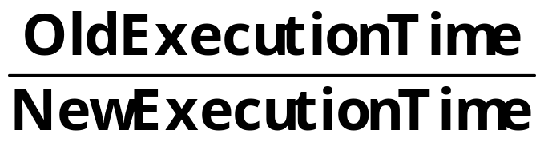
Amdahl’s Law
Speedup=
…of computation given n CPUs instead of 1
Art of Multiprocessor Programming
Notes:
This kind of analysis is very important for concurrent computation.
The formula we need is called \emph{Amdahl's Law}.
It captures the notion that the extent to
which we can speed up any complex job (not just painting)
is limited by how much of the job must be executed sequentially.
Define the \emph{speedup} $S$ of a job to be the ratio between the
time it takes one processor to complete the job (as measured by a wall clock)
versus the time it takes $n$ concurrent processors to complete the same job.
\emph{Amdahl's Law} characterizes the maximum speedup $S$ that can be achieved by $n$
processors collaborating on an application where $p$ is the fraction of
the job that can be executed in parallel.
Assume, for simplicity,
that it takes (normalized) time 1 for a single processor to complete the job.
With $n$ concurrent processors, the parallel part takes time $p/n$ and the sequential part takes time $1-p$.
Overall, the parallelized computation takes time:
$$
1 - p + \frac{p}{n}
$$
Amdahl's Law says that the speedup, that is,
the ratio between the sequential (single-processor) time and the parallel time,
is:
$$
S = \frac{1}{1 - p + \frac{p}{n}}
$$
We show this in the next set of slides

Slide 111
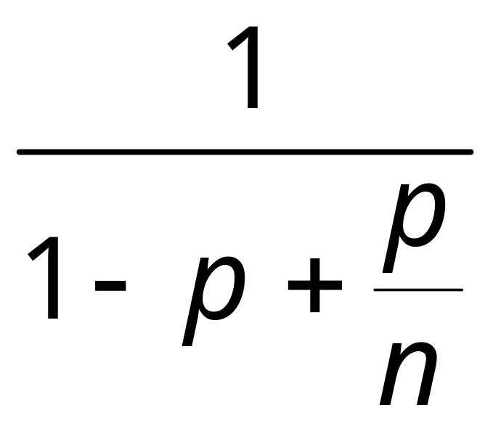
Amdahl’s Law
Speedup=
Art of Multiprocessor Programming
Notes:
AVOID USING THE WORD “CODE”, P is not a fraction of the code but if the execution time of the solution algorithm. It could be that 5% of the code are executed in a loop and account for 90% of the execution time.

Slide 112
Amdahl’s Law
Parallel fraction
Speedup=
Art of Multiprocessor Programming

Slide 113
Amdahl’s Law
Sequential fraction
Parallel fraction
Speedup=
Art of Multiprocessor Programming

Slide 114
Amdahl’s Law
Sequential fraction
Parallel fraction
Speedup=
Number of processors
Art of Multiprocessor Programming

Slide 115
Example
Ten processors
60% concurrent, 40% sequential
How close to 10-fold speedup?
Art of Multiprocessor Programming

Slide 116
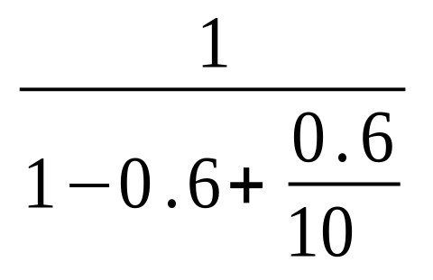
Example
Ten processors
60% concurrent, 40% sequential
How close to 10-fold speedup?
Speedup=2.17=
Art of Multiprocessor Programming
Notes:
Explain to students that you work really hard and parallelize 60% of the applications execution (NOT ITS CODE, its EXECUTION)
and get little for your money

Slide 117
Example
Ten processors
80% concurrent, 20% sequential
How close to 10-fold speedup?
Art of Multiprocessor Programming

Slide 118
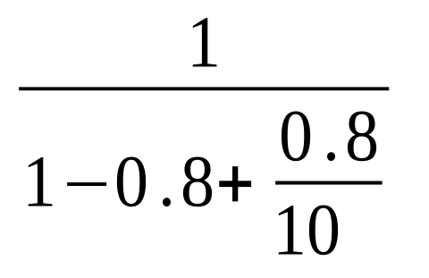
Example
Ten processors
80% concurrent, 20% sequential
How close to 10-fold speedup?
Speedup=3.57=
Art of Multiprocessor Programming
Notes:
Even with 80% we are only 2/5 utilization, we paid for 10 CPUs and got 4…

Slide 119
Example
Ten processors
90% concurrent, 10% sequential
How close to 10-fold speedup?
Art of Multiprocessor Programming
Notes:
With 90% parallelized we are using only half our computing capacity…

Slide 120

Example
Ten processors
90% concurrent, 10% sequential
How close to 10-fold speedup?
Speedup=5.26=
Art of Multiprocessor Programming
Notes:
With 99% parallelized we are now utilizing 9 out of 10. What does this say to us?

Slide 121
Example
Ten processors
99% concurrent, 01% sequential
How close to 10-fold speedup?
Art of Multiprocessor Programming

Slide 122
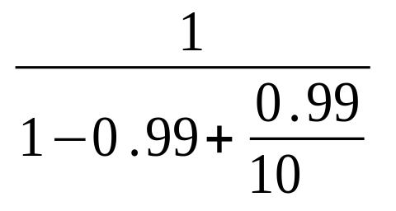
Example
Ten processors
99% concurrent, 01% sequential
How close to 10-fold speedup?
Speedup=9.17=
Art of Multiprocessor Programming

Slide 123
The Moral
Making good use of our multiple processors (cores) means
  Minimize sequential parts
  Reduce idle time in which threads wait without being productive
Art of Multiprocessor Programming
Notes:
Its not hard to imagine that in many applications, 90% of the code can be parallelized easily. The remaining 10% are typically the parts that have to do with coordination with other threads on shared data…this is where thinsg get harder. From Amdahl’s law we see that its worth our effort to try and parallelize even these last 10% since they are responsible for 50% of the untilization of our multiple processors.

Slide 124
Multicore Programming
This is what this course is about…
  The % that is not easy to make concurrent yet may have a large impact on overall speedup
Art of Multiprocessor Programming
Notes:
This is the focus of our course. The 10% or 20% of the solution that are harder to parallelize because they
involve coordination yet get us the big performance benefits if we can implement them correctly by cutting down on communication and coordination. Notcie that we did not use the word code .

Slide 125
This work is licensed under a Creative Commons Attribution-ShareAlike 2.5 License.
You are free:
  to Share — to copy, distribute and transmit the work
  to Remix — to adapt the work
Under the following conditions:
  Attribution. You must attribute the work to “The Art of Multiprocessor Programming” (but not in any way that suggests that the authors endorse you or your use of the work).
  Share Alike. If you alter, transform, or build upon this work, you may distribute the resulting work only under the same, similar or a compatible license.
For any reuse or distribution, you must make clear to others the license terms of this work. The best way to do this is with a link to
  http://creativecommons.org/licenses/by-sa/3.0/.
Any of the above conditions can be waived if you get permission from the copyright holder.
Nothing in this license impairs or restricts the author's moral rights.
Art of Multiprocessor Programming

