Slide 1
Application of Blockchain Technology in Rural Waste Management
Jasdeep Singh 2017csb1082
Guide - Dr. Shirshendu Das
Course - GEXXX
Course coordinator - Dr. Puneet Goyal

Slide 2
Introduction
India is one of the largest economies in the world but when it comes to waste management it lags behind. In a country of 1.3 billion we do not have proper mechanism for segregation of waste and its disposal which is mostly done by rag pickers to pick out valuable objects.The waste which is not properly treated and disposed has capacity to damage ecosystems permanently.
Rural areas are one of the worst affected and plagued by poor sanitation and energy shortages. The main problem is the decentralized nature of waste generation and energy usage and centralized nature of waste treatment and energy production. In this project we try to build a prototype to address this problem by adopting decentralized blockchain system in trading biomass energy and agricultural products across the waste-to-energy ecosystem.

Slide 3
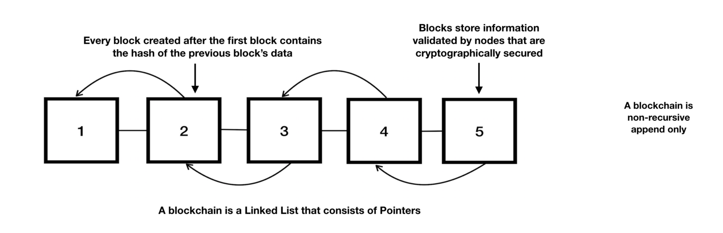
Blockchain Technology
A blockchain originally block chain, is a growing list of records, called blocks, that are linked using cryptography. Each block contains a cryptographic hash of the previous block,a timestamp, and transaction data.

Slide 4
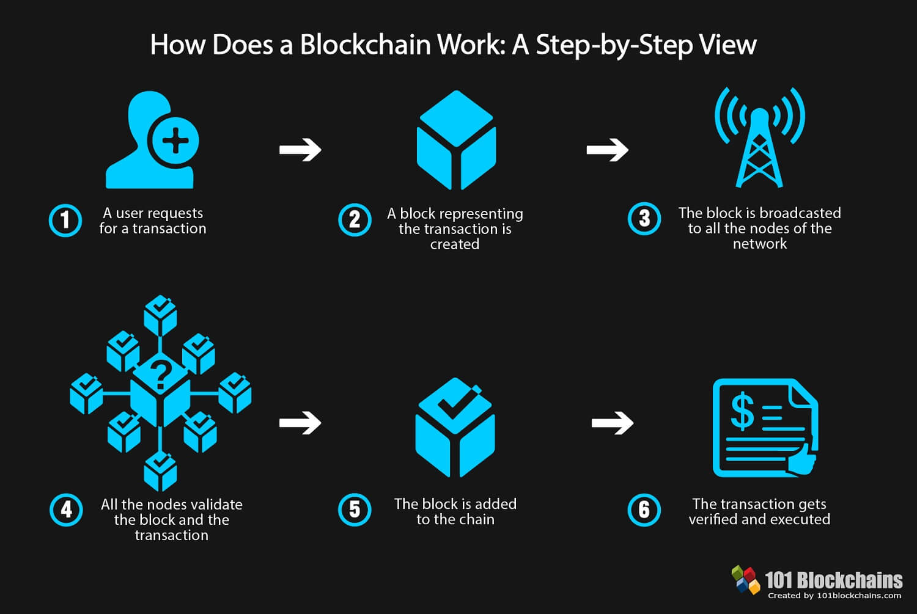

Slide 5
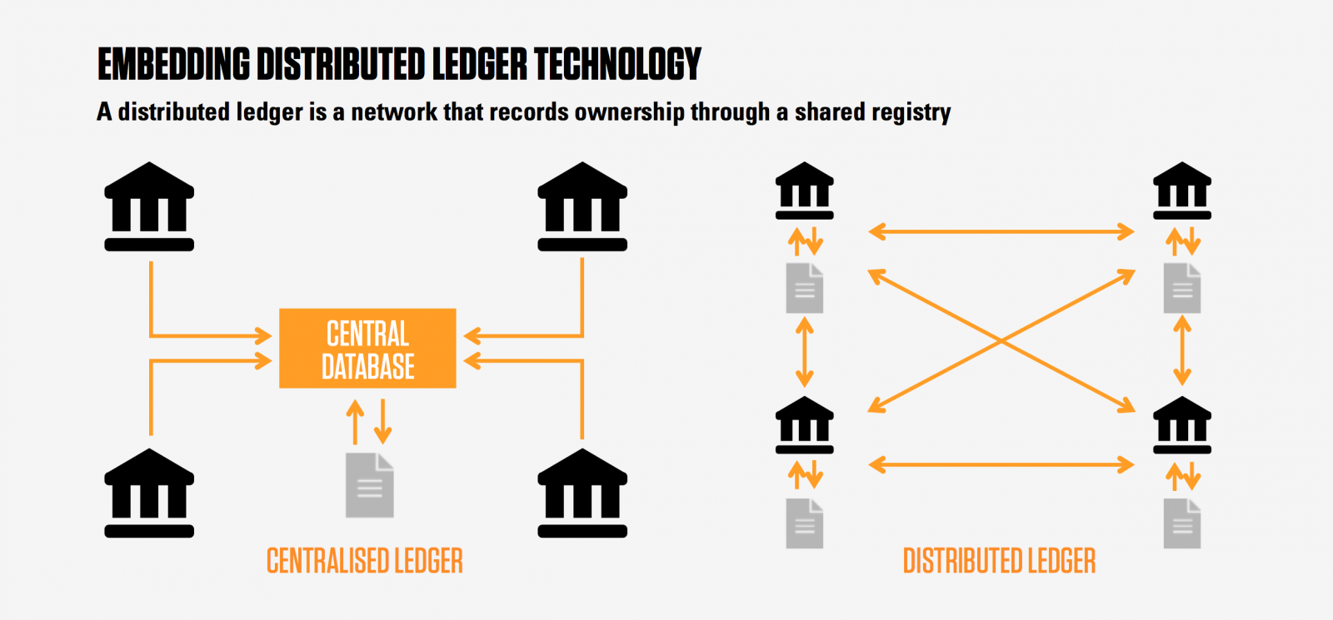

Slide 6
Advantages of Using Distributed Ledger
Eliminating the need for a third Party
Multiple non Trusting parties can perform transactions.
Once the transaction is performed it cannot be reversed.
Since all the data is shared across multiple nodes the chances of corrupting the data and performing illegal transactions is low.

Slide 7
Smart Contracts
According to Wikipedia smart contract is a computer protocol intended to digitally facilitate, verify, or enforce the negotiation or performance of a contract. Smart contracts allow the performance of credible transactions without third parties. These transactions are trackable and irreversible.
Proponents of smart contracts claim that many kinds of contractual clauses may be made partially or fully self-executing, self-enforcing, or both. The aim of smart contracts is to provide security that is superior to traditional contract law and to reduce other transaction costs associated with contracting
Smart Contracts are used to design customized transactions for various blockchain based applications usually written in Solidity.

Slide 8
Blockchain in Waste Management and Environment Protection
According to Waste360, “Waste and recycling companies are utilizing blockchain technology to reward people for recycling, solar energy generation, decentralizing energy and other waste management-related transactions.” Blockchain makes it easy for companies and public agencies to incentivize recycling and to better track waste on the journey from producers to the landfill.
Many startups are in emerging that aim to make the use of Blockchain technology for incentivizing people by offering them digital tokens or cryptocurrencies in exchange of waste. One such example is Plastic Bank.

Slide 9
Case Study : Plastic Bank
Plastic Bank, a for-profit organization founded in Vancouver, Canada in May 2013 by David Katz and Shaun Frankson, has the stated mission of reducing the amount of plastic waste in the environment while also helping to alleviate poverty in developing countries. The organization has created stores in which impoverished people ( recycling entrepreneurs ) can exchange plastic waste for digital tokens which can used to buy goods on Plastic bank app.
Less plastic ends up in the ocean and in landfills, and low-income people around the world can repurpose and monetize it instead. This value chain uses technology to improve the environment and fight poverty at the same time.

Slide 10
Waste2Currency
Build a portal in which farmers/suppliers can trade waste in exchange of digital coupons as economic incentive.
Each participant is provided with a unique address associated with its blockchain wallet which is used to perform transactions. Each waste bag/container is identified with unique uuid.
For simplicity we are considering Energy and Fertilizers coins as unit of currency i.e waste that can be used to produce energy and fertilizer products.
Facilitate safe and secure transactions across different entities and maintain record for each transaction performed to ensure accountablity.
Trace the path of waste package from source to destination .

Slide 11
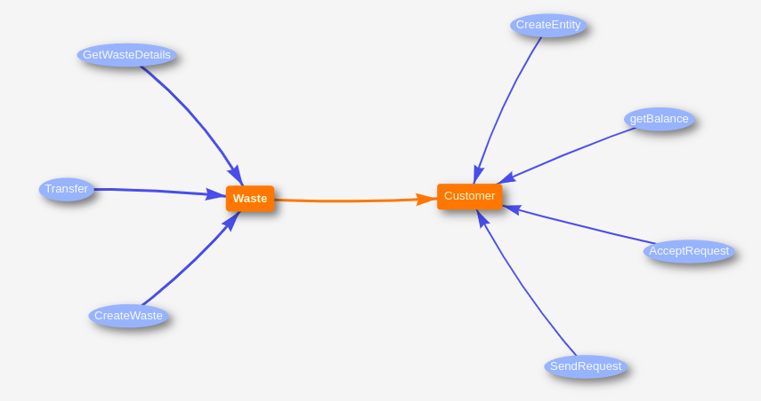
Transaction Diagram

Slide 12
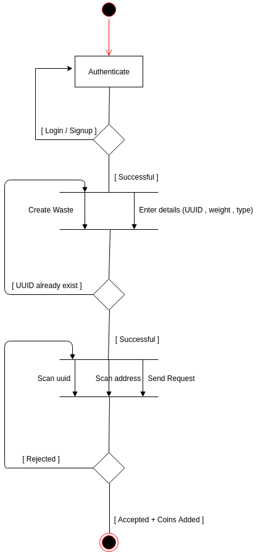
Activity Diagram

Slide 13
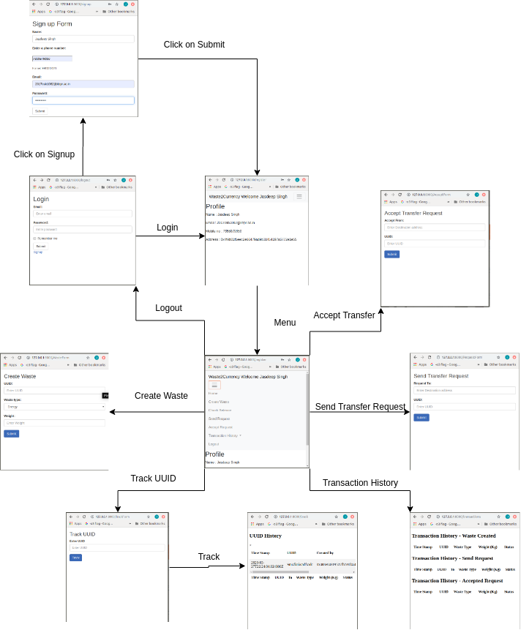

Slide 14
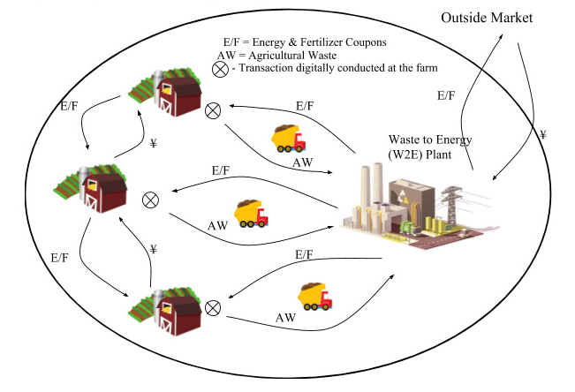

Slide 15
Use Case
Once the collected waste reaches a certain quantity the user can schedule pickup for the collection of waste.
User clicks on Create Waste and enters the relevant details by scanning the qr code containing the uuid ( universally unique identifier) associated with the waste or enter relevant details like type of waste and weight.
By default the user who creates the waste is the owner.
The user can exchange this waste in return for digital coupons or cryptocurrencies by scanning the qr code of receiver or manually entering.
These coupons can be used to buy energy or agricultural products like fertilizers.

Slide 16
Future Work
Add Location based Tracking and pickup for efficient management of supply chain.
Add QR scan based transactions for easier transactions.
Build a simulated version of Smart Bins ie. IOT based bins with sensors for automated pickup scheduling.
Make the application more user friendly and high complexities of blockchain addressing.

Slide 17
References
https://www.sciencedirect.com/science/article/pii/S187661021930027X
https://hackernoon.com/databases-and-blockchains-the-difference-is-in-their-purpose-and-design-56ba6335778b
https://101blockchains.com/ultimate-blockchain-technology-guide/
https://en.wikipedia.org/wiki/Blockchain
https://hackernoon.com/databases-and-blockchains-the-difference-is-in-their-purpose-and-design-56ba6335778b
https://medium.com/@shyamshankar/centralized-ledgers-vs-distributed-ledgers-layman-understanding-52449264ae23
https://merehead.com/blog/private-blockchain-vs-traditional-centralized-database/
https://www.multichain.com/blog/2016/03/blockchains-vs-centralized-databases/
http://www.sensanetworks.com/blog/how-is-blockchain-tech-impacting-waste-management-from-bitcoins-to-environmental-protection/
https://en.wikipedia.org/wiki/The_Plastic_Bank

