Slide 1
Pyspread
Creating your own Excel Spreadsheet
S18 FRI 8 AM IN3045 PYTHON
Programming Python

Slide 2
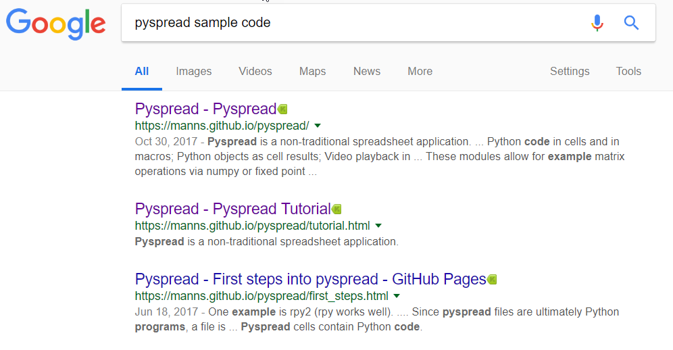

Slide 3
Module Themes:
Introducing Graphical User Interface Toolkits
PGP Encryption
Extending Pyspread to work with Excel and SQLite
Using GIT and GITHUB with the Windows Desktop Graphical Client to manage code assets for a development project
Writing a Python application that spans multiple Files

Slide 4
Pyspread: the non-traditional spreadsheet
Looking for a spreadsheet that is fully Python enabled? Look no further than Pyspread. This spreadsheet software, although lacking some major features found in other spreadsheet software such as Gnumeric and OpenOffice.org Calc, it is fully programmable in Python!
Unlike traditional spreadsheet programs, in Pyspread each cell is evaluated as a Python expression. You are even able to import Python modules into a cell, such as Numpy and many others.
It is based on the wxWindows toolkit, so it should fit in just fine with all your GTK+ applications, if you use a GTK+ desktop environment such as GNOME. It should work just fine in a Qt3/4/5 environment as well, but you will need a GTK+ engine for Qt to make it fit in nicely.
S18 FRI 8 AM IN3045 PYTHON

Slide 5
As mentioned earlier, each cell in Pyspread is evaluated as a Python expression, so in order to display a string in a cell, you must encapsulate the string in quotes.
Unlike a normal spreadsheet, there is no = sign, just enter in your expression and your good to go.
To reference other cells, you need to use a special list called S. It is in the format of S[X,Y,Z]. Which is S[row, col, sheet].
Some standard spreadsheet functions like sum() exist in Pyspread as well, and it accepts a range, such as S[1:15,2,0], which will return a range of cells that can be used as a parameter to sum().
Pyspread by default signs all of your spreadsheets using PGP, this ensures that you can only open a spreadsheet for which you have approved. (A spreadsheet can for example, erase your files).
S18 FRI 8 AM IN3045 PYTHON

Slide 6
The hugely unfortunately part about Pyspread is it's lack of import and export options.
Currently, it can only import/export CSV files. There is no option for OpenDocument format or Excel, despite Python modules existing to work easily with these formats. Another feature which is missing, which Python also supports via modules is database sources. It would be really nice to see a configuration option to use an external data source to fill cells using Python, say using a DBvariable.
However, since this spreadsheet is fully Python, it can be done manually within the spreadsheet itself.
There is a Macro menu which can be used to load external Python modules, which can in turn access external data sources and create new import/export facilities.
S18 FRI 8 AM IN3045 PYTHON

Slide 7
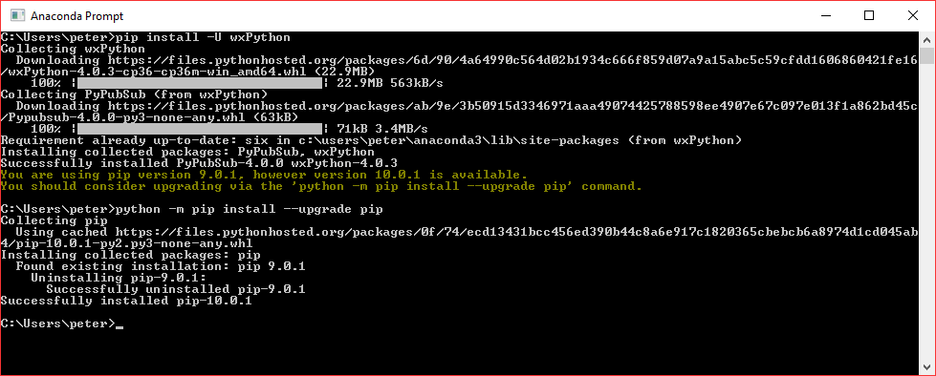
S18 FRI 8 AM IN3045 PYTHON

