Slide 1

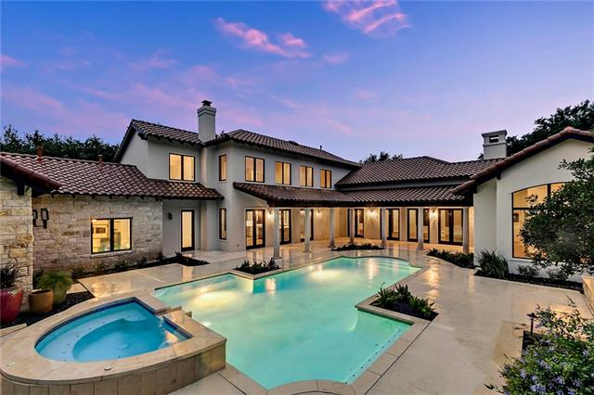
House Pricing
Finding Factors that are driving home prices using statistics
Jason Poe

Slide 2
Goal
From the perspective of an investment analyst
We are working to understand how we should allocate revenue for investments into mortgage-backed securities. To do this we will look at 3 factors that are driving the price of homes
For this analysis we will be looking at a data set of 1460 homes from Ames Iowa area
Using excel and the data analyst tools within to determine statistical significance

Slide 3
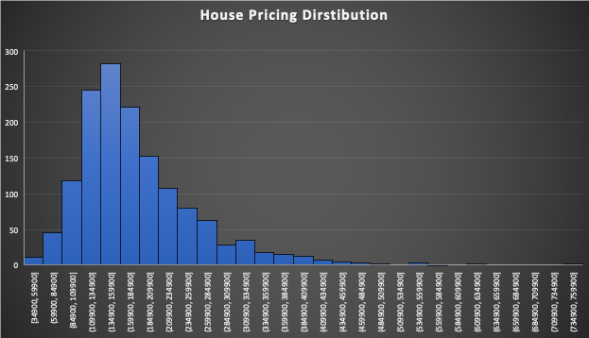
Descriptive Statistics
Avg Home Price
$180, 921.20
Max sale price
$755,000
Min. sale price
$34,900
Median Home Price $163,000

Slide 4
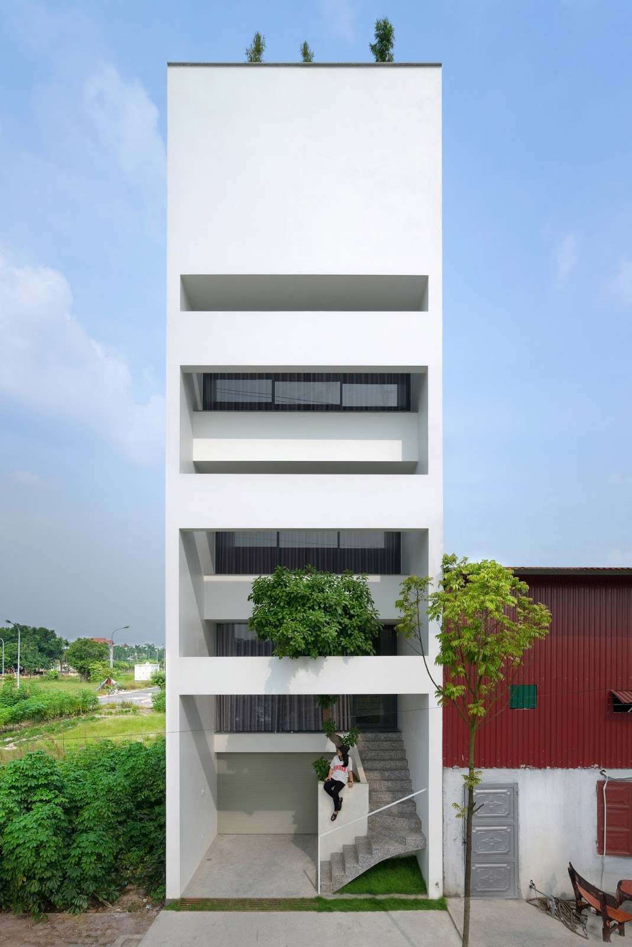
Factors
H0. there is no significant difference in homes with the roof style of hip and gable
There is no significant difference in homes based on neighborhood
There is no difference in homes that have central air
I hypothesis that 3 very important factors include:
Roof style
Neighborhood
Central air

Slide 5
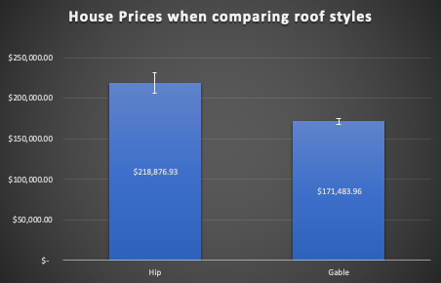
Roof style
With my P value at 2.81217E-11 which is less than 0.05
I can say with 95% confidence, the average price of houses with the roof style hip cost 37k to 75k more than housing with the gable roof style

Slide 6
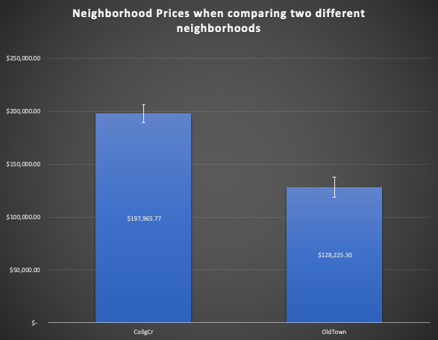
Neighborhood
With my P value at 3.3246E-22 which is less than 0.05
with 95% confidence, the average price of housing in collgCr cost between 60k and 80k more than housing in OldTown

Slide 7
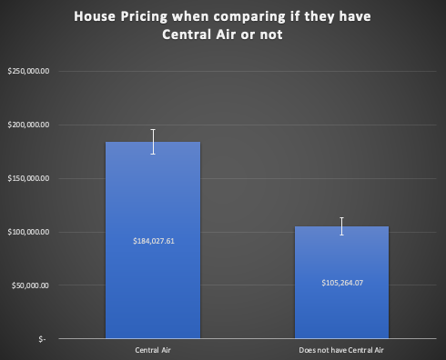
CENTRAL AIR
With my P value at 2.89122E-23 which is less than 0.05
with 95% confidence, the average price of houses with central air are 69k to 89k higher than housing without central air

Slide 8
CONCLUSION
MANY FACTORS ARE DRIVING THE PRICE OF HOMES
ROOF STYLE, NEIGHBOORHOOD, AND CENTRAL AIR
3 VERY IMPORTANT FACTORS THAT SIGNIFICANTLY AFFECT THE PRICE OF HOMES

Slide 9

THANK YOU

