Slide 1
Run and Shoot App
Presented By: (Group D) Firoozishahmirzadi Parichehreh Layeghi Mahsa Xu Jin El-Habrouk Jaser

Slide 2
Review on Run and Shoot Game
A simple map can look like this:
Destination
Player
Barrier
Arrows
The map is definitely not graphically intensive. This is just for
demonstration purpose

Slide 3
Initial definition of the function
* Assigned to: Mahsa
* Check if there is any barrier on the way of player.
* Input: player, barrier
* Output: 0 ---> player no hit & 1---> player is hit
* Return: int
int isBarrierHit(Player player, MapBarrier* barrier_p, MapSpace space);

Slide 4
Changes and Updates
Coding Conventions
Project Requirements
Our need
int isBarrierHit(Player player, MapBarrier* barrier_p, MapSpace space);
bool is_barrier_hit(map_t map, direction_t direction);

Slide 5
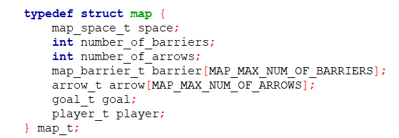
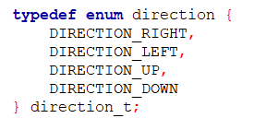
Function
This function is basically used to predict the player’s collision with any barriers
bool is_barrier_hit(map_t map, direction_t direction);
Input 1: map
Input 2: direction
Output: bool

Slide 6
Preconditions
Initialization of the map using load_map() function.
Only Allowed Directions(DIRECTION_UP, DIRECTION_DOWN, etc.)

Slide 7
Postconditions
The return value specifies the permission to move
- true -> The movement is prohibited
- false -> The movement is allowed

Slide 8
Testing Strategy
Black-box testing
1. Player on the edges of the map and wants to go further:
-Expected Output: a Boolean value of true (Movement is prohibited)
2. Player on Random Position, Wants to move in a direction of an existing barrier:
- Expected Output: a Boolean value of true (Movement is prohibited)
3. Player on Random Position, Wants to move in a direction with no barriers on way:
-Expected Output: a Boolean value of false (Movement is allowed)

Slide 9
Q & A Thank You!

