Slide 1
Run and Shoot App
Presented By: (Group D) Firoozishahmirzadi Parichehreh Layeghi Mahsa Xu Jin El-Habrouk Jaser

Slide 2
Application View
A simple map can look like this:
Destination
Player
Barrier
Arrows
The map is definitely not graphically intensive. This is just for
demonstration purpose

Slide 3
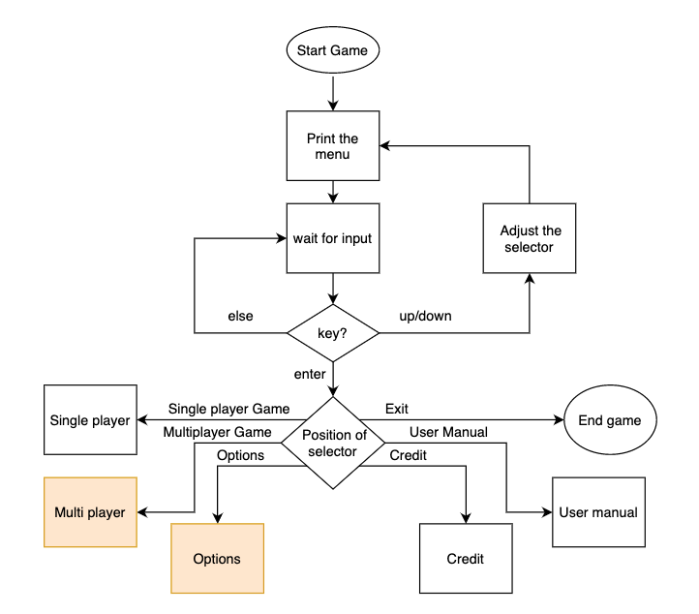
Application Flow Chart
Notes:
Each game has a 2D-map which a player can move inside it.
The map has 4 edges which act like a wall and the player movement is only defined within these walls and can't go furthur.
The map has a destination point which the player should reach it to wins.
There are some places in the map that the player can freely move around and some moving/static barriers which the player cannot move through them.
There are some random moving bullets/arrows in the map which can hit the player and if any does hit him/her, player loses a heart.
If player loses all its hearts, game is over.

Slide 4
The map has a destination point which the player should reach it to wins.
There are some places in the map that the player can freely move around and some moving/static barriers which the player cannot move through them.
There are some random moving bullets/arrows in the map which can hit the player and if any does hit him/her, player loses a heart.
If player loses all its hearts, game is over.
Single Player
Mode

Slide 5
In options tap one can select a specific map from the existing available maps:
Map number one
Map number two
One can select the game difficulty
When difficulty goes higher, the number and the speed of the arrows will increase
Easy
Moderate
Hard
Options (Available in Final Release)

Slide 6
In this level, we want to add another player to the game
The goal is reaching the destination
Both players will be able to shoot each other
If they can hit each other, the player which is shot will be out of the game and the one who is still in the game should reach the goal.
The game will over when one player reach the goal
Multiplayer Mode
(Only Available in Final Release)

Slide 7
​ | Jaser​ | Pari​ | Mahsa​ | Jin​
Week 1 25-31 Oct​ | Void print_menu (Menu menu);​ Void update_selector(Menu* menu_p, int arrowKey);​ | Void choose_menu_option(OptionMenues optionMenu);​ Map load_map(FILE* file_p,int mapNumber);​ | Void update_player_pos(Player* player, int arrowKey);​ int is_barrier_hit(Player player,MapBarrier* barrier, Mapspace space);​ | void update_barrier(MapBarrier* barrier, MapSpace space);​ void take_heart(Player* player);​
Week 2 1-7 Nov​ | void update_arrow(MapArrow* arrow, MapSpace space);​ int is_reach_goal(Player player, Goal goal);​ | int is_player_hit(Player player, MapArrow* arrow );​ void continue_game(void);​ | void win_game(Player player);​ void credit(void);​ | void update_view(Map map);​ void pause_game(void);​
Week 3 8-14 Nov​ Nov 12 – P2,D3 | int is_game_over(Player player); void back_to_menu(void); ​ | void game_over(Player player);​ void single_player(void);​ | void exit(void);​ | void user_manual(void);
Week 4 15-21 Nov​ | Finish release one and its documentation​

Slide 8
 | Jaser | Pari | Mahsa | Jin
Week 5 22-28 Nov​ | void option(void); ​ | int set_map(Option option, int key);​ | void set_difficulty(Option option, int key); void shoot(Player player, Map* map_p); | void print_option(Option* option);​ void multi_player(void);
Week 6 29 Nov-5 Dec​ | ​ ​​Finish release 2 and work on documentations – prepare presentation 3 slides ​
​Week 7 6-12 Dec 8-10 Dec (P3) | ​ ​Work on Presentation 3 and Deliverable 4 documentation ​
Week 8 13-19 Dec 18 Dec (D4) | Work on Deliverable 4 and its documentation

Slide 9
Q & A Thank You!

