Slide 1
BZETA
Notes:
(((( /-/ = queue animation ☺ ))))))
Intro?

Slide 2
?
Have you ever been in a situation that you can't control or have trouble handling?
Notes:
Have you ever been in a situation that you can't control or have trouble handling?

Slide 3

Notes:
as an organization that is aimed to create positive change in local communities through humanitarian projects,

Slide 4
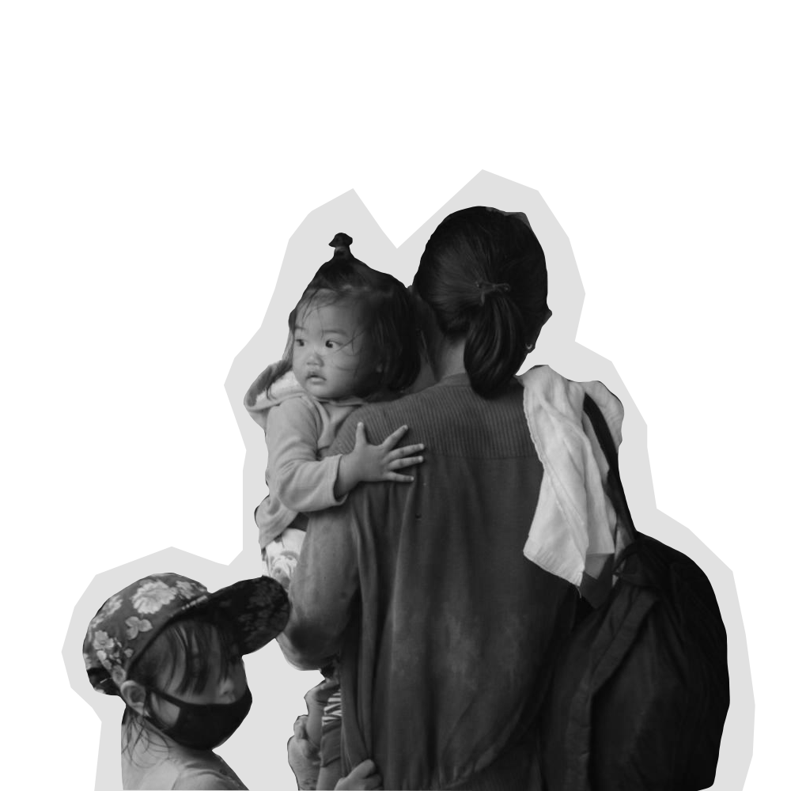


Notes:
we're sure that you've experienced instances where you /lacked the ability to respond in medical situations/ or /deal with disasters/ or /maybe even had trouble keeping tabs on your company's budget/
Part 2:
and this got us thinking...

Slide 5

DEVELOP A WEBSITE
Notes:
so, we came up with a solution, we thought of creating a website…

Slide 6

Disaster situations
Notes:
that will provide the necessary information on what to during disaster situations….

Slide 7

Medical
Emergencies
Notes:
or medical emergencies during indoor and mostly outdoor activities……

Slide 8

Online
Donation
Tracker
Notes:
Not only will the website have those information but it will also be an online tracker to keep tabs on the donations made to your organization.

Slide 9
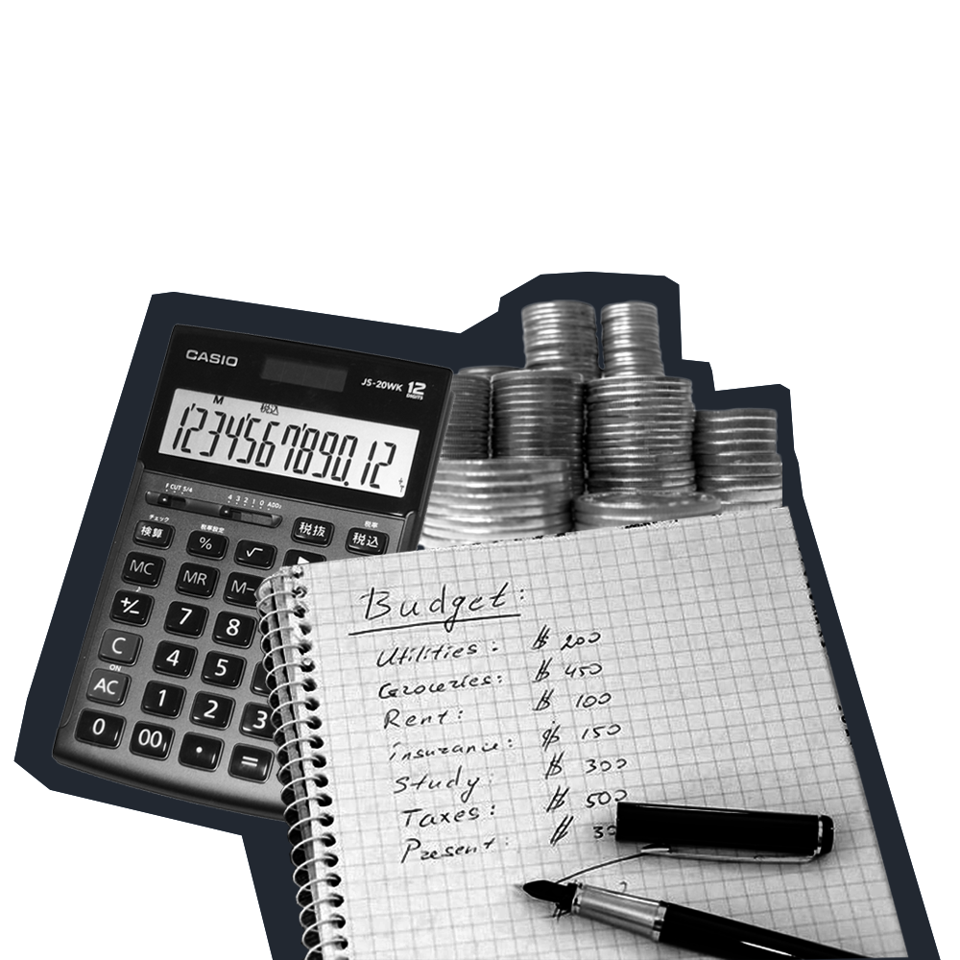
P1500
/
hour
Notes:
Part 3: (Might want to revise script?)

Slide 10
BZETA
Programmers
+
Multimedia Artists
Notes:
Part 4: BZeta is a group composed of /programmers/ /and/ /multimedia artists/, experienced in handling and developing projects. Our team is equipped with the necessary knowledge needed for web development and databases and can quickly adapt in a working environment

Slide 11

INDUSTRY
INNOVATION
INTERGRITY
Notes:
/As products of Asia Pacific College/, we are inspired and passionate individuals integrated with our Alma mater's core values: /industry ready/, /innovative mindset/, and /upholding integrity/, thus giving us an opportunity to showcase the capabilities and aptitude that APC has prepared us for. We can assure you that we will be giving you our best in both service and in product...

Slide 12
BZETA
2021
Notes:
Closing remarks????

