Slide 1
A comparison between Bacteria Foraging and Particle Swarm Optimizations for MESFET DC model parameter extraction
Rahul Kashyap

Slide 2
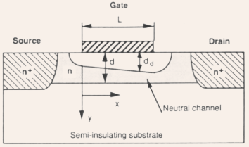
MESFET and some models
MESFET is a kind of transistor.
No standard model exists for the MESFET – various approximate models have been proposed depending on function and usage.
I-V can be measured experimentally. Model parameters can be extracted by training the models to data.
The models can then be used in different situations.
Typically, models express drain-source current as a function of drain-source voltage for fixed gate-source voltage.

Slide 3
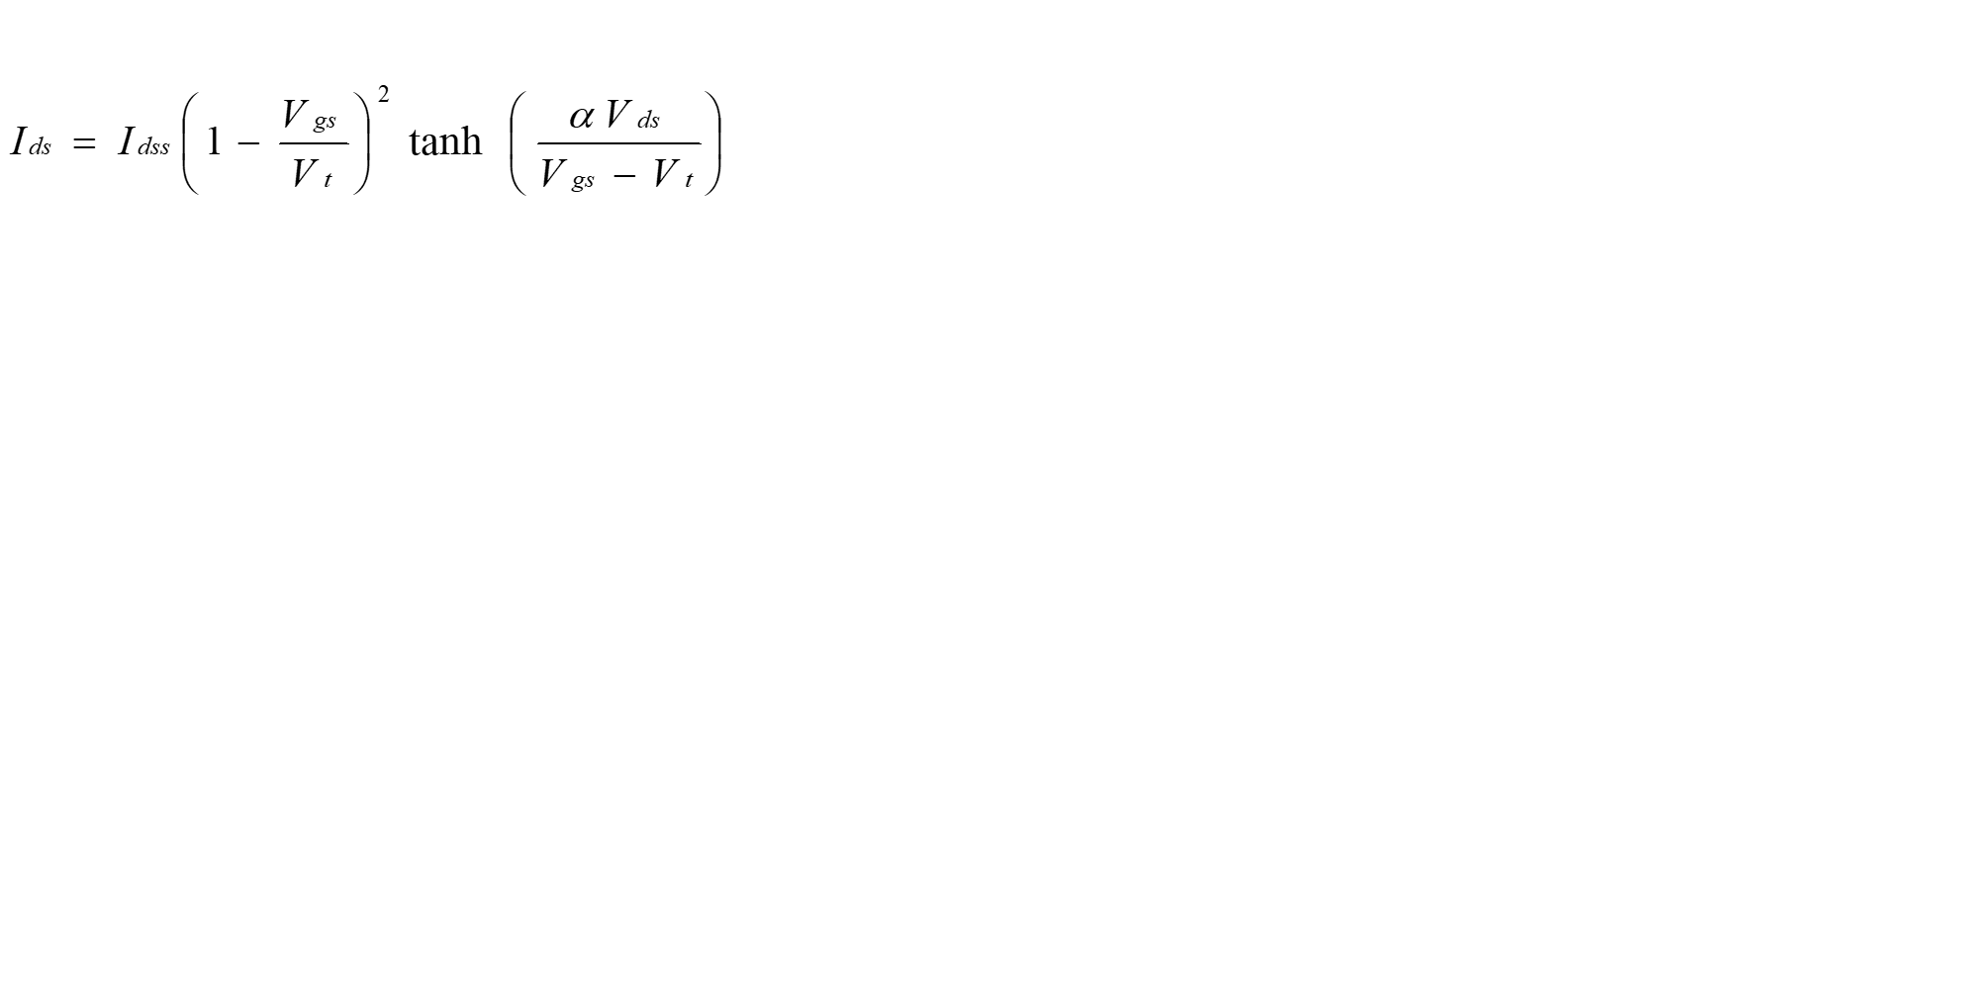


Materka-Kacprzak Model
where
Parameters to be extracted
$I_{dss}$– drain saturation current in amps
$V_{t0}$ – empirical constant
$α$– threshold voltage in volts
$γ$ – voltage slope parameter of pinch off voltage (1/volts)
Materka A. and Kacprzak T.:”Computer Calculation of Large-Signal GaAs FET Amplifier Characteristics”, IEEE Trans. Microwave Theory and Tech.”, vol. MTT-33,pp. 129-135, Feb. 1985.

Slide 4
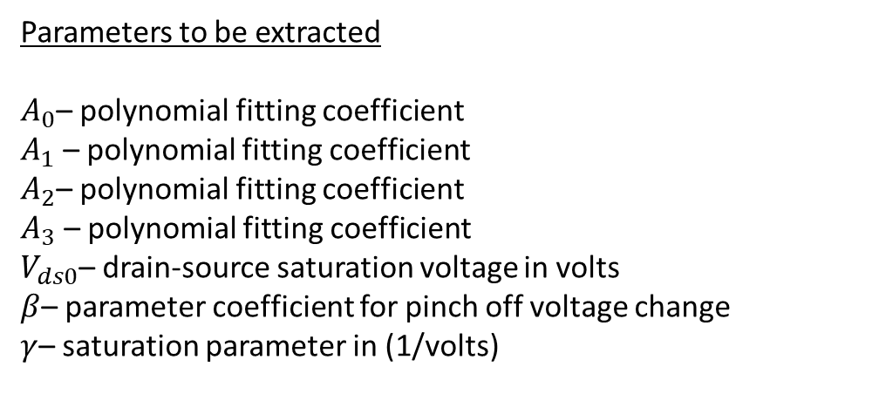
Curtice – Ettenberg Model
where
Parameters to be extracted
$A_{0}$– polynomial fitting coefficient
$A_{1}$ – polynomial fitting coefficient
$A_{2}$– polynomial fitting coefficient
$A_{3}$ – polynomial fitting coefficient
$V_{ds0}$– drain-source saturation voltage in volts
$β$– parameter coefficient for pinch off voltage change
$γ$– saturation parameter in (1/volts)
Curtice W.R. and Ettenberg M.,”A Nonlinear GaAs FET Model for Use in the Design of Output Circuits for Power Amplifiers”, IEEE Transactions on Microwave Theory and Techniques, vol. MTT -33, pp. 1383-1393, Dec 1985.

Slide 5
Particle Swarm Optimization
Evolutionary algorithm
Proposed in 1995 by James Kennedy and Russell C. Eberhart
Mimics “swarming” behaviour seen in bird flocks and schools of fish
Algorithm incorporates “learning” and communication between entities of a “swarm of particles” to converge to a common “destination”
Eberhart R. and Kennedy J.: “A New Optimizer Using Particle Swarm Theory,”, Proc. 6th Int. Symp. Micro Machine and Human Science (MHS), pp. 39-43, Oct. 1995.

Slide 6
The Algorithm
Initialize
Set X_{max} and X_{min}; NP; D (define the range, no. of particle, no. of dimension)
t 0; i 0;‘t’ for iterations and ‘i’ for particles
Initialize position X₀ and velocity V_{0,} V_{max}
Evaluate fitness function values f₀
pbest⁰ _{i} f⁰ _{i} , gbest⁰ fbest⁰

Slide 7
Main Routine
while t < Maximum Generation do
while i < NP do
Update velocity and position by
Evaluate fitness function values f_{t+1}
Update pbest ^{t}_{i} and gbest ^{t}_{d}
i i+1, go to step 7
end while
if stop criteria not meet then
t t+1, go to step 5
end if
end while
Report results
Terminate

Slide 9
Bacteria Foraging Optimization
Proposed in 2002 by Kevin M. Passino, it tries to mimic a cluster of bacteria searching for food. (foraging)
The algorithm incorporates swarming as actual organizational behaviour of the ‘bacteria’ in space.
Passino K. M.: Biomimicry of Bacterial Foraging for Distributed Optimization and Control, IEEE Control Systems Magazine, pp. 52 – 67, June 2002

Slide 10


Features of the Algorithm
Chemotaxis: The movement of bacteria in a medium is called chemotaxis. In the algorithm, it is modeled as a combination of ‘tumble’, the random orientation of the bacteria in search space and ‘swim’, the movement of the bacteria in that direction. It is given by
Here ∆ indicates the direction of the bacteria and C(i) gives the swim length. The swim length has been modified in this application as
where is the ratio

Slide 11
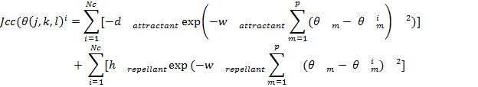
Swarming: This step tries to model the grouping of bacteria in concentric circles to move up a nutrient gradient. It is given as
Where 𝜽 = [(i)] where I runs from 1 to D is the position in search space.

Slide 12
Reproduction: This refers to the process where bacteria reproduce by splitting into two identical copies of itself. A genetic algorithm like step is added here to first kill some of the population that performs poorly
Elimination/Dispersal: In this step the bacteria are randomly dispersed over the search space and they begin their search again.

Slide 13
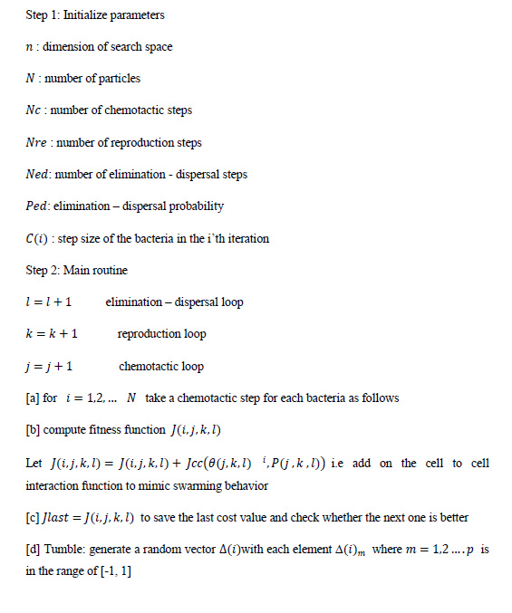
The Algorithm
Biswas A., Dasgupta S., Das S., Abraham A. : A Synergy of Differential Evolution and bacterial Foraging Optimization for Global Optimization, Neural Network World, pp. 607 – 626, June 2007

Slide 14
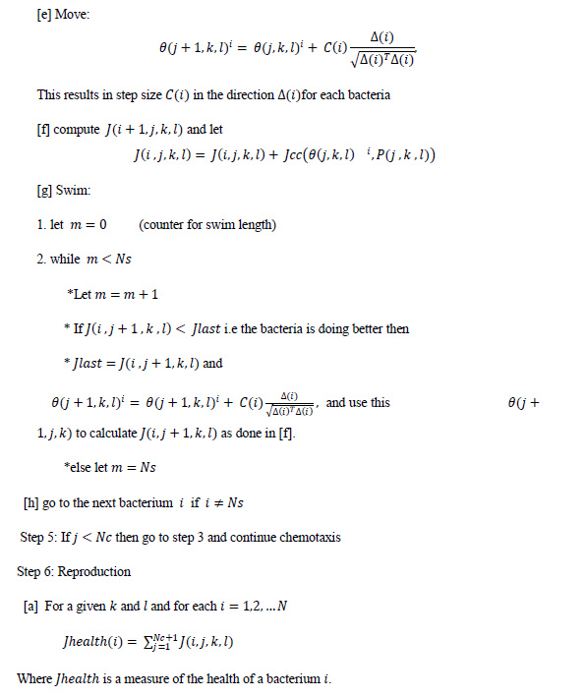

Slide 15
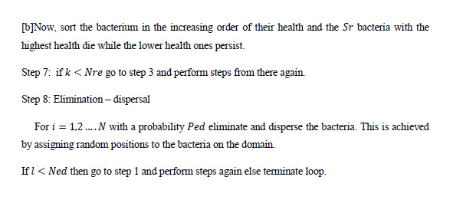

Slide 16
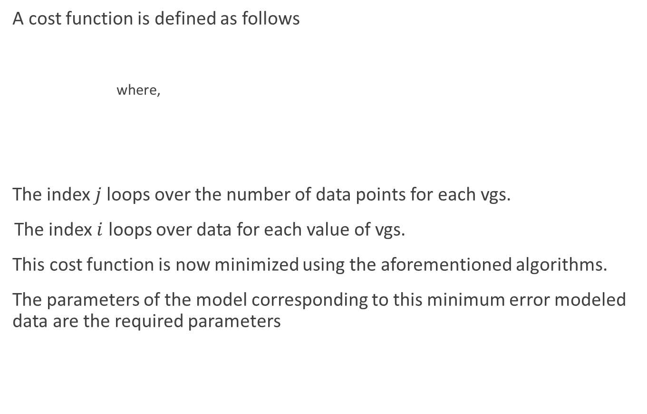
Problem set up
A cost function is defined as follows
where,
The index $j$loops over the number of data points for each vgs.
The index $i$ loops over data for each value of vgs.
This cost function is now minimized using the aforementioned algorithms.
The parameters of the model corresponding to this minimum error modeled data are the required parameters

Slide 17
The strategy to extract parameters is as follows.
1. Start
2. Load the measured data into the program
3. Load the DC model file
4. Apply PSO/BFO and extract the parameters
5. Using the model file simulate the I-V characteristics
6. Calculate objective function
7. Check if the parameters and the error fall within set limits or if total iterations are reached.
8. If no, repeat 4-7
9. Else, report and record error and parameter values
10. End

Slide 18
PSO algorithm parameters
c1 = 1.4
c2 = 1.9
w = 0.4
wmax = 0.95
wmin = 0.2
num_particles = 50
num_dimensions = 7
iterations = 1100

Slide 19
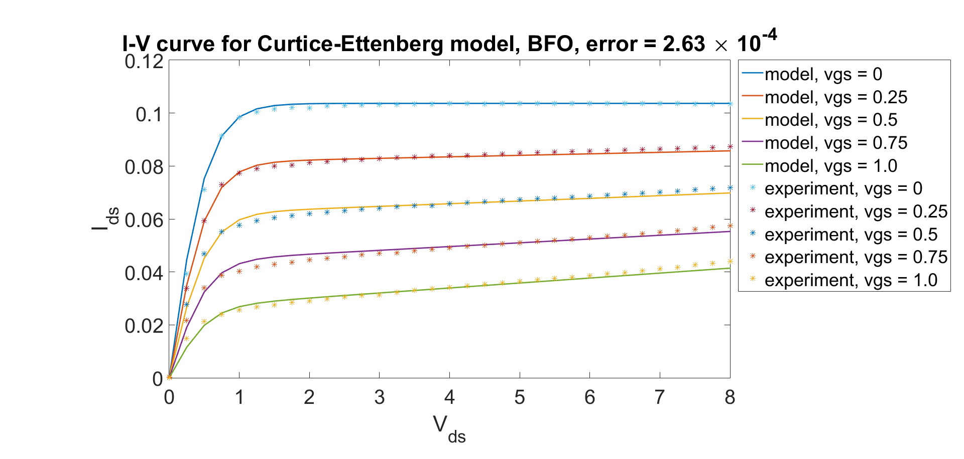
PSO results for Curtice-Ettenberg Model
Averages over 100 runs are as follows (average run time 6.12 s)
Parameters | Maximum | Minimum | Value Extracted by PSO
β | 0.0935 | -0.052 | 0.0286
A0 | 0.1235 | 0.0008 | 0.1032
A1 | 0.375 | -0.028 | 0.0728
A2 | 0.27 | -0.0417 | 0.0069
A3 | 0.023 | -0.108 | -0.0129
γ (1/V) | 2.95 | 0.95 | 1.9021
V_{ds0} (V) | 8.36 | 2.25 | 5.2106
error |  |  | 0.0011

Slide 20
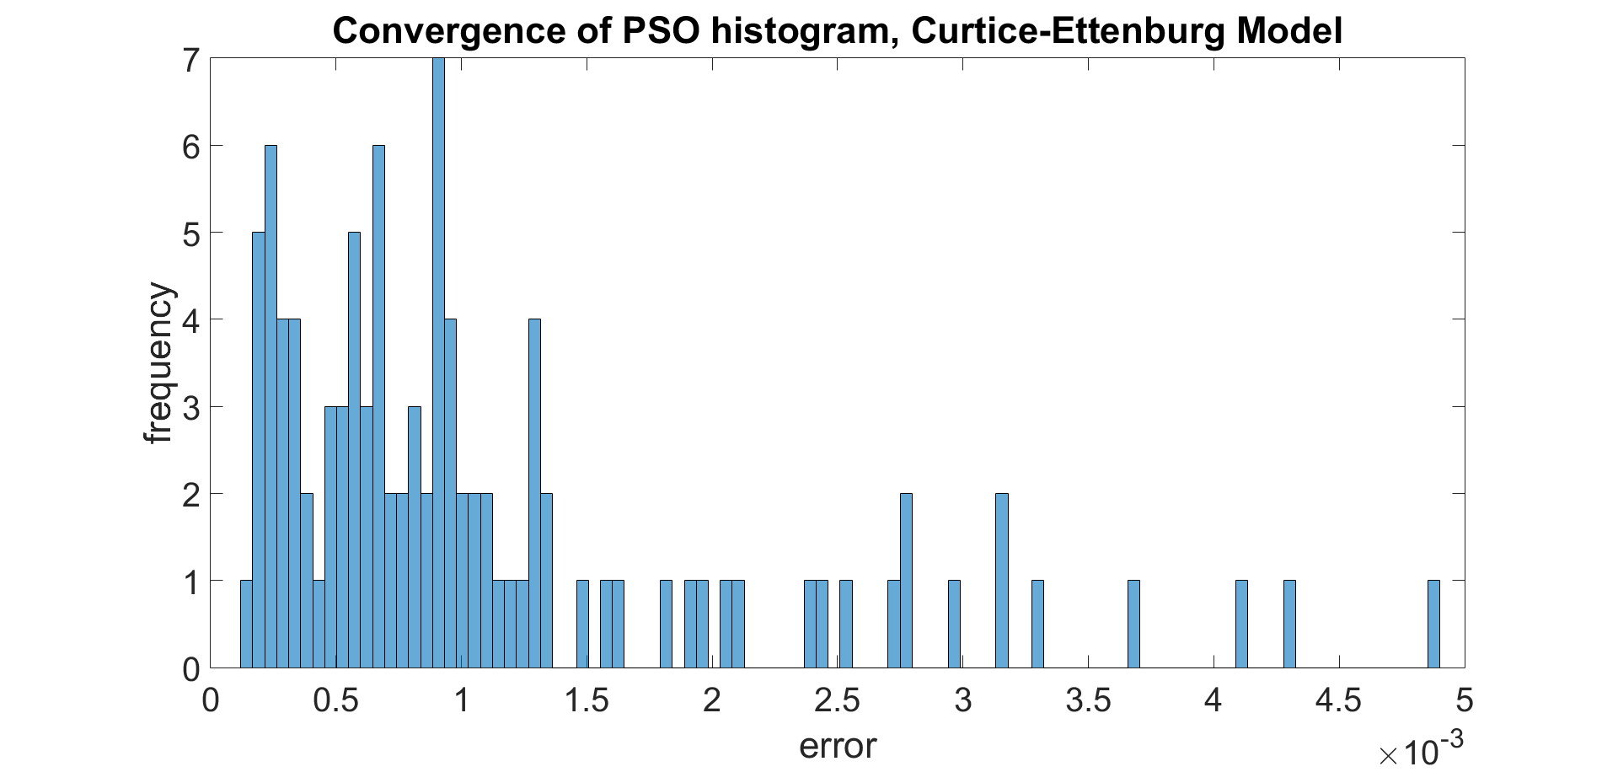
PSO convergence on Curtice-Ettenberg model
Converges to error within 10⁻³ 81% of the time. Quite consistent.
Notice the multimodal distribution. Too many parameters means the algorithm can get stuck more easily in local minima.

Slide 21
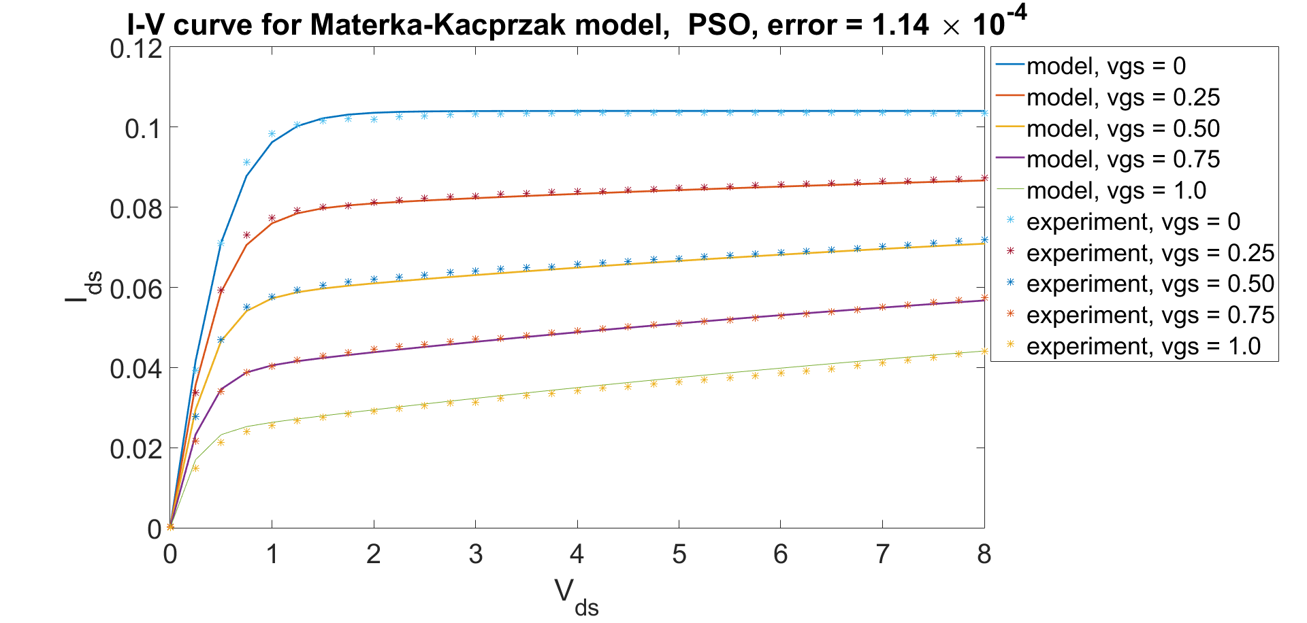
PSO results for Materka-Kacprzak model
Averages of 100 runs are as follows (average run time, 5.92s)
Parameter | Maximum | Minimum | Value Extracted by PSO
I_{dss (A)} | 0.425 | 0.0302 | 0.1041
V_{t0(}V) | 0.81 | -2.154 | -1.9043
α | 6.24 | 3.041 | 3.4056
γ (1/V) | -0.0193 | -1.6816 | -0.1193
error |  |  | 0.0002

Slide 22
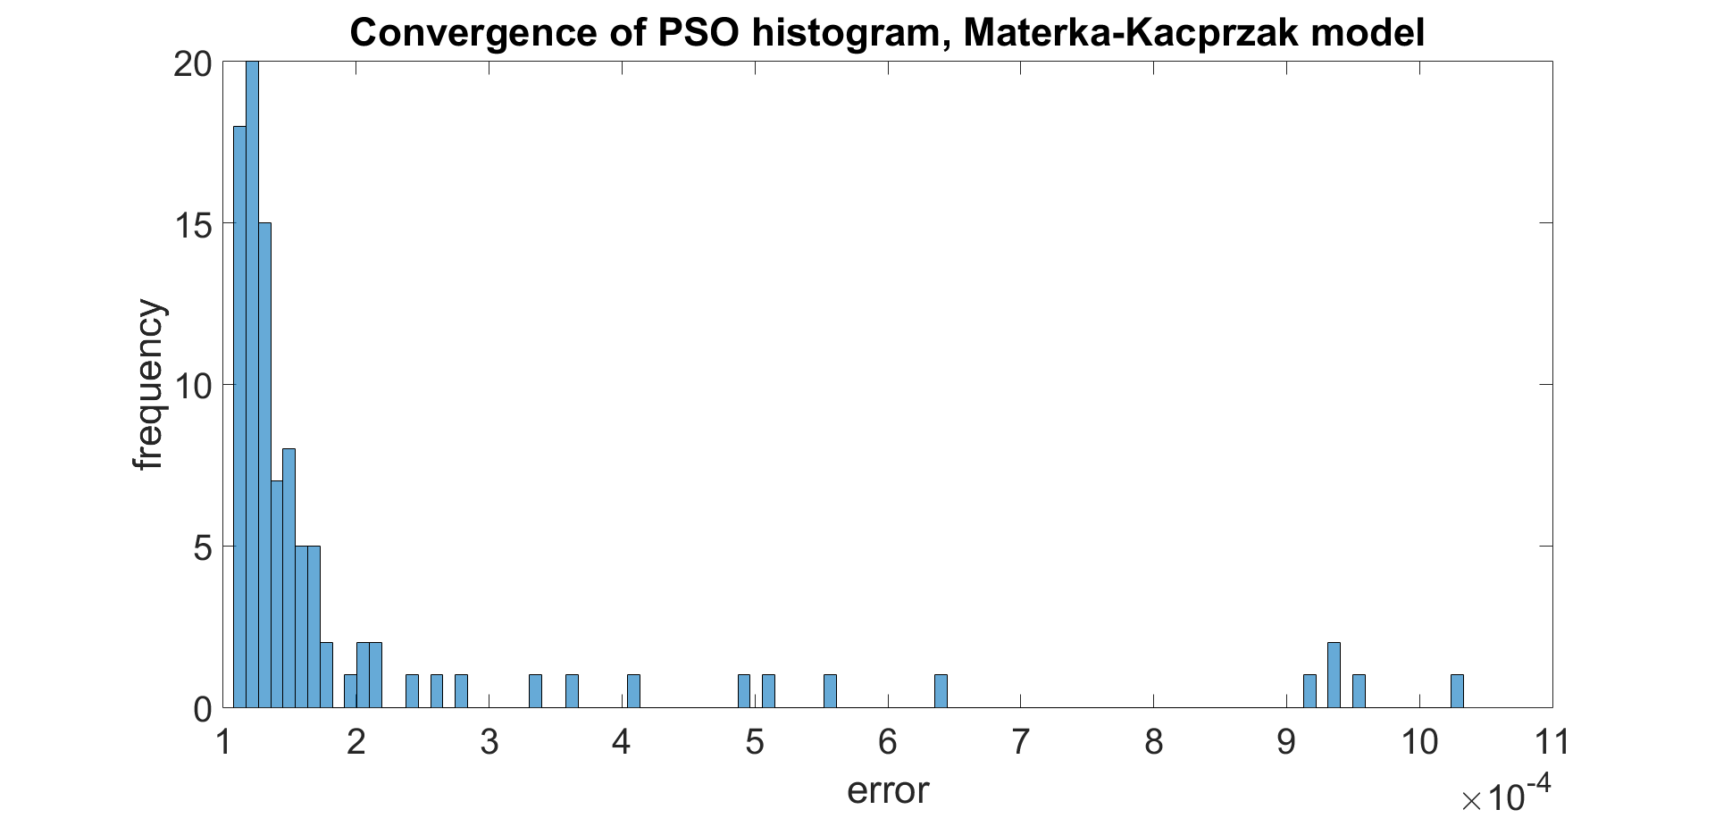
PSO convergence on Materka-Kacprzak model
Converges to error within 2 × 10⁻⁴ 82% of the time. Very consistent.
In contrast to the Curtice-Ettenberg model, the histogram here is unimodal. Direct consequence of fewer parameters – less chance of converging to local minima

Slide 23
BFO algorithm parameters
p = 4
s = 40
Nc = 5
Ns = 4
Nre = 4
Sr = s/2
Ned = 5
ped = 1.0
C(i) = 0.01*(upper_limit – lower_limit)

Slide 24
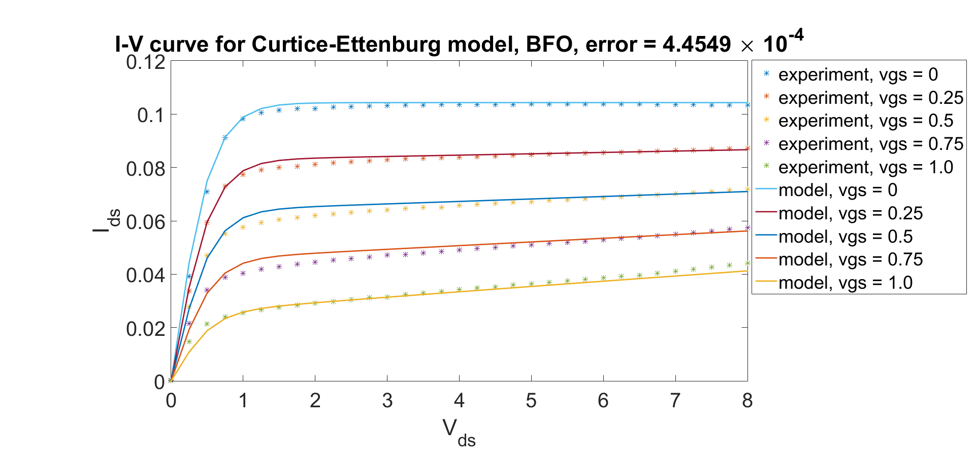
BFO results for Curtice-Ettenberg Model
Averages over 100 runs are as follows (average run time 6.27 s)
Parameters | Maximum | Minimum | Value Extracted by PSO
β | 0.0935 | -0.052 | 0.0386
A0 | 0.1235 | 0.0008 | 0.1043
A1 | 0.375 | -0.028 | 0.0830
A2 | 0.27 | -0.0417 | 0.0067
A3 | 0.023 | -0.108 | -0.0093
γ (1/V) | 2.95 | 0.95 | 1.9747
V_{ds0} (V) | 8.36 | 2.25 | 5.2430
error |  |  | 0.0026

Slide 25
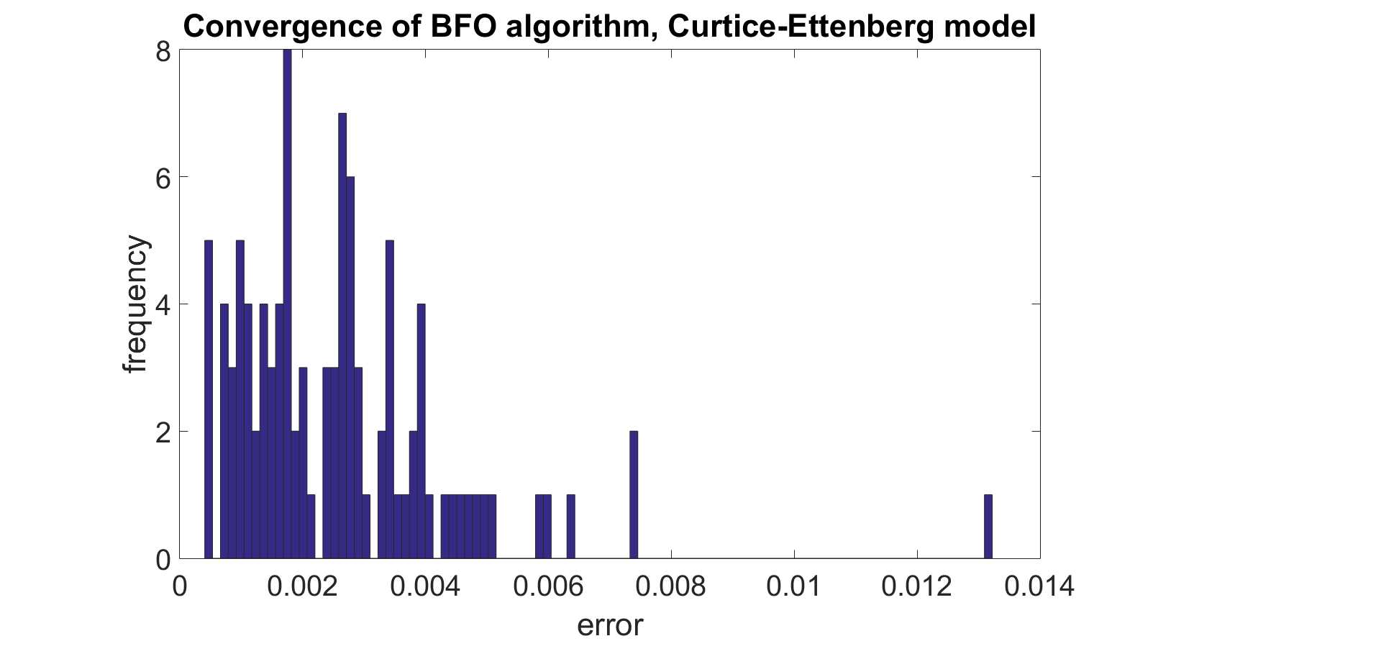
BFO convergence on Curtice-Ettenberg model
Converges to error within 10⁻³ only 21% of the time. PSO is way more consistent. Scatter is also higher.
Algorithm does not converge fast enough.
Multimodal distribution – algorithm can get stuck in local minima. Modal error twice that of PSO.

Slide 26
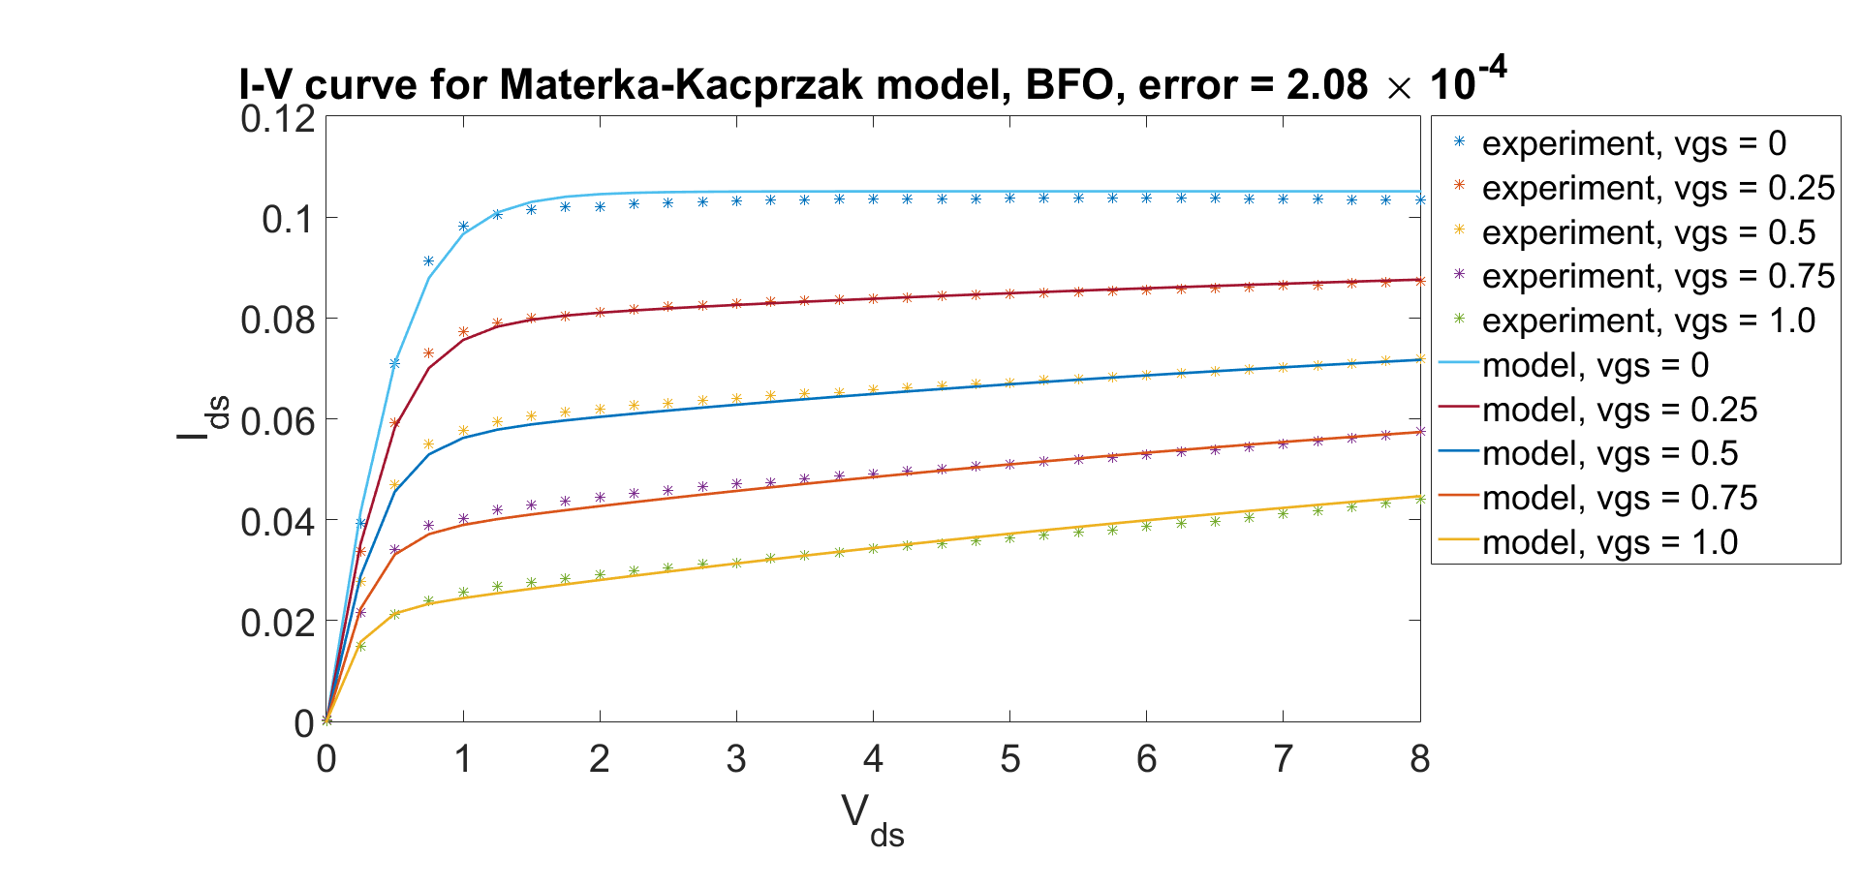
BFO results for Materka-Kacprzak Model
Averages over 100 runs (average run time 5.54 s)
Parameter | Maximum | Minimum | Value Extracted by PSO
I_{dss (A)} | 0.425 | 0.0302 | 0.1032
V_{t0(}V) | 0.81 | -2.154 | -1.8067
α | 6.24 | 3.041 | 3.8612
γ (1/V) | -0.0193 | -1.6816 | -0.1478
error |  |  | 0.0010

Slide 27
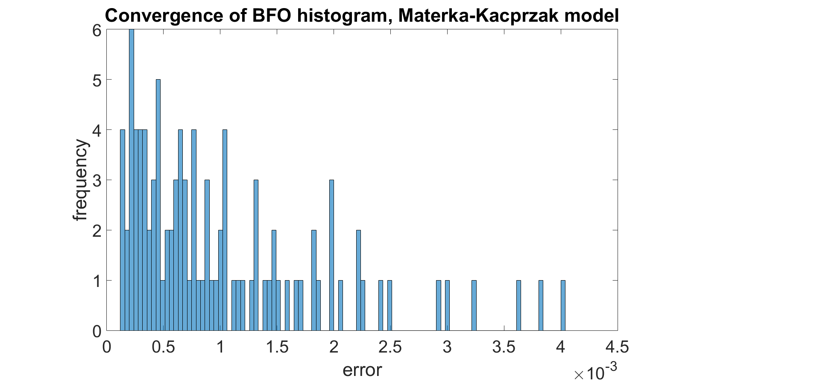
BFO convergence on Materka-Kacprzak model
Converges to error within 2 × 10⁻⁴ only 20% of the time. PSO is way more consistent. Scatter is also much higher.
Algorithm does not converge fast enough.
Multimodal distribution – algorithm can get stuck in local minima.
Modal error is twice that of PSO.

Slide 28
Summary of key results
PSO seems to converge faster and with more consistency.
Error with PSO is lower consistently.
BFO and PSO both show a tendency to get stuck in local minima when parameter space is large.
BFO has too many parameters to tune. Sometimes simpler is better.
“A Comparison of Particle Swarm Optimization and Bacteria Foraging Optimization for MESFET DC Model Parameter Extraction.”
Thesis presented in partial fulfillment of the requirements towards an Integrated Master of Science in Physics, University of Hyderabad

