Slide 1
MIMO Adaptive Beamforming for Integrated Sensing and Communication (ISAC)
May 21, 2025
https://docs.google.com/document/d/1ts46bLxKFBkV78Je-Cu6QNMBxL0eq-MB2k1U7ooAKNw/edit?tab=t.0

Slide 2
ISAC and Beamforming
ISAC Fundamentals - Enables dual-purpose usage for post-disaster networks
Adaptive Beamforming - AoA-based beam switching techniques.
Multi-target Tracking - Weak signal detection and clutter handling Critical for detecting minimal gestures.
Communication QoS Constraints - SINR-aware beam design to ensure connectivity despite sensing priorities
Notes:
To add

Slide 3
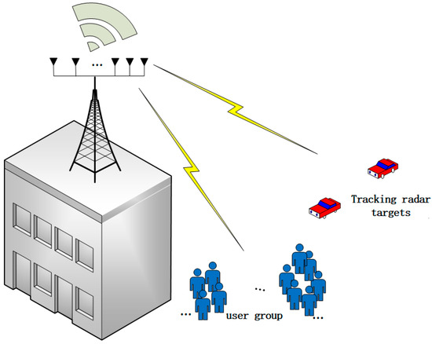
Problem Statement
We develop ISAC beamforming strategy tailored for disaster-hit, multipath-rich environments, aiming to reliably detect weak and dynamic signals—such as survivors waving—while ensuring a minimum SINR for uplink/downlink communication to clustered receivers. We use adaptive beamforming to continuously shape and steer transmission patterns, allowing the system to follow and respond to the unpredictable movements of people who may appear or shift positions anywhere in the area.
We aim to improve upon the NOMA-ISAC system as proposed in [1]

Slide 4
Objectives
Phase - I (focussed on communication)
Utilize N beams, continuously steered in all direction such that they maintain the min SINR for communication channel.
Phase - II (focussed on sensing)
Once we have detected the AoA(using one of the MUSIC, ESPRIT, Grid Pencil, LCMV) of all dynamical objects, we redistribute the spectral beams to distribute dedicated power to sensing and communication.
The sensing power is then focussed on specific directions relaying the powers based on clutter covariance matrices.

Slide 5
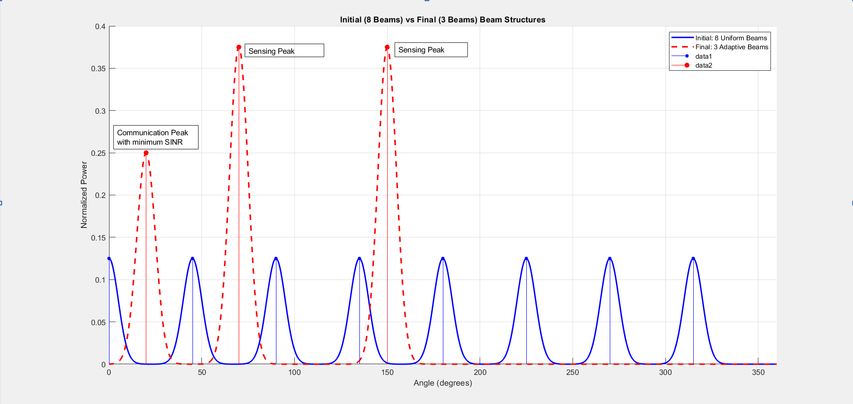
Simulations

Slide 6
Future Works
Multi-Base-Station Coordination
Enable cooperative tracking and extended coverage by integrating multiple ISAC-enabled base stations.
Refined Human Detection
Improve accuracy by distinguishing human gestures from environmental clutter using spatial and temporal signal features.
Context-Aware Beam Adaptation
Dynamically balance sensing and communication priorities based on environmental conditions needs.
Multi-Object Tracking
Using data-free filtering methods like Kalman filters and/or using data-based deep learning solutions to allow multi-object tracking once we have sensed them.

Slide 7
References
Yang, Q., Tang, R., & Peng, Y. (2024). Joint Beamforming Design and User Clustering Algorithm in NOMA-Assisted ISAC Systems. Sensors, 24(20), 6633. https://doi.org/10.3390/s24206633
S. W. Varade and K. D. Kulat, "Robust Algorithms for DOA Estimation and Adaptive Beamforming for Smart Antenna Application," 2009 Second International Conference on Emerging Trends in Engineering & Technology, Nagpur, India, 2009, pp. 1195-1200, doi: 10.1109/ICETET.2009.194.
N. Mehrotra and A. Sabharwal, "On the Degrees of Freedom Region for Simultaneous Imaging & Uplink Communication," in IEEE Journal on Selected Areas in Communications, vol. 40, no. 6, pp. 1768-1779, June 2022, doi: 10.1109/JSAC.2022.3155518.
F. Li and B. Liao, "Massive MIMO-ISAC Beamforming Design Via Sensing Energy Maximization," ICASSP 2025 - 2025 IEEE International Conference on Acoustics, Speech and Signal Processing (ICASSP), Hyderabad, India, 2025, pp. 1-5, doi: 10.1109/ICASSP49660.2025.10888130.
Zongyao Zhao, Zhenyu Liu, Rui Jiang, Zhongyi Li, Xiao-Ping Zhang, Xinke Tang, & Yuhan Dong. (2024). Joint Beamforming for Multi-target Detection and Multi-user Communication in ISAC Systems.
S. G. Jagtap and A. Kunte, "Classification and Trends in Adaptive Beamforming Techniques of MIMO Radar," 2021 International Conference on Communication information and Computing Technology (ICCICT), Mumbai, India, 2021, pp. 1-6, doi: 10.1109/ICCICT50803.2021.9510162.

Slide 8
Thank You
By
Dharmesh Mohanraj & Jash Shah

