Slide 1
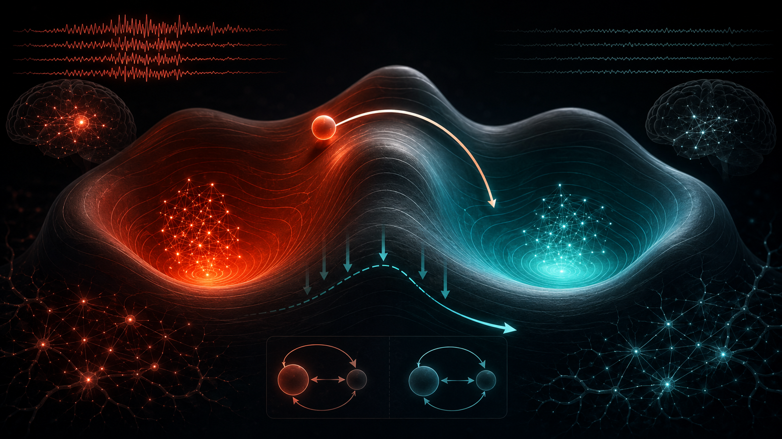
What is Already Done: From Seizure-Like Attractors to PACAN
Full computational neuroscience pipeline: E/I dynamics → stochastic basin transitions → sparse model-level intervention → EEG grounding
Seizure-like basin
Wilson–Cowan E/I
Monte Carlo Psucc
PACAN mask search
Landscape/manifold
CHB-MIT calibration
Neuroscience model
Intervention framework
Seizure-like dynamics modeled as pathological attractor states in stochastic neural population systemsWilson–Cowan excitatory/inhibitory networks; Hopfield energy-landscape benchmarksThree-phase rollout: pre-settlement → intervention → post-settlement basin retention
Boltzmann/Gibbs sampling over sparse intervention masks plus continuous amplitude refinementOptimizes high transition success with sparse, low-effort, robust neural-state shiftsCompares push interventions versus landscape-reshaping interventions
Main results so far
PACAN improves stochastic transition success over deterministic/greedy baselines: ΔPsucc = +0.0818, +0.1049, +0.1533 for N=10,15,20Pareto hypervolume improves ≈1.30×–1.38×; reshape interventions achieve ≈2.3×–2.6× higher Psucc than push at high noisePathological basin dominance grows with scale: volume ≈91.6% → 93.9% → 95.4%; barrier ΔE ≈5.3 → 7.5 → 9.6CHB-MIT calibration gives WC parameter CV <15%; MEM landscapes show 8–12 minima; Week 9: 67–75% within-manifold alignment
Central metaphor: pathological neural activity sits in a seizure-like basin; PACAN proposes sparse interventions that either push the state over a barrier or reshape basin geometry.
Psucc = Pr[xT enters healthy basin after intervention]
+0.1533
1.30×–1.38×
2.3×–2.6×
<15% CV
8–12
67–75%
49.1%
N=10–30
max ΔPsucc
Pareto HV gain
reshape > push
CHB-MIT fit
EEG minima
manifold aligned
optimizer variance N=20
scale tested
Notes:
This slide should communicate that the project is fundamentally about neural state dynamics. PACAN is the computational mechanism, but the biological question is how to move a noisy E/I neural population system out of a seizure-like attractor basin using sparse, robust intervention.

Slide 2
What More Can Be Done: Experiments Toward a Strong Neuroscience Paper
Next experiments should make the model more biologically realistic, empirically grounded, and mechanistically interpretable.
Multistable landscapes
Patient-specific EEG
Structure-informed coupling
Manifold-constrained PACAN
Immediate experiments
Publication-strength extensions
1. Multi-attractor neural benchmark
1. Patient-specific EEG calibration
Extend beyond bistable WC systems; use MEM-inspired landscapes with 8–12 minima and test target-basin selectivity.
Estimate patient-specific E/I proxies, empirical barriers, and basin occupancy; relate selected nodes to seizure-relevant EEG channels.
2. Structure-informed neural coupling
2. Larger-scale E/I networks
Use connectome or seizure-network topology; compare selected nodes to degree, controllability, and onset-zone proxies.
Scale N=50–100; measure whether PACAN advantage widens as intervention masks become more combinatorial.
3. Mechanistic fixed-point analysis
3. Stronger baselines
Explain success via Jacobian eigenvalues: destabilize pathology, lower barriers, create transient healthy basin, align with modes.
Compare simulated annealing, random, greedy, degree centrality, FVS, Bayesian, and evolutionary search.
4. Surrogate / real-time extension
Train recurrent or neural-ODE surrogate to accelerate PACAN search; report design time as translational metric.
4. Noise-regime sensitivity
5. Manifold-constrained intervention
Separate CHB-MIT-fitted σ from stress-test σ; report where PACAN is plausible vs robustness-only.
Add penalty favoring within-manifold stimulation; hypothesis: lower effort and stronger generalization.
Current evidence
Next evidence
Target contribution
WC + Hopfield + CHB-MIT + manifold analysis
Multistable + patient EEG + coupling + baselines
Noise-aware, manifold-aligned sparse intervention framework for seizure-like attractor dynamics in stochastic E/I models, grounded by CHB-MIT EEG.
Objective: maximize Psucc while minimizing |I| and energy • Psucc = Pr[xT ∈ healthy basin]
Notes:
This slide should show that the next step is not simply 'more optimization.' The next step is to make the neuroscience model more realistic: multistable empirical landscapes, patient-specific EEG grounding, structural coupling, mechanistic fixed-point interpretation, and manifold-constrained interventions.

