Slide 1
Slim Graph: Practical Lossy Graph Compression for Approximate Graph Processing, Storage, and Analytics
Maciej Besta, Simon Weber, Lukas Gianinazzi, Robert Gerstenberger,
Andrey Ivanov, Yishai Oltchik, Torsten Hoefler

Slide 2
Introduction
Large graphs are a basis of many problems in machine learning, medicine, social network analysis etc.
However, processing large graph requires unprecedented amounts of compute power, storage, and energy.
Lowering the size of such large graphs is increasingly important for academia and industry.
Compression provides speedups, storage advantages.
Two type of graph compression schemes: lossless compression and lossy compression.
Lossless compression(many frameworks proposed) have disadvantage of expensive decompression and high preprocessing costs.
Further improvement in performance and storage reductions over the existing graph analytic frameworks can be achieved by lossy graph compression and the approximate graph processing.
This is the first programming model and framework towards it.

Slide 3
Problems to be Answered.
Does one need to store and process the exact input graph datasets to ensure precise outcomes of important graph algorithms?
what is the criteria of the accuracy of lossy graph compression?
What is the actual method of lossy compression that combines large storage reductions, high accuracy, and speedups in graph algorithms?
How to easily implement compression schemes?
How to make lossy compression accurate (preserve key graph properties)?

Slide 4
Background and Notations
Compression Kernel – Its scope.
Compression Kernel – Its Goal.
Various types of compression kernel: preserves particular property while removing significant portion of Graph, edge removal with certain guarantee etc.
The term “lossy graph compression” to refer to any scheme that removes some parts of the graph.
Undirected graph G is modeled as a tuple ( V, E ) ; V is a set of vertices and E ⊆ V × V is a set of edges; | V | = n, | E | = m
Nv and dv denote the neighbors and the degree of a vertex v, respectively.
The shortest path length between vertices u and v in a graph G is dist( u, v ) .
G’s maximal degree and diameter are d and D. T is the total number of triangles in a graph.
Several abbreviations: BC, CC, TC, TR, SSSP, MST, PR.

Slide 5
Slim Graph Architecture
The Slim Graph framework consists of three main components:
(a) A programming model.
(b) An execution engine.
(c) An analytics subsystem with accuracy metrics.

Slide 6
Programming Model
This component consists of a compression kernel, which allows the users to express and implement several graph compression schemes.
These kernels are designed in such a way that its several instances can be run parallelly on several parts of the graph.
Since this kernels work on the several parts of the graph independently, they support several local view of the Graph.
Each type of kernel is associated with a specific class of graph compression algorithms. (sparsification, TR etc.)
Each of these classes can be used to reduce the graph size while preserving different properties (Connectivity, Distance bound etc).
Why we need several multiple compression schemes?

Slide 7
An Execution Engine
It executes compression kernels over input graphs, performing the actual compression.
Stage 1, a graph is compressed with a selected method.
Stage 2, a selected graph algorithm is executed on the compressed graph to verify how compression impacts the graph Structure.
If graphs do not fit into the memory of one server, we use a separate pipeline with I/O and distributed-memory tools.

Slide 8
Analytics Subsystem
It provides methods and tools for analyzing the accuracy of graph compression schemes.
The results of this analytics can be used by the Slim Graph user to provide feedback while implementing graph compression routines/Kernals.
The proposed metrics can be used to compare the outcomes of graph algorithms that generate a scalar output(CC), vector output(BC) or probability distribution(PR).

Slide 9
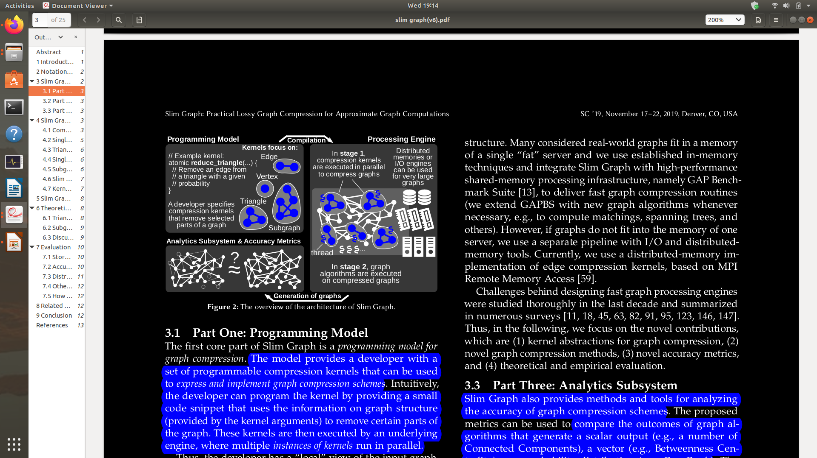
All Together

Slide 10
Compression Kernels
To implement a kernel, one first specifies a kernel name and a single kernel argument x; x can be a vertex, an edge, a triangle, or a subgraph.
Within kernel’s body, x offers properties and methods that enable accessing and modifying local graph structure, e.g., edges adjacent to x.
Framework also provides an Global Container (like class in C++/Java) SG.
SG offers various functions and parameters for accessing or modifying global graph structure, e.g.,
SG.del(e) // deletes the edge e
SG.out_edges(v) // returns all the edges with v as source vertex
We will look at three Compression kernel (Vertex, edge, Traingle Kernels).

Slide 11
Edge Kernels
Pseudocode for the Edge Kernels:
spectral_sparsify ( E e ) {
double Υ = SG.connectivity_spectral_parameter () ;
double edge_stays = min (1.0 , Υ / min ( e.u.deg , e.v.deg ) ) ;
if ( edge_stays < SG.para(0 ,1) ) atomic SG.del ( e ) ;
else e.weight = 1 / edge_stays ;
}
random_uniform ( E e ) {
double edge_stays = SG.p;
if ( edge_stays < SG.para(0 ,1) ) atomic SG.del( e ) ;
}

Slide 12
Edge Kernels
Spectral Sparsification:
Framework removes edges while preserving the graph spectrum with high accuracy.
Graph spectrum determines various properties of the graph.
In the pseudo-code edges are sampled with some probablity.
These probabilities are selected in such a way that every vertex in the compressed graph has edges attached to it w.h.p. (ensures the connectedness).
Uniform Sampling:
Here, each edge remains in the graph with a probability p.
This simple scheme can be used to rapidly compress a graph.
The main difference is that the sampling probability edge_stays(p) is identical for each edge.

Slide 13
Vertex Kernels
The Pseudo-code for the vertex kernel:
low_degree ( V v ) {
if ( v.deg ==0 or v.deg ==1) atomic SG.del( v ) ;
}
In general, it enable the user to modify a single vertex.
In the above case, it removes all vertices with degree zero and one.
This enables compressing a graph while preserving the exact values of betweenness centrality. (Why?)

Slide 14
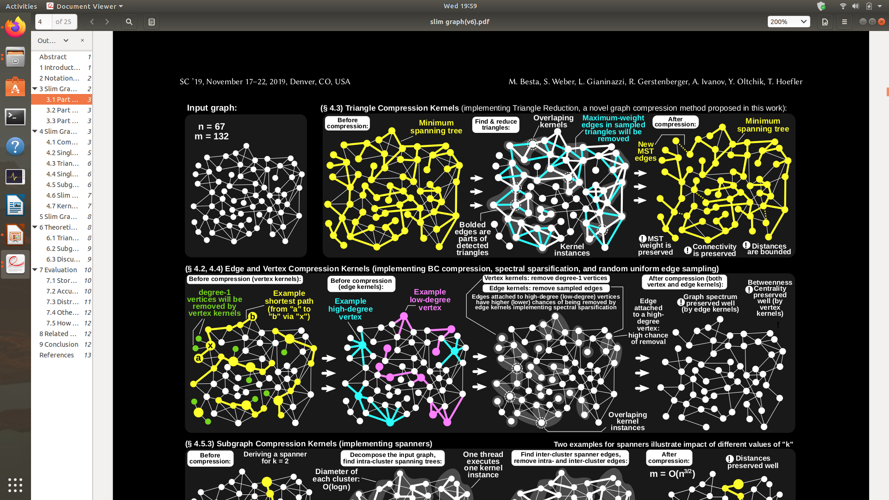
An Example

Slide 15
Triangle Kernels
The Pseudo-code for the Triangle kernels:
p-1-reduction ( vector <E > triangle ) {
double tr_stays = SG.p;
if ( tr_stays < SG.para(0 ,1) )
atomic SG.del( rand ( triangle )) ; // randomly delete one edge of the triangle. It can be more flexible.
}
p-1-reduction-EO ( vector <E > triangle ) {
double tr_stays = SG.p;
if ( tr_stays < SG.para(0 ,1) ) {
E e = rand( triangle ); // randomly select the edge of the traingle. It can be more flexible.
atomic { if (! e.considered ) SG.del ( e ) ;
else e.considered = true ; } }
}

Slide 16
Triangle Kernels
Triangle p-x-Reduction
In the basic TR variant, we select p*T triangles from a graph u.a.r., p ∈ ( 0; 1 ).
In each selected triangle, we remove x edges (x ∈ { 1, 2 } ), chosen u.a.r.
p and x are input parameters.
Edge-Once Triangle p-x-Reduction
Here, we consider each edge only once for removal.
When a triangle is selected for reduction for the first time (by some kernel instance), if a random edge is not removed, it will not be considered for removal in another kernel instance.
This protects the edge which may be the part of multiple triangle (may be a part of multiple shortest paths.).
One modification to the above scheme removes an edge with the highest weight (Preserves MST property.).
TR is much versatile then other compression schemes.

Slide 17
An Example

Slide 18
Accuracy Metrics

Slide 19
Performance Evaluation

Slide 20
Conclusion

Slide 21
Strengths and Weaknesses

