Slide 1
Harmonia: A High Throughput B+tree for GPUs
Jash Khatri
CS19S018

Slide 2
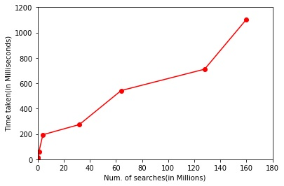
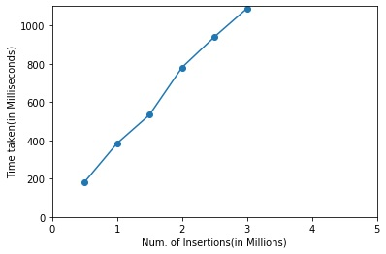
Problem Statement and Results
Problem Statement: To perform Database operations like Search, Range Query, Update, Insert, Delete using a novel B+ tree structure called Harmonia to achieve high throughput for the given operations on GPU.
Results:
Throughput(Search) = 160 Million queries / sec (approximate)
Throughput(Range Queries) = 100 Million queries / sec (approximate)
Throughput(Insertion) = 3 Million queries /sec (approximate)
Throughput(Updates) = 1 Million queries / sec (approximate)

Slide 3
Challenges Faced
Implementing Search with multiple thread to perform comparison on a node at each level. There was issue with proper coordination among threads. Resolved using barriers at proper places.
Issue in implementing radix sort for large arrays. Resolved using Batch-wise partial Radix sort.
Issue in implementing Narrow Thread Grouping. Resolved by storing the number of currently stored keys in a given Node inside the structure of Harmonia. This will avoid useless comparisons inside the Node of Harmonia.
Support for Record Pointers within the Harmonia structure. Resolved by adding tuples itself inside the structure of Harmonia.

