Slide 1
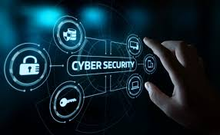
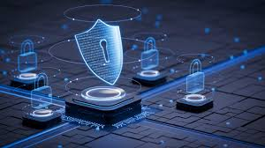

CYBERSECURITY TRENDS & THREATS IN 2025
1
Name: Jash Savsani
Roll No.: 130
Enrollment No.:24031701036
Course.: B.Sc(Hons)C.S.
Sem.: 2
Lab Batch:2
3/28/2025

Slide 2
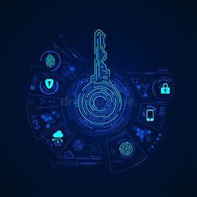
WHAT IS CYBER SECURITY?
Computer security (also cybersecurity, digital security, or information technology (IT) security) is a subdiscipline within the field of information security.
It consists of the protection of computer software, systems and networks from threats that can lead to unauthorized information disclosure, theft or damage to hardware, software, or data.
As well as from the disruption or misdirection of the services they provide.

Slide 3
CYBERSECURITY BEST PRACTICES
Strong Passwords: Using unique, complex passwords and enabling multi-factor authentication.
Software Updates: Keeping software, operating systems, and security tools up to date.
Phishing Awareness: Being cautious of suspicious emails and links, and not clicking on them without verifying their authenticity. Security Training: Educating employees about cybersecurity threats and best practices.
Firewalls and Antivirus Software: Implementing firewalls and antivirus software to protect against malware and unauthorized access.

Slide 4
COMMON CYBER THREATS
Malware: Malicious software designed to harm computer systems, including viruses, worms, Trojans, and ransomware.
Phishing: Deceptive attempts to obtain sensitive information, such as usernames, passwords, and credit card details, by disguising as a legitimate entity.
Ransomware: A type of malware that encrypts a victim's data and demands a ransom for its release.
Data Breaches: Unauthorized access to confidential information, often resulting from a combination of cyberattacks and security vulnerabilities.

Slide 5
KEY AREAS OF CYBERSECURITY
Network Security: Protecting the infrastructure and communication channels that connect devices and systems, including firewalls, intrusion detection systems, and VPNs.
Application Security: Securing software applications by addressing vulnerabilities and implementing security measures during the development and deployment process.
Cloud Security: Protecting data, applications, and infrastructure in cloud environments, ensuring data confidentiality, integrity, and availability.
Endpoint Security: Protecting individual devices (computers, laptops, smartphones) from malware, phishing attacks, and other threats.
IoT Security: Securing the growing number of connected devices (appliances, sensors, etc.) and the data they transmit.
Data Security: Protecting data at rest and in transit, using encryption, access controls, and other security measures.

Slide 6
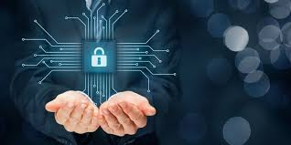
IMPORTANCE OF CYBERSECURITY
Cybersecurity is crucial for protecting individuals and organizations from cyber threats, including data breaches, financial losses, and reputational damage, by implementing robust defenses and security measures.
Financial Losses
Reputational Damage
Data Breaches
Main Importance
Reputational Damage
Disruption of Operations
Malware

Slide 7
TYPES OF CYBERSECURITY MEASURES
Network Security: Protecting the network and infrastructure from disruptions, unauthorized access, and other abuses.
Application Security: Securing software applications and the data they handle.
Information Security: Protecting sensitive information from unauthorized access, use, disclosure, disruption, modification, or destruction.
Cloud Security: Securing data and applications stored in the cloud.
IoT Security: Protecting Internet of Things (IoT) devices and networks.
Identity and Access Management: Ensuring that only authorized users have access to specific systems and data.

Slide 8
CYBERSECURITY METRIC

Slide 9
INFORMATION SECURITY PRACTICES
Employee behavior can have a big impact on information security in organizations. Cultural concepts can help different segments of the organization work effectively or work against effectiveness toward Information security within an organization.
Andersson and Reimers (2014) found that employees often do not see themselves as part of their organization's information security effort and often take actions that impede organizational changes. Indeed, the Verizon Data Breach Investigations Report 2020, which examined 3,950 security breaches, discovered 30% of cybersecurity incidents involved internal actors within a company.

Slide 10
INFORMATION SECURITY PRACTICES(CONTINUE)
Research shows information security culture needs to be improved continuously. In "Information Security Culture from Analysis to Change", authors commented, "It's a never-ending process, a cycle of evaluation and change or maintenance." To manage the information security culture, five steps should be taken: pre-evaluation, strategic planning, operative planning, implementation, and post-evaluation
Pre-evaluation: To identify the awareness of information security within employees and to analyze the current security policies.
Strategic planning: To come up with a better awareness program, clear targets need to be set. Assembling a team of skilled professionals is helpful to achieve it.
Operative planning: A good security culture can be established based on internal communication, management buy-in, security awareness and a training program.

Slide 11
CYBERSECURITY THREATS & CYBER ATTACKS

Slide 12
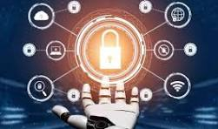
COMPUTER PROTECTION (COUNTERMEASURES)
In computer security, a countermeasure is an action, device, procedure or technique that reduces a threat, a vulnerability, or an attack by eliminating or preventing it, by minimizing the harm it can cause, or by discovering and reporting it so that corrective action can be taken.
Some common countermeasures are listed in the following sections:
Security by design
Security architecture
Security measures
Vulnerability management
Secure operating systems

Slide 13
SECURITY BY DESIGN
  Security by design, or alternately secure by design, means that the software has been designed from the ground up to be secure. In this case, security is considered a main feature.
  The UK government's National Cyber Security Centre separates secure cyber design principles into five sections:
  Before a secure system is created or updated, companies should ensure they understand the fundamentals and the context around the system they are trying to create and identify any weaknesses in the system.
  Companies should design and centre their security around techniques and defences which make attacking their data or systems inherently more challenging for attackers.
  Companies should ensure that their core services that rely on technology are protected so that the systems are essentially never down.
  Although systems can be created which are safe against a multitude of attacks, that does not mean that attacks will not be attempted. Despite one's security, all companies' systems should aim to be able to detect and spot attacks as soon as they occur to ensure the most effective response to them.
  Companies should create secure systems designed so that any attack that is successful has minimal severity.

Slide 14
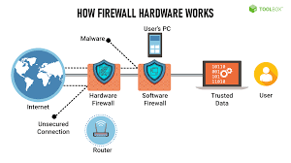
HARDWARE PROTECTION MECHANISMS
Hardware-based or assisted computer security also offers an alternative to software-only computer security. Using devices and methods such as dongles, trusted platform modules, intrusion-aware cases, drive locks, disabling USB ports, and mobile-enabled access may be considered more secure due to the physical access (or sophisticated backdoor access) required in order to be compromised.

Slide 15
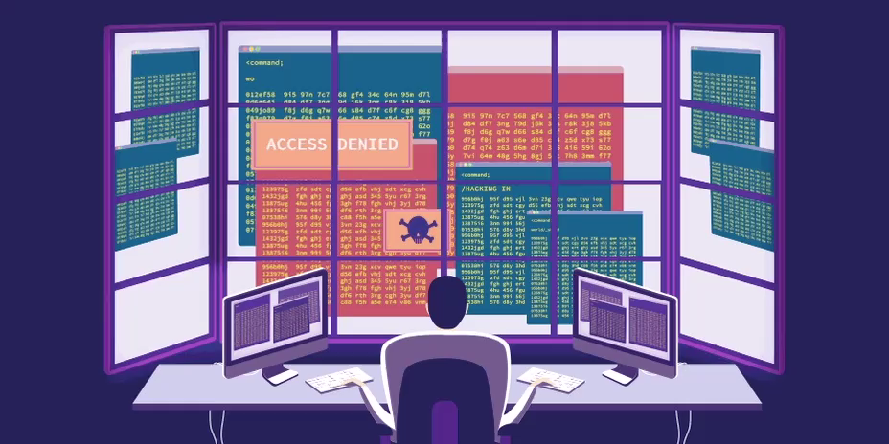
TYPES OF SECURITY AND PRIVACY
SECURITY AND PRIVACY
Data loss prevention software
Access control
Anti-keyloggers
Anti-theft
Antivirus software
Computer-aided
dispatch (CAD)

Slide 16
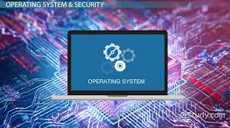
SECURE OPERATING SYSTEMS
One use implement secure of the term computer security refers to technologycertification. that is used to operating systems. Using secure operating systems is a good way of ensuring from an external security-auditing organization, the most popular evaluations are Common Criteriacomputer security. These are systems that have achieved

Slide 17
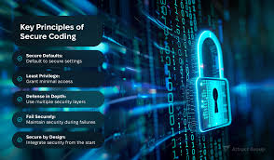
SECURE CODING
In software engineering, secure coding aims to guard against the accidental introduction of security vulnerabilities. It is also possible to create software designed from the ground up to be secure. Such systems are secure by design. Beyond this, formal verification aims to prove the correctness of the algorithms underlying a system.important for cryptographic protocols for example.

