Slide 1


THEME : ARTIFICIAL INTELLIGENCE AND MACHINE LEARNING IN HEALTHCARE
TITLE:
MEDPREDICT - ADVANCED MEDICAL PREDICTION SYSTEM USING
RANDOMFOREST CLASSIFIER ALGORITHM
DR M.G.R EDUCATIONAL AND
RESEARCH INSTITUTE
REG NO:221121101018
ANUSHA.C
REG NO:221121101062
JASHWANTH.G

Slide 2
Medical prediction plays a crucial role in early disease detection, reducing mortality rates, and enabling timely treatment.
Traditional diagnosis relies on blood tests, ECGs, MRIs, and doctor consultations, which can be time-consuming and expensive.
AI-powered medical prediction systems offer automated, fast, and accurate disease detection using machine learning models.
MedPredict is an advanced multi-disease prediction system that uses the RandomForest Classifier to diagnose:
1 .Heart Disease 2. Diabetes 3. Stroke 4. High Blood Pressure (Hypertension) 5. Fatty Liver 6. Anemia
INTRODUCTION :

Slide 3
EXISTING WORK :
Traditional Disease Diagnosis:
Manual medical checkups, lab tests, and specialist consultations.
High cost, longer wait times, and limited accessibility.
AI-Based Medical Prediction Systems:
Several ML algorithms have been used for disease classification, including Decision Trees, SVM, Naïve Bayes, and Neural Networks.
However, most models either lack accuracy or are too complex for real-time implementation.
Limitations of Existing Systems:
Many lack user-friendly interfaces.
Require high computational power or cloud dependency.
Do not integrate IoT-based real-time data collection

Slide 4
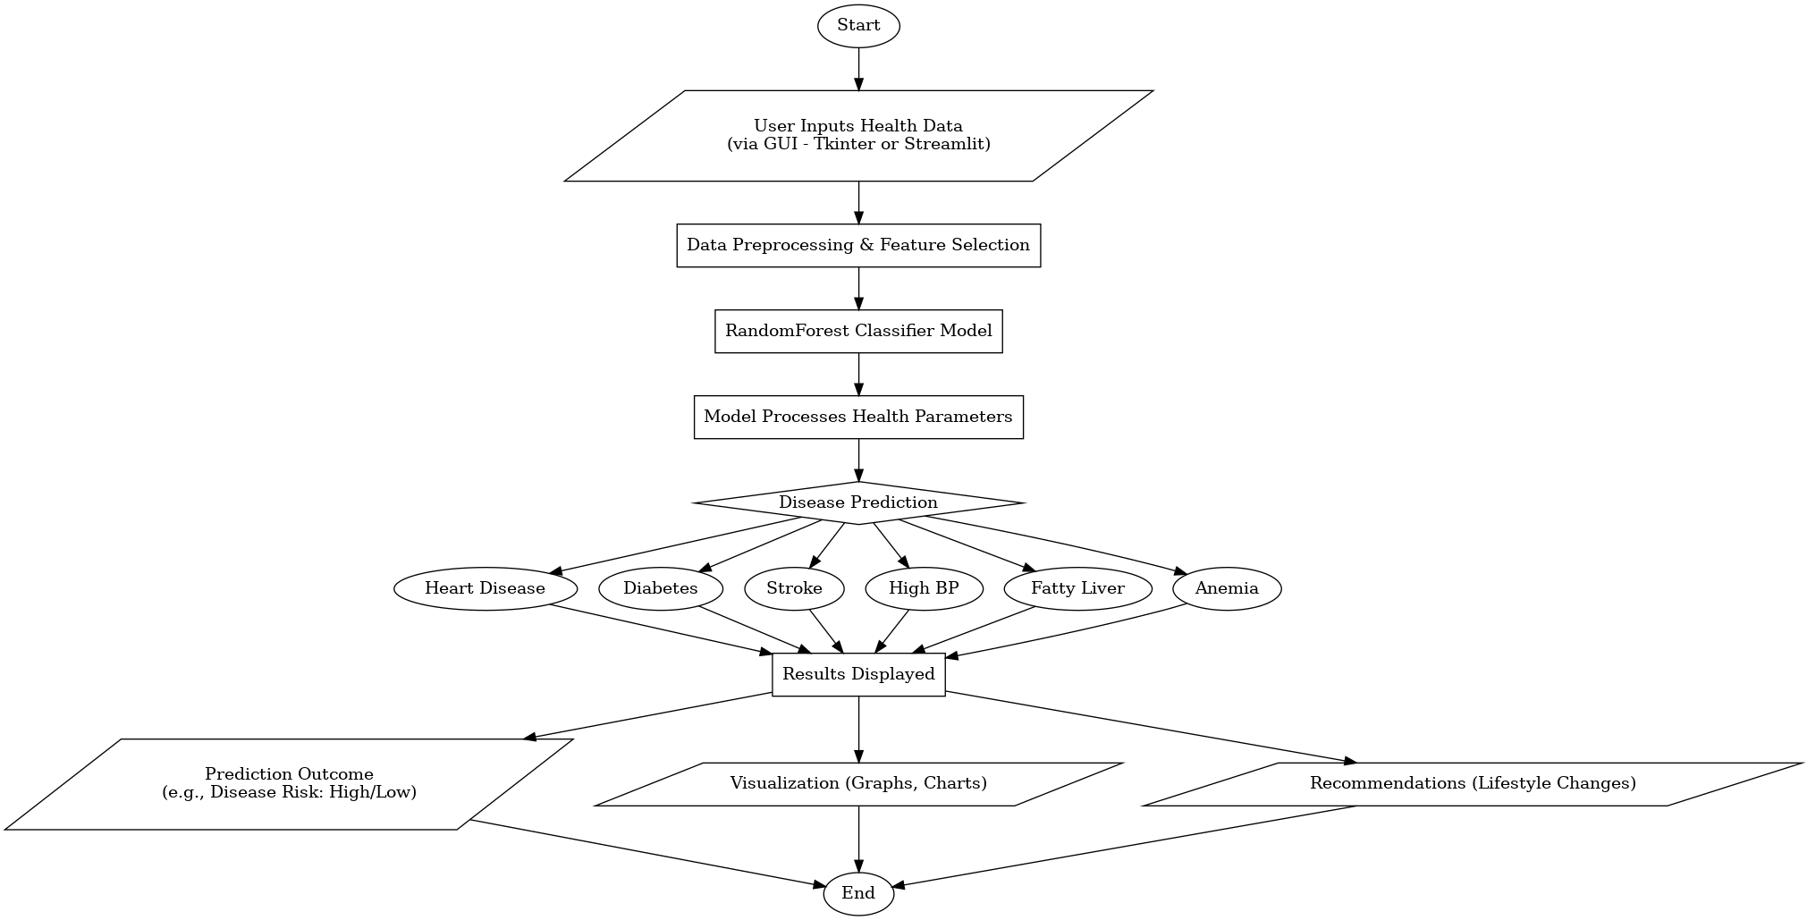
MODEL ARCHITECTURE :

Slide 5


DATASET & FEATURE SELECTION
Used Kaggle for Collecting datasets
Key Features:
Heart Disease: BP, cholesterol, ECG, age, smoking.
Diabetes: Glucose, BMI, insulin, age, family history.
Stroke: BP, heart disease history, BMI, smoking.
Kidney Disease: Creatinine, urea, BP, RBC, sodium.
Hypertension: BP, weight, sodium intake, heart rate.
MACHINE LEARNING MODEL
Why RandomForest?
Handles high-dimensional medical data.
Works well with imbalanced datasets.
Provides higher accuracy than traditional classifiers.
Training Process:
Data preprocessing & feature selection.
Training with hyperparameter tuning.
Model evaluation (accuracy 88.23)

Slide 6
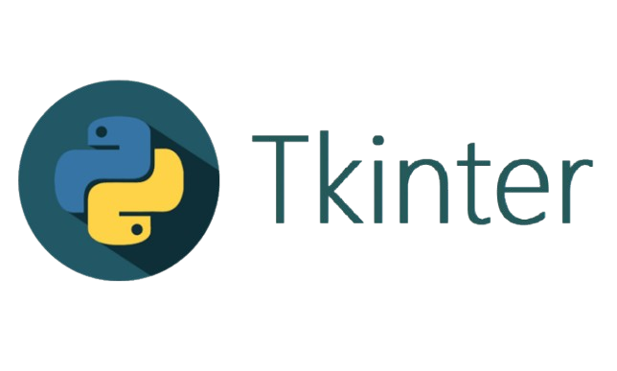
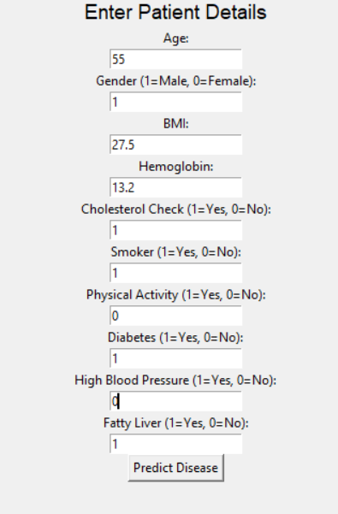
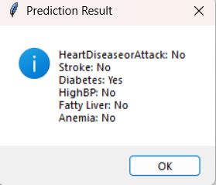
GUI IMPLEMENTATION :
Tkinter (Desktop GUI):
Lightweight, offline use, simple input & instant predictions.
PROGRAM OUTPUT :

Slide 7
FUTURE SCOPE :
Heart Disease
Hypertension (High Blood Pressure)
Diabetes (Type 1 & Type 2)
Stroke
Chronic Kidney Disease (CKD)
Liver Disease (Cirrhosis, Hepatitis)
Thyroid Disorders (Hypothyroidism, Hyperthyroidism)
Anemia
Leukemia (Blood Cancer)
Lung Diseases (COPD, Asthma)
HIV/AIDS
Hepatitis B & C
Rheumatoid Arthritis (RA)
Systemic Lupus Erythematosus (SLE)
Osteoporosis
Sepsis (Blood Infection)
Polycystic Ovary Syndrome (PCOS)
Prostate Cancer
Breast & Ovarian Cancer
Colorectal Cancer
Alzheimer’s Disease & Dementia
Depression & Anxiety Disorders
Blood Clotting Disorders (DVT, Hemophilia)
Malnutrition & Vitamin Deficiencies
Pancreatic Diseases (Pancreatitis, Cancer)
Inflammatory Bowel Disease (IBD, Crohn’s, Ulcerative Colitis)
Metabolic Syndrome (Obesity, Insulin Resistance)
Tuberculosis (TB)
Hyperlipidemia (High Cholesterol)
Hormonal Imbalances (Testosterone, Estrogen Disorders)

Slide 8
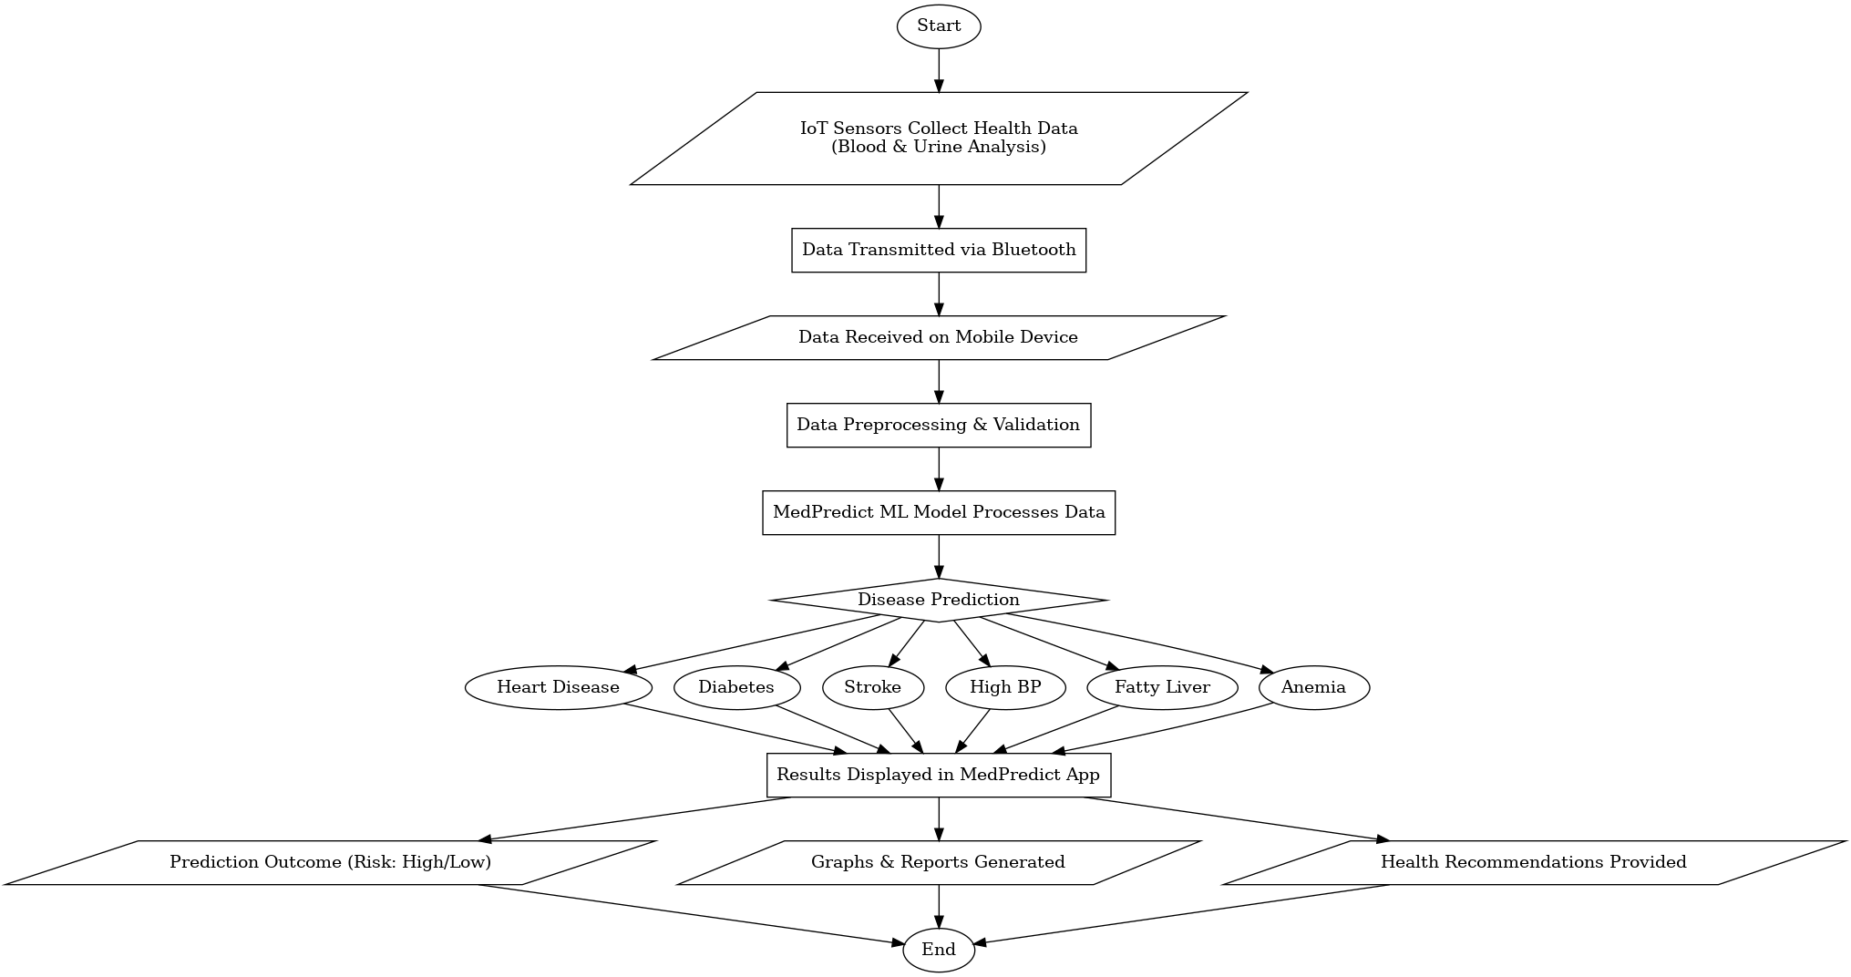
WORKING ARCHITECTURE :

Slide 9
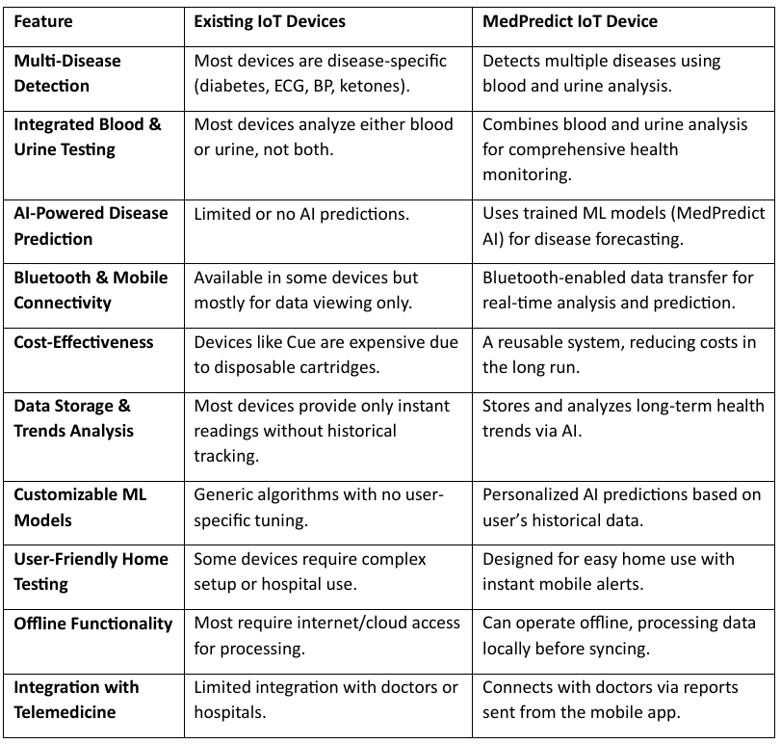
EXISTING IOT DEVICES VS MEDPREDICT IOT DEVICE

Slide 10
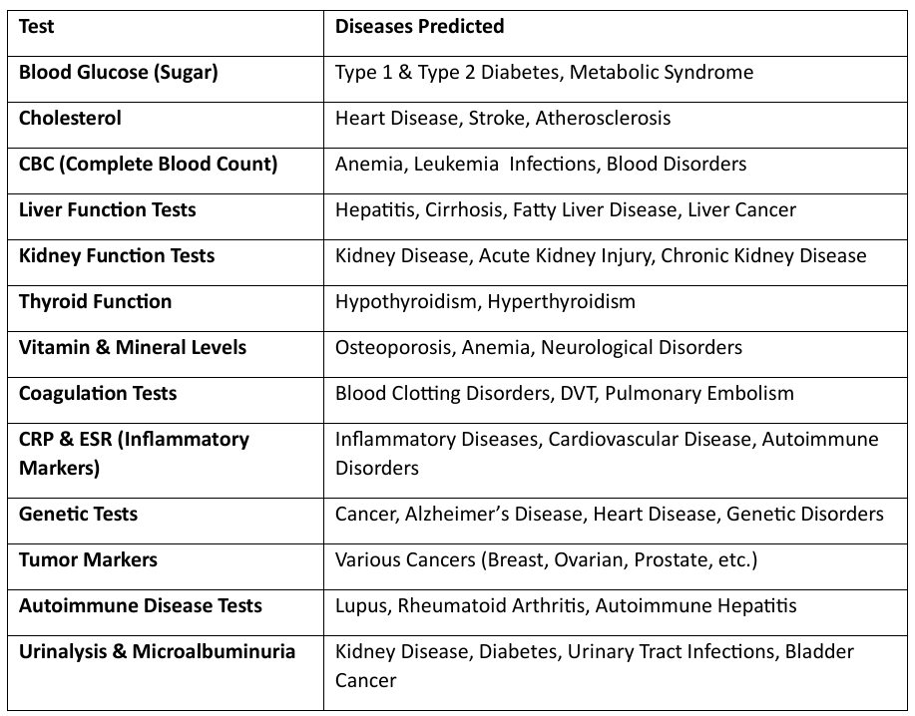
COMMON TESTS :

Slide 11
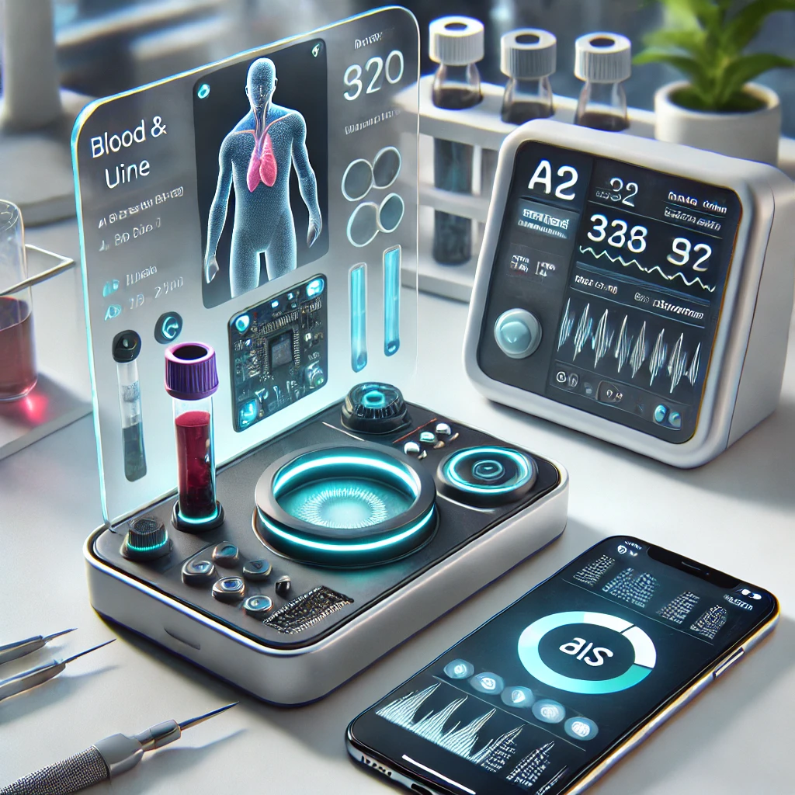
AI GENERATED IOT DEVICE IMAGE :

Slide 12
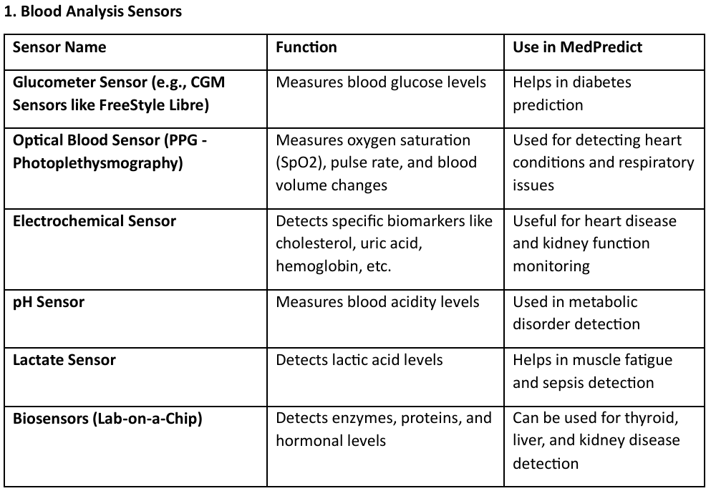
MEDPREDICT IOT DEVICE - SENSOR LIST AND FUNCTIONS

Slide 13
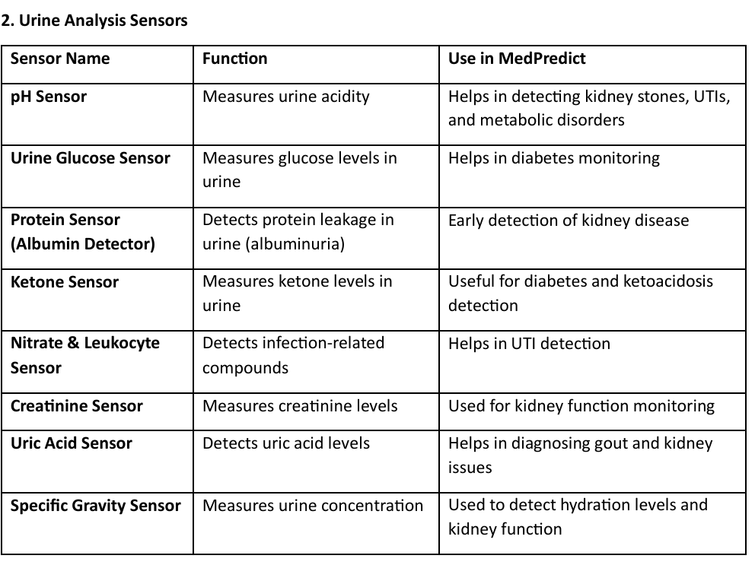

Slide 14
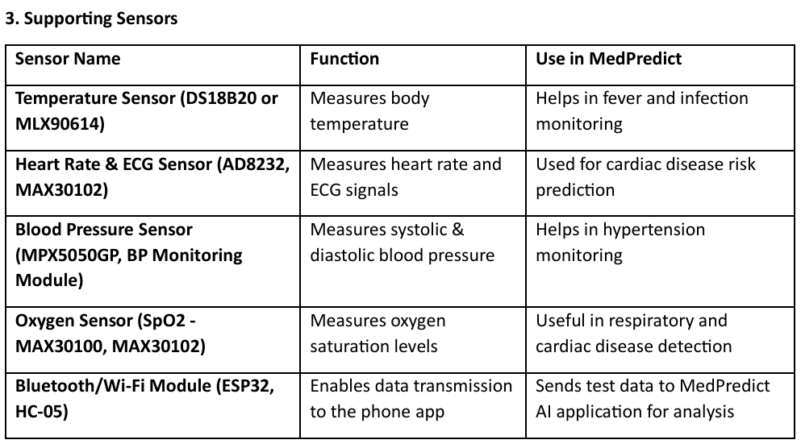

Slide 15
CONCLUSION :
MedPredict - AI-Powered Advanced Medical Prediction System is a revolutionary step toward early disease detection and comprehensive health monitoring.
Multi-Disease Diagnosis: Predicts heart disease, diabetes, stroke, kidney disease, and more.
AI & IoT Integration: Real-time blood & urine analysis via IoT devices with AI-driven insights.
Affordable & User-Friendly: A cost-effective solution for home-based health monitoring.
Future Scope: Expanding to more diseases, integrating telemedicine, and real-time wearable monitoring.
MedPredict aims to transform healthcare by making disease prediction accessible, accurate, and AI-powered!

Slide 16
REFERENCES :
Machine Learning for Early Disease Prediction Jiang, F., et al. (2017). "Artificial Intelligence in Healthcare: Past, Present, and Future." Artificial Intelligence in Medicine. DOI: 10.1016/j.artmed.2017.10.004
IoT-Based Healthcare Monitoring Systems Gubbi, J., Buyya, R., Marusic, S., & Palaniswami, M. (2021). "Internet of Things (IoT): A Vision, Architectural Elements, and Future Directions." Future Generation Computer Systems. DOI: 10.1016/j.future.2013.01.010
Wearable Biosensors for Continuous Health Monitoring Bonato, P. (2020). "Wearable Sensors and Systems for Health Monitoring." IEEE Sensors Journal. DOI: 10.1109/JSEN.2020.2972212
AI-Based Prediction of Heart Disease Lundervold, S. M., & Lundervold, A. (2019). "AI-Based Decision Support for Cardiovascular Disease Diagnosis." Journal of Biomedical Informatics. DOI: 10.1016/j.jbi.2019.103208
IoT and AI for Diabetes Monitoring A. Hussain et al. (2021). "Smart Healthcare Systems for Diabetes Prediction and Monitoring Using IoT and Machine
Blood and Urine Biomarkers for Disease Detection K. Patel et al. (2020). "Advances in Biosensors for Non-Invasive Disease Detection Using Blood and Urine Samples." Biosensors and Bioelectronics. DOI: 10.1016/j.bios.2020.112417
AI-Driven Diagnosis of Chronic Kidney Disease (CKD) J. Smith et al. (2019). "Chronic Kidney Disease Prediction Using Machine Learning Models." International Journal of Medical Informatics. DOI: 10.1016/j.ijmedinf.2019.104012
Real-Time Health Data Transmission via Bluetooth and IoT M. Shah et al. (2022). "IoT and Bluetooth-Based Real-Time Health Monitoring Systems." Sensors Journal. DOI: 10.3390/s22072654

Slide 17
THANK YOU

