Slide 1

SQL
(Structured Query Language)
&
Tableau Visualization
Presented By: Jash Suke
© All rights reserved by Fireblaze Technologies Pvt. Ltd.

Slide 2
Introduction to SQL
Introduction to Relational Database Management System (RDBMS):
RDBMS is the basis for SQL, and for all modern database systems like MS SQL Server, IBM DB2, Oracle, MySQL, and Microsoft Access.
It is a DBMS that is based on the relational model .The data in RDBMS is stored in database objects called tables. A table is the most common and simplest form of data storage in a relational database.
Introduction to Structured Query Language (SQL):
SQL is a standard language for accessing databases.
SQL lets us access and manipulate databases and also allows you to execute queries against a database . It can retrieve data from a database and can insert ,update records delete records from a database.
It is being used by wide spectrum of people like Data Scientists, ML Engineer, Software Engineers etc also people from Non-Engineering background use SQL.
It is Declarative Programming Language.
© All rights reserved by Fireblaze Technologies Pvt. Ltd.

Slide 3
Problem Statement
Database for ICIC Bank Management System:
The Bank wants to build the database for their customer and employees with all the details like creating an account in a bank type of account which helps the bank to retrieve the data on one click so they can find out the day to day update easily on their database.
There are six tables in the database ,there are the constraints and data types required while creating a Data.
They are as follows :-
Bank Details
Departments
Employees
Customer
Job_Details
Account_Type
© All rights reserved by Fireblaze Technologies Pvt. Ltd.

Slide 4
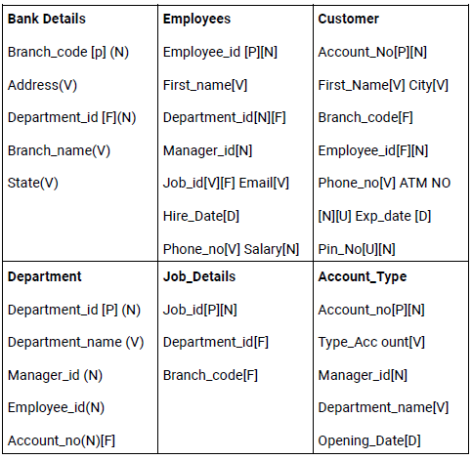
Problem Statement
Tables in the Database
Constraints and data types:
N=Number, D=Date, V=Varchar2, P=Primary Key, F=Foreign Key, U=Unique Key.
© All rights reserved by Fireblaze Technologies Pvt. Ltd.

Slide 5

Proposed Solution
In MySQL Workbench……
We will create database management system for Bank in MySQL which has Multiple tables and relationships between the tables, depending on the constraints which had been provided to us to connect with the different tables.
By using this database we will retrieve the information of particular customers and employees who are working in the bank. In this database, we will create a view also for a customer and the employees in the bank.
For above management system , we have to build the database from scratch by using all the languages in MySQL. First, we have to create an ER Model of the data and check the connection are correct or not also apply all the keys in the ER Model .
Further proceeding with next step is creating our own schema with name bank and start creating a table as per the requirement. We have to create six tables in the database in our bank schema.
© All rights reserved by Fireblaze Technologies Pvt. Ltd.

Slide 6
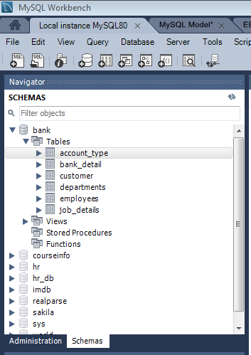
Proposed Solution
MySQL Workbench
Proceeding with MySQL Workbench:
Firstly, we will Create Schema in workbence and name the our newly created schema as bank.
After that we will proceed with creating different tables under our schema.
We have been provided worksheets by bank containing different tables, so we can Import tables from our local instance machine.
After importing all six tables under our schema from our local machine, now we have to assign constraints such as primary key, foreign key, unique value to all the provided tables.
Further providing correctly constraint, relations had been established with different tables that we can see from E-R Model.
© All rights reserved by Fireblaze Technologies Pvt. Ltd.

Slide 7
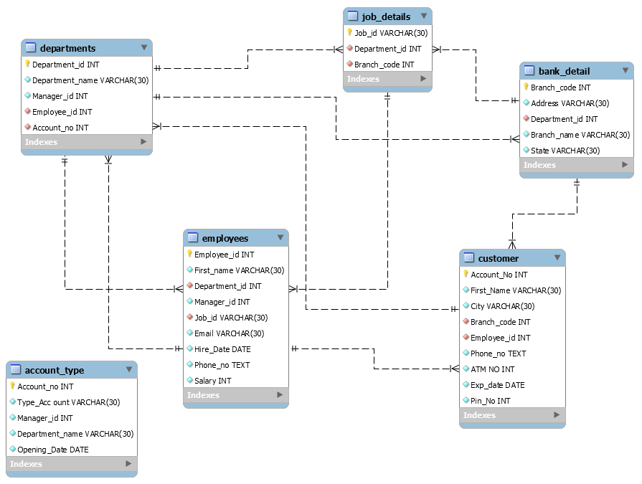
Entity –Relationship Model
© All rights reserved by Fireblaze Technologies Pvt. Ltd.

Slide 8
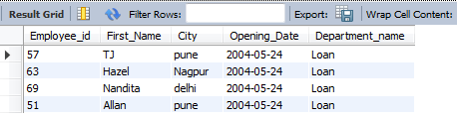
Proposed Solution
MySQL Workbench
We have update all the data in mysql and created relationship between them, so now we can retrive data with use of query and get information at one click.
For example, if we have to see the number of employees working in the loan department and show its opening dates and address.
In the snip we see that four employees working in the loan department along with their name, id and address.
© All rights reserved by Fireblaze Technologies Pvt. Ltd.

Slide 9

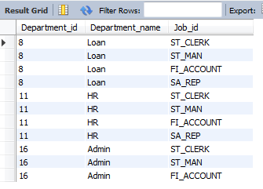
Proposed Solution
MySQL Workbench
1. We have to find details department name, address, branch code, dept _id,city of the account no 18190.
We have successfully located in one click with query the customer with account no 18190 and retrieved all details associated with it.
2. We have to find department id, department name, job id whose only work in Loan, HR, admin.
Here , also we have retrieved department id , name and job id of employee specifically who are working Loan, HR, admin sectors.
© All rights reserved by Fireblaze Technologies Pvt. Ltd.

Slide 10
Introduction to Tableau
Data Visualization
Data visualization is the graphical representation of information and data. By using visual elements like charts graps and maps data visualization tools provide an accessible way to see and understand trends, outliers, and patterns in data.
Importance of Data Visualization
Data visualization gives us a clear idea of what the information means by giving it visual context through maps or graphs. This makes the data more natural for the human mind to comprehend and therefore makes it easier to identify trends, patterns, and outliers within large data sets.
Technological advances have made data visualization more prevalent and powerful than ever before for Businesses purpose.
© All rights reserved by Fireblaze Technologies Pvt. Ltd.

Slide 11

Introduction to Tableau
Tableau is a visual analytics platform transforming the way we use data to solve problems—empowering people and organizations to make the most of their data.
Features of Tableau
It features speed to market.
It does big data.
It does any data stunning & provide Interactive plots.
It is an industry leader.
It is easy to use.
© All rights reserved by Fireblaze Technologies Pvt. Ltd.

Slide 12
Introduction to Tableau
Dashboard
Tableau Dashboards provide a wholesome view of your data by the means of visualizations, visual objects, text, etc.
Powerful tool for mixing multiple views in a unique one .
Allow us to create interactive and common filters for all the sheets grouped.
Excellent tool for generic views.
Story
Sheet that contains a sequence of worksheets or dashboards that work together to convey information .
All methods that are able for datasheets and dashboards apply to stories .
It is a powerful navigation tool for presentations.
© All rights reserved by Fireblaze Technologies Pvt. Ltd.

Slide 13
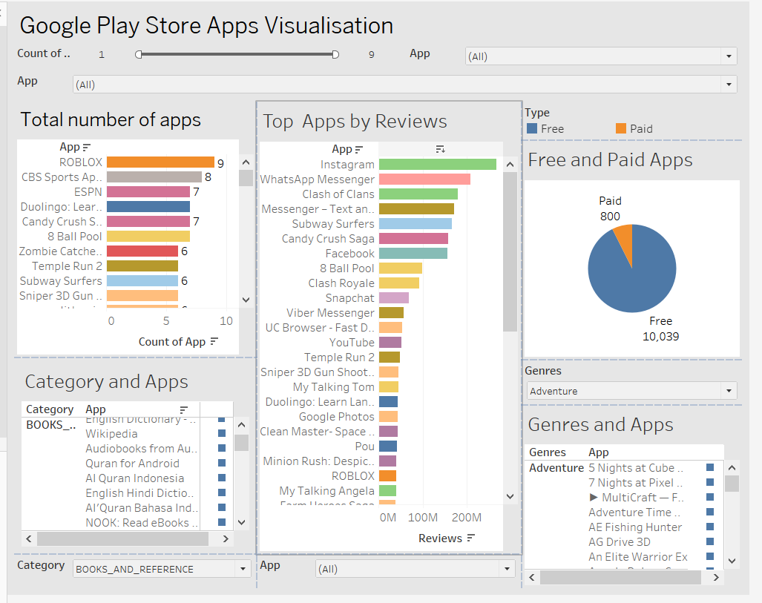
Example of Dashboard
© All rights reserved by Fireblaze Technologies Pvt. Ltd.

Slide 14
Dashboard Creation in Tableau
Data for Amazing Mart EU Customers
We have been provided three sheets of data i.e List of Orders,Order Breakdown and Sales Target.We will create create dashborad for this data and visualize in Tableau.
Now, Lets get into the Tableau where we have created worksheets containing different charts and also dashborad for better visualization……………
© All rights reserved by Fireblaze Technologies Pvt. Ltd.

Slide 15
Thank you !!
© All rights reserved by Fireblaze Technologies Pvt. Ltd.

