Slide 1

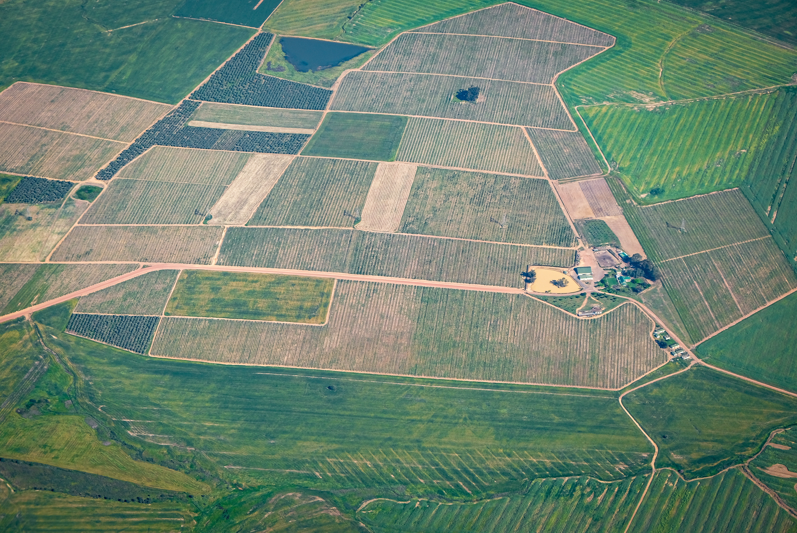
AI-Driven Geospatial Intelligence System
Automated Land Feature Segmentation & Analysis
JASHWANTH B
TEJESHWAR SENTHILKUMAR
KRISHITA SATISH KUMAR
ANUGRAH UPADHYAY
SAYANI BHARATH

Slide 2
Problem Statement
Manual geospatial analysis is slow, inconsistent, and not scalable.
Satellite imagery is underutilized due to:
Heavy reliance on manual interpretation
High time & cost
Lack of automation at scale
Rural & semi-urban regions suffer from:
Poor infrastructure visibility
Inefficient planning & resource allocation
We cannot scale development if we cannot scale understanding of land.

Slide 3
Project Objective
TO DEVELOP A HIGH-ACCURACY SEMANTIC SEGMENTATION MODEL
TO BUILD AN END-TO-END GEOSPATIAL PIPELINE
for identifying key geospatial features such as roads, roofs, water bodies, and utilities from satellite imagery.
that converts raw orthophoto data into structured, multi-class segmentation outputs.
TO DESIGN A SCALABLE AND DEPLOYABLE SYSTEM
TO ADDRESS CHALLENGES LIKE CLASS IMBALANCE AND THIN OBJECT DETECTION
that balances performance and efficiency for real-world applications in rural planning and infrastructure mapping.
using techniques such as hybrid loss functions, data augmentation, and boundary-aware learning.

Slide 4
Motivation
Rural and semi-urban regions still lack accurate and structured geospatial data for essential infrastructure such as roads, buildings, water bodies, and utilities. Current mapping approaches are largely manual, expensive, and difficult to scale, leading to inefficient planning and resource allocation. Although high-resolution satellite imagery is available, it is not effectively transformed into actionable insights.
This project is motivated by the need to bridge this gap by leveraging AI to convert raw imagery into precise, scalable, and intelligent infrastructure maps for better decision-making.

Slide 5
Proposed Solution
AI-POWERED MULTI-CLASS SEGMENTATION
HIGH-FIDELITY GEOSPATIAL PREPROCESSING
OPTIMIZED HYBRID MODEL ARCHITECTURE
An advanced deep learning system that accurately segments orthophoto imagery into roads, roofs, water bodies, and utilities for structured geospatial understanding.
Implements CRS standardization (EPSG:32644), rasterization, and 1024×1024 tiling to preserve spatial alignment and capture fine-grained details.
Utilizes DeepLabV3+ with MobileNetV2 and MIT-B4 encoders to achieve an optimal balance between computational efficiency and high segmentation accuracy.
ROBUST LOSS FUNCTION STRATEGY
END-TO-END SCALABLE PIPELINE
INTELLIGENT POST-PROCESSING & DEPLOYMENT
Combines Dice Loss with CrossEntropy/Focal Loss to effectively address class imbalance and enhance boundary precision for small and complex structures.
A complete training and inference pipeline that tiles large images, processes them and reconstructs seamless high-resolution segmentation outputs.
Incorporates post-processing and classification to refine predictions and deliver scalable, real-world-ready geospatial insights for rural deployment.

Slide 6


Workflow Pipeline
Satellite Image (GeoTIFF)
Post Processing (Cleanup)
Tiling (1024x1024)
Roof-Type Segmentation
Segmentation Model
Overlay Visualization
Tile Stitching (Full Map)
GeoJSON Export

Slide 7
Tech Stack
Data Processing:
OpenCV for image handling
NumPy for numerical operations
Albumentations for data
augmentation
Geospatial Processing:
QGIS / GDAL for CRS alignment and raster operations
Shapefile rasterization for mask generation
Training Techniques:
Mixed Precision Training (AMP)
Gradient Accumulation
Cosine Annealing Scheduler
OpenCV, AlbDeep Learning:
PyTorch for model development
segmentation_models_pytorch (DeepLabV3+)
Encoders: MIT-B4 (SegFormer backbone)
Deployment & Extensions:
TensorFlow Lite / ONNX (future)
Knowledge Distillation for lightweight models

Slide 8
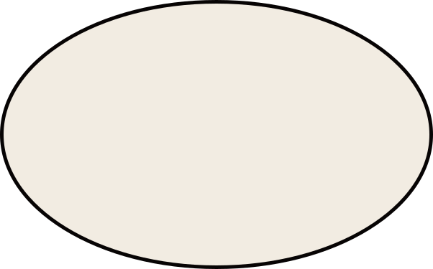
Input: High-resolution GeoTIFF images + shapefiles
CRS standardized to EPSG:32644 for spatial alignment
Shapefiles rasterized into pixel-wise masks
Images divided into 1024×1024 tiles for training
Data Processing
Retained some background tiles for dataset balance
Ensured image–mask alignment and consistent dimensions
Removed empty/low-information tiles

Slide 9
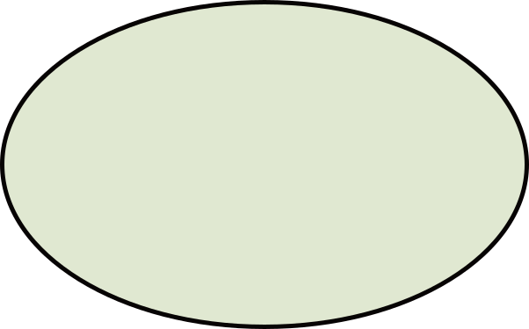
Applied threshold: >40% background → removed
Ensured high-quality tiles (≥60% useful content)
Maintained strict image–mask alignment
Eliminated empty and low-information tiles
Data Cleaning
Removed edge artifacts and size inconsistencies
Balanced dataset with controlled background samples
Improved dataset reliability and model generalization

Slide 10
Label Encoding & Classes
Pixel-wise label encoding applied to masks
Priority-based conflict handling:
Utility > Water > Roof > Road > Background
Ensures consistent and accurate class assignment
Class ID | Category
0 | Background
1 | Road
2 | Roof
3 | Water Bodies
4 | Utility
Class ID | Category
0 | Background
1 | RCC Roof
2 | Tiled Roof
3 | Asbestos

Slide 11
Model Architecture (Overview)
Architecture: DeepLabV3+ for multi-class semantic segmentation
Encoders: MIT-B4 → high-capacity encoder with strong global context
ASPP Module: Captures multi-scale spatial context for varied object sizes
Decoder: Refines features for precise boundaries and fine structures
Output: Pixel-wise classification (5 classes, 1024×1024 resolution)
Optimization Focus: Thin structures (roads) and small objects (utilities)

Slide 12
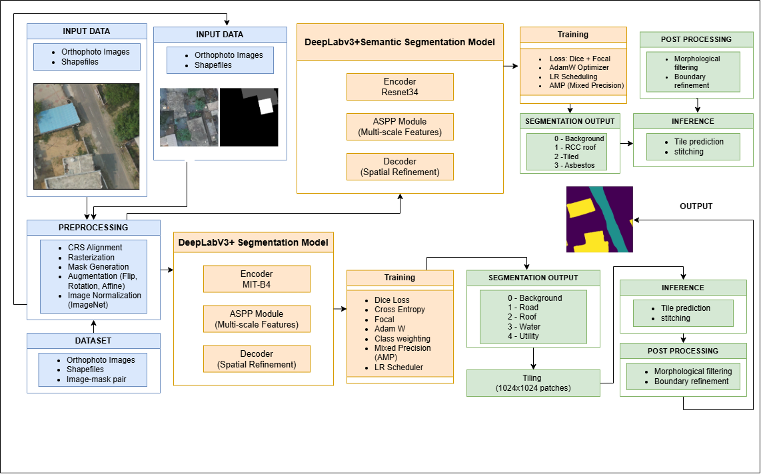
Architecture Diagram

Slide 13
Architecture Explanation
Preprocessing: Orthophoto images and shapefiles are aligned and converted into image–mask pairs for training
Encoder (ResNet34 / MIT-B4): Extracts meaningful spatial and semantic features from the input image
ASPP Module: Captures multi-scale context to detect both small and large objects effectively
Decoder: Refines feature maps to produce sharper boundaries and precise segmentation
Loss Functions: Dice, Focal, and Cross Entropy improve accuracy and handle class imbalance
Optimizer (AdamW): Updates model weights efficiently with better generalization
Tiling (1024×1024): Splits large images into smaller patches for feasible processing
Stitching: Combines predicted tiles back into a full-size output image
Post-processing: Removes noise and smooths edges for cleaner results
Output: Generates a pixel-wise classified map of infrastructure elements

Slide 14
Training Strategy & Optimization
High-resolution training on 1024×1024 image tiles
Data augmentation: flips, rotation, affine transformations
Hybrid loss: Dice + Focal for class imbalance handling
Optimizer: AdamW with learning rate scheduling
Mixed precision training (AMP) for efficient GPU utilization
Gradient accumulation to simulate larger batch sizes
Continuous validation using mIoU for model selection

Slide 15
Technical Innovation
High-Resolution Training (1024×1024):Preserves fine spatial details for roads and utilities
Hybrid Loss (Dice + Focal): Handles class imbalance and improves segmentation quality
Spatially Consistent Augmentation: Affine transforms and flips for real-world robustness
Optimization for Small & Thin Structures: Improves detection of roads and utility features
Optimized for thin and small structures (roads, utilities)
Efficient Training Pipeline: Mixed Precision (AMP) + gradient accumulation

Slide 16
Stitching & Reconstruction
OBJECTIVE
METHODOLOGY
KEY CHALLENGES
Reconstruct full-resolution segmentation from tiled predictions
Ensure spatial continuity across the entire satellite image
Large GeoTIFF images are divided into 1024×1024 tiles
Each tile is processed independently by the model
Predictions are mapped back using original tile coordinates (x, y)
Tiles are assembled to form a complete segmentation map
Edge tiles may have non-uniform dimensions
Visible seam lines between adjacent tiles
Minor alignment mismatches during reconstruction
SOLUTIONS IMPLEMENTED
OUTCOME
Applied coordinate-based placement for accurate alignment
Handled edge tiles using resizing and padding
Maintained consistent tile indexing across dataset
Prepared stitched output for further refinement
Generated high-resolution, full-area segmentation maps
Enabled seamless integration with post-processing pipeline
Ensured scalability for multi-village reconstruction

Slide 17
Post-Processing
Removed noise and false positives
Eliminated seam-line artifacts
Applied connected component filtering
Used morphological smoothing
Performed class-wise refinement
Result:
Cleaner segmentation
Improved boundaries
More accurate and realistic output

Slide 18
Results
Accurate multi-class segmentation (Road, Roof, Water, Utility)
Clear roof-type classification (RCC / Tiled / Asbestos)
Seam-free, noise-reduced outputs after post-processing
High-resolution stitched maps for entire villages
Visually interpretable overlays for real-world use

Slide 19
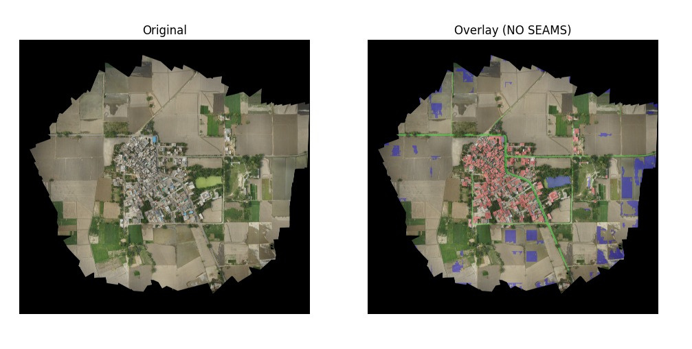
Visualization (After Stitching)
Road - Neon green
Roof - Light Red
Water - Blue
Background - Black
Legends:

Slide 20
GeoJSON Export
Converted segmentation masks → polygon features
Preserved geo-coordinates from GeoTIFF
Generated GIS-ready GeoJSON outputs
Compatible with QGIS, ArcGIS, and web maps
Enables real-world geospatial analysis

Slide 21
Expected Impact
Automates infrastructure mapping from satellite images, reducing manual surveys and improving efficiency
Environmental: Enables accurate monitoring of water bodies, supporting sustainable management and environmental protection
Social: Enhances rural planning by identifying roads, housing clusters, and utilities, improving accessibility and living standards
Economic: Reduces time, labor, and costs of traditional surveys while enabling data-driven resource allocation
Governance: Assists Panchayati Raj institutions with reliable geospatial data for planning, decision-making, and disaster response
Converts raw satellite imagery into actionable insights, enabling faster and smarter rural development

Slide 22
Scalability & Feasibility
Tile-based processing enables handling of large satellite images
Works across multiple villages with consistent preprocessing pipeline
Modular design allows easy addition of new classes/features
Lightweight models (MobileNet) support low-resource deployment
High-performance models (MIT-B2) for server-side accuracy
Compatible with GIS systems for real-world integration

Slide 23
Future Works - Knowledge Distillation
In future work, knowledge distillation will be used to compress the trained DeepLabV3+ model by transferring its learned representations into a more efficient version.
This helps reduce model size and computational requirements while retaining most of the original performance.
As a result, inference becomes faster and the system becomes more suitable for real-time applications and deployment on resource-constrained devices.

Slide 24
Conclusion
This project demonstrates an effective AI-based geospatial segmentation pipeline for identifying rural infrastructure from orthophoto imagery. By leveraging DeepLabV3+ with multi-scale feature extraction and refined decoding, the system achieves accurate pixel-level classification of key elements such as roads, roofs, and water bodies. The integration of preprocessing, efficient training strategies, and post-processing ensures reliable and high-quality outputs. Overall, the approach provides a scalable solution for automated infrastructure mapping and analysis.

Slide 25
MODEL LINK
https://drive.google.com/drive/folders/13CdjYJoWWGTNg0ZHMIfmZsf_q7d29aU-?usp=sharing

