Slide 1
PHARMACOVIGILANCE · OPEN-SOURCE · AGENTIC
Drug Safety Signal
Investigation Assistant
From a drug + suspected event + review period to an evidence-backed, fully-cited memo for human review.
Selected pair: montelukast → serious neuropsychiatric events (2019–2021)
Advisory only, never asserts causation, rates, or treatment.
Notes:
Implementation reference: https://github.com/JashB-28/Drug_safety_signal_investigation_assistant/blob/9ecd82932645e3abbbcfea9c8597c1451b54b399/src/dsi/agent/graph.py
Repository snapshot: 9ecd82932645e3abbbcfea9c8597c1451b54b399

Slide 2
THE BUSINESS PROBLEM
Early signal triage is hard, and consequential
The decision the analyst is making
Cost of getting it wrong
Are reports of this event increasing for this drug?
Is the event already described in the product label?
Is the evidence strong enough to escalate to deeper human review or is it noise?
Miss a real signal → delayed warnings; patients stay exposed (montelukast: 2008 warnings → 2020 boxed warning).
Escalate noise → scarce expert time wasted; possible unwarranted alarm.
Untraceable conclusion → unusable in a regulated, audited setting.
Spontaneous reports cannot establish causality or occurrence rates.
Notes:
Implementation reference: https://github.com/JashB-28/Drug_safety_signal_investigation_assistant/blob/9ecd82932645e3abbbcfea9c8597c1451b54b399/src/dsi/agent/graph.py
Repository snapshot: 9ecd82932645e3abbbcfea9c8597c1451b54b399

Slide 3
RESEARCH & FDE DISCOVERY
Why montelukast → neuropsychiatric events
A real, dated label change
A genuine evidence conflict
Sources (3 primary/regulatory)
FDA Boxed Warning added 2020-03-04
Escalated from 2008-2009 warnings
Makes the 'evidence changed' scenario authentic
Strong FAERS spontaneous-report signal
vs. a study finding no increased risk vs. inhaled steroids
FDA notes most reports lack detail to judge
FDA Drug Safety Communication (2020)
openFDA FAERS + drug-label APIs
FDA FAERS dashboard data-limitations
PubMed observational literature
Notes:
Implementation reference: https://github.com/JashB-28/Drug_safety_signal_investigation_assistant/blob/9ecd82932645e3abbbcfea9c8597c1451b54b399/src/dsi/agent/graph.py
Repository snapshot: 9ecd82932645e3abbbcfea9c8597c1451b54b399

Slide 4
WHAT IT DOES
One input triple → one cited, safety-checked memo
Drug montelukast
Event depression
Period 2019-2021
→
Analyst-ready memo
14 sections in a full run, with citations and language checks
Run it three ways
dsi investigate
any pair, LIVE openFDA/PubMed (no key); caches so re-runs are offline
dsi eval
reproducible offline run from a pinned snapshot; writes metrics
dsi scenarios
evidence-update and conflict demos. The constrained comparison runs in dsi eval
Notes:
Implementation reference: https://github.com/JashB-28/Drug_safety_signal_investigation_assistant/blob/9ecd82932645e3abbbcfea9c8597c1451b54b399/src/dsi/agent/graph.py
Repository snapshot: 9ecd82932645e3abbbcfea9c8597c1451b54b399

Slide 5
PROJECT AT A GLANCE
The stats
Thing | Count | What they are
AI agents | 1 | Single investigation agent running the decide loop
LLM call types | 2 | decide_next_action + generate_framing
Tools the agent can access | 3 | faers_search, label_fetch, literature_search
MCP servers | 1 | dsi-evidence-tools (FastMCP)
External API endpoints | 4 | Across 2 services: openFDA and PubMed
Agent actions (choices) | 8 | The ActionType menu
Two call types means two jobs for the model, not two calls per run.
The CLI calls tool functions directly. The MCP server exposes the same three tools separately.
Notes:
Four endpoints: /drug/event.json and /drug/label.json on openFDA. /esearch.fcgi and /esummary.fcgi on PubMed. Eight actions: retrieve_faers, retrieve_label, retrieve_literature, run_analysis, check_sufficiency, detect_conflicts, generate_memo, stop. Counts describe implemented components, not measured run totals.
Sources:
https://github.com/JashB-28/Drug_safety_signal_investigation_assistant/blob/9ecd82932645e3abbbcfea9c8597c1451b54b399/src/dsi/domain/state.py
https://github.com/JashB-28/Drug_safety_signal_investigation_assistant/blob/9ecd82932645e3abbbcfea9c8597c1451b54b399/src/dsi/agent/graph.py
https://github.com/JashB-28/Drug_safety_signal_investigation_assistant/blob/9ecd82932645e3abbbcfea9c8597c1451b54b399/src/dsi/mcp_server/server.py
https://github.com/JashB-28/Drug_safety_signal_investigation_assistant/blob/9ecd82932645e3abbbcfea9c8597c1451b54b399/src/dsi/mcp_server/openfda.py
https://github.com/JashB-28/Drug_safety_signal_investigation_assistant/blob/9ecd82932645e3abbbcfea9c8597c1451b54b399/src/dsi/mcp_server/pubmed.py

Slide 6
ARCHITECTURE
One agent, sequential, with a deterministic backbone
Single investigation agent (LangGraph)
3 tools, also exposed through MCP
initialize → normalize → decide ⇄ act → finalize
openFDA FAERS search
openFDA drug-label
PubMed citation metadata
LLM decides the next action from state
LLM writes one framing sentence
everything else = deterministic
bounded timeouts + retries (429/503 honor Retry-After) · structured errors
Deterministic analysis (no LLM)
SQLite: storage + trace + dependency graph
normalize · aggregate · seriousness · missingness · dedup · temporal
immutable evidence · analysis · memo (kept separate) · snapshot cache · metrics spine · evidence→analysis→memo graph
Notes:
Implementation reference: https://github.com/JashB-28/Drug_safety_signal_investigation_assistant/blob/9ecd82932645e3abbbcfea9c8597c1451b54b399/src/dsi/agent/graph.py
Repository snapshot: 9ecd82932645e3abbbcfea9c8597c1451b54b399

Slide 7
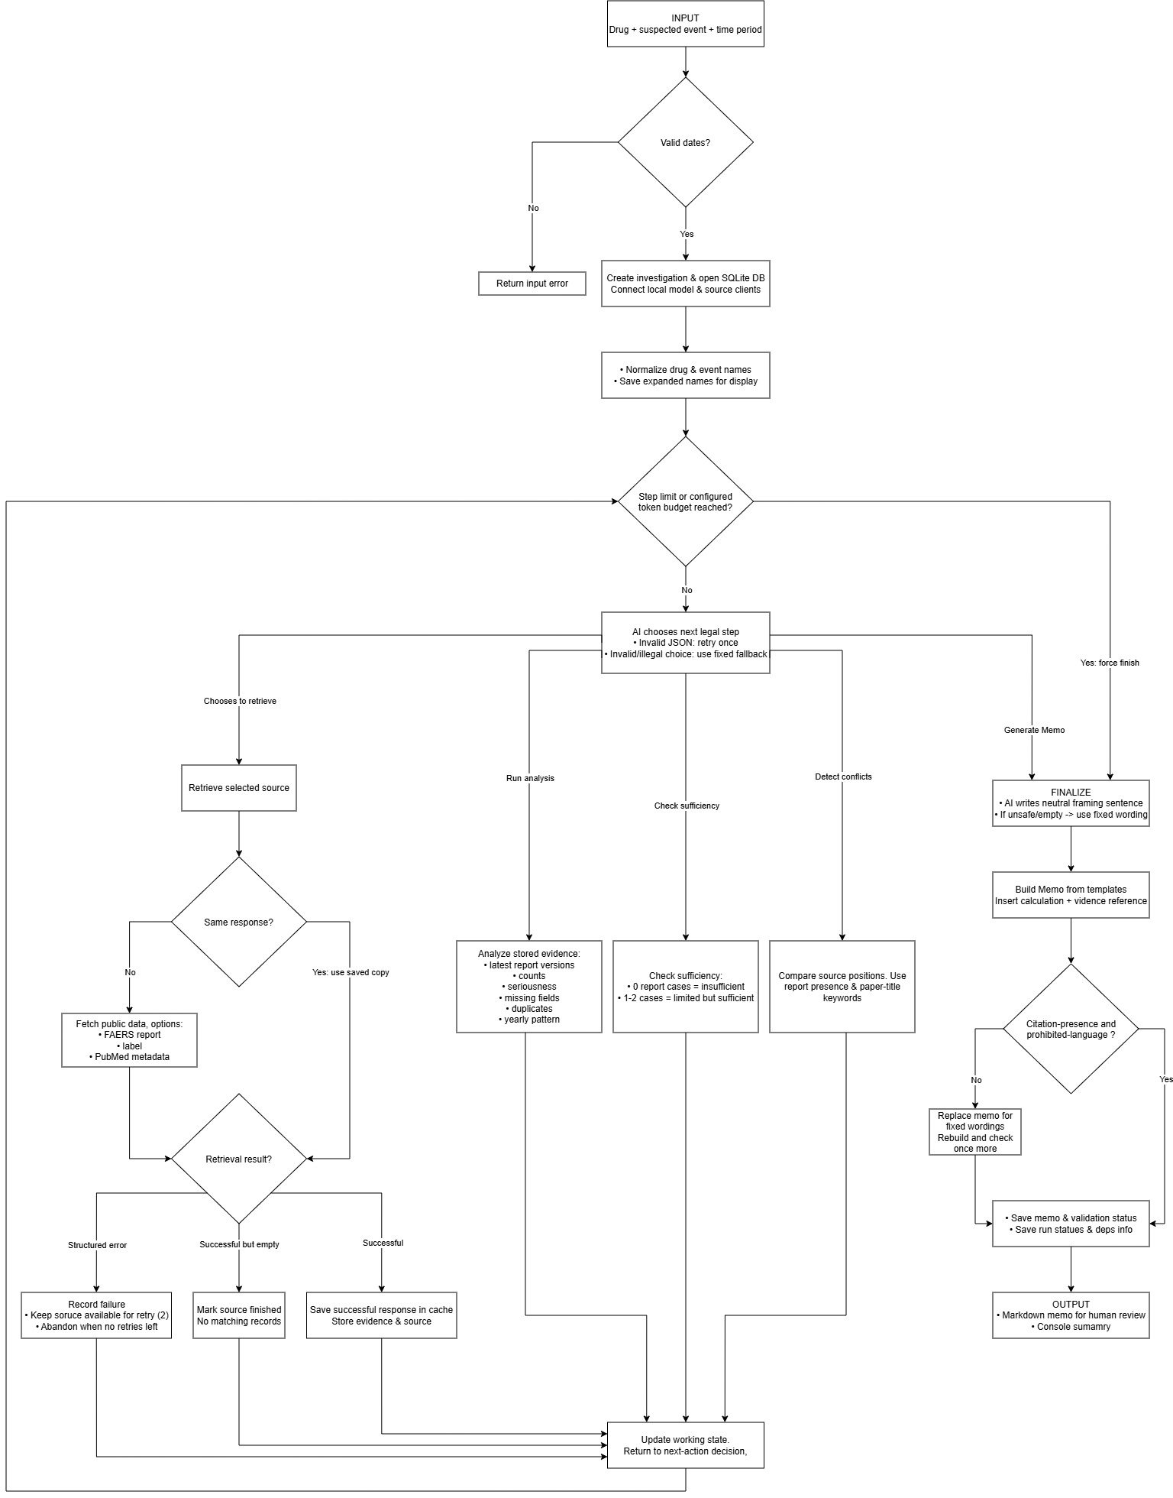
WORKFLOW
Full input-to-output flowchart
One question, one memo
The agent repeatedly chooses a permitted step. Each retrieval or check returns to the decision loop.
The next three slides show the same workflow in readable parts.
Reading the chart
“Same response?” means a saved response for the same request. Both Generate memo and Stop lead to finalization.
Notes:
Original user-supplied dsi.jpg, preserved unchanged. The flowchart is an image. Following slides provide editable diagram details. The source image omits the Stop label beside Generate memo and simplifies the validation repair: only the framing is replaced before rebuilding. Source result handling is implemented in graph.py.
Sources:
https://github.com/JashB-28/Drug_safety_signal_investigation_assistant/blob/9ecd82932645e3abbbcfea9c8597c1451b54b399/src/dsi/agent/graph.py

Slide 8
WORKFLOW 1 OF 3
Input and next-action decision
Drug + event +
Date range
Validate dates
Create investigation
Open SQLite
Normalize names
Save for display
Invalid dates return an input error.
Check step limit
and token budget
AI chooses one
legal next action
Finish and
build the memo
Within limits
Finish or stop
At the limit, finish. After other actions, return here.
8 possible choices
- Retrieve FAERS - Retrieve label - Retrieve literature - Run analysis
- Check sufficiency - Detect conflicts - Generate memo - Stop
Notes:
Setup continues from Normalize names to the guard. Diagram uses a reading break between rows. Step limit defaults to 24. Default total-token budget is unlimited unless configured. A guard forces finalization. Invalid JSON gets one re-ask then a fixed fallback. Actions return to the guard unless they finalize. The model can finish before all sources are gathered.
Sources:
https://github.com/JashB-28/Drug_safety_signal_investigation_assistant/blob/9ecd82932645e3abbbcfea9c8597c1451b54b399/src/dsi/agent/graph.py
https://github.com/JashB-28/Drug_safety_signal_investigation_assistant/blob/9ecd82932645e3abbbcfea9c8597c1451b54b399/src/dsi/agent/decisions.py
https://github.com/JashB-28/Drug_safety_signal_investigation_assistant/blob/9ecd82932645e3abbbcfea9c8597c1451b54b399/src/dsi/domain/state.py

Slide 9
WORKFLOW 2 OF 3
Retrieval, caching, and retries
Select a source
Saved response
for this request?
No
Fetch public data
Up to 3 tries per request
Yes: use saved data. A retriable failure may lead to another fetch round.
Three possible retrieval results
Error
Log failure
Agent can choose 2 more rounds.
Then abandon that source.
Success, no matches
Mark source finished
Move on without retrying.
Cache the empty response.
Records returned
Save data and source details
Cache the response.
Store evidence in SQLite.
Update state and return to the agent decision
Notes:
HTTP retries happen inside the fetch operation. Each request gets one initial attempt plus two retries. Agent-level retrieval may repeat twice more for retryable errors, if chosen. FAERS has one HTTP request per retrieval, so up to 9 attempts total. PubMed uses two endpoints, each with its own request-level retries. Cache lookup does not repeat within the HTTP retry loop. Errors are not cached. Normal outcomes return to the decision loop.
Sources:
https://github.com/JashB-28/Drug_safety_signal_investigation_assistant/blob/9ecd82932645e3abbbcfea9c8597c1451b54b399/src/dsi/mcp_server/http_client.py
https://github.com/JashB-28/Drug_safety_signal_investigation_assistant/blob/9ecd82932645e3abbbcfea9c8597c1451b54b399/src/dsi/agent/graph.py
https://github.com/JashB-28/Drug_safety_signal_investigation_assistant/blob/9ecd82932645e3abbbcfea9c8597c1451b54b399/src/dsi/persistence/cache.py

Slide 10
WORKFLOW 3 OF 3
Analysis and memo output
Run analysis
Counts, versions, duplicates
Seriousness and missingness
Check sufficiency
0 cases: insufficient
1–2 cases: limited
Detect conflicts
Report presence and
paper-title keywords
Each selected action returns to the decision loop. These steps are not a fixed sequence.
Finalize
One framing sentence
Build memo
Templates and references
Check citations
and wording
Save memo
Validation + run status
If checks fail: replace the framing, rebuild, and check once more before saving.
OUTPUT:
Markdown memo for a human reviewer + console summary
A passed check confirms citation presence and allowed wording. Human review checks the evidence.
Notes:
All three analysis/check actions are separately selectable. A run can analyze too early and fail to refresh the counts after later retrieval. The normal full memo has 14 sections; early termination can omit analysis-dependent sections. Framing uses one model call type and can fall back to fixed wording. A failed rebuilt memo is still exported with FAILED validation.
Sources:
https://github.com/JashB-28/Drug_safety_signal_investigation_assistant/blob/9ecd82932645e3abbbcfea9c8597c1451b54b399/src/dsi/agent/graph.py
https://github.com/JashB-28/Drug_safety_signal_investigation_assistant/blob/9ecd82932645e3abbbcfea9c8597c1451b54b399/src/dsi/memo/builder.py
https://github.com/JashB-28/Drug_safety_signal_investigation_assistant/blob/9ecd82932645e3abbbcfea9c8597c1451b54b399/src/dsi/memo/validator.py

Slide 11
THE CORE SPLIT
What the LLM does, and what it never touches
LLM (agentic) - 2 roles only
Deterministic Python: everything exact or safety-critical
Chooses the next action from current state (logged with the state it saw)
Writes one non-factual framing sentence (validated; safe fallback)
All counts: serious cases, missingness fractions
Duplicate & version resolution (confirmed vs. likely)
Temporal comparison (counts only, never rates)
Conflict detection (preserves positions)
Which next actions are legal (bounds the agent)
Safety validation of the final memo
Notes:
Implementation reference: https://github.com/JashB-28/Drug_safety_signal_investigation_assistant/blob/9ecd82932645e3abbbcfea9c8597c1451b54b399/src/dsi/agent/graph.py
Repository snapshot: 9ecd82932645e3abbbcfea9c8597c1451b54b399

Slide 12
EVIDENCE DISCIPLINE & SAFETY
Evidence storage and output checks
Three categories kept separate
Evidence is immutable
raw evidence · deterministic analysis · LLM prose - prose is rebuildable from the first two
database triggers block UPDATE/DELETE; a correction is a new row
Every material claim is cited
Deterministic safety validator
checks citation presence. A reviewer must verify that the source supports the claim
flags prohibited wording. A failed memo still saves with its validation label
Untrusted input is fenced
Conflicts preserved
retrieved text enters the model only inside delimited DATA blocks
disagreement kept with dates + limitations; never forced to consensus
Notes:
Implementation reference: https://github.com/JashB-28/Drug_safety_signal_investigation_assistant/blob/9ecd82932645e3abbbcfea9c8597c1451b54b399/src/dsi/agent/graph.py
Repository snapshot: 9ecd82932645e3abbbcfea9c8597c1451b54b399

Slide 13
ENGINEERED, NOT A PROMPT
Retries, saved state, and model output
Tool failures
Saved state and cache
Unreliable model JSON
timeouts / 5xx / 429 → bounded retry + backoff
429 & 503 honor the server's Retry-After
empty result is a valid answer, not a crash
state persisted at every step
storage replay is tested. Full graph resume is not wired into the CLI
cache serves repeated requests
validate every output (Pydantic)
one bounded re-ask on failure
then fixed fallback for invalid JSON. Connection errors can still stop the run
Notes:
Implementation reference: https://github.com/JashB-28/Drug_safety_signal_investigation_assistant/blob/9ecd82932645e3abbbcfea9c8597c1451b54b399/src/dsi/agent/graph.py
Repository snapshot: 9ecd82932645e3abbbcfea9c8597c1451b54b399

Slide 14
SCENARIO A: EVIDENCE CHANGES
Selective recompute on synthetic evidence
8
11
5 to 6
✓
analysis + memo nodes recomputed
nodes reused verbatim
serious count, before → after
prior run preserved
A corrected follow-up version of one case arrives → only its evidence 'slot' changes.
The dependency graph walks evidence → analysis → memo and recomputes only what's affected.
Short-circuit: an analysis recomputed to the SAME output stops the cascade, its memo section is reused.
The earlier run's memo, analyses, and graph stay in the database, a full audit trail.
Notes:
Synthetic evaluation: 7 distinct cases. A corrected version changes the serious count from 5 to 6. The saved result reports 8 recomputed nodes and 11 reused nodes. Conflict updates are incomplete in this scenario.
Sources:
https://github.com/JashB-28/Drug_safety_signal_investigation_assistant/blob/9ecd82932645e3abbbcfea9c8597c1451b54b399/data/outputs/eval_results.json
https://github.com/JashB-28/Drug_safety_signal_investigation_assistant/blob/9ecd82932645e3abbbcfea9c8597c1451b54b399/src/dsi/scenarios/a_evidence_update.py

Slide 15
SCENARIO B: CONFLICTING EVIDENCE
Conflicting sources in the synthetic demo
FAERS
A spontaneous-report signal, serious cases, including deaths
Label
Synthetic label text describes the events (effective 2020-03-04)
Literature
One study: no increased risk vs. inhaled steroids · one case series: a signal
Result: marked UNRESOLVED - every position kept with its date and limitations; nothing dropped, no false certainty.
Notes:
Implementation reference: https://github.com/JashB-28/Drug_safety_signal_investigation_assistant/blob/9ecd82932645e3abbbcfea9c8597c1451b54b399/src/dsi/agent/graph.py
Repository snapshot: 9ecd82932645e3abbbcfea9c8597c1451b54b399

Slide 16
SCENARIO C: CONSTRAINED RUN
Token savings in the synthetic evaluation
1851→1042
43.7%
held
model tokens
fewer tokens
quality floor
How the cost dropped
Checks reported by the evaluation
framing moved into deterministic logic
fewer selected case entries (5 to 2)
budget guard curtails late LLM decisions
Factual claims carry references
All 14 sections remain present
The language scanner passes
These checks do not prove factual accuracy
Notes:
Saved run: baseline 1851 tokens, constrained 1042. Reduction = (1851-1042)/1851 = 43.7%. The eval quality_floor_held field checks schema/section and citation/language properties. The separate Scenario C helper has additional exact-count checks.
Sources:
https://github.com/JashB-28/Drug_safety_signal_investigation_assistant/blob/9ecd82932645e3abbbcfea9c8597c1451b54b399/data/outputs/eval_results.json
https://github.com/JashB-28/Drug_safety_signal_investigation_assistant/blob/9ecd82932645e3abbbcfea9c8597c1451b54b399/src/dsi/eval/run_eval.py
https://github.com/JashB-28/Drug_safety_signal_investigation_assistant/blob/9ecd82932645e3abbbcfea9c8597c1451b54b399/src/dsi/scenarios/c_constrained.py

Slide 17
MEASUREMENTS
Recorded evaluation results
41.7s
11.0s
0 / 0
3/3
cold latency
warm p50
uncited claims / wording flags
tool calls cached (offline)
Saved benchmark: one synthetic drug/event pair, 3 runs, local Mistral model.
Baseline: 8 model calls, 1,851 tokens, 3 cached tool calls, 14 evidence records.
The memo contains 26 material claims and all 14 sections. Citation and language checks pass.
Memory is a process RSS reading. VRAM was not measured. Small sample, not a clinical benchmark.
Notes:
Saved results, not new measurements. Cold 41710.65 ms. Warm values 11193.14 and 10982.36 ms. The repository percentile implementation reports p50 10982.36 ms. Memory is sampled RSS, not a continuously observed peak.
Sources:
https://github.com/JashB-28/Drug_safety_signal_investigation_assistant/blob/9ecd82932645e3abbbcfea9c8597c1451b54b399/data/outputs/eval_results.json
https://github.com/JashB-28/Drug_safety_signal_investigation_assistant/blob/9ecd82932645e3abbbcfea9c8597c1451b54b399/src/dsi/eval/metrics.py

Slide 18
DESIGN DECISIONS & TRADEOFFS
What I chose, and the simpler thing I rejected
One agent
not retriever/analyst/writer, no boundary earns the coordination cost or the agent-to-agent tokens
LangGraph
for a legible cyclic state machine, honestly, a ~50-line custom loop would also do; it's the swappable dependency
Deterministic validator
explicit citation and language checks supplement the model prompt
SQLite
transactions, persisted state, and database rules that prevent evidence edits
Synthetic eval data + live investigate
reproducible offline demo, real data on demand
Notes:
Implementation reference: https://github.com/JashB-28/Drug_safety_signal_investigation_assistant/blob/9ecd82932645e3abbbcfea9c8597c1451b54b399/src/dsi/agent/graph.py
Repository snapshot: 9ecd82932645e3abbbcfea9c8597c1451b54b399

Slide 19
LIMITATIONS & WHAT I DID NOT BUILD
Current limits and next steps
Known limits
Open work
FAERS returns one page of up to 100 reports.
Normalized terms do not expand the live query.
PubMed supplies metadata only. Review dates filter FAERS only.
Duplicate and conflict checks use simple rules.
Analysis can run early and miss later evidence.
No web UI, multi-user access, or authentication.
No full graph resume through the CLI.
Evaluation data is synthetic.
Next: pagination, term expansion, and refresh analysis after new evidence.
Verify label claims and update conflict findings after corrections.
Notes:
Implementation reference: https://github.com/JashB-28/Drug_safety_signal_investigation_assistant/blob/9ecd82932645e3abbbcfea9c8597c1451b54b399/src/dsi/agent/graph.py
Repository snapshot: 9ecd82932645e3abbbcfea9c8597c1451b54b399

Slide 20
Drug Safety Signal
Investigation Assistant
Turns public evidence into a traceable memo for human review.
Thank you!
Notes:
Implementation reference: https://github.com/JashB-28/Drug_safety_signal_investigation_assistant/blob/9ecd82932645e3abbbcfea9c8597c1451b54b399/src/dsi/agent/graph.py
Repository snapshot: 9ecd82932645e3abbbcfea9c8597c1451b54b399

