Slide 1
Python Project
Fake News Detection Model
(Tackling Fake News with Python Libraries)
Submitted By :
Jashanjit Kaur (2210990440)
Submitted To :
Mr.

Slide 2
Table of content
Introduction
Problem Statement
Learning Objectives
Technical Details
Data Collection and Exploration
Text Processing
Modal Training
Model Evaluation and improving the Model
Model Deployment
References/Links used

Slide 3
Introduction
In today’s fast-paced digital world, spreading fake news has become a significant concern. With the increasing ease of access to social media platforms and other online sources of information, it has become more challenging to distinguish between real and fake news. In this project-based article, we will learn how to build a machine-learning model to detect fake news accurately.

Slide 4
Problem and Solution Statement
This project aims to classify news articles as real or fake based on their content. Specifically, we will use machine learning to build a model to predict whether a given news article is real or fake based on its text.

Slide 5
Learning objectives:
Understand the basics of natural language processing (NLP) and how it can be used to preprocess textual data for machine learning models.
Learn how to use the Count Vectorizer class from the scikit-learn library to convert text data into numerical feature vectors.
Build a fake news detection system using machine learning algorithms such as logistic regression and evaluate its performance.

Slide 6
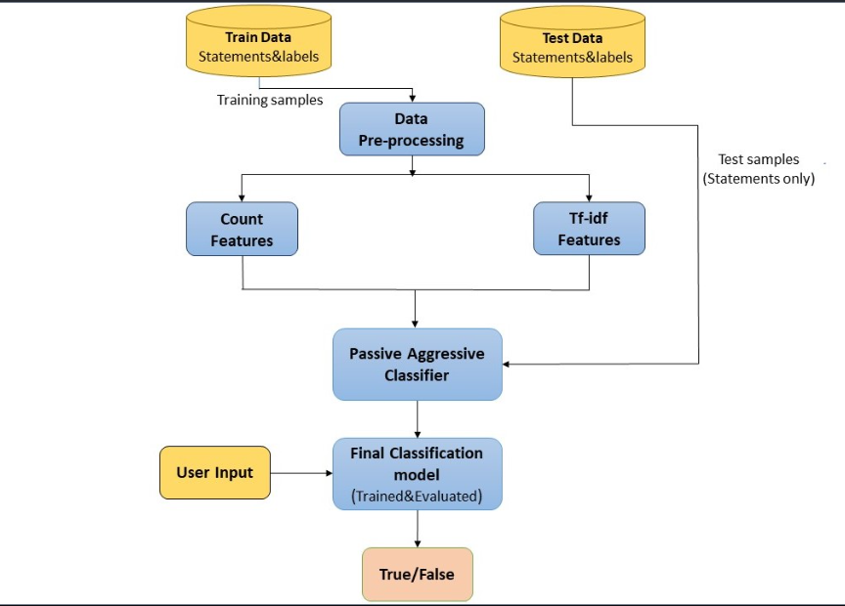
Process Flow
The model will work on the depicted format:

Slide 7
Technical Details
Fake News Detector is built using Python Libraries:
To complete this project, we need to understand Python programming, data manipulation.
visualization libraries such as Pandas and Matplotlib, and machine learning libraries such as Scikit-Learn.
Additionally, some background knowledge of natural language processing (NLP) techniques and text classification methods would be helpful.

Slide 8
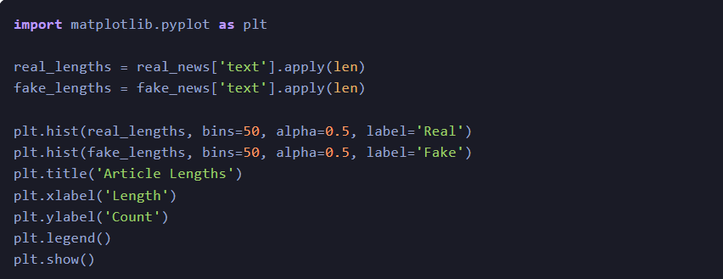
Data Collection and Exploration :
Before we can start training our model, we need to do some exploratory data analysis to get a sense of the data.

Slide 9
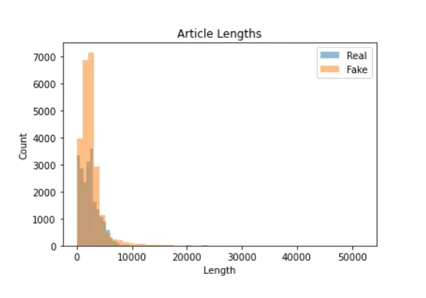
.
The output should look something like this:

Slide 10
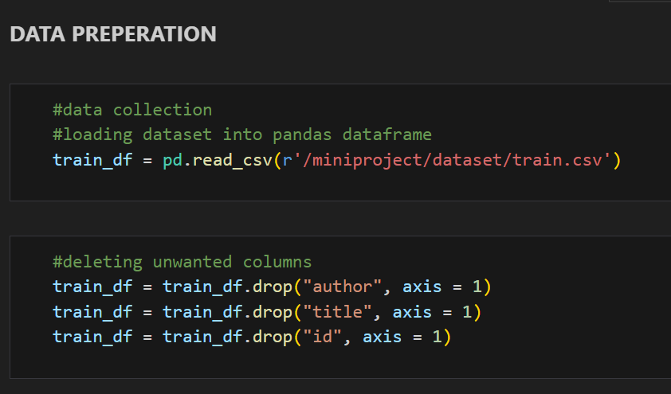
Text Preprocessing :
The data is first rendered before using it as training data, to train the model. Several steps are taken to make data ready for training.
Lowercasing the text
Removing punctuation and digits
Removing stop words
Stemming or lemmatizing the text

Slide 11
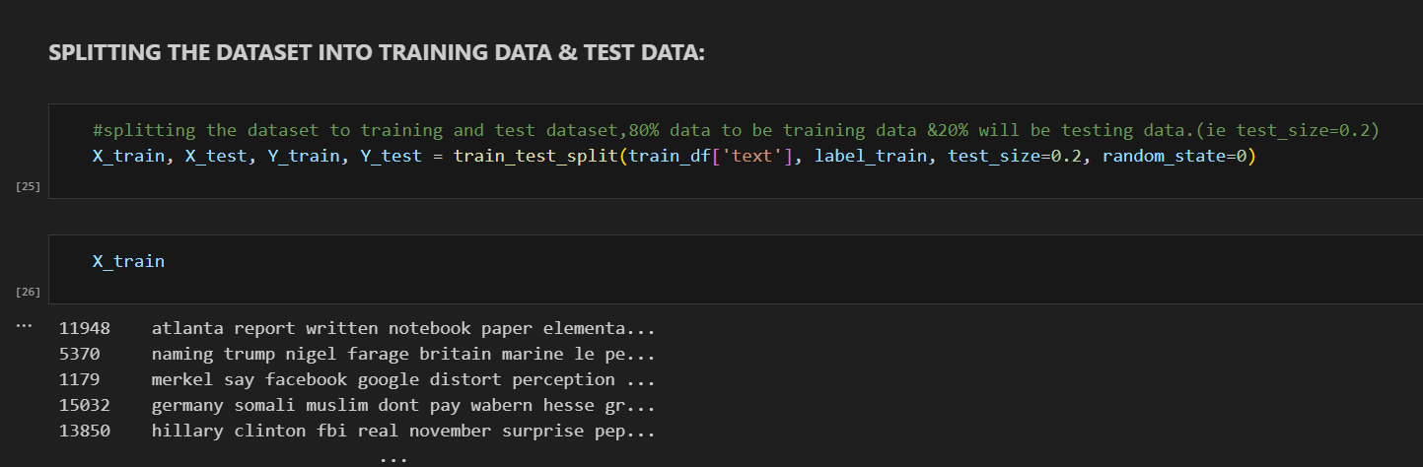
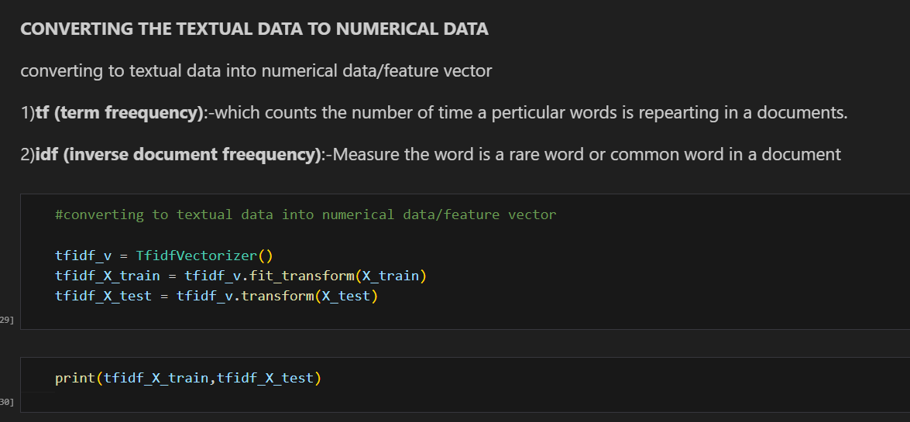
Splitting Dataset:
Dataset is splitted between two categories i.e., Training Dataset and Testing Dataset
The Data is converted in Numeric Data as numeric data is easier for Machine to understand

Slide 12
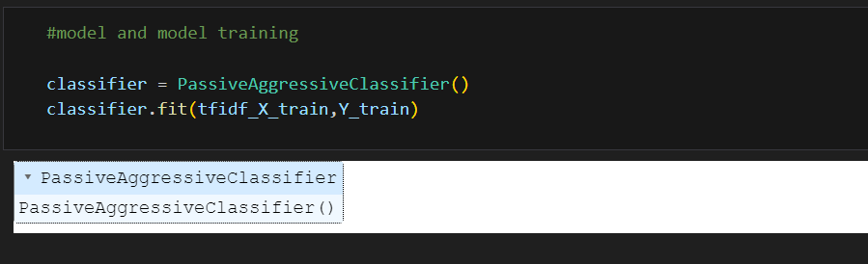
CLASSIFICATION MODEL:
PASSIVE AGGRESSIVE CLASSIFIER: Passive-Aggressive algorithms are generally used for large-scale learning. In algorithms, the input data comes in sequential order and the model is updated step-by-step where the entire training dataset is used at once. This is very useful in situations where there is a huge amount of data it is infeasible to train the entire dataset because of the sheer size of the data.

Slide 13
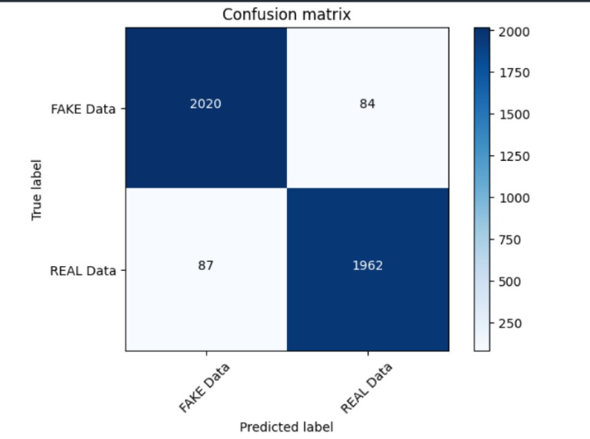
Model Training :
We can train our model now that we have preprocessed our text data. We will use a simple bag-of-words approach, representing each article as a vector of word frequencies. We will use the Count Vectorizer to convert the preprocessed text into feature vectors.
Accuracy Score and
Prediction Table

Slide 14
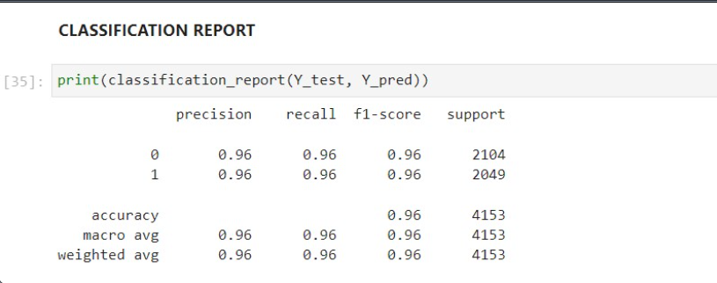
Model Evaluation:
Now that we have trained our model, we can evaluate its performance on the test set. We will use our evaluation metrics for accuracy, precision, recall, and score.

Slide 15
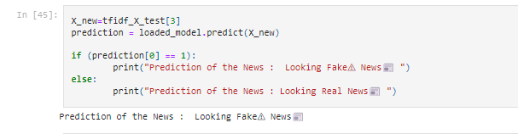
Model Deployment:
Finally, we can deploy our model as a web application using the Flask framework. We will create a simple web form where users can input text, and the model will output whether the text is likely to be real or fake news.

Slide 16
Conclusion :
Preprocessing is an essential step in natural languages processing tasks such as text classification, and techniques such as lowercasing, removing stop words, can significantly improve the performance of models.
We compared the performance of logistic regression and support vector machines and found that logistic regression had the best performance.
The project demonstrates the potential of machine learning for automated fake news detection and its potential applications in the media industry and beyond.

Slide 17
References/Links used
FreeCodeCamp - freecodecamp.org
Kaggle Documentation - Kaggle.com
Google - Google Scholar
W3School – w3school.com

Slide 18

.

