Slide 1

Recipe Book Website
Submitted To:
Baljeet Kaur
Vikas Patel
Submitted By:
Jashanjit Kaur (2210990440)
Jinny Kapur (2210990462)
Jiya Gaba (2210990464)
Kashika (2210990493)
Group-3
G10

Slide 2
Table of Contents
Introduction
Problem Statement
Technical Details
Key Features
Project Highlights
Conclusion
References/Links used

Slide 3
Introduction
In this project, we have created a recipe book viewing website. This website deals with 6 types of cuisines including Indian, Chinese, Italian, Thai, Mexican and Lebanese. The project will include different technical details such as HTML, CSS, and JavaScript.

Slide 4
Problem Statement
The creation of a responsive website aimed towards foodies is the main goal of this project.
There will be six different cuisines available on the website.
Users will have access to a list of appropriate items that are readily available for home cooking, as well as step-by-step directions for making a variety of cuisines.
In addition, the website will have a search option that lets visitors look at recipes from more than just the first six cuisines.

Slide 5

Technical Details
The project will utilize HTML, CSS, and JavaScript for the development of the recipe book website FORKIFY.
HTML will define the layout and structural
elements of the site, ensuring proper organization and hierarchy.
CSS will enhance the visual aesthetics by styling elements and incorporating animations to create an engaging user experience.
JavaScript will be instrumental in implementing interactive functionality, including features such as the search button and other dynamic components.

Slide 6
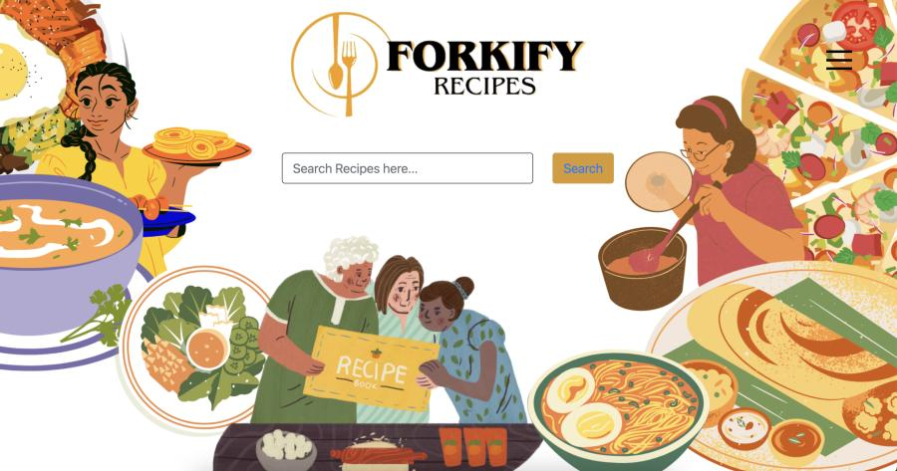
Key Features
Home Page.

Slide 7
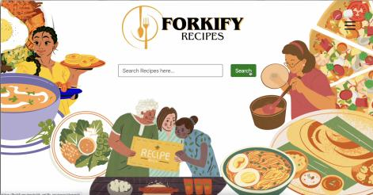
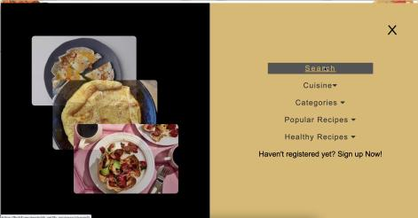
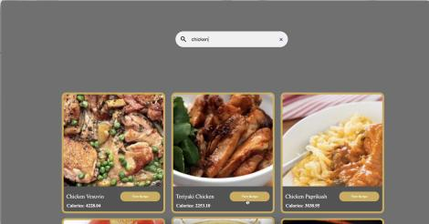
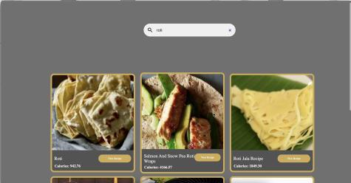
Key Features
Search Button and usage of Edamam API.

Slide 8
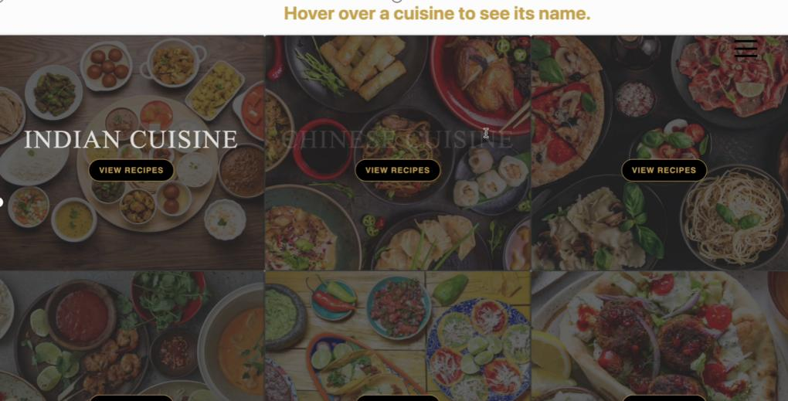
Key Features
6 types of cuisines shown in the website

Slide 9
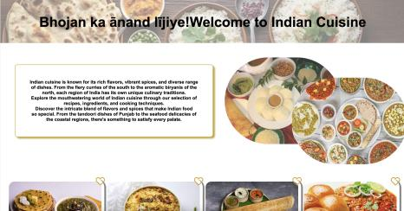
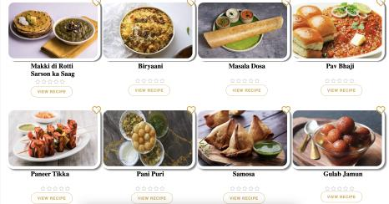
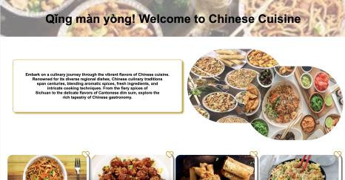
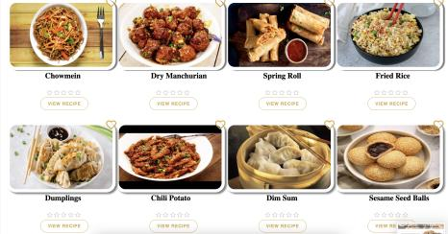
Key Features
Each cuisine has 8 popular recipes

Slide 10
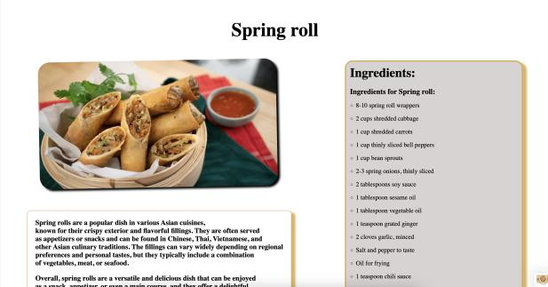
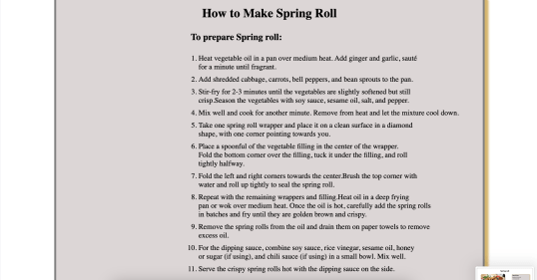
Key Features
this is how recipes for the 6 cuisines’s 8 popular dishes looks like:

Slide 11
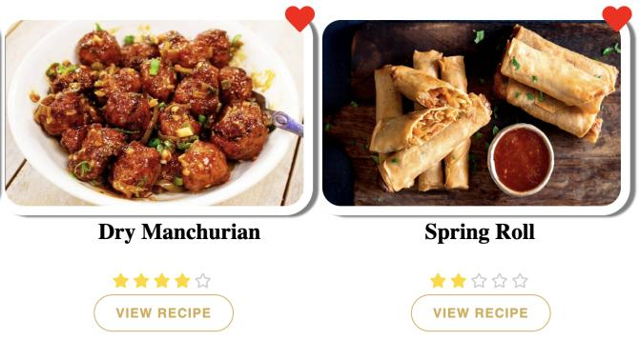
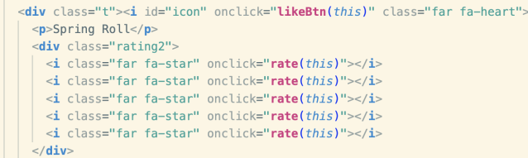
Key Features
Like and rating buttons functionality

Slide 12
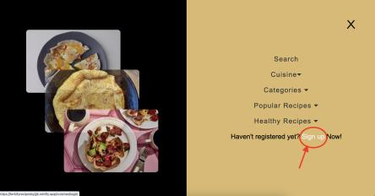
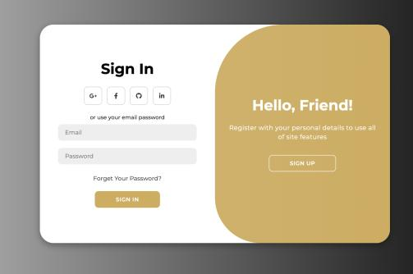
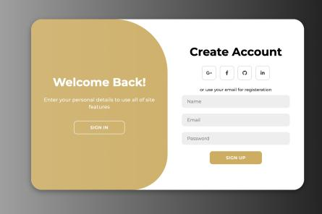
Key Features
Sign up and login page

Slide 13
Project Highlights
The project will showcase how to use Javascript to set API. We have used a food database based API named Edaman API.
The project will demonstrate how to use CSS to make the website visually appealing. We have added time based transitions to enhance the user interface.
The project will highlight how to use HTML to structure and layout the website.
The project will showcase how to implement a search feature using API.

Slide 14
Conclusion
In conclusion, creating a recipe book site make it easier for users to view and search recipes of different cuizines easily. By using HTML, CSS, and Javascript, we can create a visually appealing and functional website for recipe viewing and searching.

Slide 15
References/Links used
edamam api : https://developer.edamam.com/food-database-api
bootstrap
https://getbootstrap.com/
3. udemy
https://www.udemy.com/course/the-complete-javascript-course/learn/lecture/22648275#content*

Slide 16


