Slide 1

Forever:E-Commerce Website
Project Presentation of Exploratory Project(EP)
On
Jashanjot Singh (2210990441)
Jasmeet Singh (2210990449)
Jasneet Singh (2210990452)
Harsh Bansal (2210990376)
Supervised By
Mrs.Isha Kansal/Jashanjot Singh
Department of Computer Science and Engineering, Chitkara University, Punjab

Slide 2
FOREVER: Comprehensive Shopping Experience A fully-functional e- commerce website designed for a streamlined shopping experience. Features include diverse product categories, advanced filtering, and a scalable architecture ready for future expansion.

Slide 3
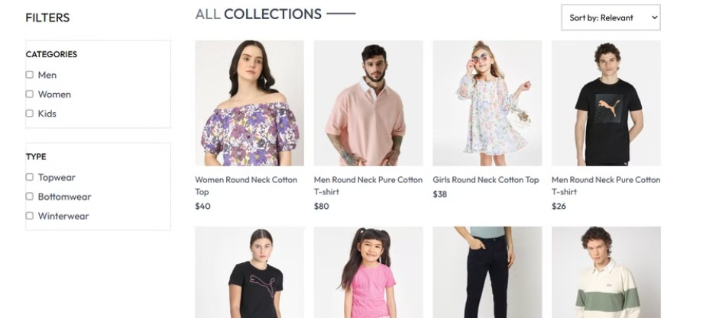
Product
The site offers a rich user experience through robust segmentation. Categories include Men, Women, and Kids, alongside product types like Topwear, Bottomwear, and Winterwear. Navigate effortlessly to find exactly what you need.

Slide 4
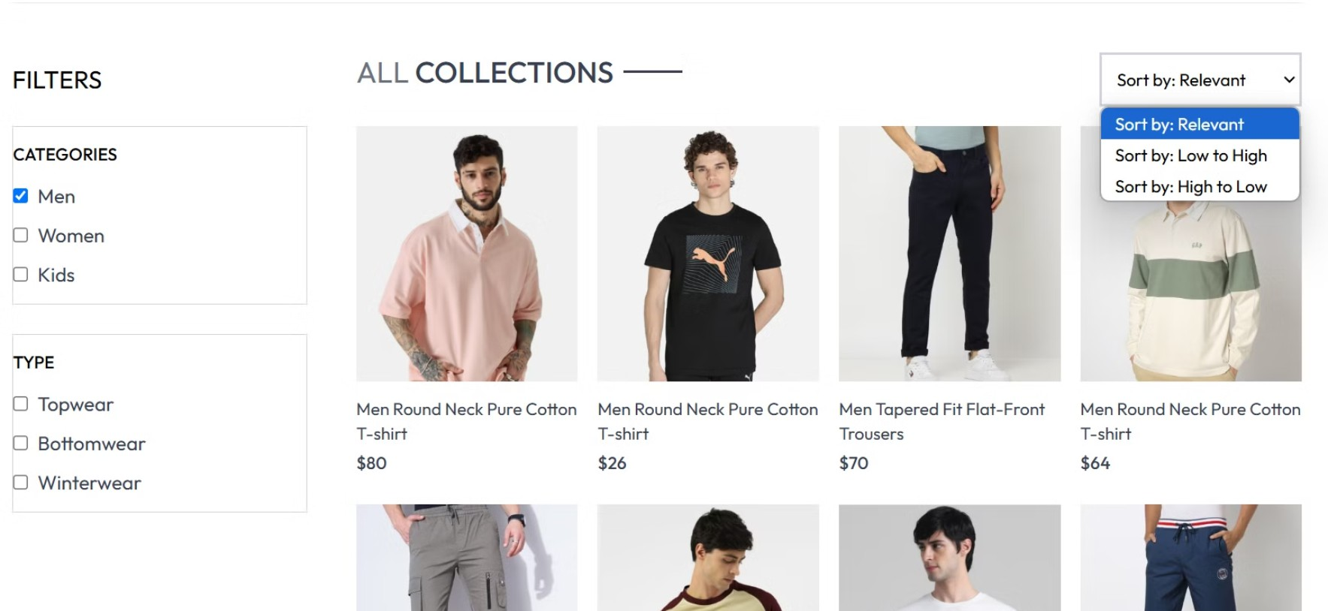

Advanced Sorting Functionality
Enhance your shopping with our price-based sorting. Choose to view items from Low to High or High to Low. Find the best deals quickly. Refine your search and enjoy a seamless user experience.

Slide 5

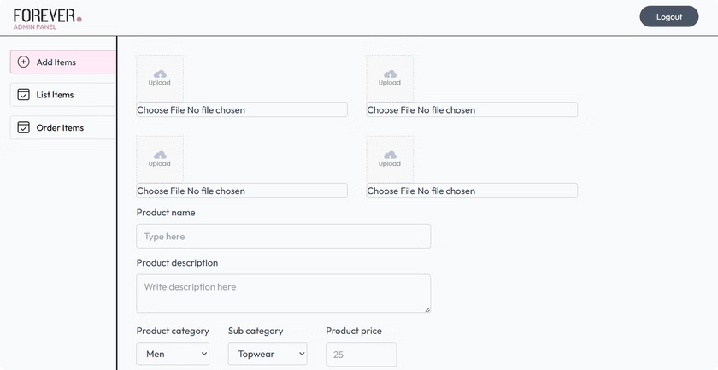
Admin Management Interface
The admin interface allows centralized product and inventory management. Enjoy full control over content updates. Benefit from secure administrative access, streamlining your workflow efficiently.

Slide 6

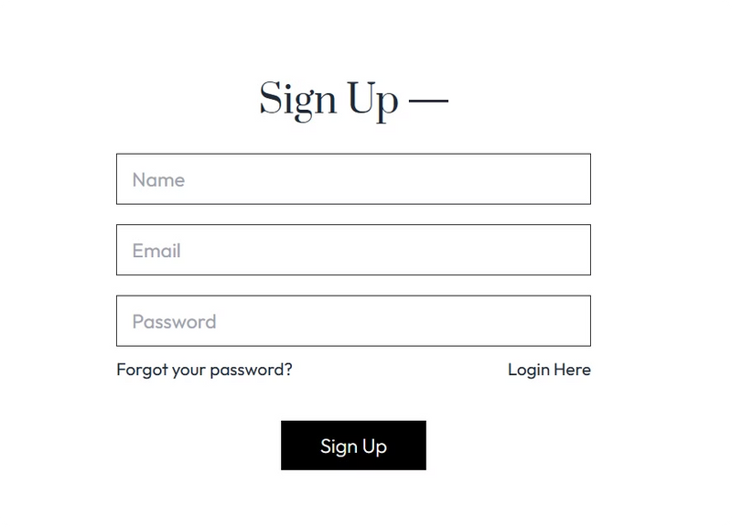
User Authentication System
Secure user accounts are managed through robust sign-up and sign-in features. Data protection and privacy are key. Enjoy personalized shopping experiences, tailored to your needs.

Slide 7
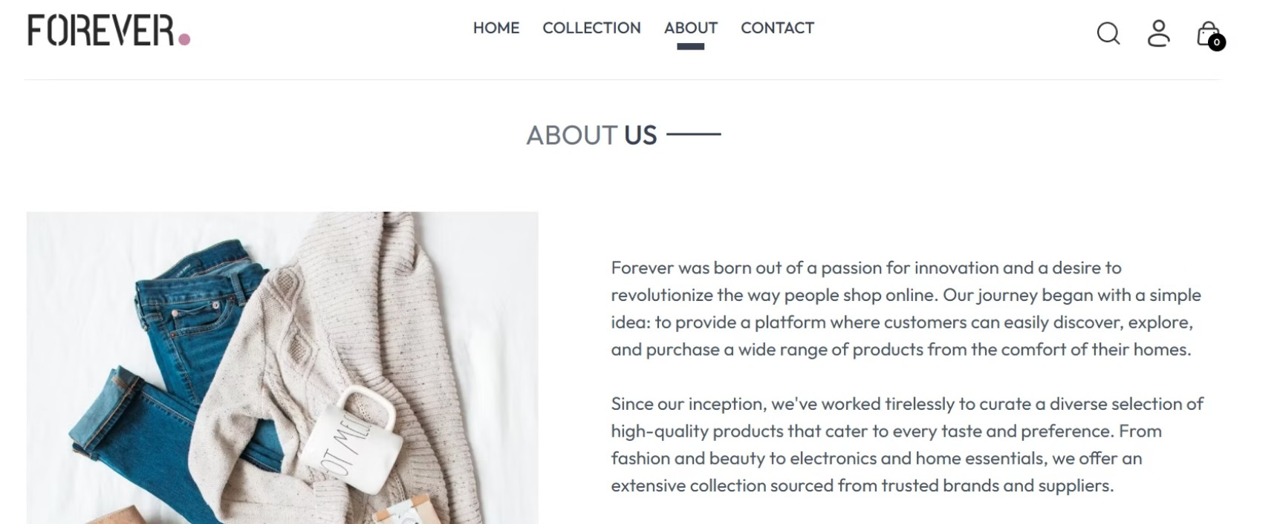
Website Navigation
A clear and intuitive site structure makes the navigation a breeze. Access essential information via the About and Contact pages. The site's design ensures easy access to key details.

Slide 8

Future Development: Payment
Planned integration includes secure payment systems. Expect multiple payment methods for user convenience. Look forward to a streamlined checkout process, making purchasing easy.

Slide 9
Tech Stack
Frontend :-
Backend :-
1. HTML5
1. Tailwind CSS
1. Javascript 1. ReactJS 1. Axios
1. React Router
Node.js
Express.js
MySQL
REST API
Sequelize
JWT(json web token)

Slide 10

Technical
A responsive web design ensures mobile and desktop compatibility. Benefit from a scalable backend infrastructure, optimized for performance. The platform is technically sound and adaptable.

Slide 11
Thank You

