Slide 1

Internship Presentation
Jashank · Fullstack Developer & DevOps Engineer
SHIVEN ENTERPRISES

Slide 2

About Shiven Enterprises
Who We Are
Industry
Shiven Enterprises is a technology-driven company delivering innovative digital solutions across web, mobile, and cloud infrastructure.
Operating in the software development and digital services space, with a focus on scalable, modern applications for diverse clients.
Work Domain
Full-stack product development, DevOps automation, cloud hosting, and end-to-end deployment pipelines.

Slide 3

My Role
Fullstack Developer
DevOps Engineer
Responsibilities
Designed and built responsive web interfaces using React, HTML, CSS, and JavaScript, alongside robust backend logic and APIs.
Managed deployment pipelines, cloud hosting environments, and CI/CD workflows to ensure reliable, continuous delivery.
End-to-end ownership — from writing code and reviewing UI to configuring servers, automating builds, and monitoring uptime.

Slide 4
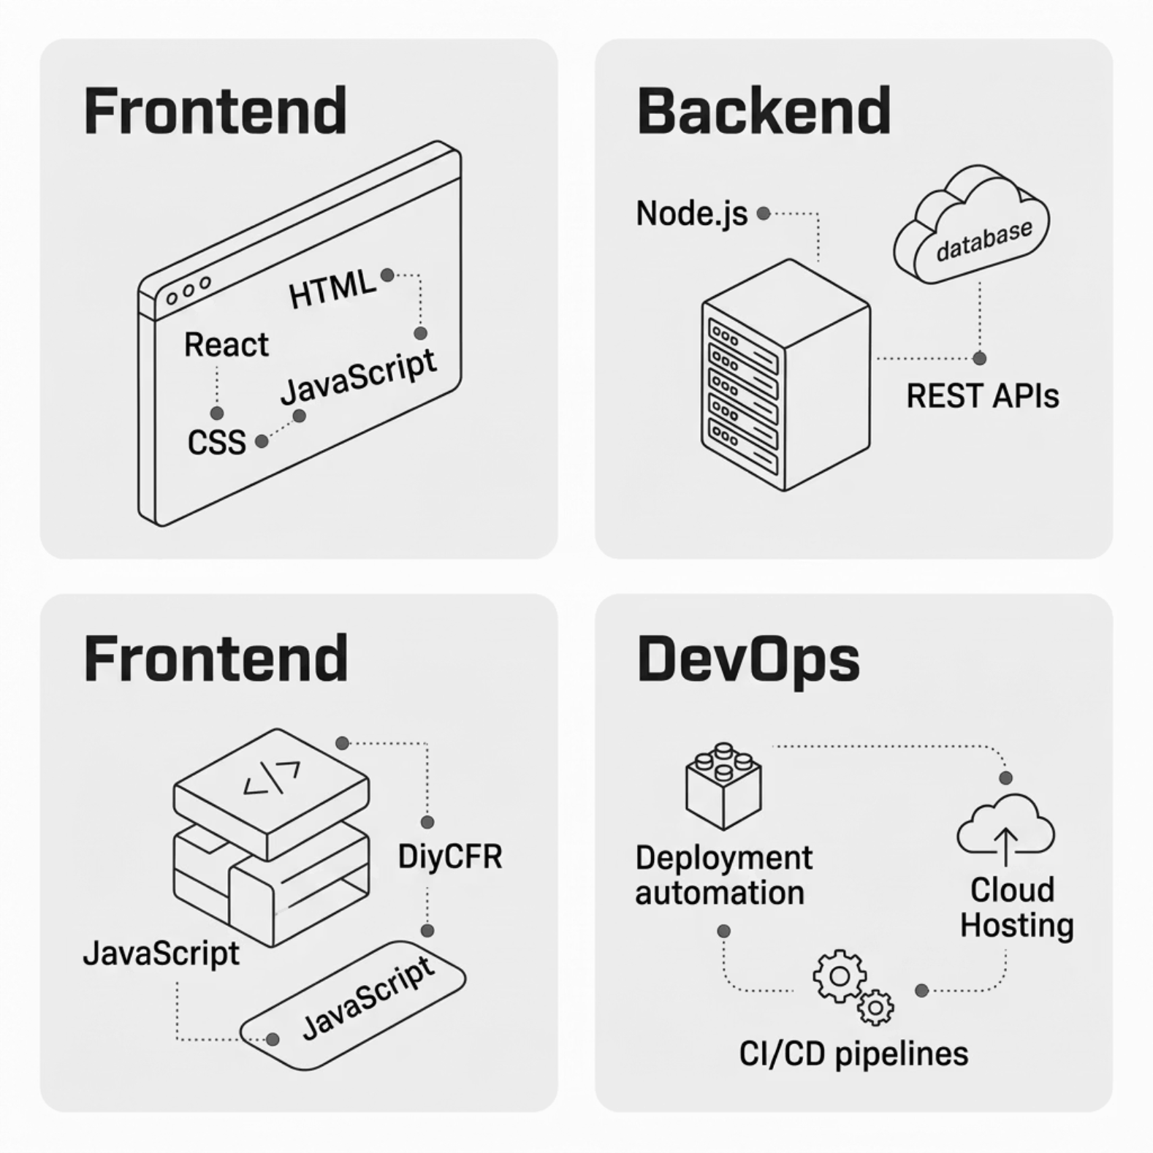

Technologies Used
A Modern, Versatile Stack
The internship demanded proficiency across the entire development lifecycle — from pixel-perfect frontends to automated cloud deployments.
Frontend: React, HTML5, CSS3, JavaScript (ES6+)
Backend: Node.js, REST APIs
DevOps: CI/CD, cloud hosting, automated deployment

Slide 5


Web Applications Developed
PalBamb
Email Sender Prox
A feature-rich web platform built for modern commerce. Designed with a clean UI, optimised performance, and seamless user experience.
A professional bulk email sending platform enabling users to manage, schedule, and send high-volume campaigns with ease and reliability.
palbamb.com
emailsenderprox.online

Slide 6


MOBILE APPLICATION
Email Sender Pro App
A native Android application extending the email platform's capabilities to mobile users — available on the Google Play Store.
Compose and send bulk emails from mobile
Manage contact lists and campaigns on the go
Real-time delivery tracking and analytics
Clean, intuitive UI optimised for Android

Slide 7
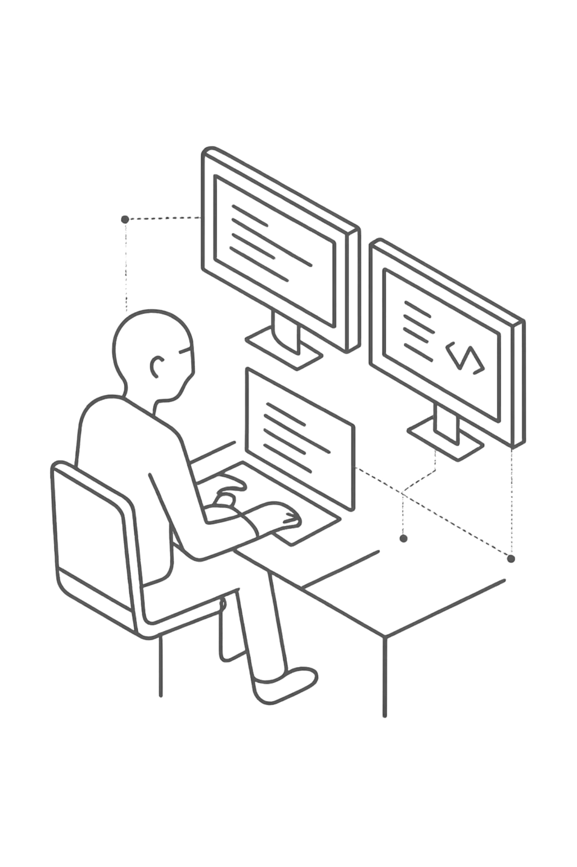
Key Contributions
Full-Stack Development
Architected and delivered two production-grade web applications, handling both frontend interfaces and backend API logic end-to-end.
Deployment & Hosting
Configured and maintained cloud hosting environments, ensuring high availability, security, and smooth release cycles.
Performance & UI Improvements
Optimised page load speeds, refined UI components, and enhanced overall user experience across web and mobile platforms.

Slide 8
Challenges & Solutions
Challenge: Deployment Complexity
Challenge: Performance Bottlenecks
Challenge: Cross-Platform Consistency
Configuring stable CI/CD pipelines across multiple environments proved difficult initially. Resolved by standardising scripts and adopting environment-specific config files.
Ensuring the web and mobile apps maintained consistent behaviour required rigorous testing protocols and shared component logic.
Early builds faced slow load times. Solved through code splitting, lazy loading in React, and backend query optimisation.

Slide 9

Learning Outcomes
Technical Growth
Professional Skills
Deepened expertise in React and Node.js
Hands-on CI/CD pipeline configuration
Cloud hosting and server management
Android app development lifecycle
End-to-end product ownership
Problem-solving under real deadlines
Cross-functional collaboration
Documentation and code quality practices

Slide 10

Conclusion
This internship at Shiven Enterprises was a defining chapter in my development as a software engineer — delivering real products, solving real problems, and growing across the full technology stack.
Experience Summary
Delivered two live web applications and an Android app, managed cloud deployments, and contributed meaningfully to a professional engineering team.
Future Goals
To deepen expertise in cloud-native architecture, DevOps automation, and scalable full-stack systems — and to continue building impactful digital products.

