Slide 1

Uncovering YouTube Insights: Crowd Source Systems for Effective Big Data Analysis
CSCE - 5300 - Introduction to Bigdata and Data Science (Fall 2023)
Under:
Dr. Pavlo Tymoshchuk Volodymyrovych
Team Members
Anusha Yaramala
Jashia Mitayeegiri
Divya Sree Sandineni
Pavani Pabboju
Bojja Hemanth

Slide 2

Problem Statement
The difficulty in managing streaming data efficiently emerges in the big data space, where massive volumes of data are created at unprecedented rates.
The streaming platform paradigm presents challenges for traditional data storage solutions, which are frequently dispersed, because of the high cost of data input and querying.
Streaming Analytics, a crucial instrument for deriving insights from dynamic data features, has challenges when utilizing current methods and technologies.
This study's main goal is to design and build an analytical platform on top of streaming data to find hidden patterns and glean insightful information from the ever-changing streaming landscape.

Slide 3

Existing solutions
The creation of big data systems that can effectively handle "big data" and "fast data" for analytical purposes has drawn more attention in recent years. "Fast data" includes high-velocity, real-time or almost real-time data streams, such as system logs, impressions, click streams, search queries, and Twitter feeds.
The framework should enable large-scale data and be scalable across several computers while maintaining user-specified latency limitations. The work addresses high latency in current Hadoop systems and presents an expanded architecture with processing and shuffling done by mini-batches.
The paper examines scheduling algorithms with an emphasis on application-aware techniques for stream data management (Babcock et al., 2004). In addition to improving algorithms to suit application specific QoS expectations and offering an approximation strategy for balancing scheduling quality with overhead concerns, it stresses rigorous decision-making in parameters such as train size and super box traversal techniques

Slide 4

Existing Solution
Big data is seeing a growth in the need for streaming computing models, especially for low latency uses like machine learning and real-time log monitoring. This is addressed by D-Streams, a revolutionary architecture for distributed streaming computing, which achieves fast recovery from errors and stragglers in sub-second timeframes without requiring resource-intensive replication.
Apache Flink, a flexible dataflow engine that can manage batch and stream analytics, to overcome these constraints. Operator state and logical intermediate outcomes are treated as fundamental components in Flink, and the streaming API makes it easier to manage recoverable state and divide, transform, and aggregate data stream windows in an effective manner

Slide 5
Comparative analysis
The smart grid big data ecosystem based on the Lambda architecture combines batch and real-time processing for managing large volumes of smart grid data.
A Hadoop-based data lake, along with technologies like NiFi and Kafka, is utilized for managing batch, real-time, or hybrid data ingestion.
Spark is used for processing data within the Hadoop ecosystem, while visualization tools are employed to present the outcomes.
An online system for real-time TCP performance monitoring combines collectors, Spark Streaming, and Kafka as its core components.
Different strategies employ various combinations of tools to meet specific data processing requirements.

Slide 6

Comparative analysis
The YouTube technique for real-time analytics utilizes PySpark, MongoDB, Kafka Streams, YouTube APIs, and visualization tools.
R. Liu and H. Isah's approach employs Hadoop, NiFi, Kafka, Spark, and visualization tools for general big data processing.
Munshi and Mohamed's Lambda architecture focuses specifically on managing and processing smart grid data.
The suggested approach for YouTube data analysis leverages the MapReduce architecture and specialized tools like PySpark, MongoDB, Kafka Streams, and a real-time analytics dashboard.
The Dynamic Adaptive Streaming over HTTP (DASH) technique prioritizes adaptive video streaming based on connection bandwidth, while YouTube data analysis focuses on providing insights into top-performing videos, rivals, and channels.

Slide 7
Methodology Used
Step 1: Gathering Metadata from YouTube API: The first stage focuses on collecting metadata such as video titles, channel names, and publication dates using YouTube APIs. This helps in understanding the content and identifying potential success indicators.
Step 2: Streaming Data Management with Kafka Streams: The second stage utilizes Kafka Streams to handle streaming data efficiently. Video objects are subscribed to a Kafka topic, leveraging Kafka's scalability and fault-tolerant nature for managing high volumes of messages.
Step 3: Processing Streaming Data with PySpark: The third stage involves using PySpark, an open-source framework for large-scale distributed computations, to process the data ingested from Kafka Streams. Spark and Kafka are combined to handle the challenge of ingesting streaming events from multiple producers to multiple consumers.

Slide 8
Step 4: Storing Processed Metadata in MongoDB (NoSQL Database): The fourth stage focuses on storing the processed video metadata in a NoSQL database. While the research paper suggests using Apache Cassandra, in this case, MongoDB is used due to its ease of use and adaptability to the dynamic nature of streaming data. MongoDB's scalable architecture ensures high availability and the ability to subscribe to real-time changes, which is crucial for managing streaming data.
Step 5: Creating a Live-Streaming Analytics Dashboard: The final stage involves developing a live-streaming analytics dashboard using various Python modules and Semantic-UI for both front-end and back-end tasks. The dashboard provides real-time presentation of metrics and data, enhancing the understanding of different insights derived from the processed data.
Methodology Used

Slide 9
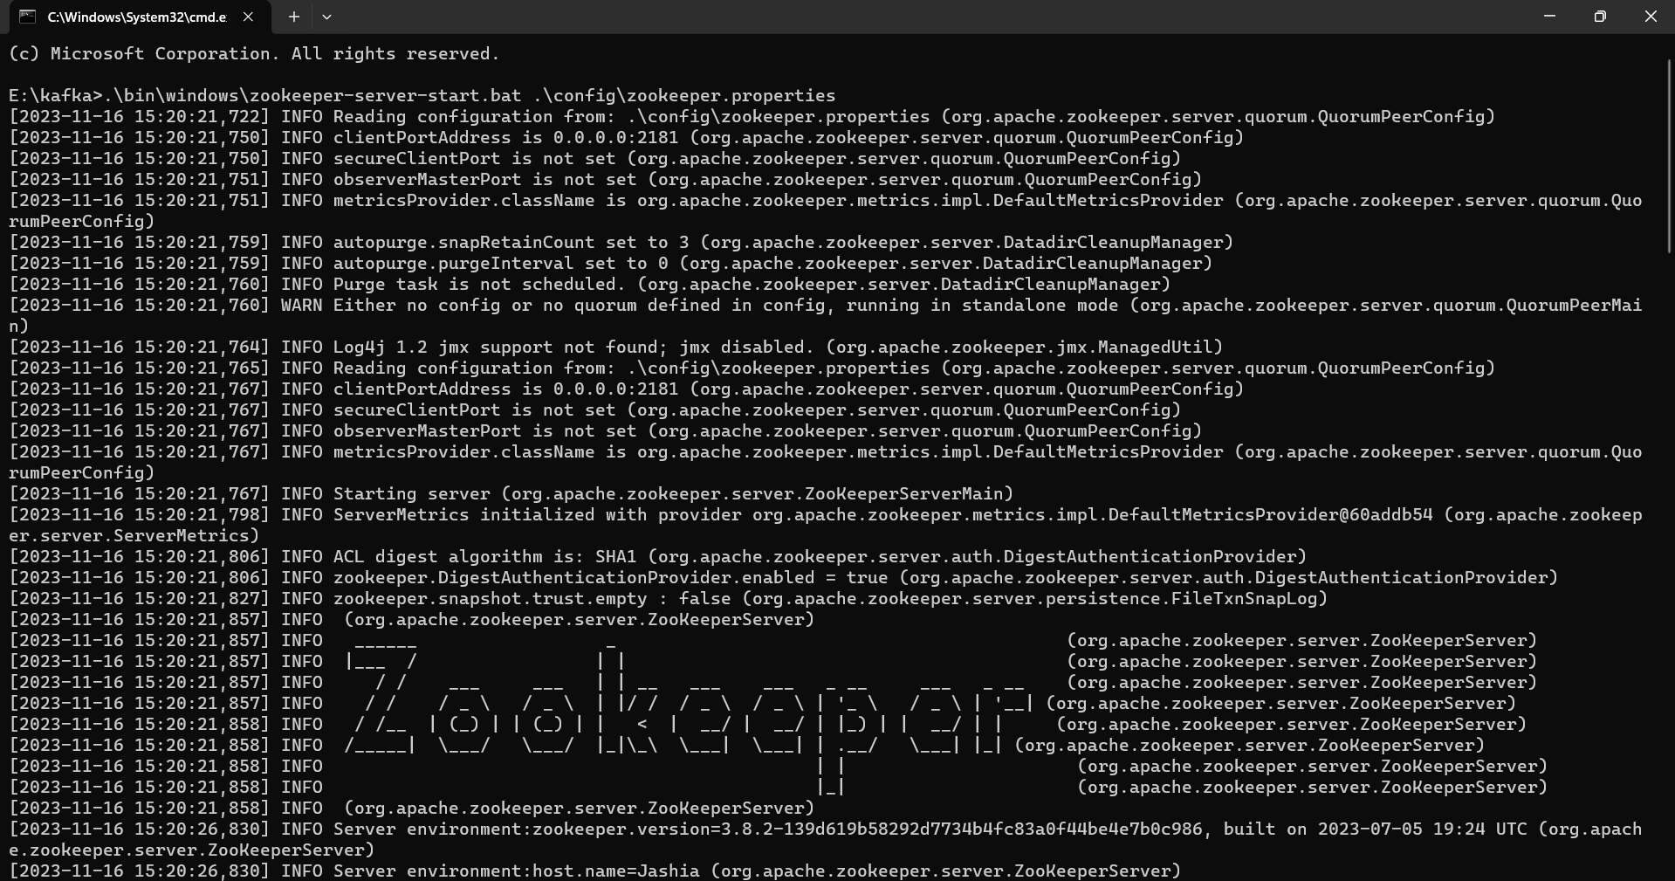
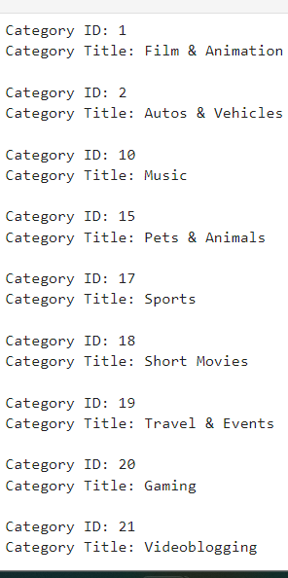
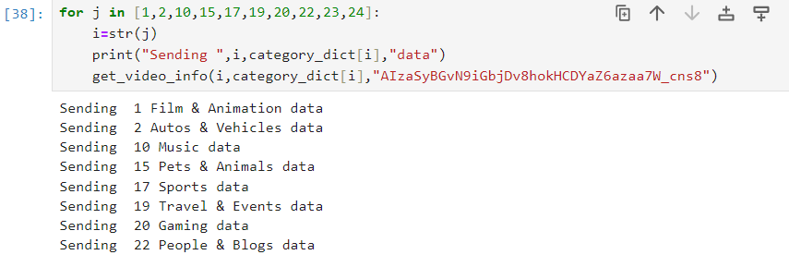
Simulation of results
Before we get the videos uploaded in a specific duration, we will have to get the categories in which YouTube puts the videos.
we create a method which called as get_videos_info () which takes the id, category and the API key used to access the YouTube data.

Slide 10
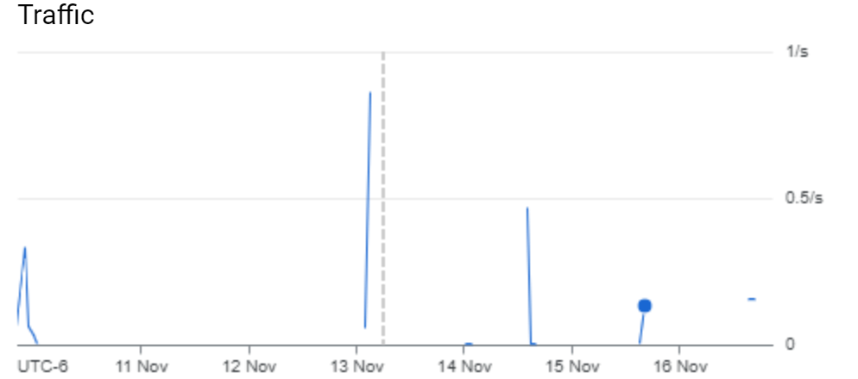
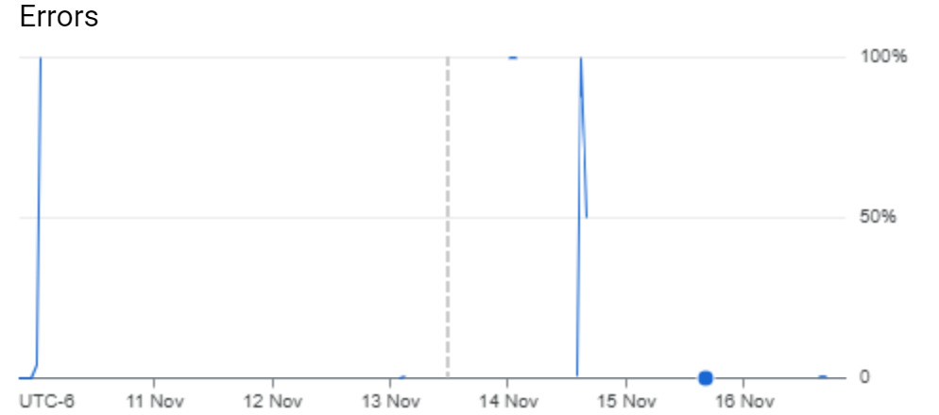
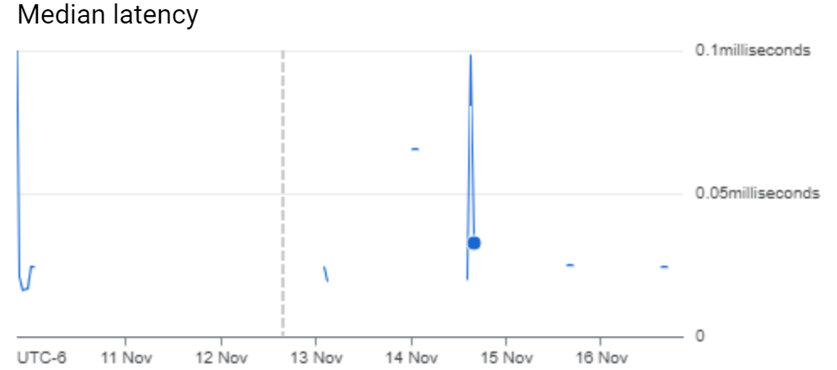
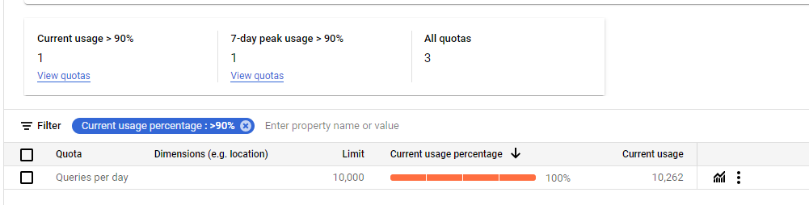
Youtube API
When we are retrieving the meta data related to the video, the youtube API v3 provides a dashboard which tells us the request generated and the quotas that user has exceeded.

Slide 11
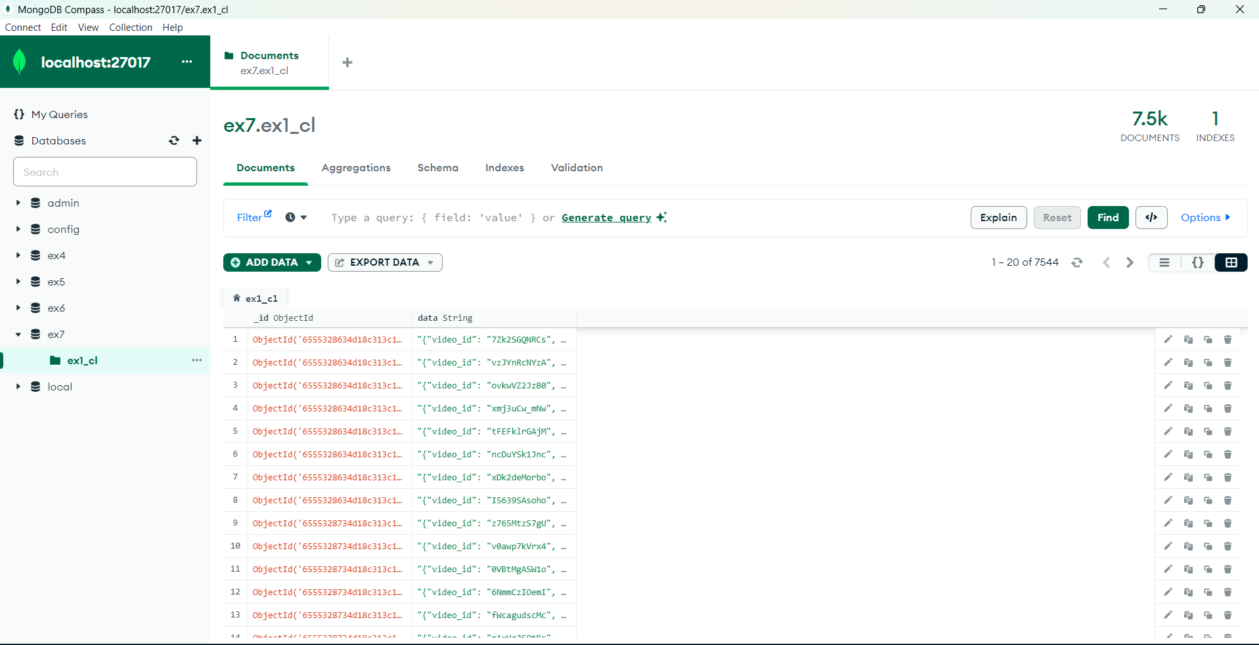
MongoDB downstream
After the Kafka takes the data from the YouTube API and the consumer which is our mongoDB takes the data using a consumer which subscribes to the topics of the producer.

Slide 12
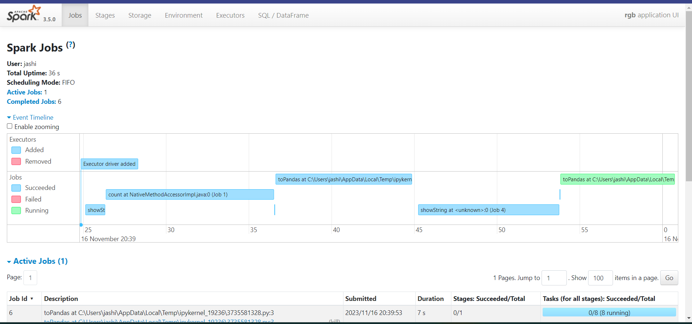
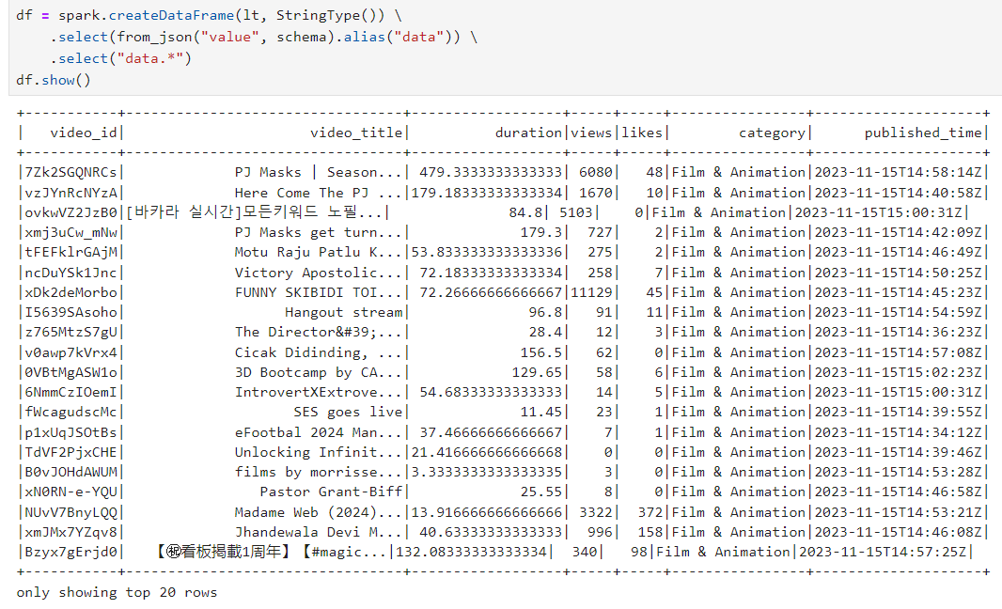
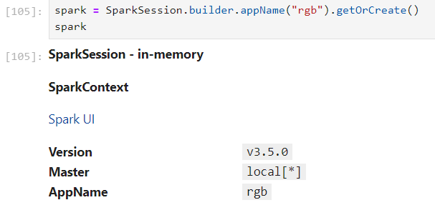
Analytics
When we perform the analytics with pypark a spark connection is create which takes performs the necessary analytics much faster.

Slide 13
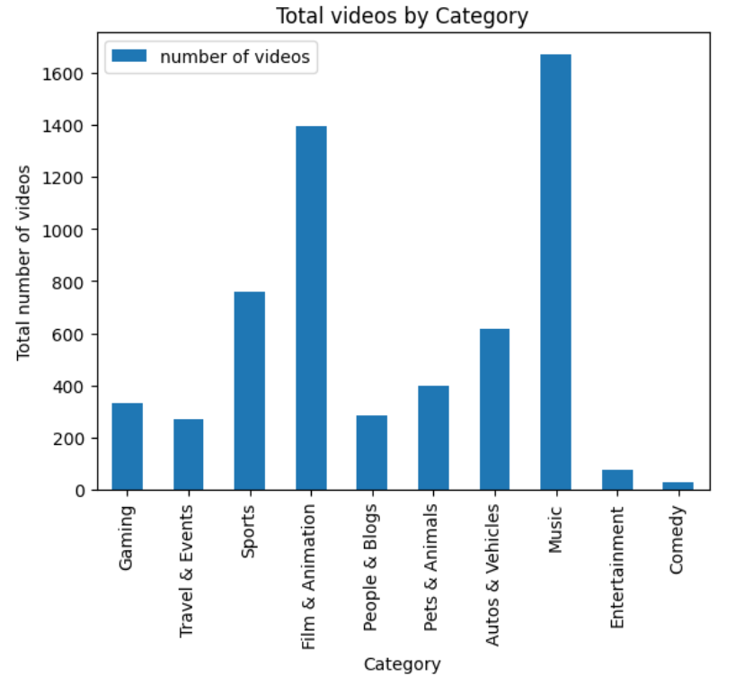
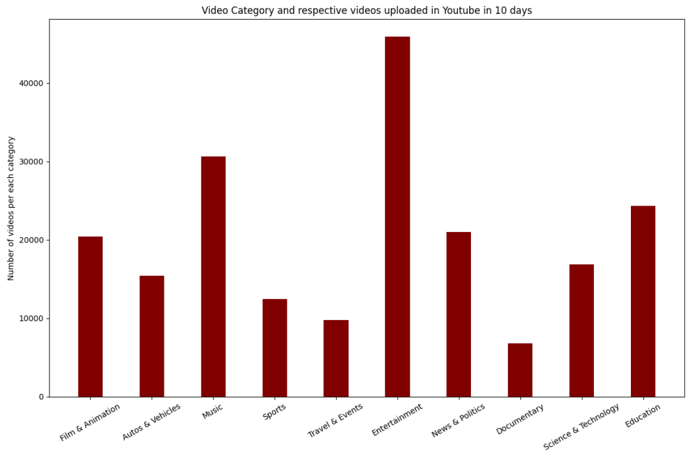

Slide 14
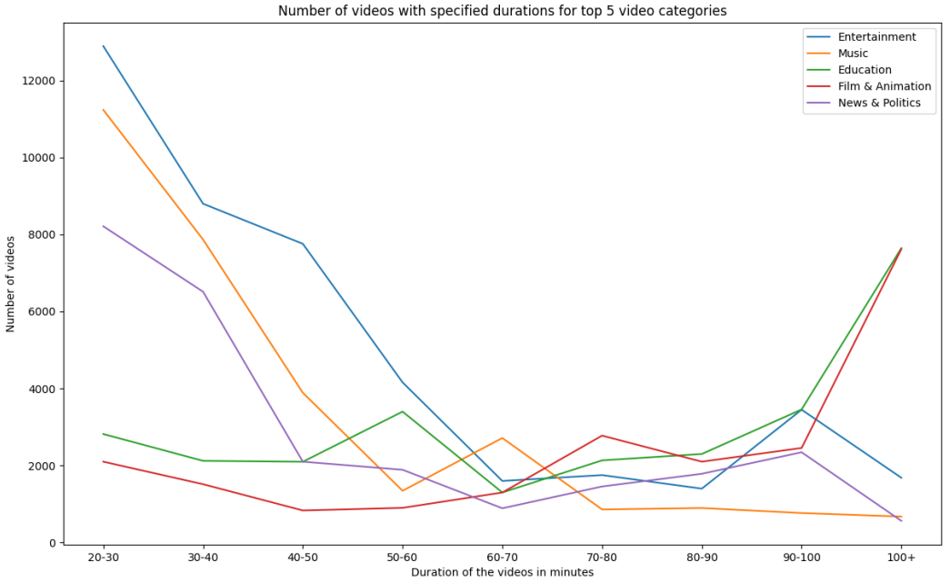
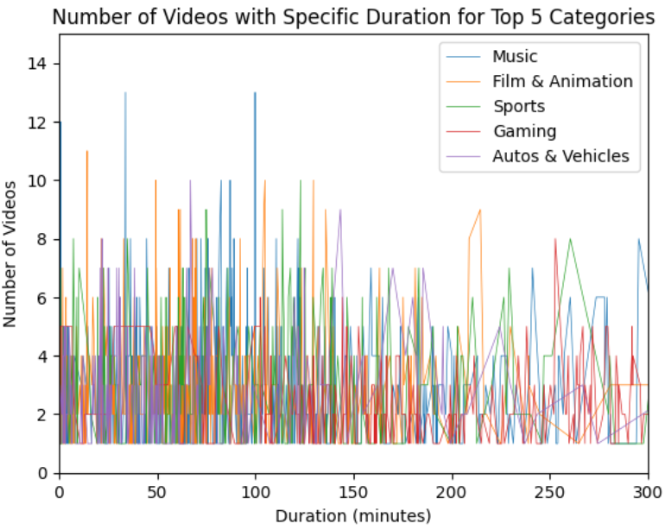

Slide 15
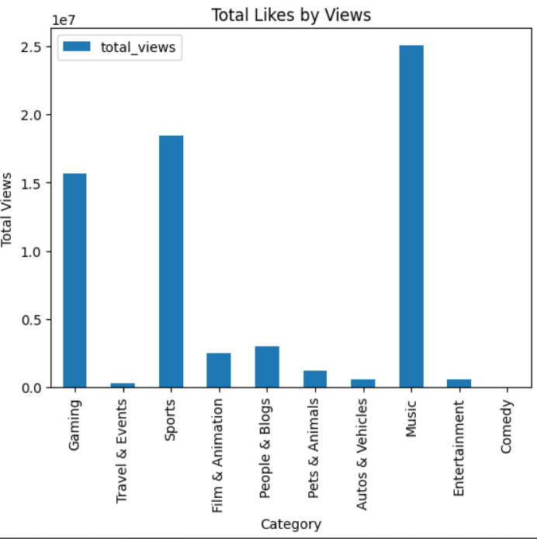
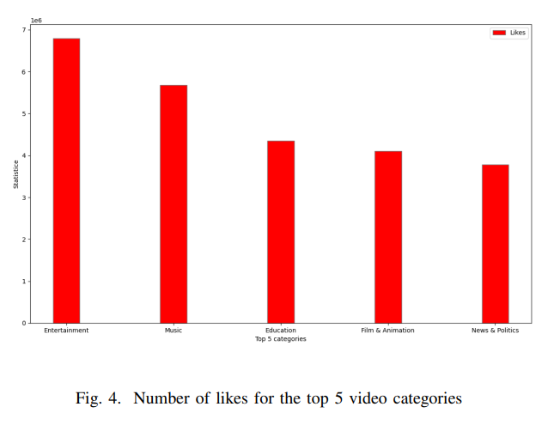

Slide 16
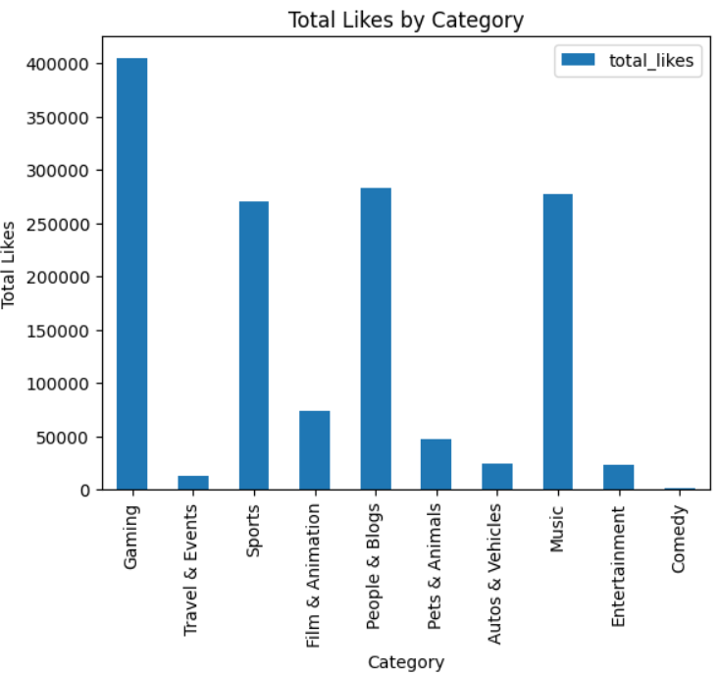
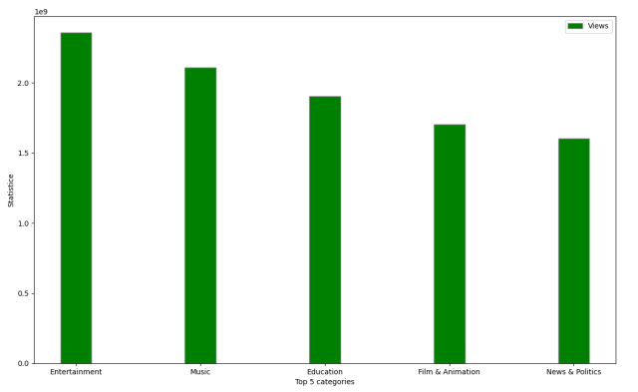

Slide 17
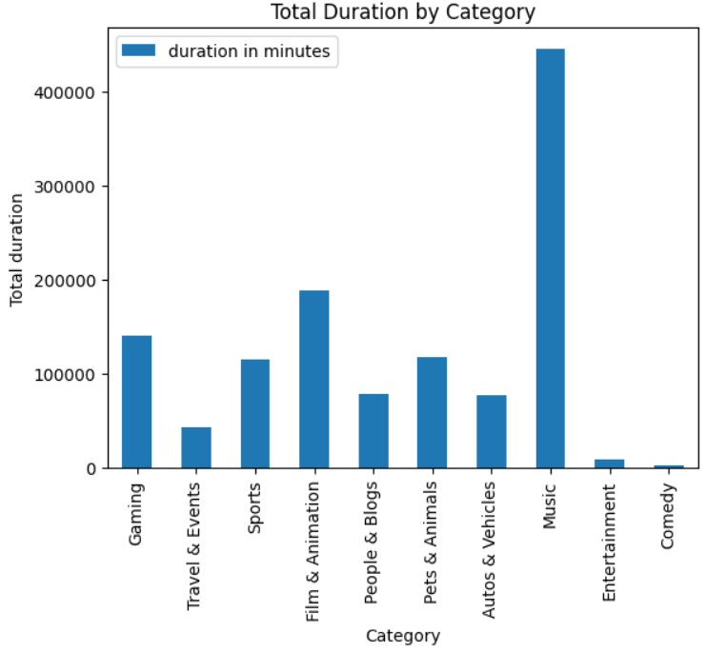

Slide 18
APPLICATION
YouTube Video Generation: Content creators can gain valuable insights into viewer preferences and trends, enabling them to create videos that are more likely to engage and attract viewers.
Content Strategy Improvement: Understanding metrics like views, likes, and other metadata can help video creators optimize their content strategy and stay competitive in the YouTube landscape.
Public Opinion Analysis: Governments and businesses can leverage YouTube data to analyze public opinion and responses to specific events, providing valuable insights for decision-making.
Data Processing in Various Industries: The architecture of the suggested method can be extended for data processing applications in industries such as logistics, health, and space science.

Slide 19
Pros and Cons
Pros | Cons
Scalability: The method demonstrates adaptability in processing massive amounts of streaming data effectively, leveraging big data technologies like Hadoop, Spark, Kafka Streams, and MongoDB. | The study mentions the cost associated with ingesting and querying data, emphasizing the need for efficient streaming analytics methods and tools.
Real-Time Insights: The real-time analytics tool enables content creators to monitor the performance of their work overtime and identify popular categories and videos. | The system relies on YouTube's API, which has a daily cap of 100,000 queries. Careful monitoring of API requests is necessary to ensure uninterrupted data collection.
Versatility: The system's flexibility allows for potential applications across multiple industries outside of content development, showcasing its scalability and usefulness. | Streaming data introduces complexities in terms of data collection and processing, requiring careful consideration and monitoring during system implementation and development.

Slide 20
References
Babcock, B., Babu, S., Datar, M., Motwani, R., & Thomas, D. (2004, December). Operator scheduling in data stream systems. The VLDB Journal, 13(4), 333–353. https://doi.org/10.1007/s00778-004-0132-6
Li, B., Diao, Y., & Shenoy, P. (2015, July). Supporting scalable analytics with latency constraints. Proceedings of the VLDB Endowment, 8(11), 1166–1177. https://doi.org/10.14778/2809974.2809979
B. Li, et al. A platform for scalable one-pass analytics using MapReduce. In SIGMOD, pp. 985–996, 2011.
M. Zaharia, et al. Discretized streams: fault-tolerant streaming computation at scale. In SOSP, pp. 423–438, 2013. https://dl.acm.org/doi/10.1145/2517349.2522737
P. Carbone, A. Katsifodimos, S. Ewen, V. Markl, S. Haridi, and K. Tzoumas, “Apache flink: Stream and batch processing in a single engine,” Bulletin of the IEEE Computer Society Technical Committee on Data Engineering, vol. 36, no. 4, 2015.
R. Liu, H. Isah, and F. Zulkernine, “A big data lake for multilevel streaming analytics,” in 2020 1st International Conference on Big Data Analytics and Practices (IB- DAP), 2020, pp. 1–6.
Munshi, A. A., & Mohamed, Y. A. R. I. (2018). Data Lake Lambda Architecture for Smart Grids Big Data Analytics. IEEE Access, 6, 40463–40471. https://doi.org/10.1109/access.2018.2858256
Baojun Zhou, Jie Li , Xiaoyan Wang, Yu Gu, Li Xu, Yongqiang Hu, and Lihua Zhu (2018). Online Internet traffic monitoring system using spark streaming. (2018, March). Big Data Mining and Analytics, 1(1), 47–56. https://doi.org/10.26599/bdma.2018.9020005
T, A., LM, S., E, M., & S Padti, S. (2021, March 1). Youtube Data Analysis Using Hadoop Framework. International Journal of Engineering Applied Sciences and Technology, 5(11). https://doi.org/10.33564/ijeast.2021.v05i11.051

