Slide 1

Predicting Song Popularity Using Machine Learning Algorithms
End-Semester Project Presentation
Group 27 - Aakashvani
CSE523 - Machine Learning
Course Instructor - Dr. Mehul Raval
Bihag Dave (AU1949007)
Koushiki Bhattacharyya (AU2029005)
Prayag Savsani (AU1841035)
Yashraj Kakkad (AU1841036)
Notes:
This is our title.

Slide 2

Introduction
Problem Statement
Music information retrieval (MIR)
The interdisciplinary science of retrieving information from music.
Given song metadata*, predict the
Song popularity score (regression)
Whether or not the song is popular (classification).
Hit Song ScienceTM
Predicting whether a song will be a hit, before its distribution using automated means such as machine learning software.”
* Use a dataset^{[1]} comprising of audio features and other metadata fetched using Spotify’s API
a term coined by Mike McCready
Definitions source: Wikipedia

Slide 3
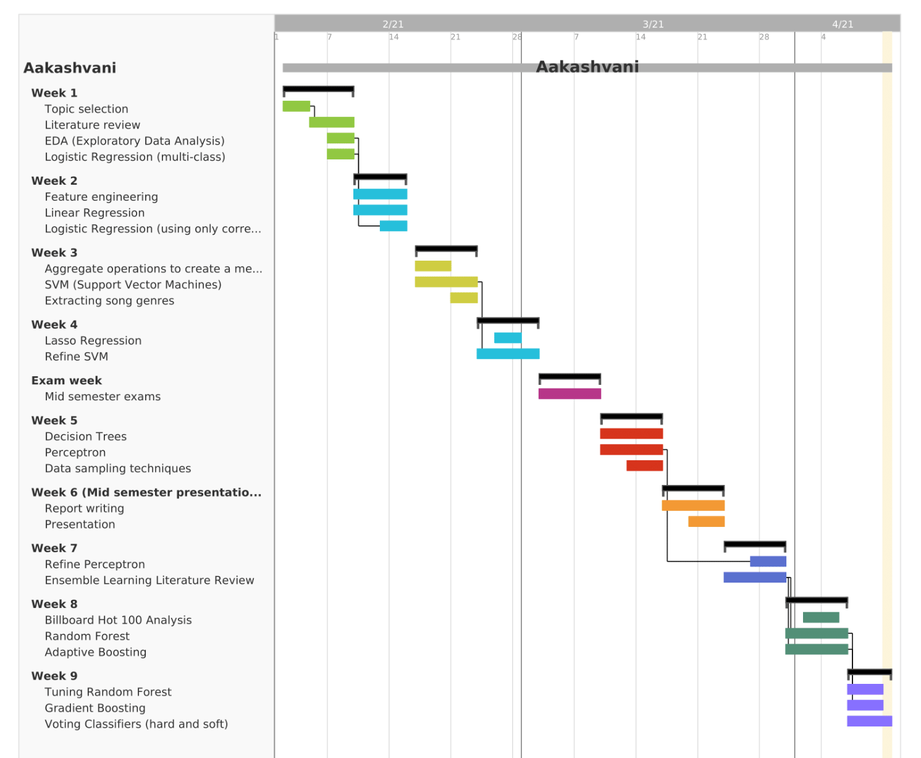
GANTT Chart

Slide 4
Existing Body of Work
B. Logan et. al predicts the popular songs using ML algorithms by quantifying certain lyrical and acoustical characteristics. [5]
R. Nijkamp uses attributes of Spotify dataset to build a linear regression model. [3]
A. Shinghi et. al use a song’s lyrical features to predict popularity and found that it worked better than audio features in popularity predictions. [4]
Bischoff et. al uses social media metrics of the artist or buzz created by users. [8]
E. Zangerle et. al has also investigated correlations between twitter hashtag #nowplaying and billboard top 100 charts. [7]
Notes:
One of the earlier works in this direction was published by Beth Logan et. al. who used both acoustical and lyrical characteristics of a song to train a classification model. Instead of using metadata like we are going to, their dataset used actual song audio as samples.
Coming to more recent work, R. Nijkamp uses the same dataset that we do and uses the basic attributes provided by the Spotify API to train a Linear Regression Model with a much smaller dataset. But here the author tries predict the stream count on spotify instead of the popularity metric.
Other work focuses on using only lyrical features to predict popularity, and found that text works better than acoustical characteristics in predicting hit songs. There have also been attempts to predict song popularity using social media metrics, buzz around an artist, and even twitter hashtags.

Slide 5
Our Approach
Clearing, Merging, EDA…..
Danceability
Threshold determination from Billboard Hot 100
Loudness
Accousticness
Artist, genre characteristics
Data preprocessing
Valence…..
Tempo
Popularity Score Prediction
Regression
Training suitable models
Machine Learning Pipeline
Determining popular or not popular
Determining popular or not popular
Classification
Popularity
Hyperparameter tuning
Ensemble Learning

Slide 6
Data Preprocessing
Aggregate operations for joining artist data
Remove redundant features
Feature | Operation
Accousticness | Mean
Energy | Max
Popularity | Max
... | ...
Categorical Variables
One-hot Encoding
id | key
1 | 2
2 | 1
3 | 3
id | key_1 | key_2 | key_3
1 | 0 | 1 | 0
2 | 1 | 0 | 0
3 | 0 | 0 | 1
Information related to artist and year is joined.
Data aggregation and joining
Notes:
Redundant features like duration, names, date
One hot encoding is necessary because many fields are categorical. Every category gets its column.
Date aggregation - group by and aggregate functions before join.
Information related to artists and year.

Slide 7
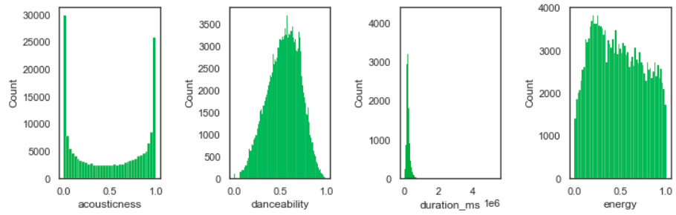
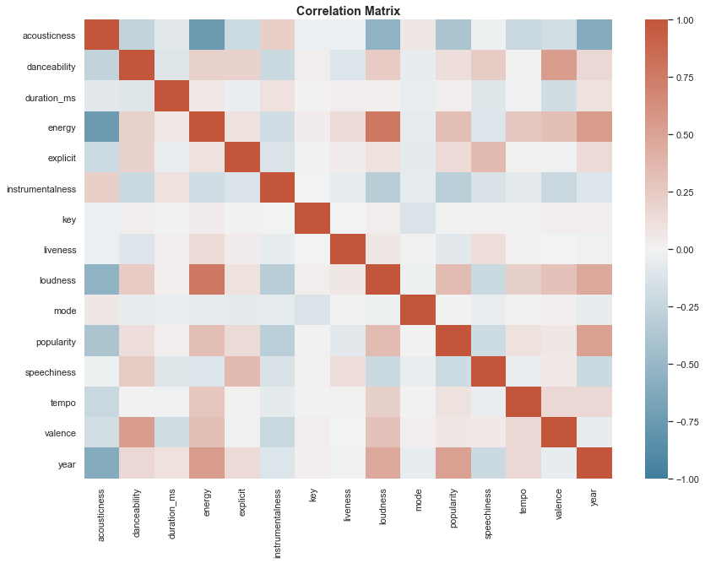
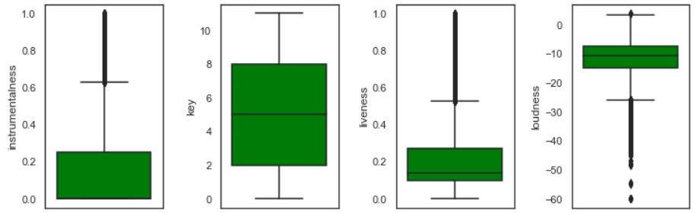
Exploratory Data Analysis
Histograms
Correlation Coefficients
Box Plots
Notes:
For EDA we plotted basic things like histograms to see the distribution of features and box plots to see outliers in a distribution. We found a peculiarity in the distribution of popularity that Prayag will discuss when talking about classification and we also found two features with almost no variance that we removed from linear and polynomial regression models.
We also plotted correlation matrix, a truncated form of which is shown here to see how the features correlate with each other and our output (popularity). There are some intuitively obvious correlations between valence and danceability, energy and loudness. We also found no strong correlation between any of the usable features and popularity which track well with our early linear regression models not being very successful.

Slide 8
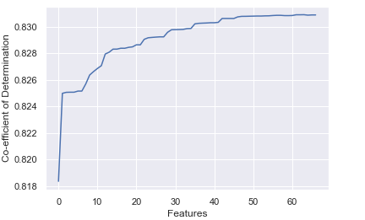
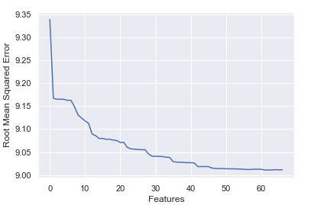
Regression Algorithms
Algorithm | R2_{Train} | R2_{Test} | RMSE_{Train} | RMSE_{Test}
Linear Regression | 0.82907 | 0.82920 | 9.03576 | 9.05644
Polynomial Regression | 0.84282 | 0.84208 | 8.66458 | 8.70819
LASSO Regression | 0.79677 | 0.83086 | 8.98626 | 9.01212
Decision Tree Regression | 0.86986 | 0.85649 | 7.88407 | 8.30317
R2 Score vs. Number of features for Linear Regression
RMSE vs. Number of Features for Linear Regression
Notes:
After 2 features were removed from linear and polynomial models owing to their ~0 variance we ended up using SelectKBest method from sci-kit learn where we selected k features and ran regression models to find that initially there is a spike as we increase the number of selected features and at around 30 features it approaches a plateau. We settled at 25 features for linear and polynomial regression and the table shows R2 and RMSE scores for both test and train data for the same. EXTRA: for just 2 features, (popularity_ar and popularity_yr) we were at a higher than 0.80 R2 score.
LASSO Regression -
Overfitting is not the problem. Gave only two features.
Decision Tree Regression -
Overfitting
Hyperparameter tuning - mse, maximum depth - 10, min samples to split, min_samples_leaf (helps in smoothing)
Very fast
All features
Require no feature scaling

Slide 9
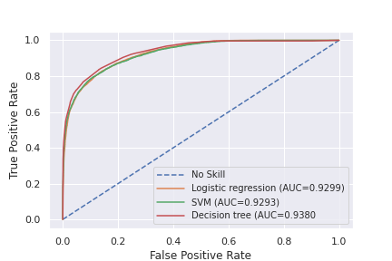
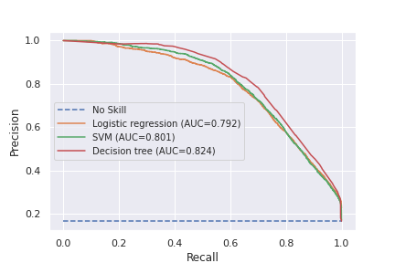
Classification Algorithms
ROC Curve
Algorithm | Train accuracy | Test accuracy | Precision score | Recall score | F1 score
Logistic Regression | 0.9105 | 0.9110 | 0.79 | 0.64 | 0.70
SVM | 0.9144 | 0.9142 | 0.86 | 0.58 | 0.69
Decision tree | 0.9198 | 0.9211 | 0.83 | 0.65 | 0.73
Perceptron | 0.8116 | 0.8133 | 0.69 | 0.50 | 0.58
Precision Recall Curve
Notes:
Classification in general
Inherent imbalance in class distribution
Why did we choose this set of metrics?
Tried sampling techniques
LR
SVM
Computationally demanding
Non linear kernel
Tuning - C (regularization parameter), gamma (kernel coef)
Decision tree
Mostly elaborated in regression
Here max depth was lesser - 8
Explanation of curves

Slide 10
Voting classifiers
Random Forest
Ensemble Learning for classification
“ Aggregating models to try to get better results”
Boosting
Adaptive Boosting
Gradient Boosting

Slide 11
Voting Classifier
Soft Voting
Hard Voting
Ensemble’s vote
(More weightage is given to more confident votes)
We choose a diverse set of classifiers so that different models ideally make different mistakes.
Ensemble’s vote
(Weightage is same for all votes)
We plugged in the tuned hyperparameter values for each classifier.
1
1
0
1
SVM
Decision Tree
Logistic Regression
Perceptron
Perceptron only works for hard voting.
Dataset

Slide 12
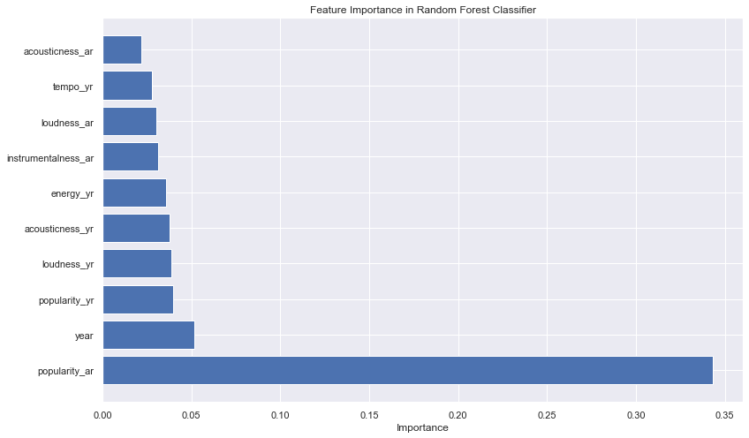
Random Forest
Feature importance curve
Dataset
Decision Tree 1
Decision Tree 2
Decision Tree N
...
Hyperparameter | Value
Number of trees | 20
Max depth | 20
Minimum samples required at leaf | 4
Minimum samples required to split | 2
Max features required at each node | sqrt
Voting
Prediction

Slide 13
Boosting
Adaptive Boosting
Weights
Weak learner
Weak learner
...
Weak learner
Data
Decision Stump 1
“Converting weak learners to strong learners”
Strong learner
Weights
Data
Decision Stump 2
Soft Voting
Prediction
“Update weights based on previous mistakes”
Weights
Hyperparameter | Value
Number of estimators | 250
Learning Rate | 0.68
Data
Decision Stump N
Tradeoff
Notes:
Diagram
Results
Hyperparameters (discuss or draw)
Bayesian Search graph

Slide 14

Gradient Boosting
As gradient boosting is computationally expensive, we use an implementation of “Histogram Gradient Boosting”
Data
“Train on the residues of the previous classifier”
Decision Tree 1
Hyperparameter | Value
1. Number of estimators/iterations | 200
2. Learning Rate | 0.06
3. Maximum number of leaf nodes | 100
4. Min. samples required at leaf | 78
Residue
Decision Tree 2
Sigmoid of Sum
Threshold
Residue
Prediction
Decision Tree N
Tradeoff between: 1 and 2, 3 and 4
Notes:
Diagram
Results
Hyperparameters (discuss or draw)
Bayesian Search graph

Slide 15
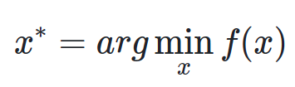
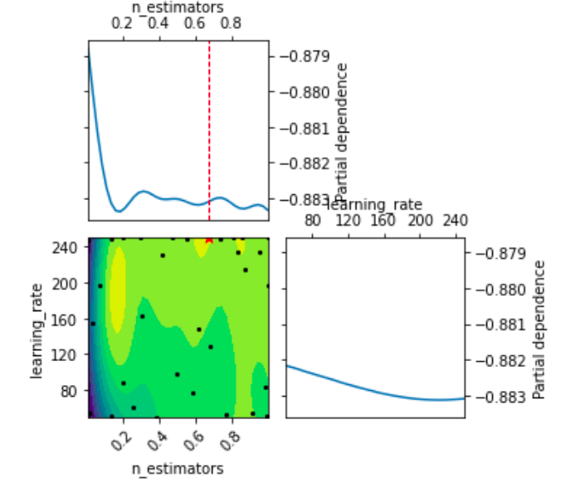
Bayesian Optimization for Hyperparameter Tuning
Useful for minimizing a noisy “black-box” function [10]-[11]
For example, in AdaBoost:
Initial sampling set
Model training
Training of Gaussian Process Regressor
Calling acquisition function
Current best parameters

Slide 16
Ensemble Learning Results
Algorithm | Train accuracy | Test accuracy | Precision score | Recall score | F1 score
Random Forest | 0.9545 | 0.8954 | 0.86 | 0.69 | 0.76
Hard Voting Classifiers | 0.9144 | 0.9142 | 0.86 | 0.58 | 0.69
Soft Voting Classifiers | 0.9198 | 0.89 | 0.84 | 0.67 | 0.75
Adaptive Boosting | 0.8837 | 0.8820 | 0.83 | 0.70 | 0.76
Gradient Boosting | 0.8918 | 0.8911 | 0.86 | 0.70 | 0.77
Notes:
0.95
0.90
0.86
0.69
0.76

Slide 17
Role of each group member in the project
 | Exploratory Data Analysis and preprocessing | Regression Algorithms | Classification algorithms | Random Forests | Voting Classifier | AdaBoost and Gradient Boosting
Bihag | ✔ | ✔ |  | ✔ | ✔
Koushiki |  |  | ✔ | ✔ | ✔
Prayag | ✔ |  | ✔ |  | ✔
Yashraj | ✔ | ✔ | ✔ |  |  | ✔

Slide 18
Conclusions
Popularity can be predicted reasonably well, the bottleneck being popular songs classified as non-popular.
Tree-based algorithms show competitive results.
Ensemble algorithms give similar results, with voting classifiers and Random forest giving better accuracy and boosting algorithms giving better recall and F1 score.
Parallelizable ensemble algorithms may be preferred due to their speed, owing to similar results.

Slide 19
References
Y. E. Ay, “Spotify dataset 1921-2020, 160k tracks (version 10n)” Jan 2021. [Online]. Available: https://www.kaggle.com/yamaerenay/spotifydataset-19212020-160k-tracks/version/10
F. Pedregosa, G. Varoquaux, A. Gramfort, V. Michel, B. Thirion, O. Grisel, M. Blondel, P. Prettenhofer, R. Weiss, V. Dubourg, J. Vanderplas, A. Passos, D. Cournapeau, M. Brucher, M. Perrot, and E. Duchesnay, “Scikit-learn: Machine learning in Python,” Journal of Machine Learning Research, vol. 12, pp. 2825–2830, 2011.
R. Nijkamp, “Prediction of product success: explaining song popularity by audio features from spotify data,” in 11th IBA Bachelor Thesis Conference, 2018.
A. Singhi and D. Brown, “Can song lyrics predict hits?” 2015.
R. Dhanaraj and B. Logan, “Automatic prediction of hit songs,” pp. 488–491, 2005.
Spotify Web API Reference. [Online]. Available: https://developer.spotify.com/documentation/web-api/reference
E. Zangerle, M. Pichl, B. Hupfauf, and G. Specht, “Can microblogs predict music charts? an analysis of the relationship between nowplaying tweets and music charts,” in Proceedings of the 17th International Society for Music Information Retrieval Conference 2016 (ISMIR 2016). ISMIR, 2016.
K. Bischoff, C. S. Firan, M. Georgescu, W. Nejdl, and R. Paiu, “Social knowledge-driven music hit prediction,” in Proceedings of the 5th International Conference on Advanced Data Mining and Applications, ser. ADMA ’09. Berlin, Heidelberg: Springer-Verlag, 2009, p. 43–54.
A. Géron, Hands-on machine learning with Scikit-Learn, Keras, and Tensorflow: Concepts, tools, and techniques to build intelligent systems. O’Reilly Media, 2019.
T. Head, M. Kumar, H. Nahrstaedt, G. Louppe, and I. Shcherbatyi, “scikit-optimize/scikit-optimize,” 2020. [Online]. Available: https://zenodo.org/record/4014775
J. Snoek, H. Larochelle, and R. P. Adams, “Practical bayesian optimization of machine learning algorithms,” 2012

