Slide 1

Intrusion Detection System for Internet of Vehicles using Optimized CNN
MOHAMED FAHEEJ N - 23MCA0028
MUDASSIR KHAN G - 23MCA0056
JASHWANTH KUMAR S - 23MCA0076
GUIDE: PROF. JAYALAKSHMI P

Slide 2
Agenda
Introduction
Algorithms
Data Description
Result and Discussion
Conclusion.

Slide 3
Introduction
In this modern world, there are many new technologies evolving and in the same way Cyber-attack is also following up. Modern vehicles, including Electric vehicles, autonomous vehicles and connected vehicles, are increasingly connected to the external world, which enables various functionalities and services. These inbuild technologies in vehicles helps the cyber attackers to attack the Internet of Vehicles (IoV), causing its vulnerabilities to cyber threats. Due to the need of more security and encryption performance in vehicular network, Intrusion Detection Systems (IDSs) are much needed strategy to protect the modern vehicle systems from cyber threats.

Slide 4
Cont.,
In this project, we are referring the Transfer Learning with use of ML and ensemble learning-based IDS is proposed for IoV using Convolutional Neural Network (CNN) and some hyper-parameter optimization techniques. The Car-Hacking dataset and the CICIDS2017 dataset, we are using here. This will show the definitiveness of the proposed IDS for Cyberattack detection in both intra and external vehicular networks.

Slide 5
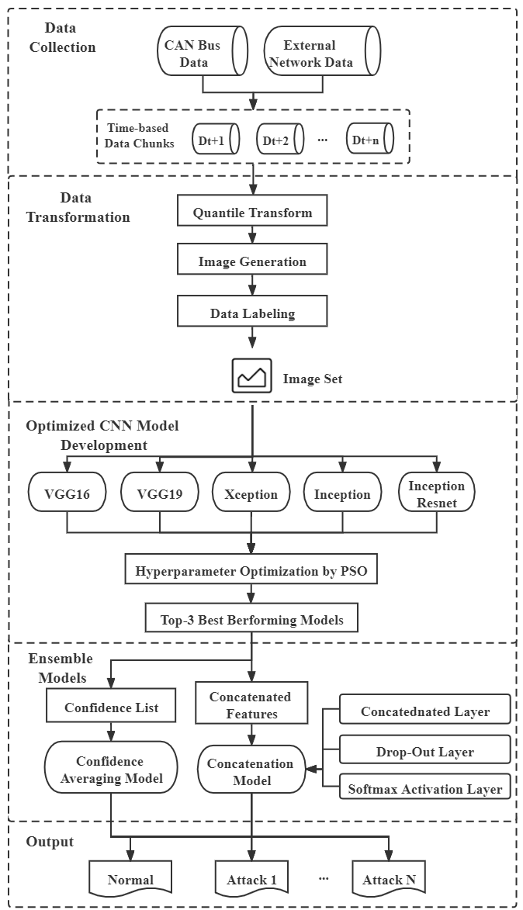

Slide 6
Cont.,
Most IoV systems use intra-vehicle communications. Both internal and external networks (IVNs).
Cyber attackers can conduct several types of attacks, including DoS, fuzzy, and spoofing attacks, by injecting malicious messages into IVNs due to the absence of fundamental security safeguards.
On the other hand, because of the developing cellular connections between connected vehicles and external networks, these vehicles are becoming more susceptible to common cyberattacks.
Everyone recently interested in machine learning (ML) and deep learning (DL) applications in cyber security and car systems due to the advancement of these techniques.

Slide 7
Cont.,
To the best of our knowledge, no previous work proposed such an optimized IDS model that integrates CNN, transfer learning, ensemble learning, and HPO techniques to effectively detect various types of attacks on both intra-vehicle and external networks.

Slide 8
“The IDS can be installed in IVNs on top of the CAN-bus to identify unusual CAN messages and produce alarms.”

Slide 9
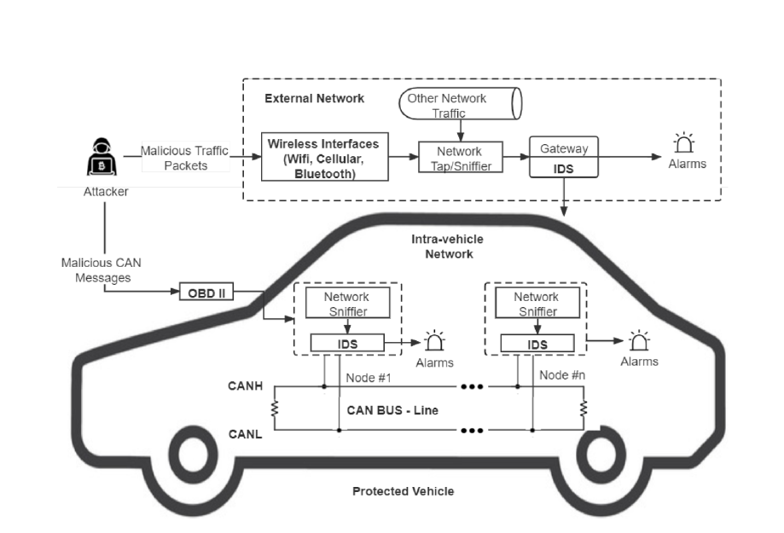
IDS PROTECTED VEHICLE

Slide 10
DATA DESCRIPTION AND TRANSFORMATION
Two datasets are used to create the proposed IDS for both IVNs and external vehicular networks. The Car-Hacking dataset, which constitutes the first dataset,
Attacks of the DoS, fuzzy, gear spoofing, and Revolutions Per Minute (RPM) spoofing varieties are the four main categories included in the Car-Hacking dataset.
The CICIDS2017 dataset, which represents external network data, is the second dataset selected since it is a cutting-edge network security dataset that contains the most recent attack patterns.

Slide 11
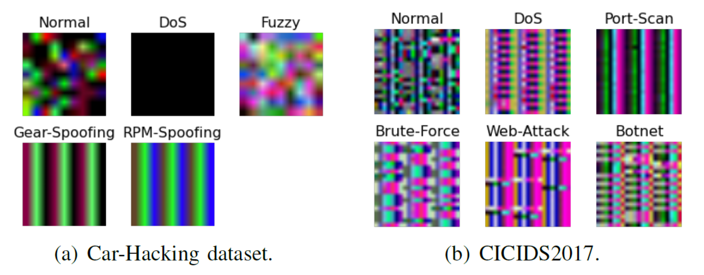
Sample data’s

Slide 12
Algorithm and models
DL models like CNN are frequently employed in picture classification and recognition issues.
Without the need for additional feature extraction and data reconstruction procedures, the images can be immediately entered into CNN models.
Convolutional, pooling, and fully-connected layers make up the majority of layers in a CNN.
We have chosen VGG16, VGG19, Xception, Inception, and InceptionResnet as the basis models for the proposed system.

Slide 13
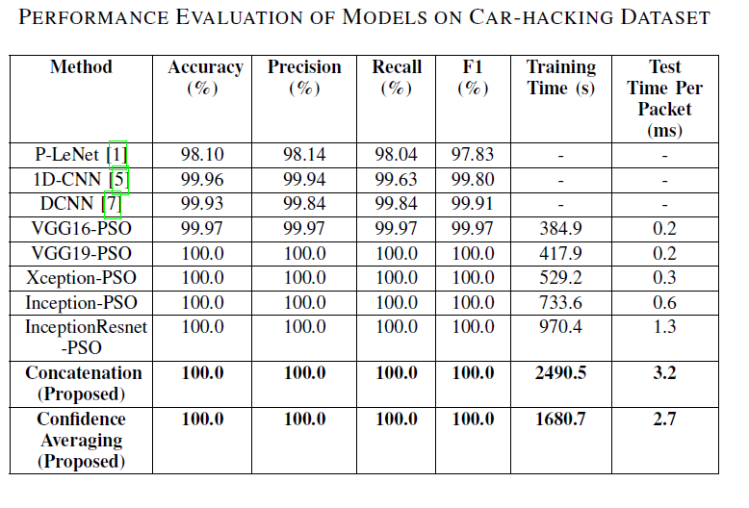
RESULTS

Slide 14
CONCLUSION
The cyberthreats to IoV systems are considerably growing as modern automobiles become more linked.
This paper suggested a transfer learning and ensemble learning-based IDS framework that employs optimal CNN models to recognize various forms of attacks in IoV systems in order to safeguard connected cars from being penerated by cyberattacks.
The proposed IDS framework can more successfully identify different types of attacks with higher F1-scores of 100 percent and 92.925 percent.

Slide 15
References
[1] Liao, H. J., Lin, C. H. R., Lin, Y. C., and Tung, K. Y. (2013). Intrusion detection system: A comprehensive review. Journal of Network and Computer Applications, 36(1), 16-24.
[2] Smaha, S. E. (1988, December). Haystack: An intrusion detection system. In Fourth Aerospace Computer Security Applications Conference (Vol. 44).
[3] Vigna, G., Kemmerer, R. A. (1999). NetSTAT: A network-based intrusion detection system. Journal of computer security, 7(1), 37-71.
[4] Hoque, M. S., Mukit, M., Bikas, M., Naser, A. (2012). An implementation of intrusion detection system using genetic algorithm. arXiv preprint arXiv:1204.1336.
[5] Javaid, A., Niyaz, Q., Sun, W., Alam, M. (2016, May). A deep learning approach for network intrusion detection system. In Proceedings of the 9th EAI International Conference on Bio-inspired Information and Communications Technologies (formerly BIONETICS) (pp. 21-26).
[6] Heady, R., Luger, G., Maccabe, A., Servilla, M. (1990). The architecture of a network level intrusion detection system (No. LA-SUB-93-219). Los Alamos National Lab.(LANL), Los Alamos, NM (United States); New Mexico Univ., Albuquerque, NM (United States). Dept. of Computer Science.
[7] Ilgun, K. (1993, May). USTAT: A real-time intrusion detection system for UNIX. In Proceedings 1993 IEEE Computer Society Symposium on Research in Security and Privacy (pp. 16-28). IEEE.
[8] Peddabachigari, S., Abraham, A., Grosan, C., Thomas, J. (2007). Modeling intrusion detection system using hybrid intelligent systems. Journal of network and computer applications, 30(1), 114-132.
[9] Vinayakumar, R., Alazab, M., Soman, K. P., Poornachandran, P., Al- Nemrat, A., Venkatraman, S. (2019). Deep learning approach for intelligent intrusion detection system. Ieee Access, 7, 41525-41550.
[10] Ertoz, L., Eilertson, E., Lazarevic, A., Tan, P. N., Kumar, V., Srivastava, J., Dokas, P. (2004). Minds-minnesota intrusion detection system. Next generation data mining, 199-218.

Slide 16




THANK YOU

