Slide 1
TNSDC-Generative AI
IPL SCORE PREDICTION SYSTEM USING CNN
Presented by : JASHWANTH E M,
au211521104057,
Pre-Final Student,
Computer Science and Engineering,
Panimalar Institute of Technology.

Slide 2

OUTLINE
Problem Statement
Proposed Solution
System Approach
Algorithm
Result
Conclusion
References

Slide 3
PROBLEM STATEMENT
The aim is to develop a robust IPL Score prediction system capable of accurately predicting the projected score from the datasets . For this, Convolutional Neural Network (CNN) is utilized and This prediction is usually done with the help of data analytics. Before, when there were no advancements in machine learning, predictions were usually based on intuition or some basic algorithms. The goal is to achieve high accuracy while maintaining efficiency in processing time.

Slide 4
PROPOSED SOLUTION
Utilizing Convolutional Neural Network (CNN) architecture implemented in Python. The system will consist of multiple layers of convolutional and pooling operations to extract relevant features from given datasets.
Training data will be fed into the CNN model to learn and optimize the parameters through backpropagation. Techniques such as data augmentation and regularization will be employed to improve generalization and prevent overfitting.
Additionally, the system will be optimized for efficiency to ensure low latency in processing, enabling seamless integration into various user-interfaces for ipl score prediction system using deep learning.

Slide 5
SYSTEM APPROACH
Hardware:
CPU: The system requires a CPU with sufficient processing power to handle the computational demands of Convolutional Neural Network (CNN) training and inference. A multi-core processor, preferably with a clock speed of at least 2 GHz or higher, is recommended.
Memory: A minimum of 8 GB RAM is recommended for smooth operation, especially during model training, where large datasets are processed. More RAM may be required for handling larger datasets or concurrent user requests.
Internet Speed: A stable internet connection is necessary for downloading and updating Python packages, model weights, and serving the web application. A broadband connection with a minimum download speed of 5 Mbps and upload speed of 1 Mbps is sufficient for most purposes.

Slide 6
SYSTEM APPROACH –CONT.
Software:
Python: The system is built using Python programming language
Pandas: Pandas is a software library written for the Python programming language for data manipulation and analysis. In particular, it offers data structures and operations for manipulating numerical tables and time series.
NumPy: NumPy is a fundamental package for scientific computing in Python, essential for handling multidimensional arrays and mathematical operations. It is used extensively for data preprocessing, manipulation, and numerical computations within the CNN model.
TensorFlow: TensorFlow is a free and open-source software library for machine learning and artificial intelligence. It can be used across a range of tasks but has a particular focus on training and inference of deep neural networks

Slide 7

ALGORITHM
Phase 1: Data Preparation and Preprocessing
Well, for the smooth running of the project we’ve used few libraries like NumPy, Pandas, Scikit-learn, TensorFlow, and Matplotlib.
Loading the dataset using .read_csv() method into a dataframe using pandas and displayed the first 5 rows of each dataset.
Dropping unimportant features and label encoding is done in this phase
Phase 2: Train Test Split
We have split the data into training and testing sets. The training set contains 70 percent of the dataset and rest 30 percent is in test set.
X_train contains the training data for your input features.
X_test contains the testing data for your input features.
y_train contains the training data for your target variable.
y_test contains the testing data for your target variable.
Feature Scaling
We have performed Min-Max scaling on our input features to ensure all the features are on the same scale
Scaling is performed to ensure consistent scale to improve model performance.
Scaling has transformed both training and testing data using the scaling parameters.

Slide 8
ALGORITHM - CONT.
Phase 3: Define Neural Network
We have defined a neural network using TensorFlow and Keras for regression.
After defining the model, we have compiled the model using the Huber Loss.
Phase 4: Model Training
We have trained the neural network model using the scaled training data.
After the training, we have stored the training and validation loss values to our neural network during the training process.
Phase 5: Model Evaluation
We have predicted using the trained neural network on the testing data.
The variable predictions contains the predicted total run scores for the test set based on the model’s learned patterns.

Slide 9
ALGORITHM - CONT.
Phase 6: Creating Interactive Widget
We have created an interactive widget using ipywidgets to predict the score based on user input for venue, batting team, bowling team, striker, and bowler.
We have created dropdown widgets to select values for venue, batting team, bowling team, striker, and bowler.
Then, we have added a “Predicted Score” button widget. Whenever, the button will be clicked, the predict_score function will be called and then perform the following steps:
Decodes the user-selected values to their original categorical values.
Encodes and scales these values to match the format used in model training.
Uses the trained model to make a prediction based on the user’s input.
Displays the predicted score.

Slide 10
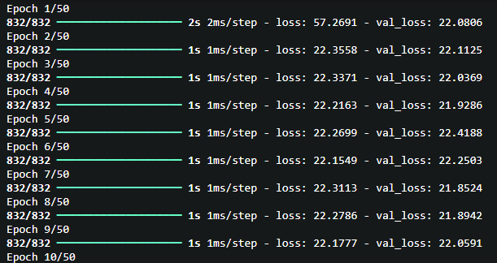
RESULT
Training The Model
Figure 1
10

Slide 11
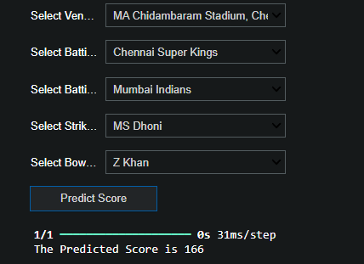
RESULT
Figure 2
11

Slide 12
Conclusion
The implemented IPL Score Prediction system, employing Convolutional Neural Network (CNN) architecture with Pandas and TensorFlow, stands operational on localhost. Presently, users can test the model's performance in real-time. For future development, optimizing the system's performance with advanced CNN architectures and exploring techniques like transfer learning could enhance accuracy and generalization. Additionally, refining the user interface and deploying on cloud servers could extend accessibility and scalability. Future expansions could include predicting overall performance of a team and handling net-worth of overall Players and Teams ,opening new application domains in finance, Sports and Education.
12

Slide 13
REFERENCES
Tensorflow: https://www.tensorflow.org/
Numpy: https://numpy.org/
Pandas: https://pandas.pydata.org/
Scikit-learn: https://scikit-learn.org/stable/
Inspiration: https://www.geeksforgeeks.org/ipl-score-prediction-using-deep-learning/
13

