Slide 1
Westify Musik: Mobile Application
A Flutter Application
Submitted by
Jashwanth E M

Slide 2
Application Details
Purpose: Westify Musik App is a mobile application designed to allow users to browse and play music tracks stored in a Firebase database. The tracks are streamed from URLs hosted on GitHub, with support for viewing track details, playing/pausing music, and switching between English and Tamil languages.
Key Features:
1) Pre-set music library:
Displays a list of music tracks fetched from Firebase Firestore.
Each track includes details like title, artist, and album art (image URL).
Users can play tracks by tapping a play button, with the currently playing track displayed in a bottom player control bar.
Sample tracks include:
"Sample Song" (Artist: Sample Artist, Streamed from GitHub URL, Date: 2025-03-17).

Slide 3
Application Details
2) Music Playback:
Streams audio directly from GitHub-hosted URLs using the audioplayers package.
Users can play, pause, or stop a track via the player controls.
Example: Tapping "Sample Song" streams the audio from https://raw.githubusercontent.com/your-username/music-files/main/sample_song.mp3
3) Track Filtering:
A search screen allows users to filter tracks by title or artist.
Example: Searching for "Sample" shows only tracks like "Sample Song."
4) Track Details:
Tapping a track in the library shows its details (title, artist, album art).
Example: "Sample Song" displays its title, artist ("Sample Artist"), and album art loaded from a provided image URL.
4) Localization:
Supports language switching between English and Tamil.
Example: The app title changes from "Westify" (English) to "வெஸ்டிஃபை" (Tamil), and UI elements like "Home" change to "முகப்பு."

Slide 4
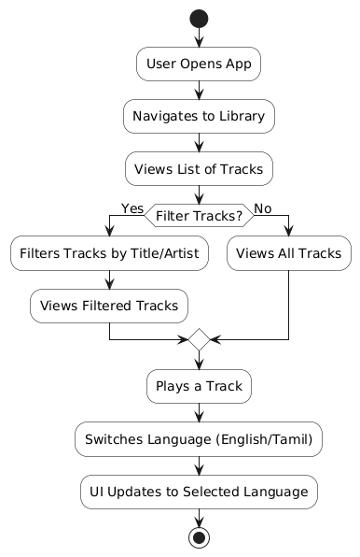
Workflow Diagram

Slide 5
Workflow Diagram
User Initiation:
User opens the Westify Musik App, initiating the music streaming experience.
Automatically navigates to the Home screen, displaying a grid of artists (placeholder).
Navigation to Music Library:
User navigates to the Library screen via the bottom navigation bar, the main page displaying a list of tracks.
Viewing Tracks:
User selects the "Library" tab to explore the music library.
Views the list of tracks with details like title, artist, and album art.
Decides whether to filter tracks by searching for a specific title or artist.
Filtering Tracks:
If the user chooses to filter, they enter a search query in the "Search" tab (e.g., "Sample").
Views filtered tracks matching the query (e.g., "Sample Song").
If no filter is applied, the user views all tracks in the library.

Slide 6
Workflow Diagram
Interacting with Tracks:
User plays a track by tapping the play icon, streaming the audio from the GitHub URL.
Views the currently playing track in the player controls at the bottom.
Pauses or stops the track using the player controls.
Switching Language:
User selects the "Switches Language" option from the AppBar to toggle between English and Tamil.
Switches the language, updating the UI to the selected language (e.g., "Library" to "நூலகம்").
The entire app UI, including labels and buttons, reflects the chosen language.
Workflow Termination:
The process concludes after the user completes their chosen action, with the workflow converging to a stop state.
Future enhancements could include user authentication and playlist creation.

Slide 7
Flutter Concepts Used
Widgets:
StatelessWidget: Used for static UI components like the track cards in the library (e.g., displaying title, artist, album art).
StatefulWidget: Used for dynamic components like the player controls (to handle play/pause state) and the Home screen (to manage navigation).
Scaffold: Provides the app’s basic structure with an AppBar (e.g., "Westify" title) and body (track list).
AppBar: Displays the app title and language switcher dropdown.
ListView: Renders the list of tracks in the library dynamically.
Card: Wraps each track in the library for a clean, elevated look.
TextField: Used in the Search screen for filtering tracks by title or artist.
DropdownButton: Implements the language switcher with options (English, Tamil).
IconButton: Used for actions like play/pause in the track tiles and player controls.
2. State Management:
Provider: Manages the audio playback state across the app using AudioProvider.
Example: final audioProvider = Provider.of<AudioProvider>(context, listen: false);
audioProvider.play(song);
setState: Manages state changes, such as updating the UI when switching languages.
Example: setState(() {
_locale = newLocale;
});

Slide 8
Flutter Concepts Used
3. Navigation:
Navigator: Handles navigation between screens.
Example: Navigating to the Search or Library screen via the bottom navigation bar.
BottomNavigationBar: Implements tab navigation (Home, Search, Library).
4. Localization:
flutter_localizations Package: Enables localization support for English and Tamil.
LocalizationsDelegate: Defines supported languages (Locale('en'), Locale('ta')).
intl Package: Manages translations for UI elements.
Example: AppLocalizations.of(context)!.home displays "Home" (English) or "முகப்பு" (Tamil).
Language Switcher: A dropdown in the AppBar to toggle between languages, updating the UI by rebuilding the app with the new locale.
5. Network and Storage:
Firebase (Firestore): Stores track data (title, artist, audio URL, image URL)
http Package (Indirect): Streams audio from GitHub URLs using audioplayers.

Slide 9
Flutter Concepts Used
Example:
await _firestore.collection('songs').add({
'title': 'Sample Song',
'artist': 'Sample Artist',
'audioUrl':'https://raw.githubusercontent.com/your-username/music- files/main/sample_song.mp3',
'imageUrl': 'https://example.com/sample_image.jpg',
});
6. Audio Playback:
audioplayers Package: Streams audio from GitHub-hosted URLs.
Example: await _audioPlayer.play(UrlSource(song.audioUrl));
7. UI Design:
Material Design: Follows Flutter’s Material Design guidelines for a consistent look (e.g., Card, AppBar, IconButton).
Custom Styling: Uses ThemeData to define colors (e.g., Spotify green 0xFF1DB954 for buttons) and typography.
Image Loading: Displays album art using Image.network with the provided image URL.

Slide 10
Flutter Concepts Used
9. File Structure:
lib/main.dart: Entry point of the app, setting up Firebase, localization, and providers.
lib/screens/: Contains screens like HomeScreen, SearchScreen, LibraryScreen.
lib/models/: Defines models like Song (e.g., class Song { String title; String artist; String audioUrl; String imageUrl; ... }).
lib/providers/: Contains AudioProvider for managing audio playback state.
lib/services/: Contains FirebaseService for interacting with Firestore.
lib/widgets/: Contains reusable widgets like SongTile and PlayerControls.
lib/generated/: Contains localization files (e.g., l10n.dart, generated from app_en.arb and app_ta.arb).
10. Future Enhancements with Flutter Concepts
User Authentication: Add Firebase Authentication for user login and personalized playlists.
Playlist Creation: Allow users to create and manage playlists stored in Firestore.
Search Enhancement: Improve search functionality with a SearchDelegate for more advanced filtering.
Push Notifications: Notify users of new tracks using Firebase Cloud Messaging.
More Languages: Extend localization to support additional languages like Hindi or Spanish.
Offline Playback: Cache audio files locally using path_provider for offline access.
Advanced State Management: Use Bloc or Riverpod for more complex state management (e.g., managing playlists).

