Slide 1
FragPunk Games : "Your Story, Our Craft."
An Angular Application
Submitted by
Jashwanth E M

Slide 2
Application Details
Purpose: FragPunk is a basic web application designed to showcase games developed by FragPunk, a fictional game development company inspired by industry leaders like Rockstar. It provides a user-friendly interface to browse game titles, view game details, and submit feedback. The application is a prototype with static elements (e.g., buttons) and limited functionality, focusing on demonstrating Angular concepts for educational purposes.
Key Features:
Homepage:
A welcome section with the tagline: "Experience the next generation of gaming with FragPunk’s innovative titles.
Navigation links to key sections: Games, Add Game, and Feedback.
A static "Explore Games" button to direct users to the game list.

Slide 3
Application Details
2) Games Section:
Displays a static list of games fetched from a local JSON file (`api.json`).
Each game card includes: - Game title and description. - Genre, release date. - A static "View Details" button (placeholder, no functionality).
Sample games: - *FragPunk: Arena* ($79, FPS, Release: Dec 15, 2024, "Fast-paced first-person shooter"). - *CyberFrag* ($89, RPG, Release: Mar 20, 2025, "Open-world cyberpunk adventure").
3) Add Game Section:
A form to input new game details (title, genre, release date, description).
On submission, logs data to the console (no backend integration).
Includes basic validation (e.g., required fields, minimum description length).
Filter Options based on Games’s Genre to filter games(e.g.,Action , Adventure ,Racing , Casual , RPG , Strategy , etc..).

Slide 4
Application Details
4)News Section:
A static page displaying recent company updates and game-related announcements.
Sample news items:
"FragPunk: Arena Beta Testing Begins!" (Dec 1, 2024).
"CyberFrag Wins Best RPG Concept Award" (Feb 15, 2025)
No interactive features (static text display).
5)Upcoming Section:
A static page showcasing games in development or soon to be released.
Each upcoming game card includes: Game title, genre, and expected release date. - A brief teaser description. Sample upcoming games: FragPunk: Skies (Flight Simulator, Q3 2025, "Soar through dystopian skies"). Neon Blade (Action, Q4 2025, "Hack and slash in a neon-lit world").
No functionality for pre-orders or notifications.
6) Feedback Section:
A functional feedback form where users can input their name, email, rating (1-5), and comments.
On submission, form data is stored in the browser's local storage (no backend integration).
Purpose: Collect user feedback to improve the platform.

Slide 5
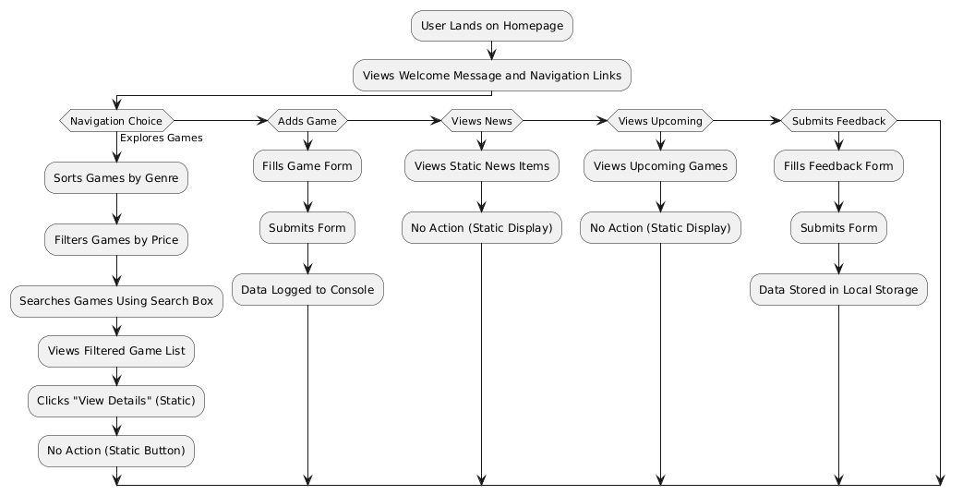
Workflow Diagram

Slide 6
Workflow Diagram
User Initiation: User begins by landing on the FragPunk homepage, marking the starting point of the application.
Welcome and Navigation:
User views the welcome message and navigation links (Games, Add Game, Feedback).
Navigation choice determines the subsequent user action based on the selected section.
Exploring Games:
User selects the "Games" option from the navigation or clicks "Explore Games."
Views a list of games fetched from api.json.
Clicks the "View Details" button on a game card (static and non-functional).
No action is triggered due to the button being a placeholder.
User sorts games by genre to organize the list.

Slide 7
Workflow Diagram
Adding a Game:
User selects the "Add Game" option from the navigation.
Fills the game form with details (title, genre, release date, description).
Submits the form, triggering a console log of the data.
No persistent storage or backend action occurs (prototype limitation).
Viewing News:
User selects the "News" option from the navigation.
User views static news items (e.g., "FragPunk: Arena Beta Begins!").
User scrolls through news archive (static content).
No action is available (static display).
Submitting Feedback:
User selects the "Feedback" option from the navigation.
Fills the feedback form with details (name, email, rating, comments).
Submits the form, storing data in local storage.
Provides basic interactivity without backend support.

Slide 8
Angular Concepts Used
1. Angular Modules:
The application uses Angular modules (NgModule).
AppModule: The root module that bootstraps the application and imports necessary modules (e.g., HttpClientModule, FormsModule).
2. Components:
AppComponent: Root component rendering the main layout (header, navigation, router outlet).
GameListComponent: Parent component displaying the list of games.
GameCardComponent: Child component rendering individual game details.
GameFormComponent: Manages the add game form with reactive form functionality
PlansPricingComponent: Shows the subscription plans (static display).
AboutUsComponent: Displays the "About Us" text (static).
FeedbackComponent: Manages the feedback form with local storage functionality.

Slide 9
Angular Concepts Used
3. Parent-Child Components:
GameListComponent (parent) passes game data to GameCardComponent (child) using @Input().
Example:
<app-game-card [game]="game"></app-game-card> in game-list.component.html.
4. Templates and Data Binding:
Templates:Each component has an HTML template (e.g., game-card.component.html for game details).
Interpolation ({{}}): Displays dynamic data (e.g., {{ game.title }}).
Property Binding ([property]): Binds data to attributes (e.g., [game]="game").
Event Binding ((event)): Handles form submission (e.g., (ngSubmit)="onSubmit()").
5. Directives:
Structural Directives:
*ngFor: Loops through games (e.g., *ngFor="let game of games").
*ngIf: Conditionally shows loading state (e.g., *ngIf="isLoading").
Attribute Directives:
[ngClass]: Applies styles conditionally (e.g., [ngClass]="{'featured': game.id === 1}").

Slide 10
Angular Concepts Used
6. Services:
GameService: Fetches game data from api.json using HttpClient.
Injected into GameListComponent via dependency injection.
7. Routing:
AppRoutingModule: Manages navigation between sections.
Routes:
/ : GameListComponent
/add-game: GameFormComponent
RouterLink: Used in navigation (e.g., <a routerLink="/">Games</a>).
RouterOutlet: Renders the current route’s component (e.g., <router-outlet>).
8. Forms:
Reactive Forms: Used in GameFormComponent for adding games.
Example: Form controls with validators (e.g., title: ['', Validators.required]).
Submission logs to console.

Slide 11
Angular Concepts Used
9. Observables:
Used in GameService to handle HTTP requests (e.g., getGames(): Observable<Game[]>).
Subscribed in GameListComponent to fetch and display games.
8. API Calls:
HttpClient fetches static data from assets/api.json.
Example: this.http.get<Game[]>(this.apiUrl).
9. Pipes:
Custom ReleaseDatePipe: Formats release dates (e.g., {{ game.releaseDate | releaseDate }}).
10. Local Storage:
Could be added to GameFormComponent to store submitted game data locally.
Example: onSubmit() {
if (this.gameForm.valid) {
localStorage.setItem('newGame', JSON.stringify(this.gameForm.value));
}
}

Slide 12
Angular Concepts Used
13. Styling:
Component-specific CSS (e.g., game-card.component.css for card styling).
Global styles in styles.css for consistent layout.
14. File Structure:
src/app/components/: game-list, game-card, game-form.
src/app/services/: game.service.ts.
src/app/models/: game.model.ts.
src/app/pipes/: release-date.pipe.ts.
app-routing.module.ts, app.module.ts, app.component.*.
12. Future Enhancements with Angular Concepts:
HTTP Client: Connect to a real backend API for dynamic game data.
Reactive Forms Enhancements: Add complex validation (e.g., unique titles).
State Management: Use NgRx for managing game list state.
Dynamic Features: Implement game details view or user authentication.
Lazy Loading: Load components on demand for better performance.

