Slide 1
DATA ANALYSIS OF SMALL BUSINESS SERVICES IN NEW YORK CITY -G16 Vaishnavi Chintala:M00362155 Jashwanth Reddy Yelakonda: M00363129

Slide 2
CONTENTS
Overview
Business Case
Proposed solution
Raw data
Cleaning Data
Control Flow Overview
Cleaning Process
Normalizing Data
Dimensions Tables
Integration Data
Result with Example

Slide 3

OVERVIEW Goal: Data Management of Small business services in New York City Problems: Inconsistent Data, Missing values, Duplicate values and scattered Data Influence: The utilization of the resulted analyzed data can be used by Local Economic Development Agencies, Market Researchers and Consultants, Venture Capitalists and Investors, Non-Profit Organizations, Academic Institutions, Corporate CSR Departments, Marketing Firms, Chambers of Commerce and Business Associations, Policy Makers and Local Government, Real Estate Developers and Planners, and Supply Chain Managers and Procurement Officers.

Slide 4
BUSINESS CASE
Analyzing and Cleaning "SBS Business List" Data for Enhanced Collaboration. Organizations can easily identify and collaborate with businesses based on their specific requirements and preferences.
Market Researchers and Consultants: Will benefit from access to accurate and categorized business data for market analysis and strategic consulting.
Venture Capitalists and Investors: Can make better investment decisions by identifying promising businesses based on specific criteria.
Non-Profit Organizations: Can identify potential partners or beneficiaries based on the nature of their operations and services.
can easily identify and collaborate with businesses based on their specific requirements and preferences

Slide 5
Proposed Solution
Data Profiling: Understanding the structure, faults, ways to make data effective.
Data Cleaning: Sorting NULL values, commas and duplicate values , editing improper names and adding date
Creating Dimension tables : Sorting contract details using sort filter and creating three dimension tables based on contract, geographic info and vendor details.
Establishing Relationships: Using lookup and sort tools, we establish relationship between tables.
Creating FACT Table: Using sort and merge function we join the tables with proper relationships into a FACT table
SQL SSMS QUERY: Solving business problem using SSMS

Slide 6
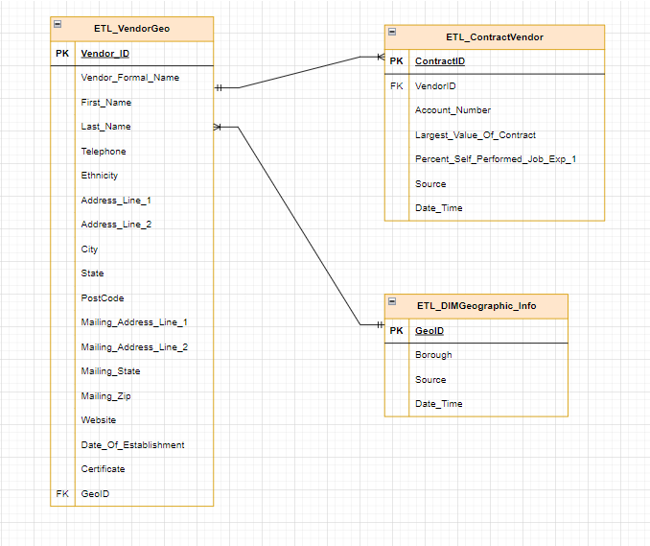
ERD

Slide 7
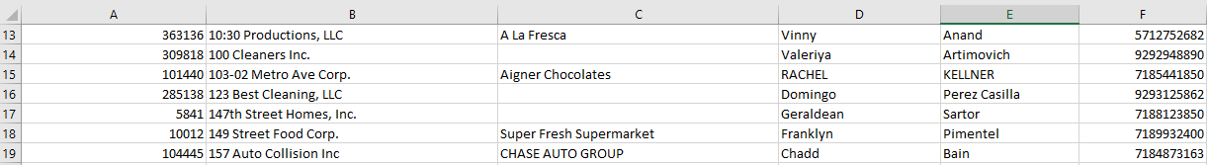
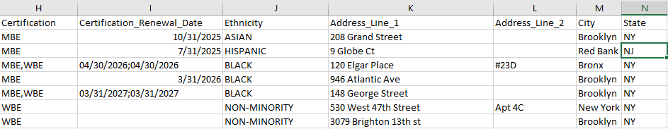
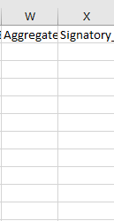
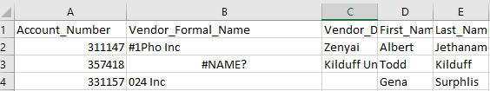
RAW DATA
RAW DATA
Commas
NULLS
Duplicates
Empty
Columns
Improper name format

Slide 8
Cleaning Data
Cleaned data using these steps:
Removed null values using replace null function in string functions using derived columns tool
Replaced improper names with “UNKNOWN” string
Replaced Commas using Derived function> Replace expression> “” empty string
Deleted null columns with no information
Replaced columns with multiple certifications information in commas format to single string format

Slide 9
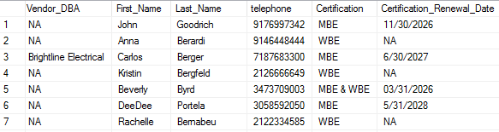

Cleaned Data
Changed improper name format
Replaced NULL values with “NA”
Replaced commas in certification with “&” as required for the business case
Removed duplicate dates in Certificate_Renewal_Date column
Added Additional columns named date and source as per project requirements

Slide 10
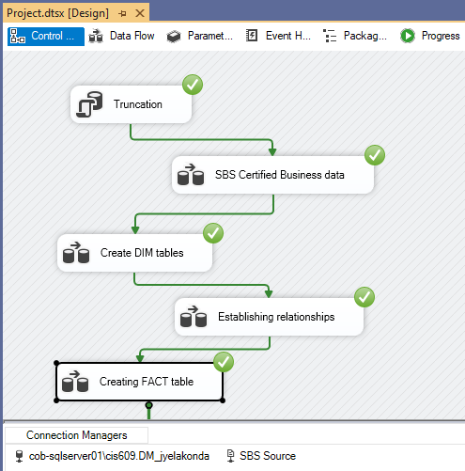
Control Flow Overview
All dataflow tasks have been performed without any errors. Sorting out NULL values, addressing formatting issues like commas and duplicates, and editing incorrect names while adding date information. Each step retains the full count of rows, ensuring that no data is lost. The final output is a cleaned dataset of 10,990 rows, now well-prepared for subsequent analysis or reporting tasks. This streamlined workflow effectively ensures data quality and usability without compromising data integrity.

Slide 11
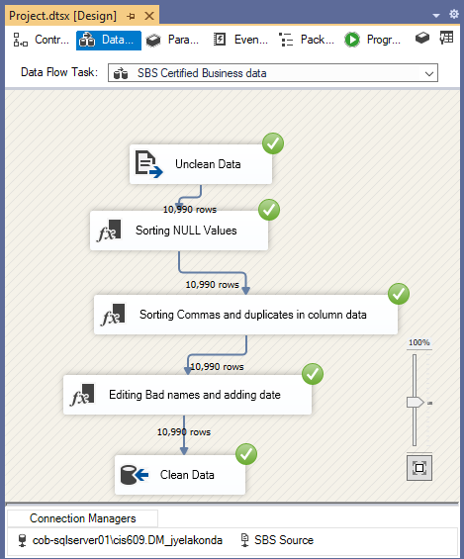
Data flow Task1-SBS business data cleaning
The sequence begins with unclean data which undergoes several transformations: sorting out NULL values, correcting issues like extraneous commas and duplicates, and revising incorrect names while appending date information. Each transformation step retains the full data count, ensuring no data is discarded.

Slide 12
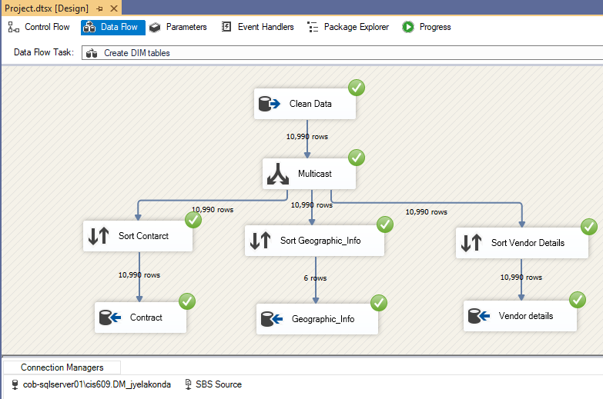
Data Flow Task2: Creating Dimension tables
Each stream targets different aspects of the data: contracts, geographic information, and vendor details. The contract and vendor streams sort 10,990 rows each, while the geographic info stream sorts and outputs only 6 rows, indicating a specific filter or selection criteria. The sorted data is directed into respective dimension tables—Contract, Geographic_Info, and Vendor details—tailored to organize and store distinct types of information for efficient data retrieval

Slide 13
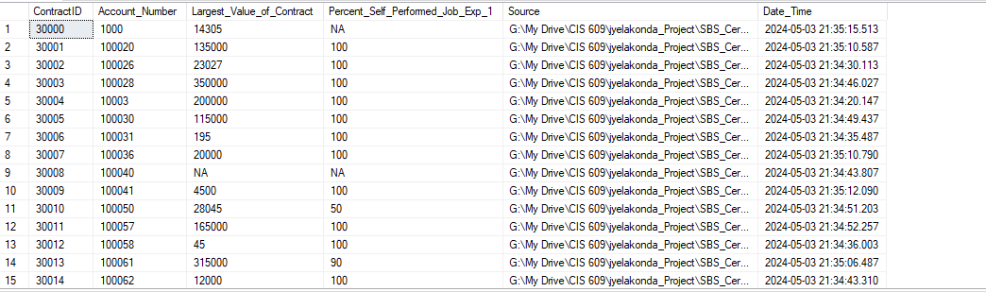
Resulted Dimension Tables: TABLE-1
ETL_DIMContract table

Slide 14
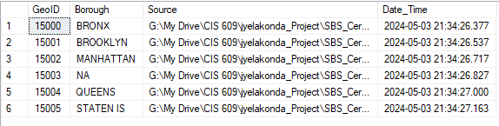
Resulted Dimension Tables: TABLE-2
ETL_DIMGeographic_Info_

Slide 15
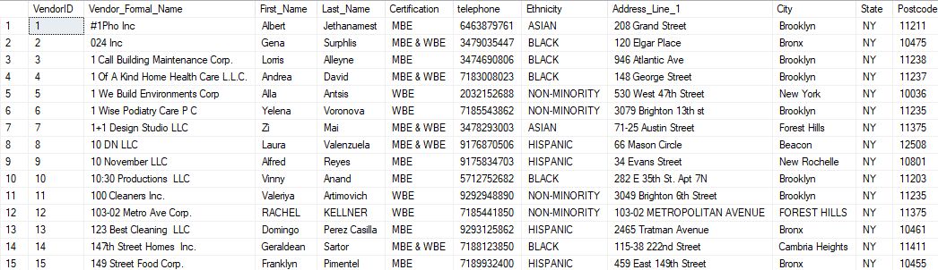
Resulted Dimension Tables: TABLE-3
ETL_DIMVendor_Details Table

Slide 16
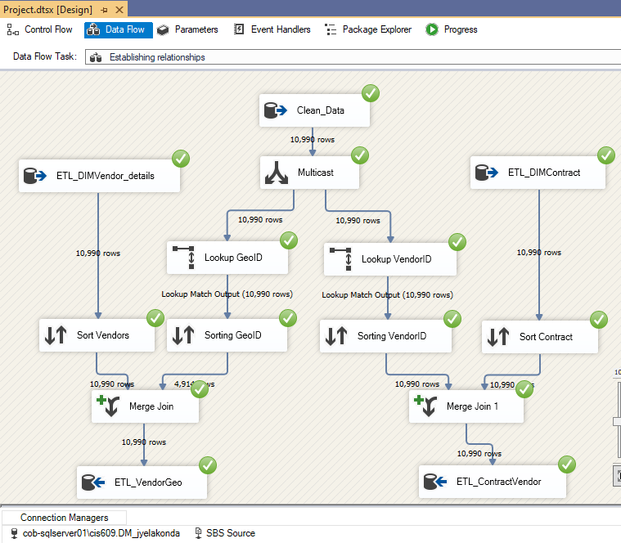
Establishing Relationships
Starting with 10,990 rows of clean data, it's split via Multicast into two paths: GeoID and ContractID. Each stream involves looking up specific IDs (GeoID and VendorID), followed by sorting. The sorted data streams are then merged to form comprehensive datasets, specifically for vendor-geo relationships and contract-vendor relationships. Each path maintains the original row count through various transformations, indicating precise data alignment and no loss, ensuring accurate relational data is sent to corresponding tables in the database.

Slide 17
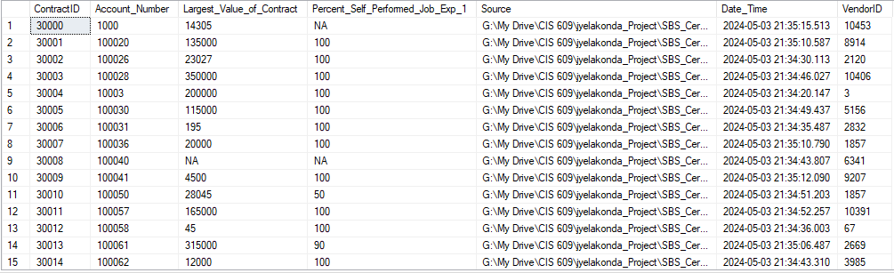
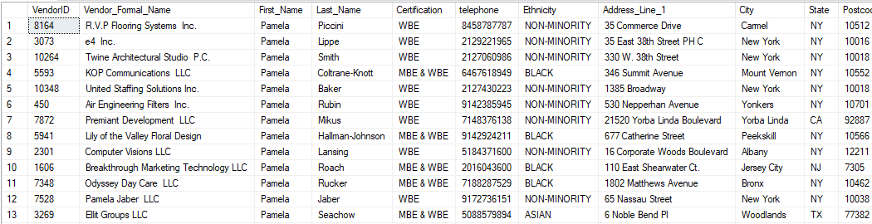
Resulted Tables
ETL_ContractVendor
ETL_VendorGeo

Slide 18
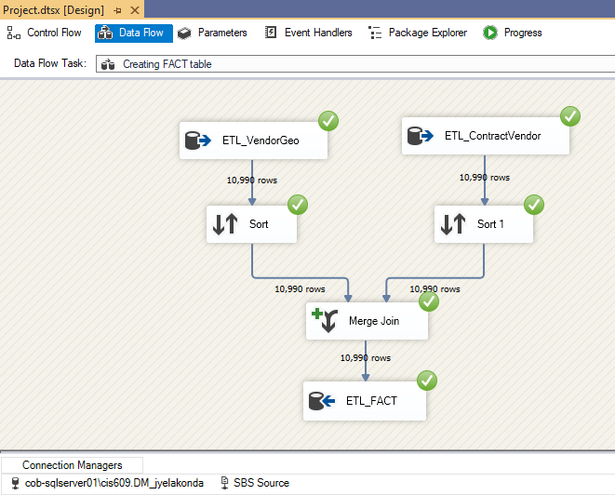
Creating FACT table
Creation of a FACT table by merging data from two sources: ETL_VendorGeo and ETL_ContractVendor, each with 10,990 rows. The process involves sorting each data stream, which ensures that data is ordered correctly for merging. Following sorting, the two streams undergo a merge join operation, retaining all 10,990 rows. This suggests a perfect alignment between the datasets, likely matching on key identifiers. The merged output is then directed into the ETL_FACT table, effectively consolidating vendor and contract information into a central repository for analysis and reporting within the database.

Slide 19
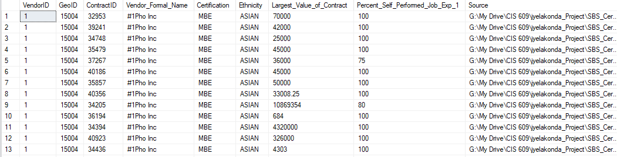
Resulting FACT table
ETL_FACT

Slide 20
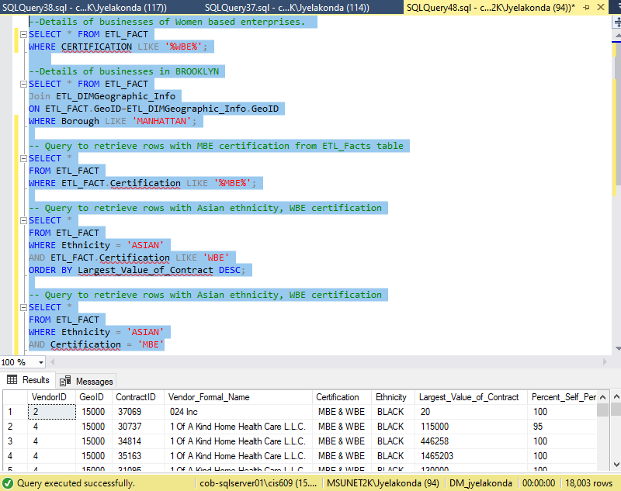
Business case solution in SSMS
The first query filters rows where certifications match 'WBE%' indicating Women Business Enterprise certifications.
Another query joins the FACT table with a geographic info table to select records in 'MANHATTAN'.
Further queries filter for Minority Business Enterprise (MBE) certifications and sort businesses with Asian ethnicity and WBE certification by the largest value of their contracts.

Slide 21
Thank you
Vaishnavi Chintala
Jashwanth Reddy Yelakonda

