Slide 1

SUMMER INTERNSHIP(MAY TO JUNE,2023)
ROLE :PHP-DEVELOPER
PRESENTED BY:
JASHWANTH VEMURI
Y20AIT516

Slide 2
WHAT IS PHP DEVELOPER?
PHP stands for Hypertext pre-processor, and it is used in web development. With this language, we can make web pages dynamic, and they can be directly embedded into HTML.
PHP developers have to resolve platform and browser disturbances when developing an application on a personal server and solve bugs while making the application responsive.
PHP is an open-source, interpreted, and object-oriented scripting language that can be executed at the server-side.

Slide 3
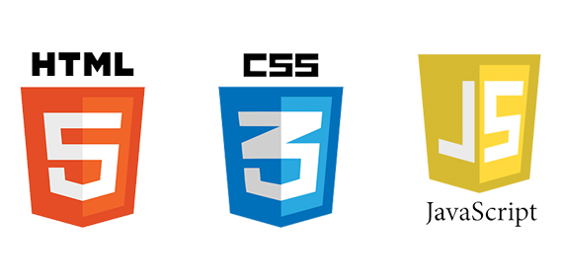
Trained on
HTML
CSS
BOOTSTRAP
JAVASCRIPT
JSON

Slide 4

HTML
HyperText Mark-up Language (HTML) is the standard mark-up language for creating Web pages.
Html describes the structure of web page.
Html used to display content on web pages.
Html provides a lot of elements, attributes, tags that are used to display contain different formats.
Html is case-insensitive language that means we can use tags either in lowercase or in upper case.
Html attributes gives the additional information to the elements.
HTML is a structuring language ,not a programming language.

Slide 5
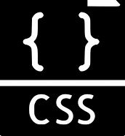
CSS
CSS stands for Cascading Style Sheets.
It is used to define styles and layouts of web pages written in HTML.
CSS syntax can be defined as a rule consisting of a selector, property, and its value.
The selector points to the HTML element where CSS style is to be applied.
Three ways to insert CSS:
INLINE STYLING
INTERNAL STYLE SHEET
EXTERNAL STYLE SHEET

Slide 6
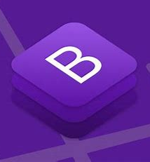
BOOTSTRAP
Bootstrap is a free front-end framework for faster and easier web development.
It is designed to enable responsive development of mobile-first websites, Bootstrap provides a collection of syntax for template designs.
Bootstrap is completed free to download and use.
Bootstrap is developed by Twitter.
It provides a collection of pre-designed components and a responsive grid system, streamlining web development.

Slide 7
Java Script
JavaScript is the programming language of the Web.
JavaScript is one of the 3 languages all web developers must learn.
JavaScript is used to program the behavior of web pages.
As a scripting language, JavaScript brings interactivity and dynamic behavior to web pages.
It runs on the client side, allowing manipulation of the Document Object Model (DOM) in real time.
JavaScript is fundamental for creating engaging and user-friendly web applications.
The HTML SCRIPT element is used to define JavaScript.
You can use script element in 3 ways
In the HEAD Element
In the BODY Element
As an External script file

Slide 8
JSON
JSON stands for JavaScript Object Notation.
JSON is a data interchange format often used in web development.
It is widely used for transmitting data between a server and a application.
It represents data as key-value pairs, making it easily readable by both humans and machines.
JSON is commonly employed in APIs to transmit data between servers and web applications, facilitating seamless communication and data exchange.
JSON uses a straightforward syntax that consists of key-value pairs enclosed in curly braces {}
Keys are always strings, followed by a colon and values can be strings, numbers, Booleans, arrays and nested objects
Example:
person = {
"name": "John Doe",
"age": 30,
"email": "johndoe@example.com",
"address": {
"street": "123 Main St",
"city": "New York",
"state": "NY"
},
"favorite_colors": ["blue", "green", "red"]
};

Slide 9


Slide 10
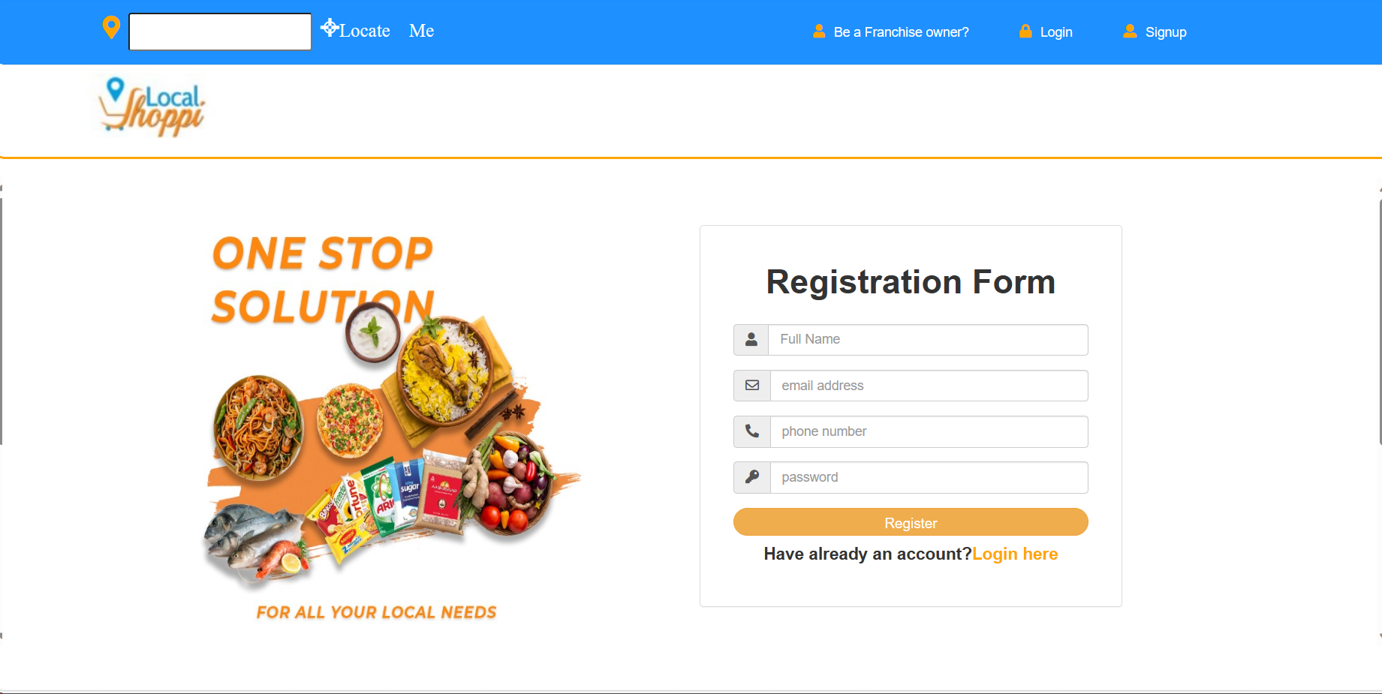
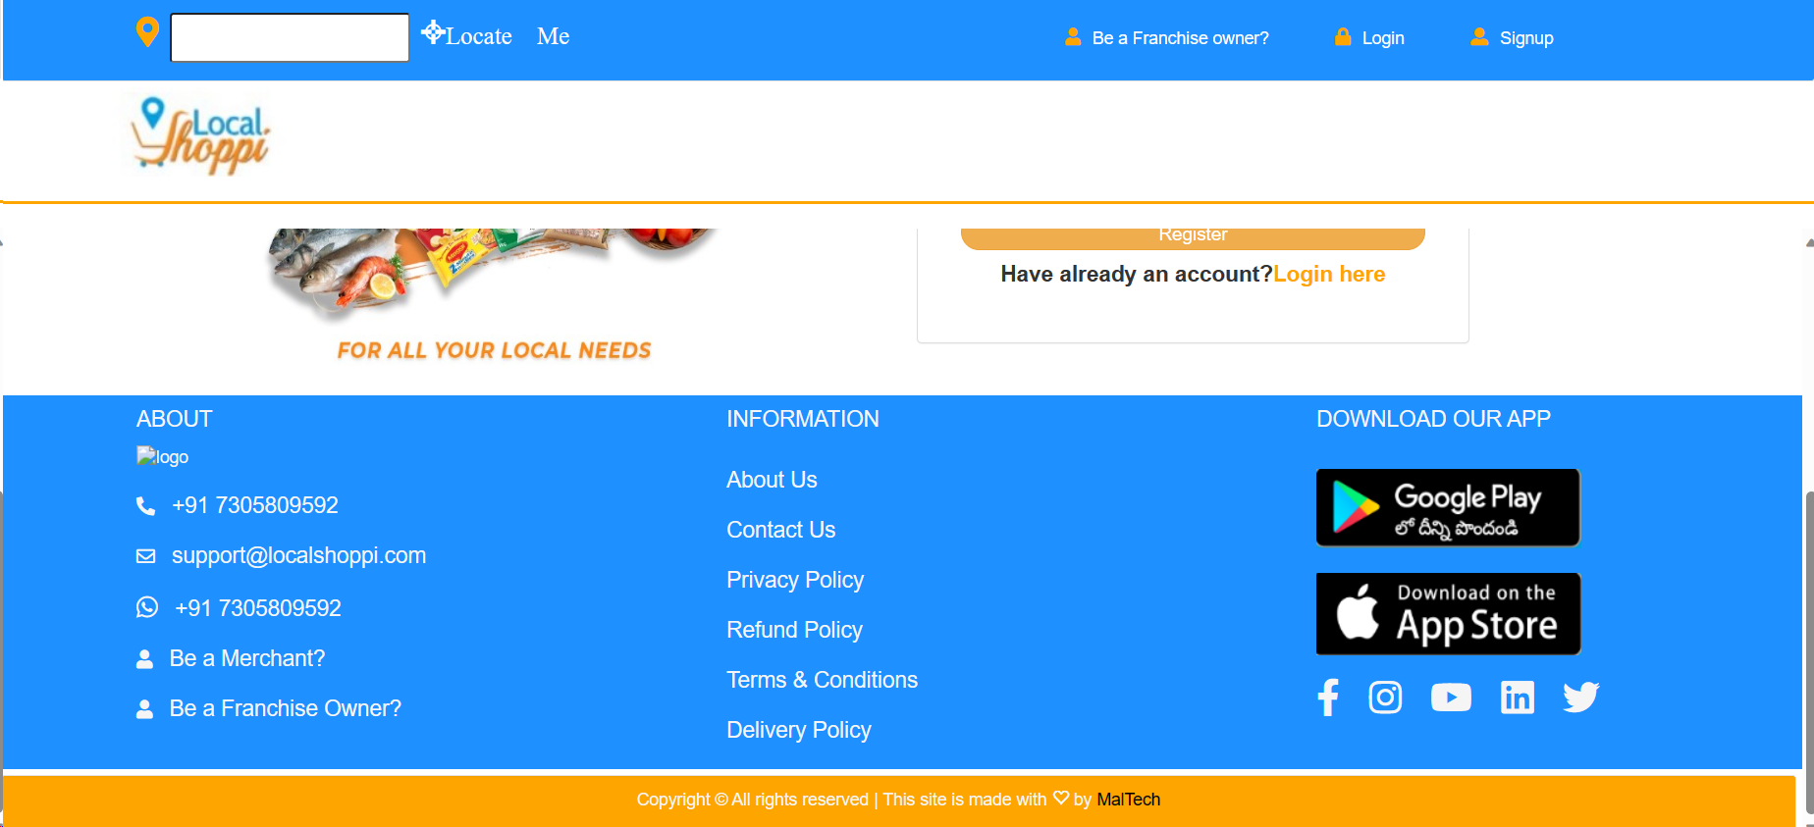
Task 1 : Landing Page Create a basic landing page for a company or product that includes a header, footer, and some basic information

Slide 11
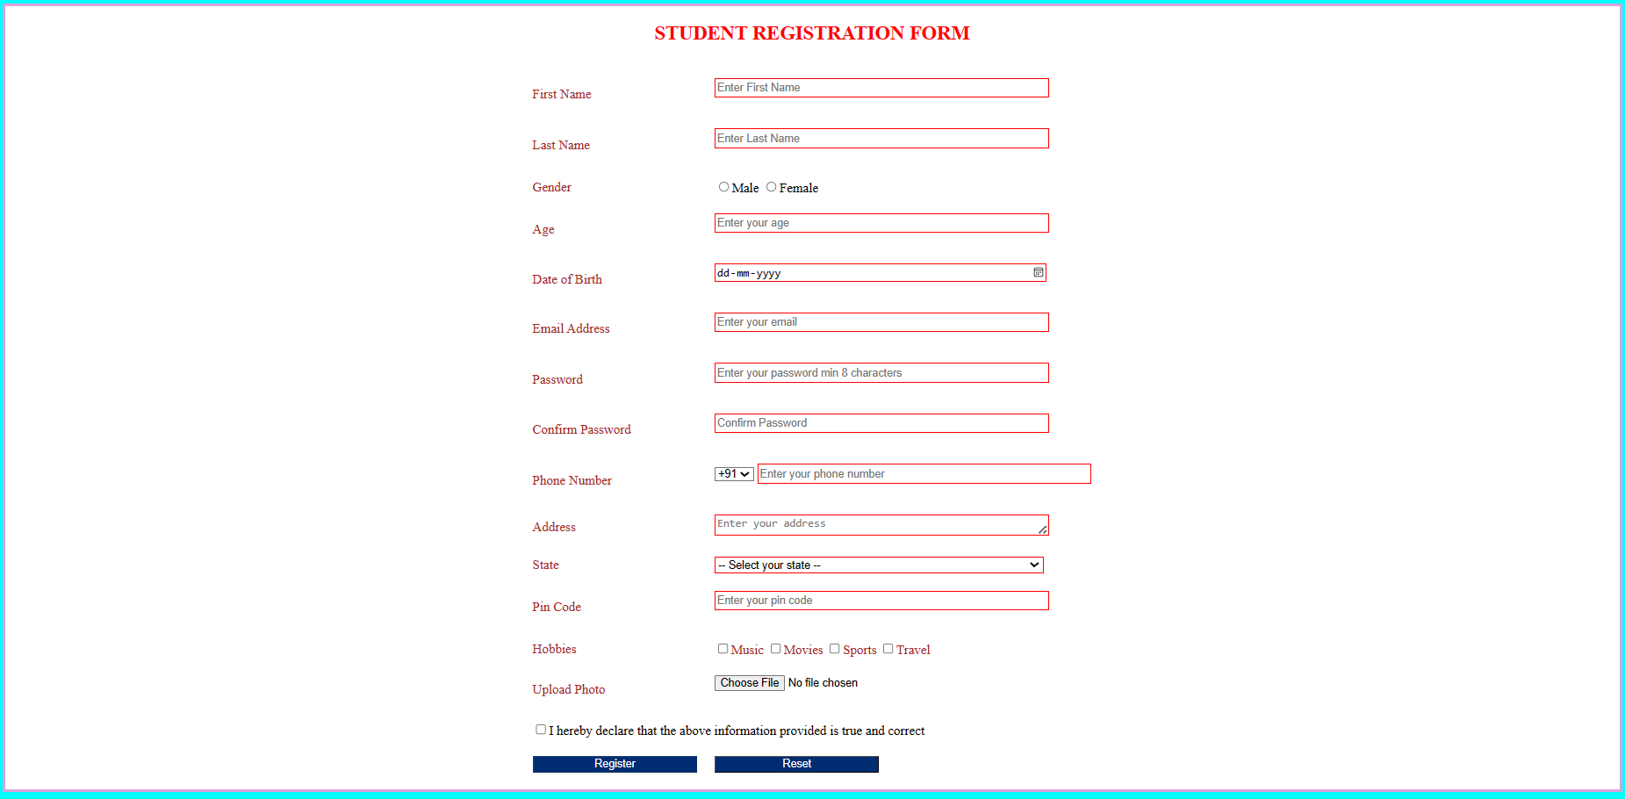
Task 2 : Create a registration form Develop a registration form for a website or app, complete with input validation and error message

Slide 12
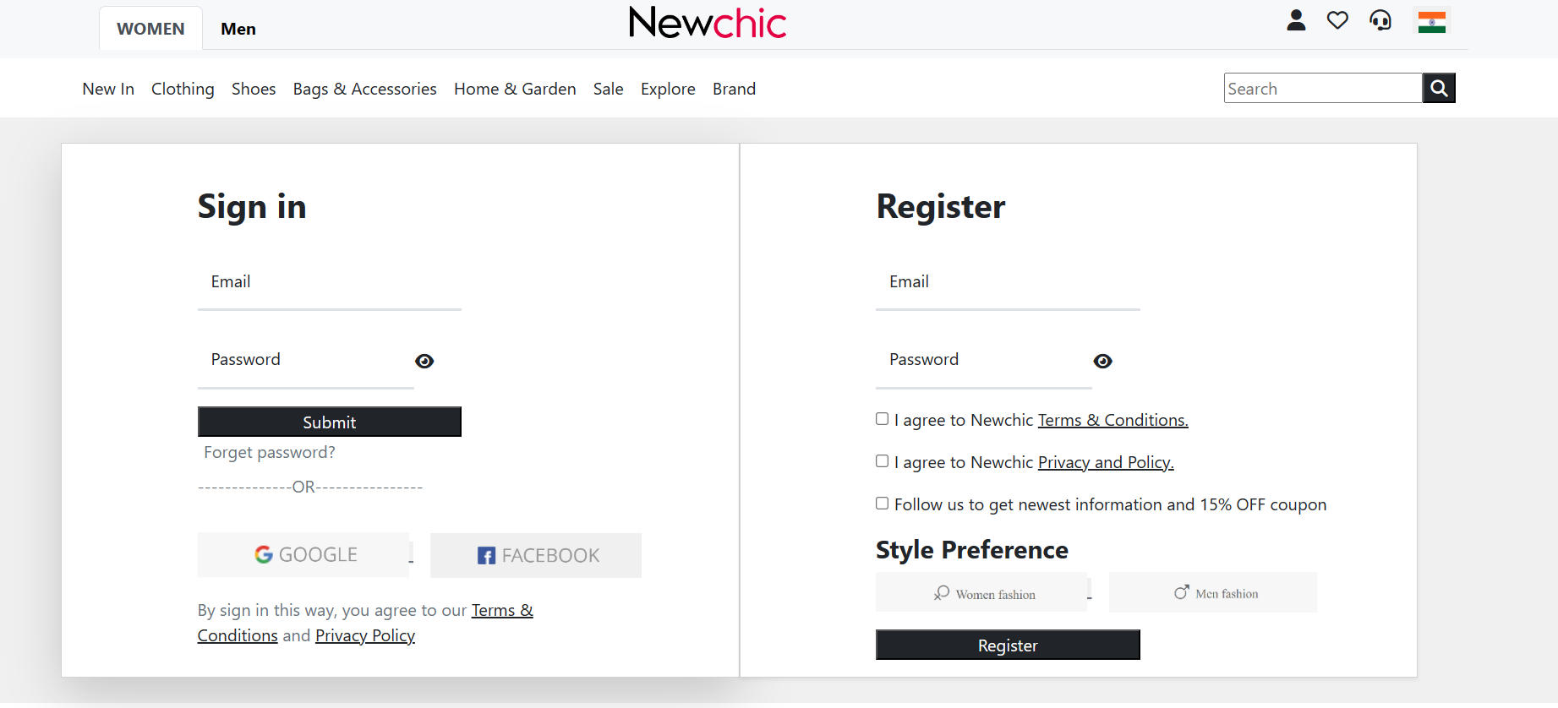
Task 3 : Build a login page Create a login page for a website, complete with input validation and password hashing.

