Slide 1
S
O
L
I
D
SOLID Principles in C#
Aniket Kumar Prasad

Slide 2
What is SOLID?
S
S -> Single Responsibility
O
O -> Open/Closed
L
L -> Liskov Substitution
I
I -> Interface Segregation
D
D -> Dependency Inversion

Slide 3
Why SOLID?
Easy to maintain
Easy to extend
Makes program loosely Coupled
Better structure
Easy to understand

Slide 4
SRP: Single Responsibility Principle
“A class should have only one responsibility”

Slide 5
SRP: Simple Meaning
One class = one job
If a class does many things -> harder to manage
Keep things focused and clean

Slide 6

SRP: Real-Life Example
A teacher teaches
A printer prints report cards
If teacher also prints, manages fees, and cleans -> messy system

Slide 7
SRP: Bad vs Good
Bad
Good
class Invoice
{
public void Calculate() { }
public void Print() { }
}
class Invoice
{
public void Calculate() { }
}
class InvoicePrinter
{
public void Print() { }
}

Slide 8
OCP: Open Closed Principle
“Open for extension, closed for modification"

Slide 9
OCP: Simple Meaning
You can add new features
But don’t change existing code
Avoid breaking working code

Slide 10
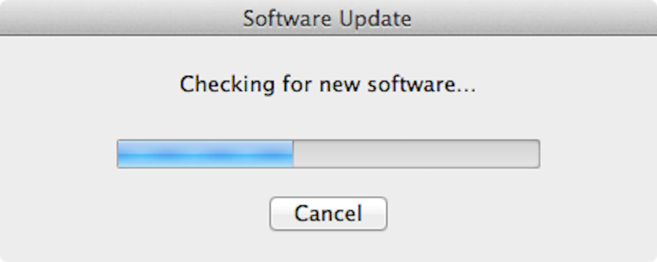
OCP: Real-Life Example
Mobile apps get updates with new features
Existing features still work same
You don’t rebuild the whole app every update

Slide 11
OCP: Code
Bad
Good
class Discount
{
public double GetDiscount(string type)
{
if (type == "Regular") return 10;
else return 20;
}
}
interface IDiscount
{
double GetDiscount();
}
class Regular : IDiscount
{
public double GetDiscount() => 10;
}

Slide 12
LSP: Liskov Substitution Principle
“If you replace a parent class object with a child class object, the program should still work correctly”

Slide 13
LSP: Simple Meaning
Child class should behave like parent
No unexpected behavior
Replace parent -> program should still work

Slide 14


LSP: Real-Life Example
If you replace a car driver with another driver -> car should still run
But replacing with someone who can’t drive -> system breaks

Slide 15
LSP: Code
Bad
Good
class Bird
{
public virtual void Fly() { }
}
class Ostrich : Bird
{
public override void Fly()
{
throw new Exception();
}
}
Bird bird = new Ostrich(); bird.Fly(); // 💥 crashes
class Bird { }
public interface IFlyingBird
{
void Fly();
}
class FlyingBird : Bird
{
public void Fly() { }
}

Slide 16
ISP: Interface Segregation Principle
“Don’t force classes to implement unused methods"

Slide 17
ISP: Simple Meaning
Don’t force classes to implement things they don’t need
Split big interfaces into small ones

Slide 18

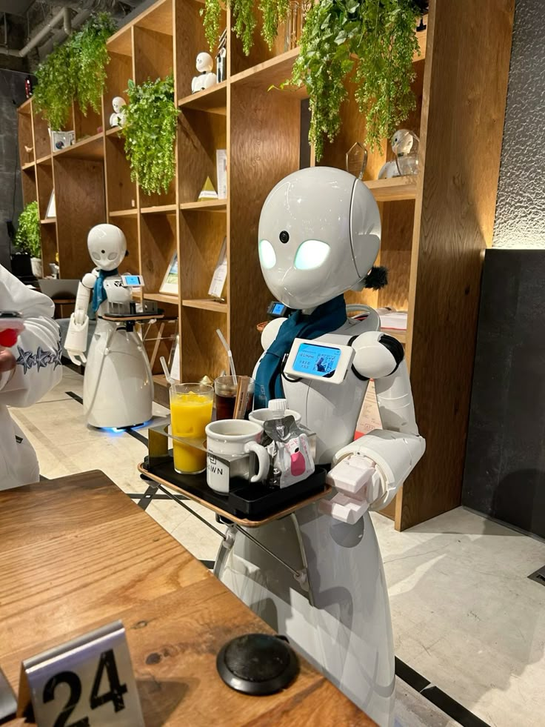
ISP: Real-Life Example
A robot worker only works, no eating
A human worker works and eats
So don’t force robot to have Eat()

Slide 19
ISP: Code
Bad
Good
interface IWorker
{
void Work();
void Eat();
}
interface IWork
{
void Work();
}
interface IEat
{
void Eat();
}

Slide 20



s
DIP: Dependency Inversion Principle
“Depend on abstractions, not concrete classes"
High
Level
Code
Low
Level
Code
Abstraction

Slide 21
DIP: Simple Meaning
Depend on abstraction (interface), not actual class
Makes system flexible and replaceable

Slide 22
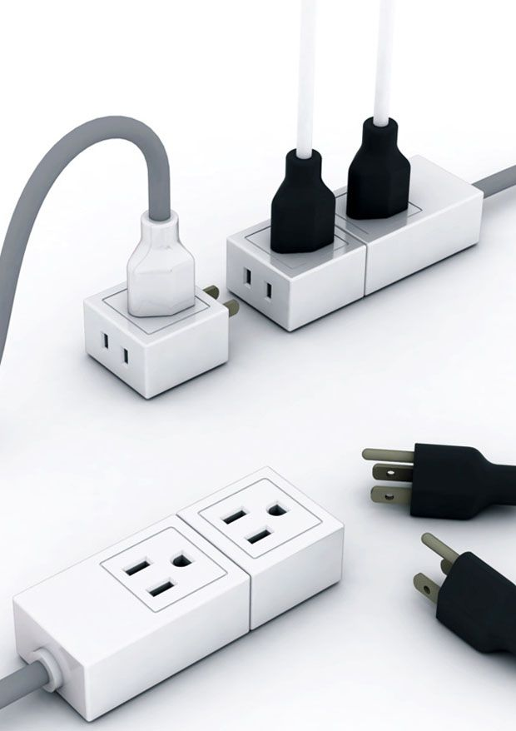
DIP: Real-Life Example
You plug devices into a socket (interface)
You don’t care if it’s charger, TV, or laptop
Socket stays same -> devices can change

Slide 23
DIP: Code
Bad
Good
class Service
{
private EmailSender email = new EmailSender();
}
class Service
{
private IMessage message;
public Service(IMessage msg)
{
message = msg;
}
}

Slide 24
Summary
SRP -> One job
OCP -> Extend without modifying
LSP -> Replace safely
ISP -> Small interfaces
DIP -> Use abstractions

