Slide 1
Healthcare Analytics Platform
Data-driven insights transforming patient care delivery
Notes:
AI-generated content may be incorrect. ---

Slide 2
Healthcare Analytics Platform Overview
Notes:
Title Slide – Healthcare Analytics Platform, Project Overview, System Architecture, Technology Stack, Core Features, Web API & Security, Database Design, Cloud & DevOps Strategy, AI & Modernization, Live Demonstration, Q & A

Slide 3

Title Slide – Healthcare Analytics Platform
Modern Healthcare Solution
The platform offers a modern approach to healthcare management focusing on data-driven decision-making and analytics.
Regulatory Compliance
Built with strict data privacy, security, and audit compliance to meet healthcare regulatory requirements.
Operational Modernization
Supports workflow modernization, reduces manual efforts, and improves patient outcomes through technology.
Future-Ready Architecture
Combines clean architecture, cloud practices, and secure APIs for efficient care delivery and operational excellence.
Notes:
The title slide introduces the Healthcare Analytics Platform as a modern, compliant solution designed to address the growing complexity of healthcare management. The title emphasizes analytics and platform thinking, signaling that the solution goes beyond basic record keeping and focuses on data-driven decision-making. The subtitle, “A Compliant Solution for Modern Healthcare Management,” highlights two critical priorities in today’s healthcare ecosystem: regulatory compliance and modernization. Healthcare organizations operate under strict regulations such as data privacy, security, and audit requirements, and any digital solution must be built with these constraints in mind. At the same time, providers are under pressure to modernize workflows, reduce manual effort, and improve patient outcomes through technology. This slide sets the tone for the presentation by clearly positioning the application as both secure and future-ready. Including the presenter or team name establishes ownership and accountability, which is important in professional and academic settings. Overall, this opening slide frames the narrative of the presentation: a thoughtfully engineered healthcare application that combines clean architecture, modern cloud practices, and secure APIs to support efficient care delivery and operational excellence.

Slide 4

Project Overview
Business Objectives
The platform aims to enhance care delivery and operational efficiency by reducing administrative burdens and errors.
Business Context
Healthcare systems face challenges of fragmentation, scalability, maintenance, and security requiring a centralized solution.
Core Platform Purpose
Provides a secure, compliant application for managing patient data and appointments with a modern user experience.
Future-Ready Architecture
The platform is designed for cloud deployment and scalability, supporting future technological advancements.
Notes:
The project overview explains the motivation and purpose behind building the Healthcare Analytics Platform. The primary business objective is to improve care delivery and operational efficiency for healthcare providers. This includes reducing administrative overhead, minimizing errors in patient data handling, and enabling staff to focus more on patient care rather than manual processes. The business context addresses a real-world need: many healthcare organizations struggle with fragmented systems that are difficult to scale, maintain, and secure. A robust and compliant platform is essential to manage patient appointments, records, and related operational data in a centralized manner. The core purpose of the application is to provide a secure, modern solution for managing patient information and appointments while ensuring compliance with healthcare standards. Additionally, the platform is designed with a future-ready architecture, making it suitable for cloud deployment and further enhancements. This slide connects business needs with technical goals, clearly demonstrating how the solution aligns technology decisions with organizational objectives and long-term sustainability.

Slide 5
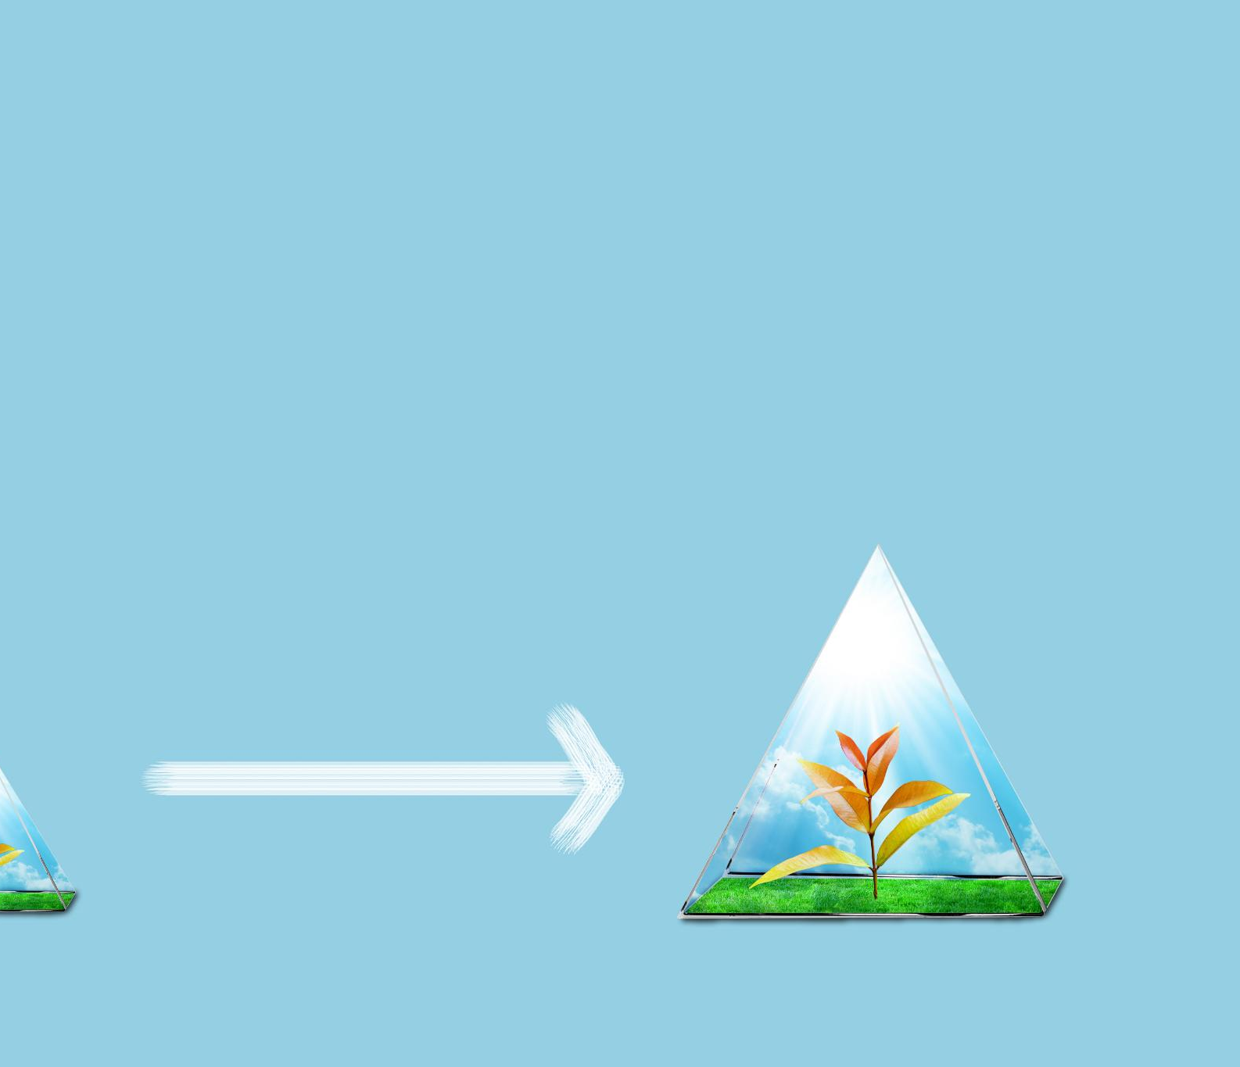
System Architecture
Clean Architecture Principles
Clean Architecture ensures separation of concerns, keeping business logic independent from UI and databases.
Domain Layer
The Domain layer contains core business entities like Patient and Appointment critical to healthcare systems.
Application and Infrastructure Layers
Application layer manages business logic and use cases; Infrastructure handles database access and external integrations.
Presentation Layer
Presentation layer includes ASP.NET Core Razor Pages UI and a Web API for external access.
Notes:
The system architecture slide describes the structural foundation of the application, which is based on Clean Architecture principles. Clean Architecture promotes a clear separation of concerns, ensuring that business logic remains independent of frameworks, databases, and user interfaces. This architectural style brings key benefits such as improved testability, easier maintenance, and long-term flexibility. The Domain layer contains the core business entities, such as Patient and Appointment, representing the most critical concepts in the healthcare system. The Application layer encapsulates business logic and use cases, orchestrating how entities interact to fulfill functional requirements. The Infrastructure layer handles technical details such as database access through Entity Framework Core and integration with external services. Finally, the Presentation layer includes ASP.NET Core Razor Pages for the user interface and a Web API for external access. This layered approach ensures that changes in one area, such as the UI or database, have minimal impact on the core business logic, making the system robust and adaptable.

Slide 6

Technology Stack
Backend Development
Uses .NET 8, C#, and ASP.NET Core for a high-performance, secure, and cross-platform backend foundation.
User Interface Technologies
Built with Razor Pages, HTML5, CSS, JavaScript and AJAX for a responsive and interactive user experience.
Data Access and Storage
Entity Framework Core and Repository Pattern manage database operations with Microsoft SQL Server ensuring reliable data storage.
API and Security
RESTful Web API enables integration, secured by JWT authentication to protect sensitive healthcare data.
Notes:
The technology stack slide outlines the tools and frameworks used to build the Healthcare Analytics Platform. The backend is developed using .NET 8, C#, and ASP.NET Core, providing a high-performance, secure, and cross-platform foundation. The user interface is built with Razor Pages, along with standard web technologies such as HTML5, CSS, and JavaScript, enhanced with AJAX for responsive interactions. Data access is managed using Entity Framework Core combined with the Repository Pattern, which abstracts database operations and improves testability. Microsoft SQL Server is used as the relational database, offering reliability and strong support for transactional data. The platform exposes functionality through a RESTful Web API, enabling integration with external systems and future mobile applications. Security is handled using JWT-based authentication and authorization, ensuring that only authenticated and authorized users can access sensitive healthcare data. Together, this technology stack reflects modern best practices in enterprise application development.

Slide 7
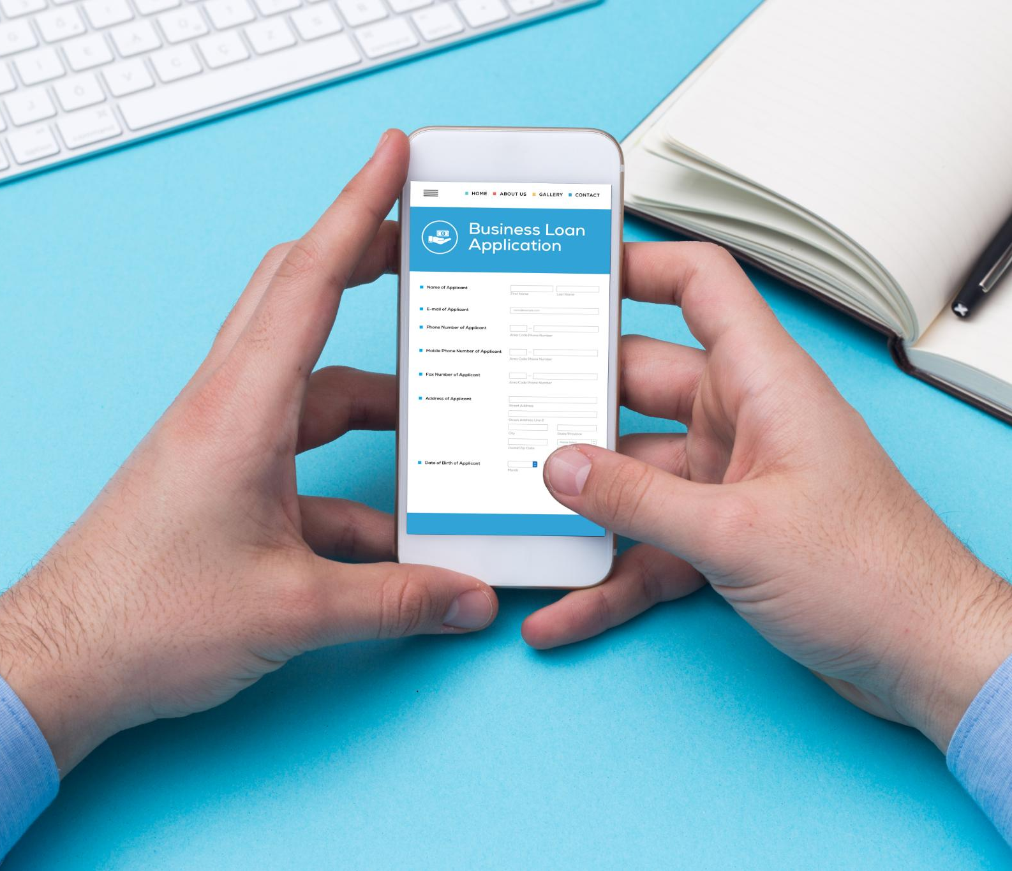
Core Features
Patient Management
Provides secure CRUD operations to manage patient records efficiently and accurately.
Appointment Scheduling
Enables scheduling, viewing, updating, and canceling appointments to optimize patient flow.
Data Validation
Implements server and client-side validation to ensure data accuracy and compliance.
User-Friendly Interface
Features an intuitive design using Razor Pages to minimize training and speed adoption.
Notes:
The core features slide highlights the primary capabilities of the platform. Patient management is a fundamental feature, providing full CRUD operations to create, read, update, and delete patient records in a secure and controlled manner. Appointment scheduling allows healthcare staff to efficiently schedule, view, update, and cancel appointments, reducing scheduling conflicts and improving patient flow. Data validation is enforced at both the server and client levels to ensure data integrity, accuracy, and compliance with business rules. This reduces the risk of incorrect or incomplete data entering the system. The platform also emphasizes a user-friendly interface built with Razor Pages, designed to be intuitive and efficient for healthcare staff. By focusing on usability, the system minimizes training requirements and supports faster adoption. These core features collectively address the most common operational needs in healthcare settings while laying the groundwork for future enhancements.

Slide 8

Web API & Security
Secure RESTful API Endpoints
The platform offers secure RESTful API endpoints accessible by mobile apps and third-party systems for seamless integration.
JWT Authentication
Authentication uses JWT tokens to verify users, providing a stateless and scalable security solution for distributed systems.
Role-Based Authorization
Role-based authorization allows different access levels, ensuring users perform only permitted actions based on roles.
Secure Coding Practices
Secure coding protects against common vulnerabilities like unauthorized access, data leaks, and injection attacks.
Notes:
This slide focuses on the Web API and security aspects of the platform. The RESTful API exposes secure endpoints that can be used by mobile applications, third-party systems, or future integrations. Authentication is implemented using JWT, which ensures that only verified users can access the API. JWT tokens provide a stateless and scalable security mechanism suitable for modern distributed systems. Authorization is role-based, allowing different levels of access depending on user roles, such as administrators or staff members. This ensures that users can only perform actions they are permitted to. Secure coding practices are applied throughout the application to protect against common vulnerabilities such as unauthorized access, data leaks, and injection attacks. In a healthcare context, where data sensitivity is extremely high, these security measures are critical to maintaining trust and compliance.

Slide 9

Database Design
Normalized Database Schema
The schema is normalized to reduce redundancy and ensure data consistency within the platform.
Key Data Entities
Patients and Appointments are core entities forming the backbone of the application's data model.
Repository Pattern with EF Core
Repository Pattern abstracts data access logic, promoting separation of concerns and easier testing.
Database Migration Management
EF Core Migrations manage schema changes, enabling safe and controlled updates across environments.
Notes:
The database design slide explains how data is structured and managed within the platform. The schema is normalized and implemented in Microsoft SQL Server to ensure data consistency and reduce redundancy. Key entities include Patients and Appointments, which form the backbone of the application’s data model. The Repository Pattern is used on top of Entity Framework Core to abstract data access logic, making the application easier to test and maintain. This approach also supports clean separation between business logic and persistence concerns. Database schema changes are managed using EF Core Migrations, allowing controlled evolution of the database over time. This ensures that updates can be applied safely across environments without manual intervention. A well-designed database is essential for performance, reliability, and long-term scalability, especially in data-intensive healthcare systems.

Slide 10
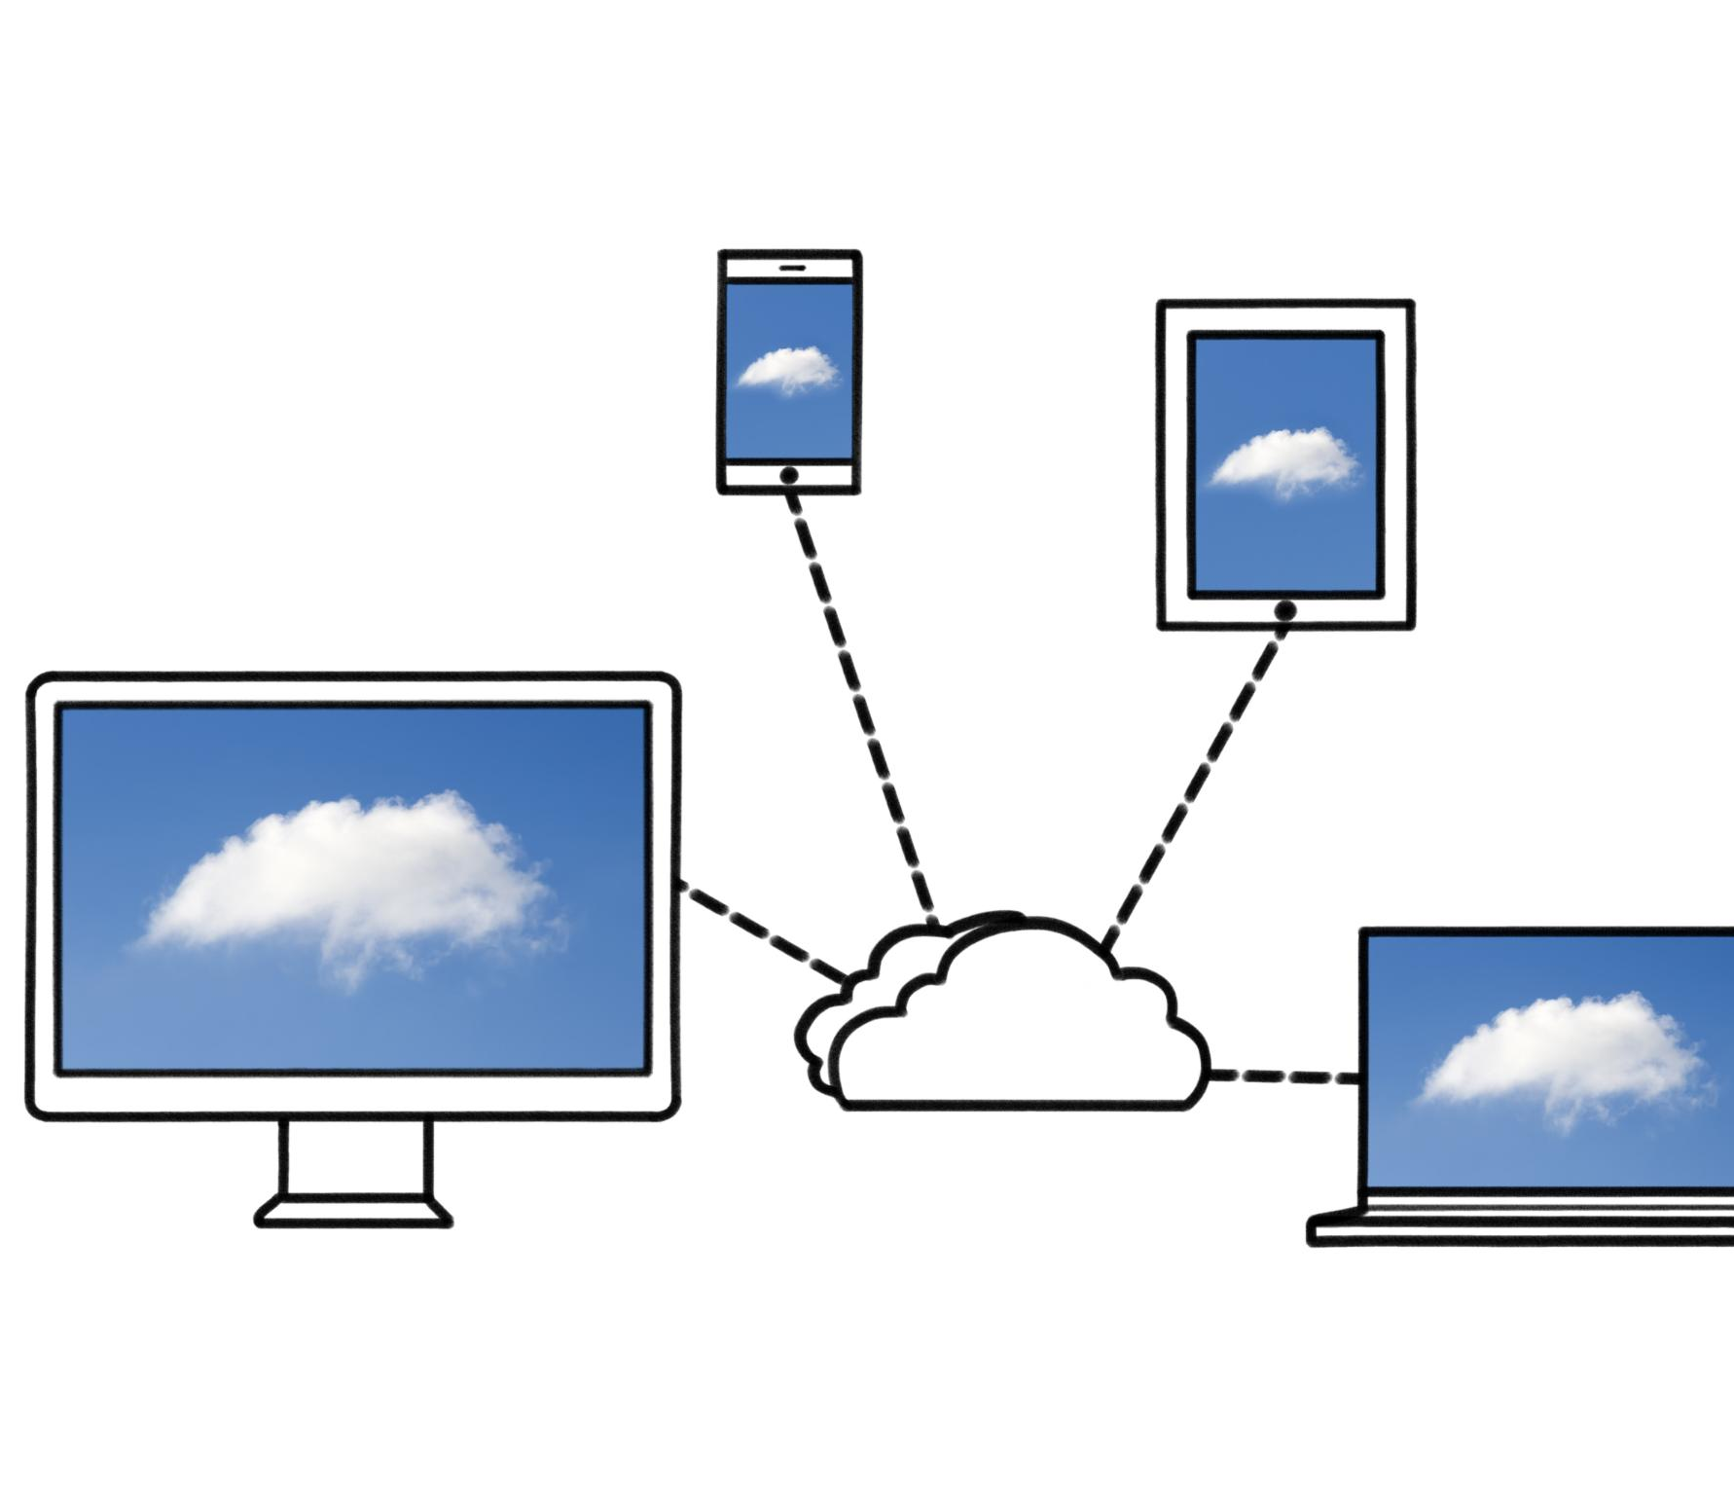
Cloud & DevOps Strategy
Containerization with Docker
The platform uses Docker to ensure consistent application behavior across development, testing, and production environments.
CI/CD Automation
GitHub Actions enable automated building, testing, and deployment, reducing errors and speeding delivery cycles.
Cloud Hosting on Azure
The application is hosted on Azure App Services, offering scalability, high availability, and managed infrastructure.
Benefits of Cloud & DevOps
Adopting cloud and DevOps practices supports rapid iteration, easier maintenance, and scalable platform growth.
Notes:
The cloud and DevOps strategy slide outlines how the application is prepared for modern deployment practices. The platform is containerization-ready using Docker, ensuring consistent behavior across development, testing, and production environments. A conceptual CI/CD pipeline using GitHub Actions is proposed to automate building, testing, and deployment processes. This reduces manual errors and accelerates delivery cycles. The application is designed for hosting on Azure App Services, which provides scalability, high availability, and managed infrastructure. By adopting cloud and DevOps practices, the platform supports rapid iteration, easier maintenance, and the ability to scale based on demand. This strategy aligns with industry trends toward cloud-native healthcare applications.

Slide 11

AI & Modernization
AI-assisted Development
GitHub Copilot enhances developer productivity through code generation, refactoring, and documentation assistance.
Future AI Integration
Proposed AI agent endpoint aims to summarize clinical notes to reduce documentation burden for clinicians.
Innovation and Stability
The project balances cutting-edge AI advancements with maintaining system stability and reliability.
Notes:
This slide highlights AI and modernization aspects of the project. GitHub Copilot was used to enhance developer productivity by assisting with code generation, refactoring, and documentation. This demonstrates the adoption of modern AI-assisted development tools. Additionally, the presentation proposes a conceptual future AI integration in the form of an AI agent endpoint for summarizing clinical notes. While not implemented, this idea showcases a forward-looking vision for the platform, where AI can support clinicians by reducing documentation burden and extracting insights from unstructured data. This slide emphasizes innovation and readiness for future advancements without compromising the stability of the current system.

Slide 12

Q & A
Engaging Audience Interaction
Q&A sessions encourage audience feedback and clarifications, fostering active engagement and meaningful dialogue.
Reinforcing Design Decisions
The session provides a chance to explain design trade-offs and demonstrate deep understanding of healthcare and software principles.
Exploring Future Possibilities
Stakeholders can discuss future topics such as system scaling, compliance, and AI-driven feature integration during Q&A.
Promoting Transparency and Collaboration
Open discussions in Q&A sessions reinforce transparency and collaboration essential in healthcare and software engineering.
Notes:
The final slide is dedicated to questions and discussion. This section invites feedback, clarifications, and deeper technical or business questions from the audience. A Q&A session is an opportunity to reinforce key design decisions, explain trade-offs, and demonstrate understanding of both healthcare requirements and software architecture principles. It also allows stakeholders to explore future possibilities, such as scaling, compliance extensions, or AI-driven features. Ending the presentation with an open discussion reinforces transparency and collaboration, which are essential values in both healthcare and software engineering domains.

